Slide 1
Workforce
And
Labor
Data
Online
Center for Workforce Information & Analysis (CWIA)
April 2023

Slide 2
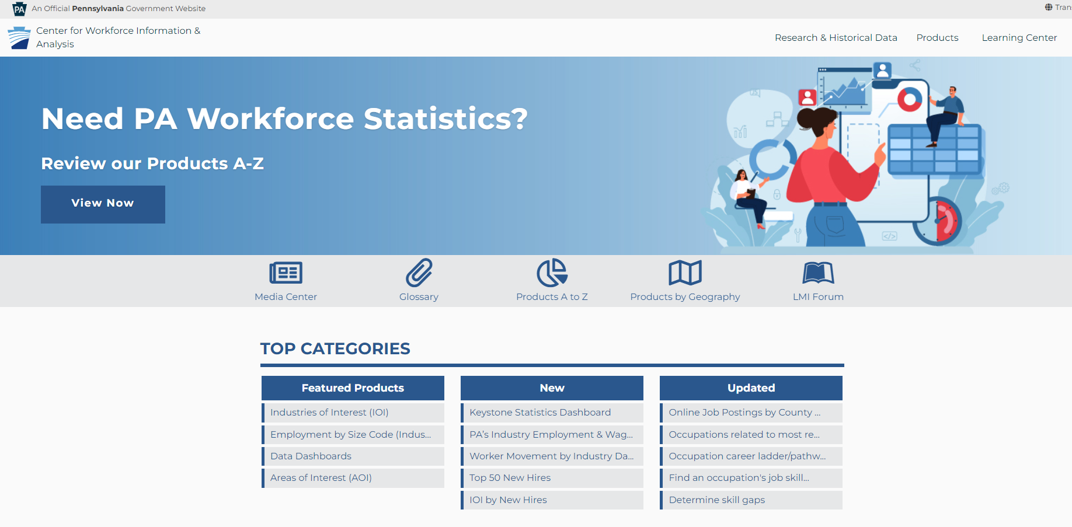
Products A to Z
https://www.workstats.dli.pa.gov

Slide 3
Home Page – Top Navigation
The menu located in the top right-hand corner of our website contains three main areas:
Research & Historical Data
Products
Learning Center
These three areas will provide access to the contents of our entire website.

Slide 4
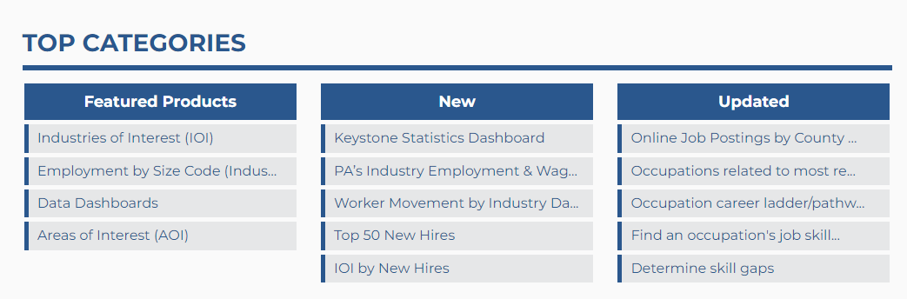
Home Page – Top Categories
On the homepage you will find content boxes that highlight featured, new, and recently updated information:

Slide 5
Products A to Z
I got an e-mail about the PA Monthly WorkStats but I lost it. Where can I find that publication?
(Products A to Z)
https://www.workstats.dli.pa.gov/Pages/ProductsAtoZ.aspx

Slide 6
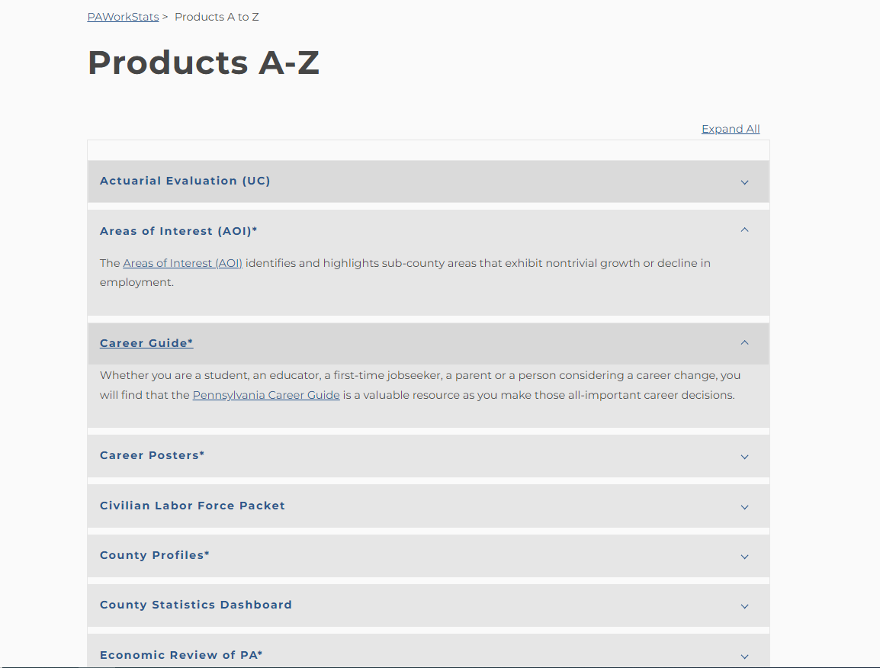
Products A to Z
An alphabetical listing of all products located on the website:
Notes:
Patricia will start after this slide

Slide 7
Products by Geography
I just started working for the Lehigh Valley Workforce Development Board.
Where can I go to find information specific to my area?
(Products by Geography)
https://www.workstats.dli.pa.gov/Products/Pages/Products%20By%20Geography.aspx

Slide 8
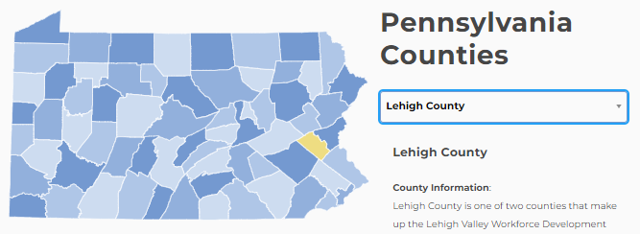
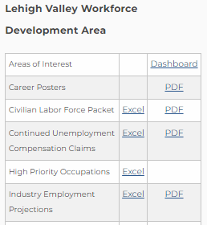
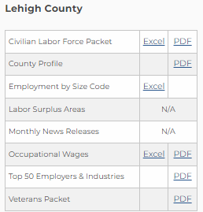
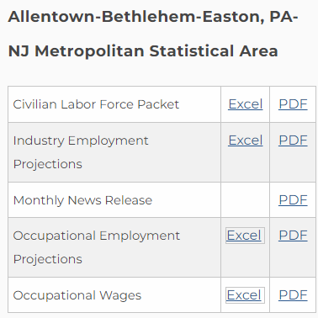
Products by Geography
A customized listing of all products containing data for your county, workforce development area (WDA), and metropolitan statistical area (MSA)
https://www.workstats.dli.pa.gov/Products/Pages/Products%20By%20Geography.aspx
Please visit the Products by Geography page to view the full listing of products for your county and surrounding area

Slide 9
Products by Category – Customer Type
It’s my first year working for my local PA CareerLink® and I’m looking for resources to help point clients in the right direction for relevant information.
Where can I find this kind of information?
(Products by Customer – Workforce Professionals)
https://www.workstats.dli.pa.gov/Products/ByCustomer/Pages/WorkforceProfessionals.aspx

Slide 10
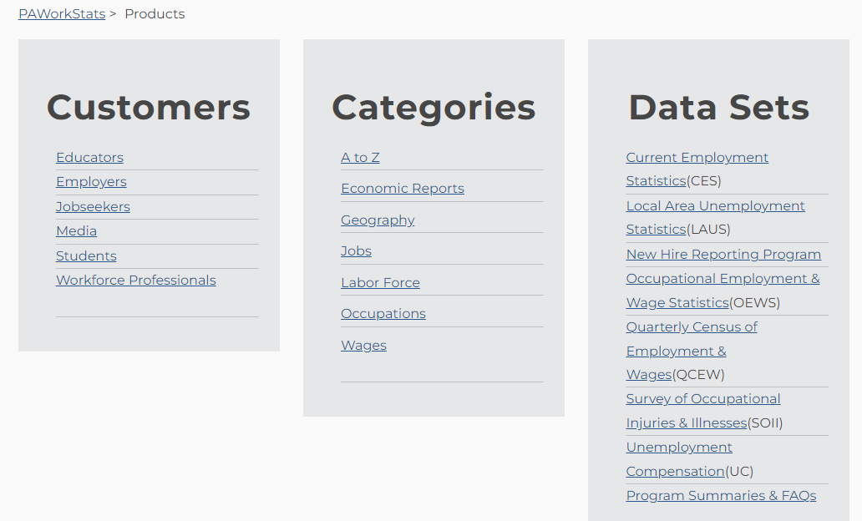
Products by Category – Customer – Workforce Professionals

Slide 11
Products by Category – Customer – Workforce Professionals

Slide 12
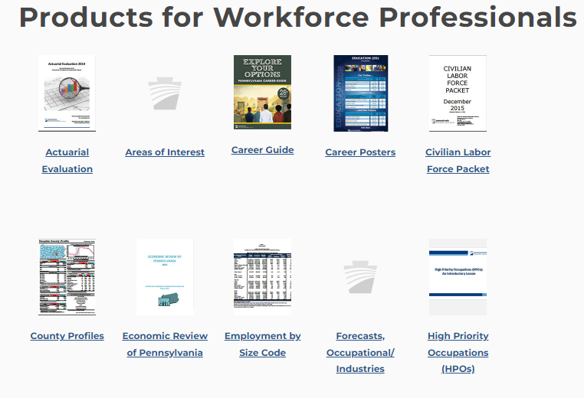
Products by Category – Customer - Workforce Professionals

Slide 13
Media Center
I saw an article in my local paper with information on the area labor market.
Where can I find more information or the data used for that?
(Media)
https://www.workstats.dli.pa.gov/MediaCenter/Pages/default.aspx

Slide 14
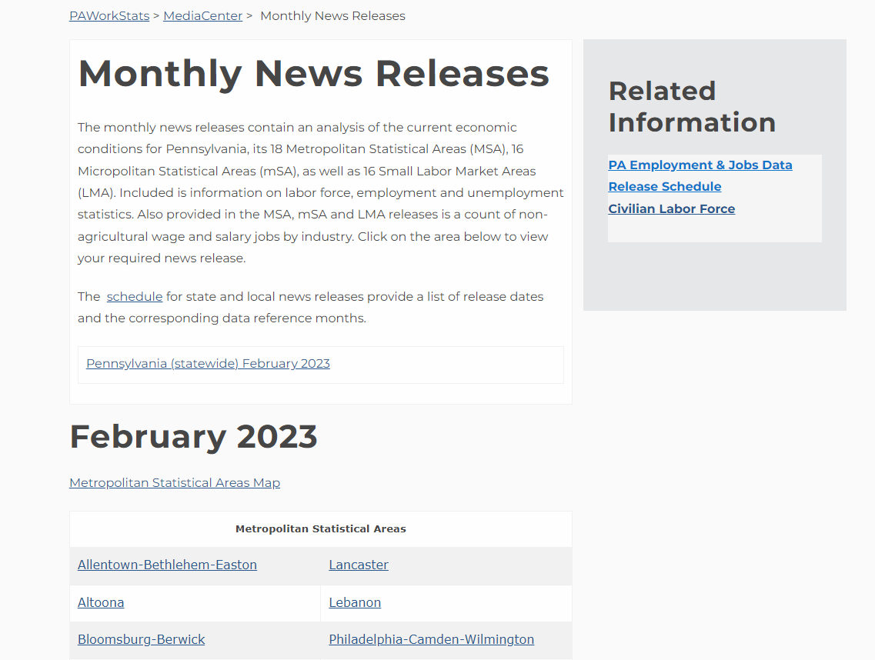
Media Center -
MontCo
Sentinel
https://www.workstats.dli.pa.gov/MediaCenter/Pages/ReleaseSchedule.aspx

Slide 15
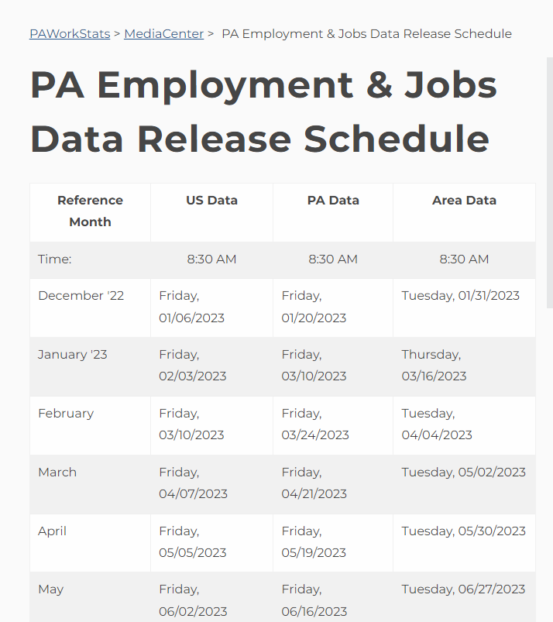
Media Center - Employment & Jobs Data Release Schedule
https://www.workstats.dli.pa.gov/MediaCenter/Pages/ReleaseSchedule.aspx

Slide 16
Research & Historical Data
Our region is working on our Workforce Investment and Opportunities Act (WIOA) plan. All I can find is the current unemployment rate. Where can I find rates from previous time periods?
(Research & Historical Data)
https://paworkstats.geosolinc.com/vosnet/lmi/default.aspx?plang=E

Slide 17
Research & Historical Data
The “Research & Historical Data” portion of our website allows you to download historical occupational, industry, and labor force data for analysis.
Today, we are going to demonstrate with just one of these three types of data because the process is similar for each. We will demonstrate the labor force (LAUS) data.
The slides that follow use screenshots to walk you through the menus that you will see and the clicks you will need to make in order to access the labor force data. As mentioned above, you can use these same clicks to access CES, OEWS and QCEW data as well.
We’ve also included some tips for the “dos and don’ts” of this area of our website.

Slide 18
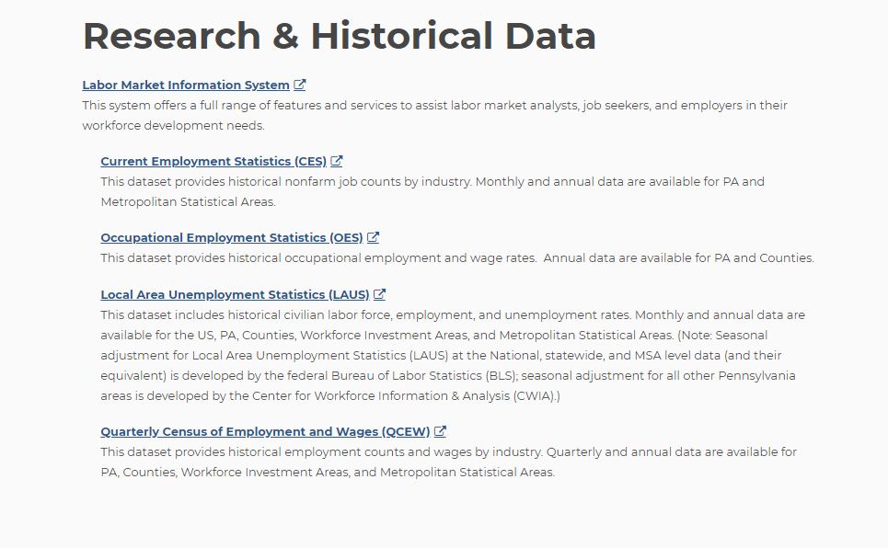
Research & Historical Data
These links can and should be bookmarked for future use and direct access to historical data

Slide 19
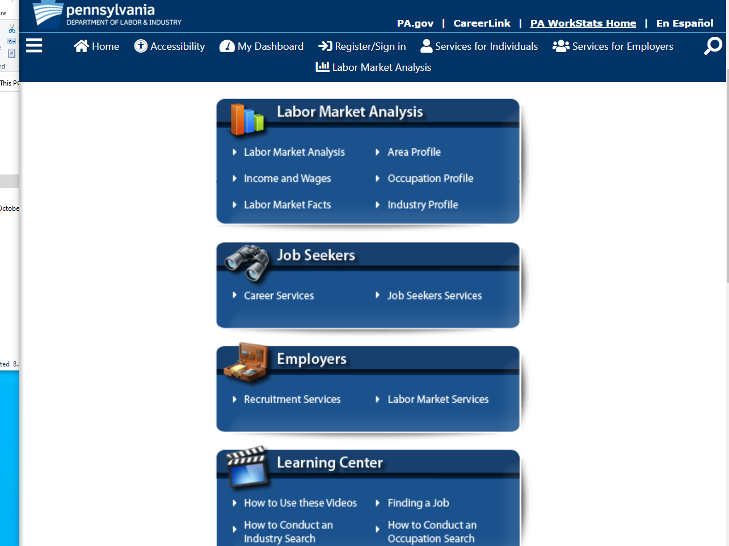
Research & Historical Data
Click the triple bar or “hamburger” symbol (labeled menu if on a large enough screen) to expand a menu of options

Slide 20
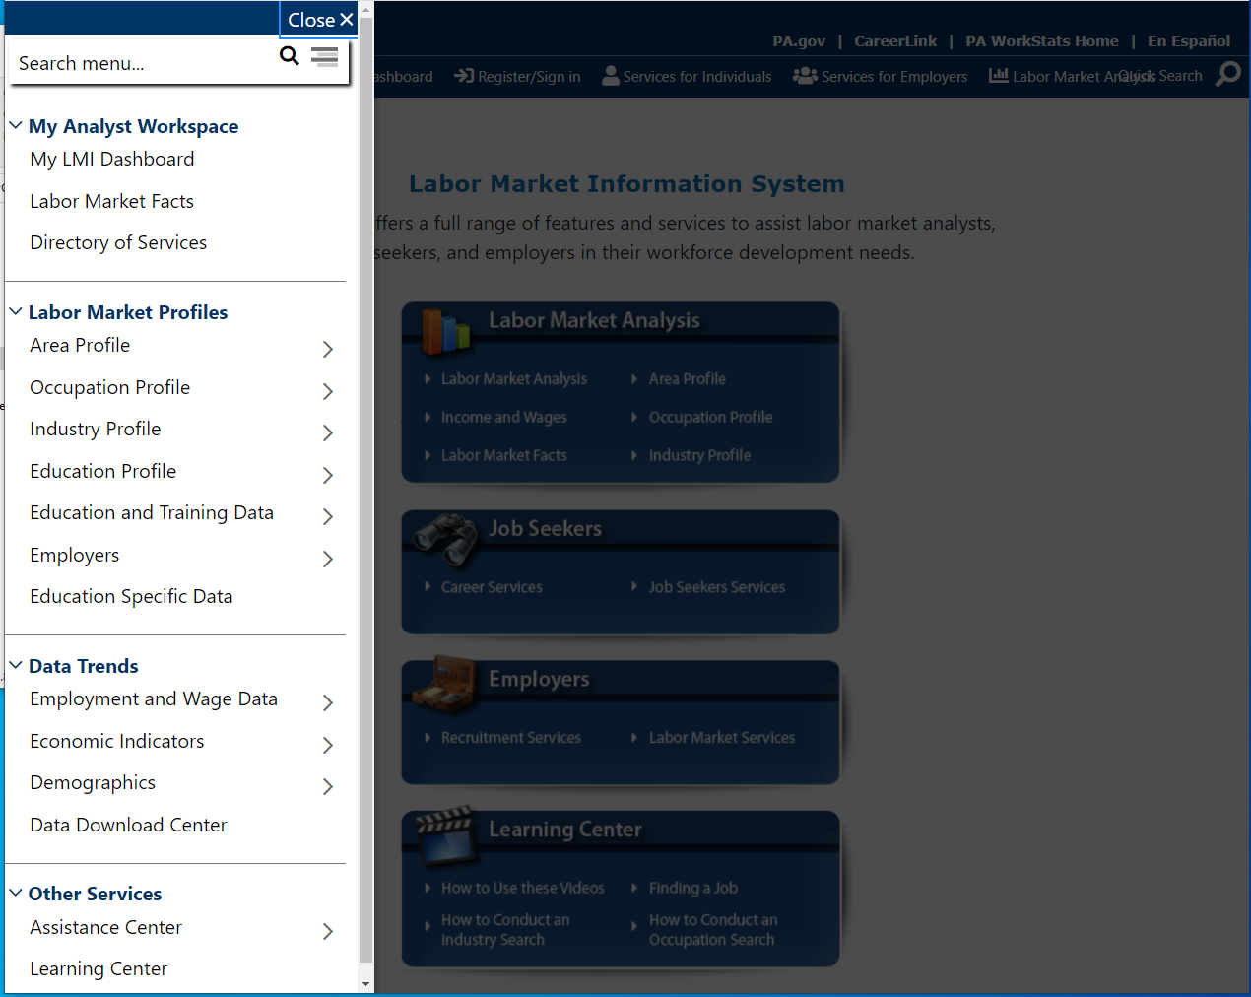
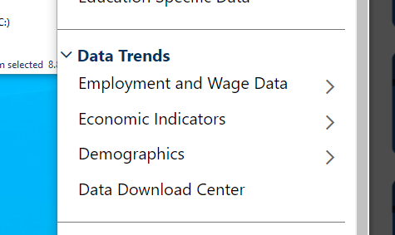
Research & Historical Data
The “Data Trends” menu is the most important area of this portion of our website
Here you can access and download historical data.

Slide 21
Research & Historical Data
From here the menus that follow will look different depending on what you click but you will arrive at the same information.
If you click on the actual text you will see menus like those depicted on the next slide (slide 22)
If you click on the arrow icons (>) you will see menus like those depicted on slide 23

Slide 22
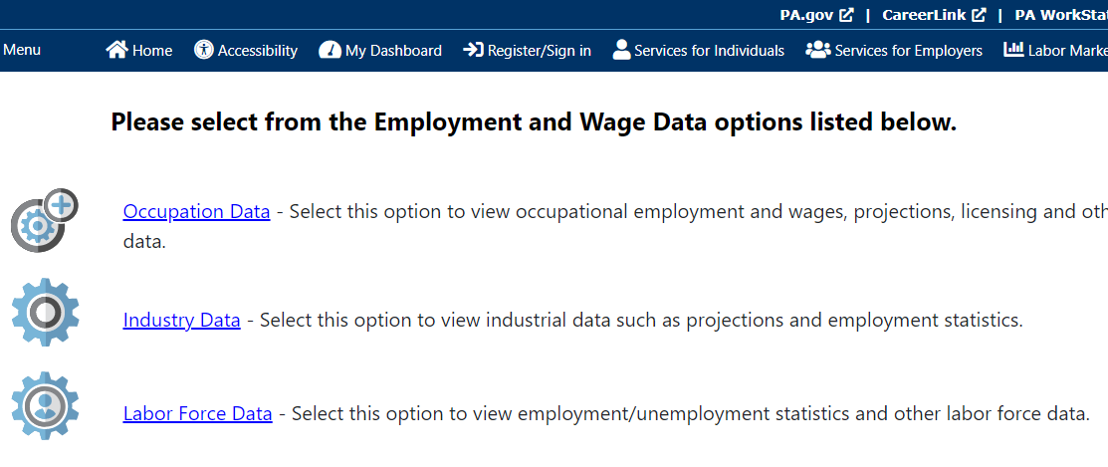
Research & Historical Data - Labor Force Data
If you click on the actual text in the “Data Trends” menu you will see menus formatted like the ones below.

Slide 23
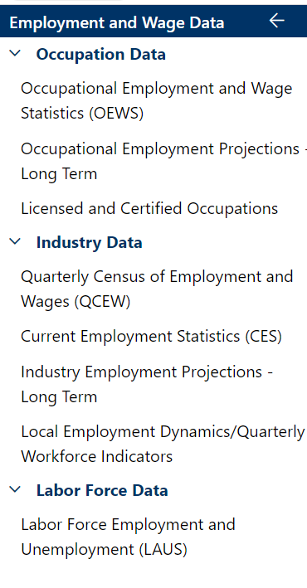
Research & Historical Data
If you click on the arrow icons (>) you will see menus formatted like the one to the right rather than the ones shown on the previous slide

Slide 24
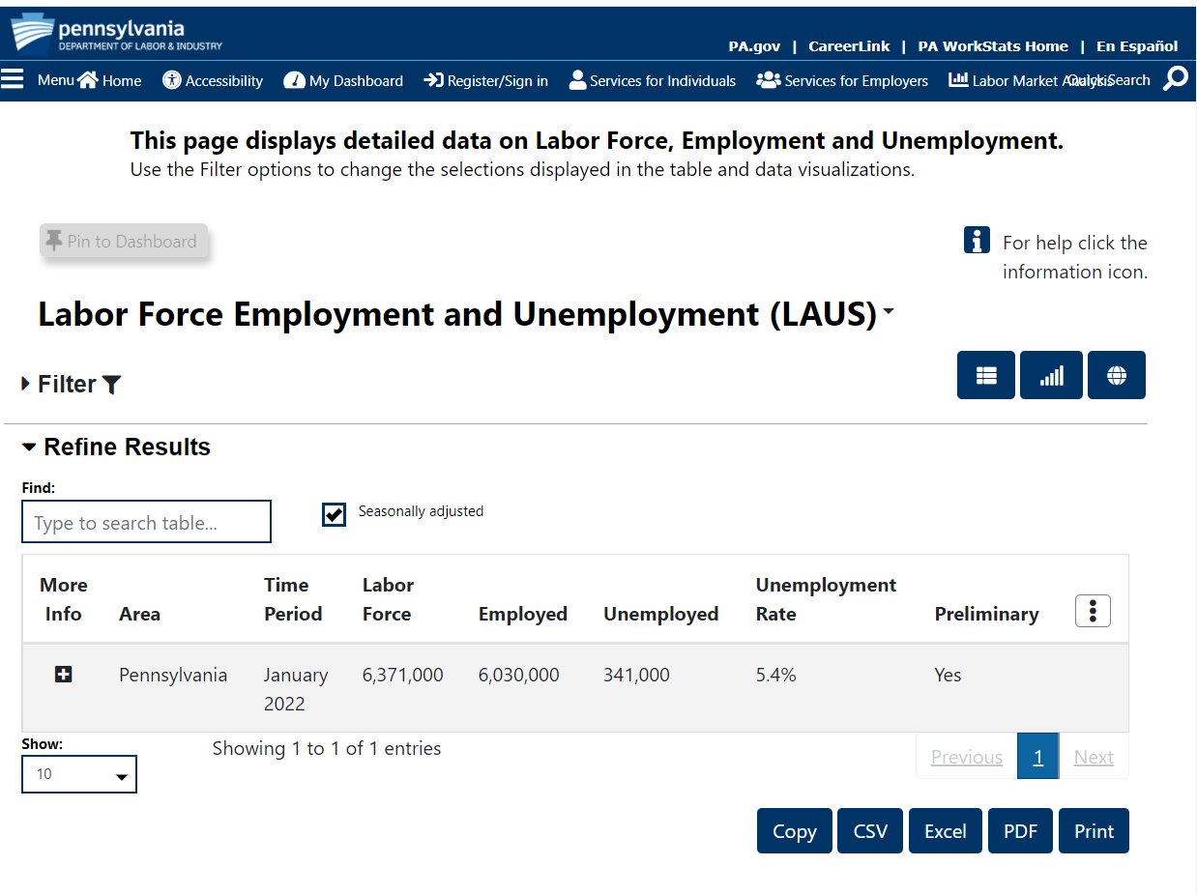
Research & Historical Data
To view and download data, click the filter button to expand a menu of choices

Slide 25
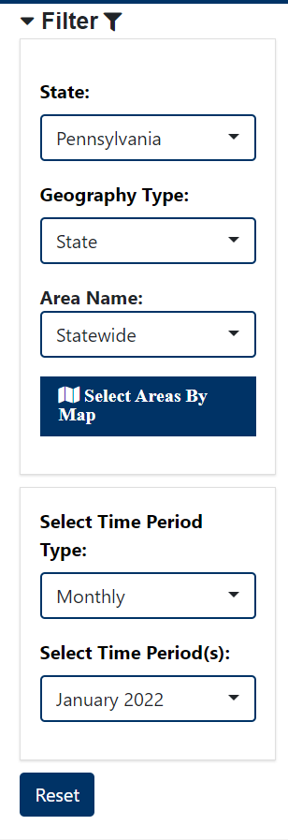
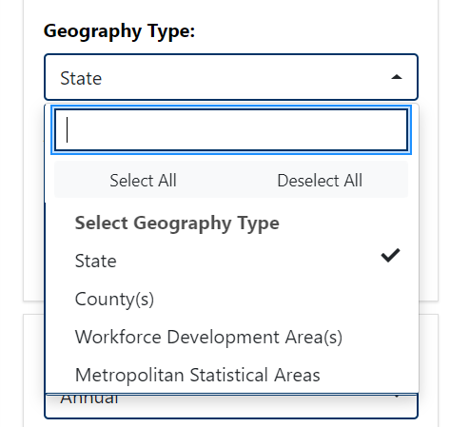
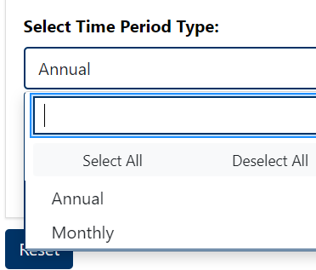
Research & Historical Data
Expand the filters to the left to view choices for geography, time period, etc.
The number of results displayed can be adjusted below the table and there are multiple options for downloading the data

Slide 26
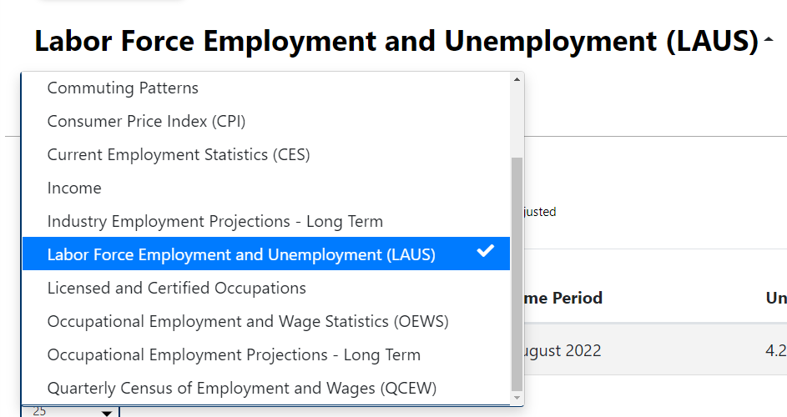
Research & Historical Data
Shortcut for navigating between data sets:
Use the drop-down menu at the top of the page to switch from one dataset to another. This will save you from having to go back to the menu on the left and making several clicks.

Slide 27
Research & Historical Data – Data Download Center
The “Data Download Center” is another way to access historical data.

Slide 28
Research & Historical Data – Data Download Center

Slide 29
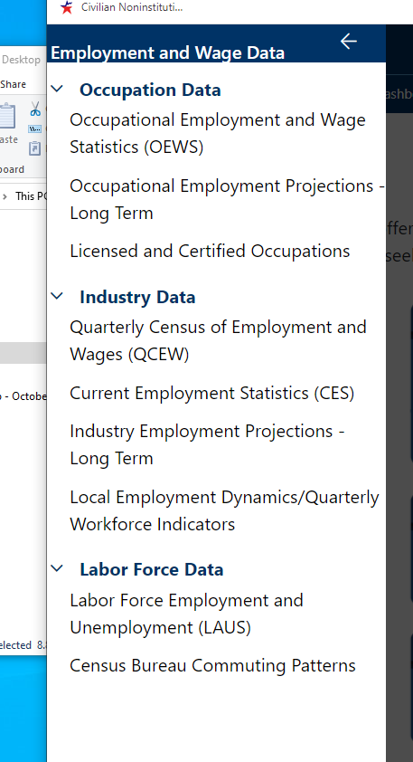
Research & Historical Data
Access through Research & Historical side:
Access through WorkStats side
(less clicks – can bookmark these links):

Slide 30
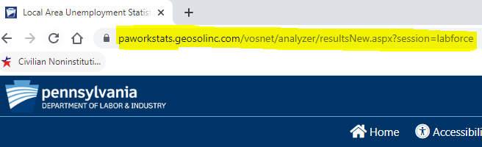
Research & Historical Data
Links copied from the Research side of the website can’t be bookmarked
Links copied from the WorkStats side of the website CAN be bookmarked:
https://paworkstats.geosolinc.com/vosnet/analyzer/resultsNew.aspx?session=labforce
Right-click the link and click “copy link address” to copy/save the link
https://paworkstats.geosolinc.com/altentry.asp?action=lmiguest&whereto=LABFORCEDATA

Slide 31
Research & Historical Data – Returning to WorkStats Website
Q: How do I return to the “WorkStats” side of the website after I’m finished on the “Research & Historical Data” side?
A: When you open the “Research & Historical Data” link it should open in a new browser leaving the “WorkStats” area of the website untouched. If the browser tab is still open, you can simply click on the other tab to return to the WorkStats website.
If for some reason you’ve closed the other tab, you can return to the WorkStats area by first clicking the “home” button to return to the homepage for “Research & Historical Data” and then clicking the “PA WorkStats Home” button found in the top right-hand corner of the “Research & Historical Data” area.

Slide 32
Data Dashboards
I heard that CWIA has some really cool interactive data visualizations.
Where can I find those?
(Data Dashboard)
https://www.workstats.dli.pa.gov/dashboards/Pages/default.aspx

Slide 33
Dashboards
Dashboard screenshot
https://www.workstats.dli.pa.gov/dashboards/Pages/KeyStats.aspx

Slide 34
LMI Forum Page & Learning Center
What happens when I get home from training today?
Is there a place where I can go to brush up on what I learned today?
(LMI Forum & Learning Center)
https://www.workstats.dli.pa.gov/Products/Presentations/Pages/LMI-Forum-Presentations.aspx
https://www.workstats.dli.pa.gov/LearningCenter/Pages/default.aspx

Slide 35
LMI Forum Page
We mentioned at the beginning of the presentation that we would come back to the gray menu on the homepage at the end.
Now that you have seen what our website has to offer, we hope you can see why we saved this for last.
This menu contains all the topics we discussed today. We have placed them on our homepage for your convenience.

Slide 36
LMI Forum Page
There is even an area of our website dedicated solely to our
LMI Forums where you can find presentations of various CWIA program areas and datasets.
This is where you can find details for upcoming forums such as flyers and agendas as well as the PowerPoint slides from presentations from previous events.

Slide 37
Learning Center

Slide 38
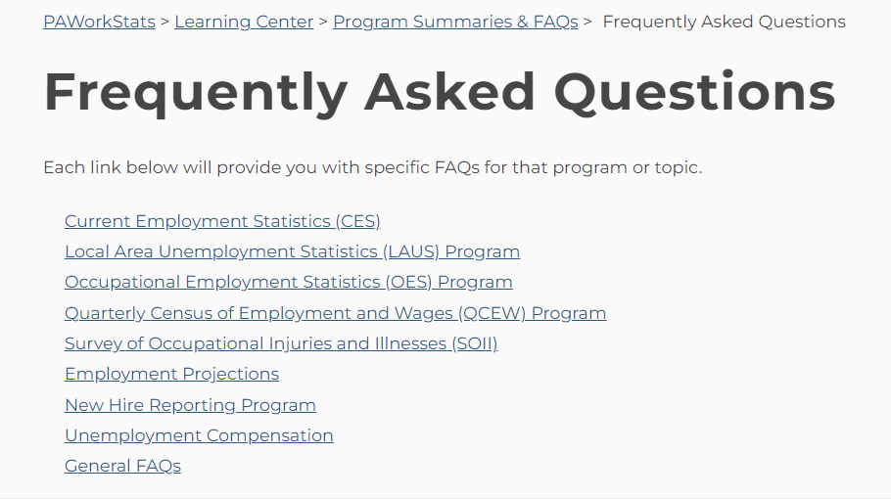
Learning Center - FAQs

Slide 39
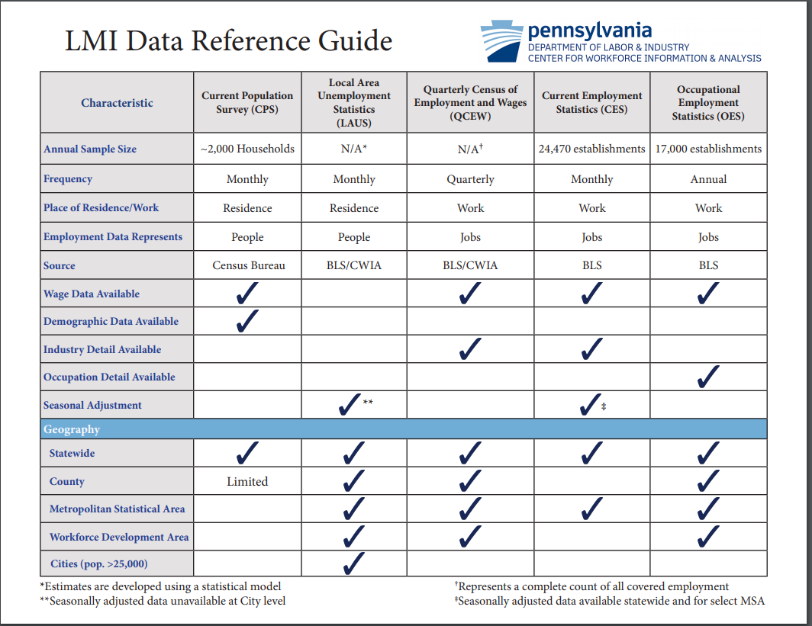
Learning Center – LMI Guide

Slide 40
How Can I Stay Informed?
Sign up for our E-mail Distribution List!
We maintain an e-mail distribution list that we use to announce the
release of statewide and local area data, new products, upcoming
LMI Forums, etc.
Please contact us at workforceinfo@pa.gov or 877-493-3282 to be added to the list.
If you remember receiving e-mails from us but haven’t received any recently, please reach out so we can figure out if we need to update your e-mail address or if there may be another issue.

Slide 41
For Website Assistance Contact:
Customer Response: 877-493-3282 (877-4WF-Data)
Hours: 8:00 am – 4:00 pm
Email: workforceinfo@pa.gov
Online: www.workstats.dli.pa.gov
A “Contact Us” button appears in the gray footer of every page on the website. The Contact Us page lists our phone number and e-mail address and includes a form that you can fill out and send to us with your questions.

