Slide 1

CWIA Resources
Regional Symposium – State College
Kim DeLellis, Shelli Long, Nick Reighard & Jim Studt
Center for Workforce Information & Analysis (CWIA)
May 18, 2023

Slide 2
Who is CWIA?
CWIA (Center for Workforce Information & Analysis) is a bureau within L&I that produces workforce and economic statistics and analysis.
  CWIA’s key roles:
  Provide labor market information (LMI) products & services to wide range of customers
  Measure and report on PA’s labor force (employed and unemployed), employers, industries, occupations, wages, and skills through various products & services
  Calculate performance and outcome metrics for workforce program participants
  Perform data analysis and reporting on Unemployment Compensation, Workers’ Compensation & New Hires program activities
CWIA website: www.workstats.dli.pa.gov
Customer Service: 877-493-3282 (877-4WF-Data) or Email: workforceinfo@pa.gov

Slide 3

Workforce
And
Labor
Data
Online

Slide 4
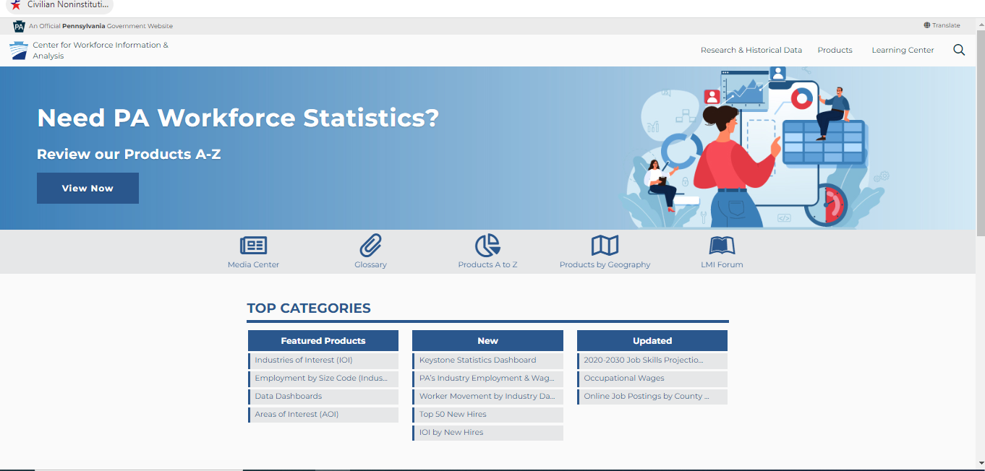
Products A to Z
https://www.workstats.dli.pa.gov

Slide 5

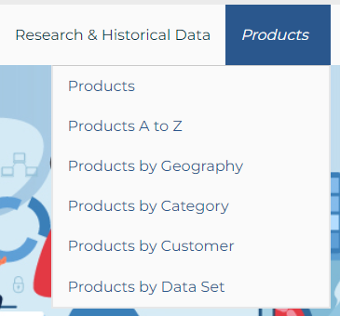
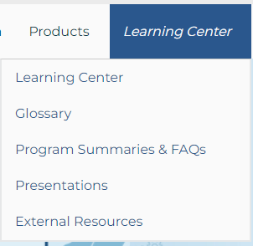
Home Page – Top Navigation
The menu located in the top right-hand corner of our website contains three main areas:
Research & Historical Data
Products
Learning Center
These three areas will provide access to the contents of our entire website.

Slide 6
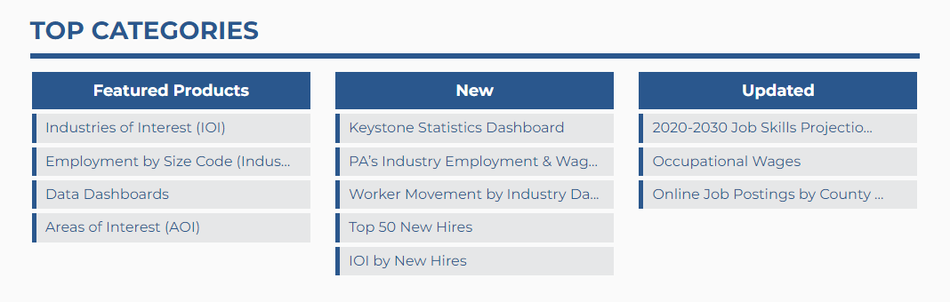
Home Page – Top Categories
On the homepage you will find content boxes that highlight featured, new, and recently updated information:

Slide 7
Products by Category – Customer Type
It’s my first year working for my local PA CareerLink® and I’m looking for resources to help point clients in the right direction for relevant information.
Where can I find this kind of information?
(Products by Customer – Workforce Professionals)
https://www.workstats.dli.pa.gov/Products/ByCustomer/Pages/WorkforceProfessionals.aspx

Slide 8
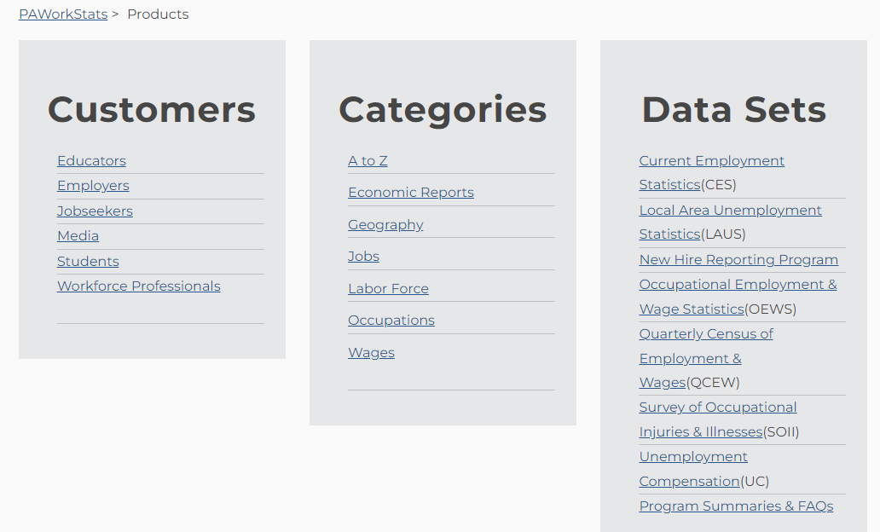

Products by Category – Customer – Workforce Professionals

Slide 9
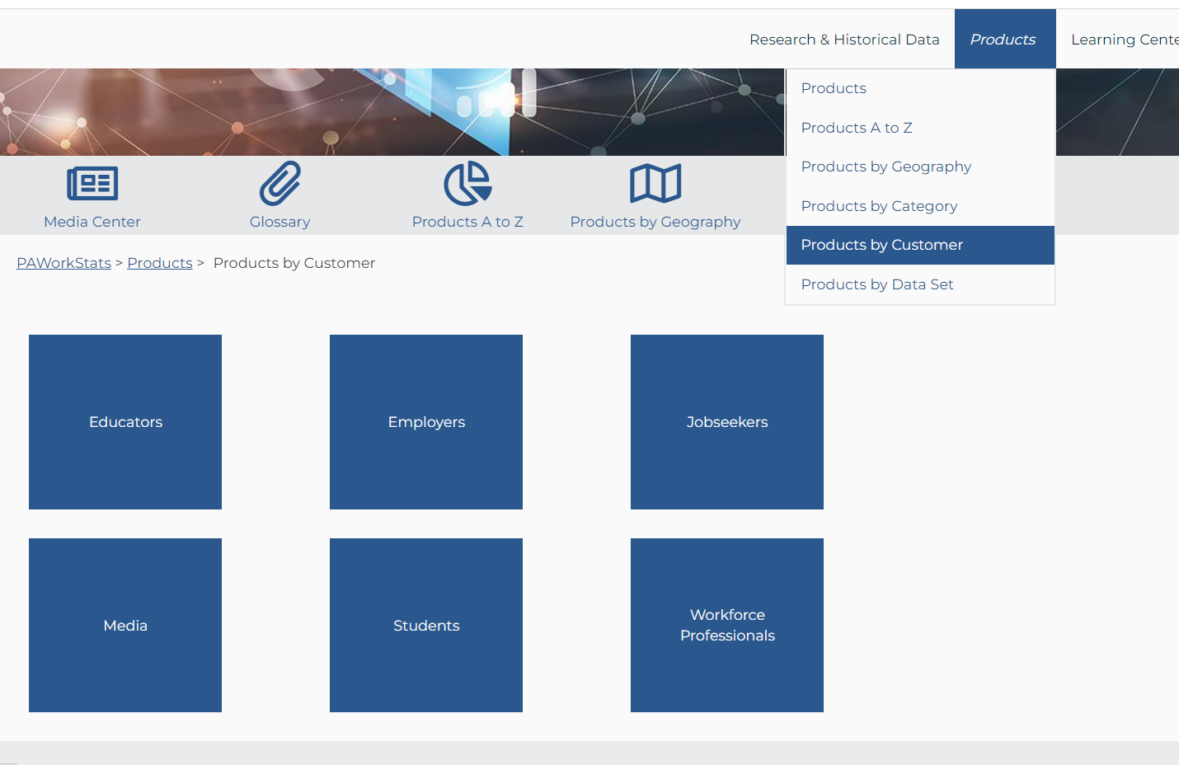
Products by Category – Customer – Workforce Professionals

Slide 10
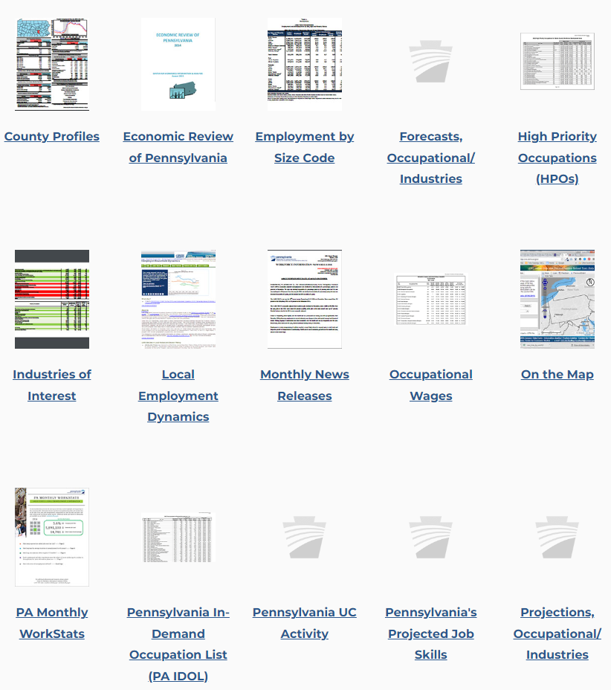
Products by Category – Customer - Workforce Professionals
The two gold stars indicate products discussed today and that should be useful in your work.
High Priority Occupations (HPOs)
PA In-Demand Occupation List
(PA-IDOL)

Slide 11
Products by Geography
I just transferred to Central PA.
Where can I go to find information specific to my area?
(Products by Geography)
https://www.workstats.dli.pa.gov/Products/Pages/Products%20By%20Geography.aspx

Slide 12
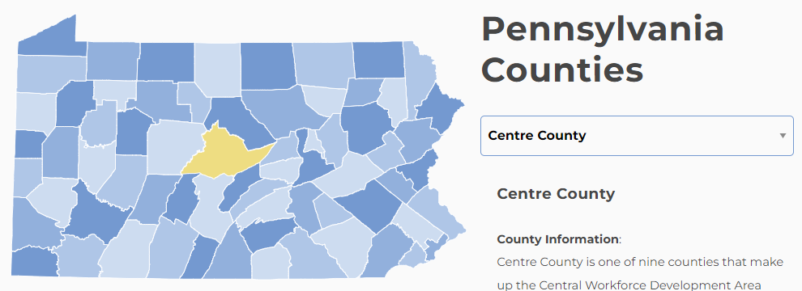

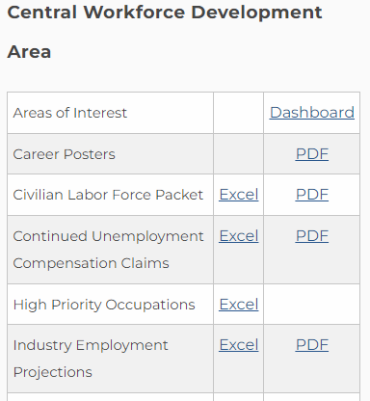
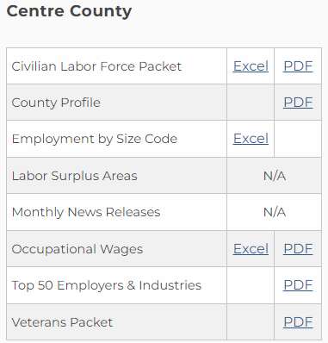
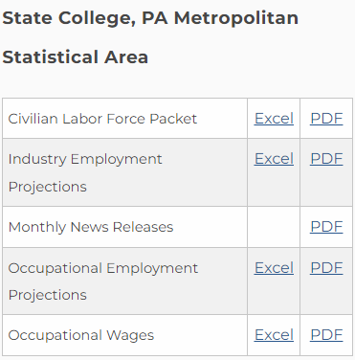
Products by Geography
A customized listing of all products containing data for your county, workforce development area (WDA), and metropolitan statistical area (MSA)
https://www.workstats.dli.pa.gov/Products/Pages/Products%20By%20Geography.aspx
Please visit the Products by Geography page to view the full listing of products for your county and surrounding area

Slide 13
Products A to Z
I got an e-mail about a recent product that was released but I lost it. Where can I find that publication?
(Products A to Z)
https://www.workstats.dli.pa.gov/Pages/ProductsAtoZ.aspx

Slide 14
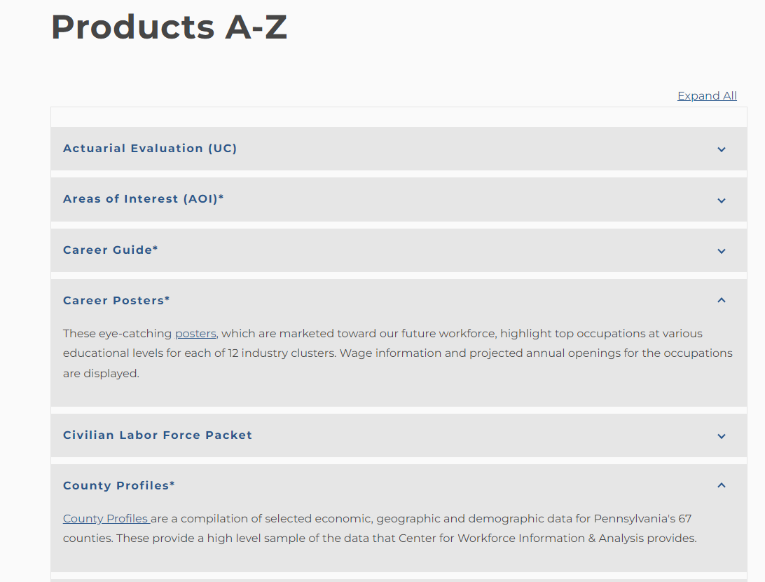

Products A to Z
An alphabetical listing of all products located on the website:
Notes:
Patricia will start after this slide

Slide 15
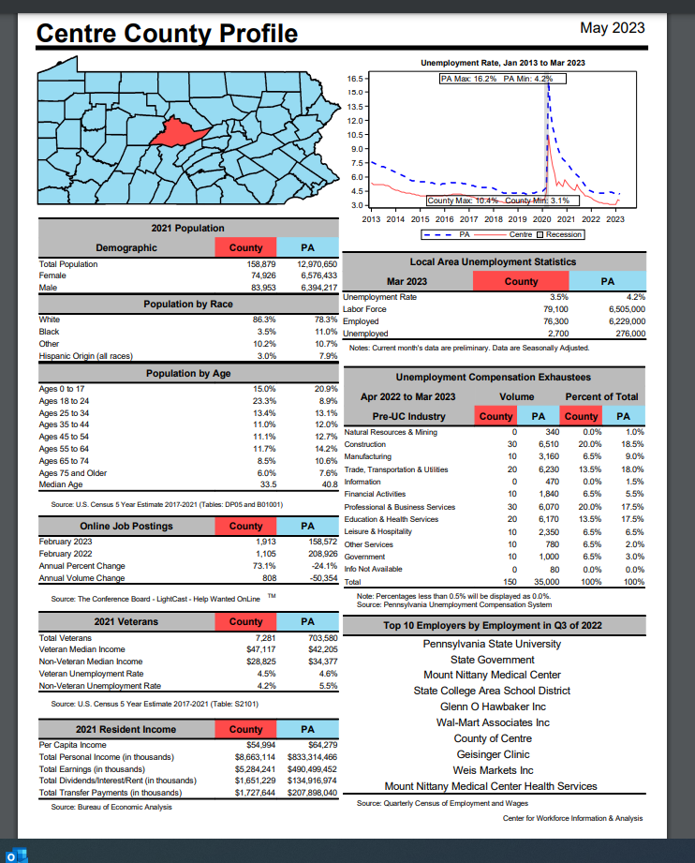
Products A to Z – County Profiles
https://www.workstats.dli.pa.gov/Documents/County%20Profiles/Centre%20County.pdf
Notes:
Patricia will start after this slide

Slide 16
Data Dashboards
I heard that CWIA has some really cool interactive data visualizations.
Where can I find those?
(Data Dashboard)
https://www.workstats.dli.pa.gov/dashboards/Pages/default.aspx

Slide 17
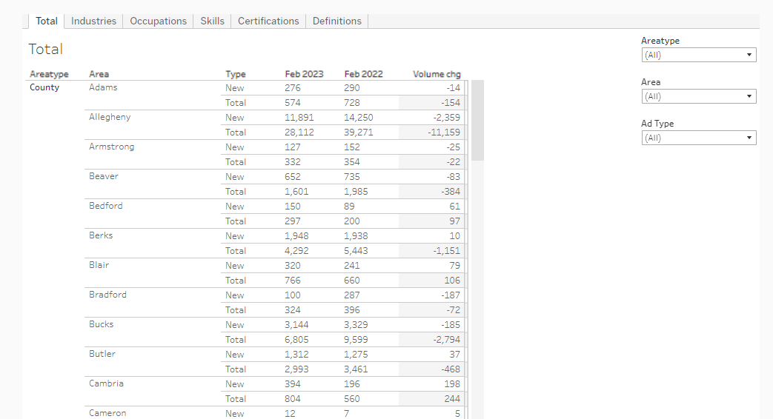
Dashboards – Online Job Postings
https://www.workstats.dli.pa.gov/dashboards/Pages/Online-Job-Postings-by-WDA.aspx

Slide 18
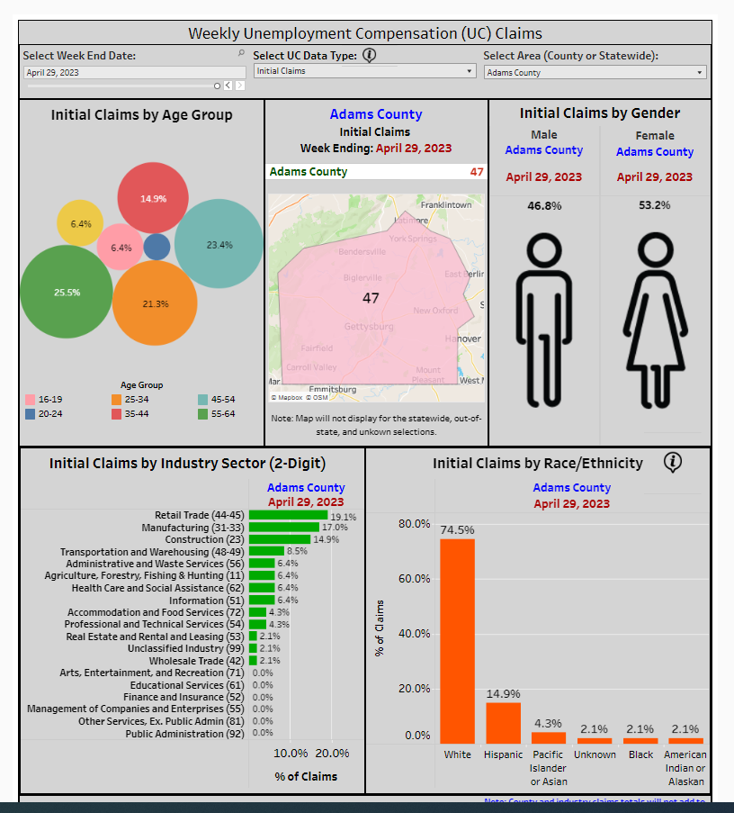
Dashboards – Weekly UC Claims
https://www.workstats.dli.pa.gov/dashboards/Pages/Weekly-UC.aspx

Slide 19
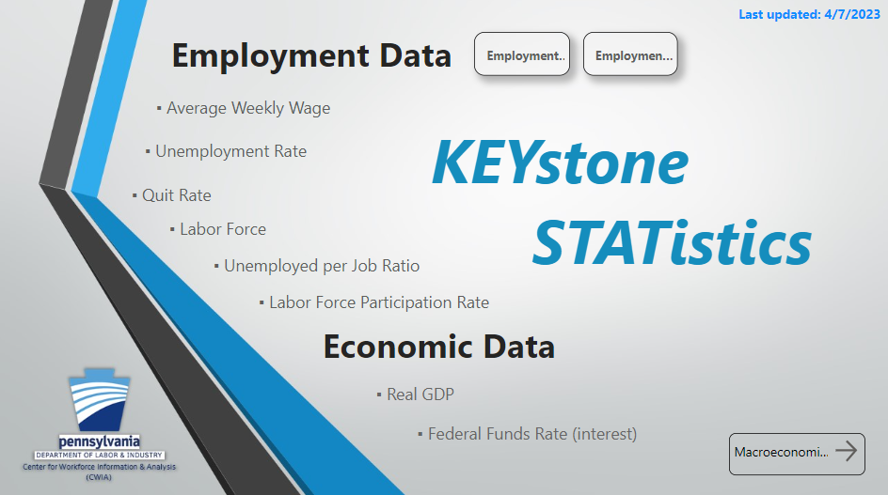
Dashboards – KEYstone Statistics
Dashboard screenshot
https://www.workstats.dli.pa.gov/dashboards/Pages/KeyStats.aspx

Slide 20
Learning Center
What happens when I get home from training today?
Is there a place where I can go to brush up on what I learned today?
(Learning Center & LMI Forum)
https://www.workstats.dli.pa.gov/LearningCenter/Pages/default.aspx
https://www.workstats.dli.pa.gov/Products/Presentations/Pages/LMI-Forum-Presentations.aspx

Slide 21
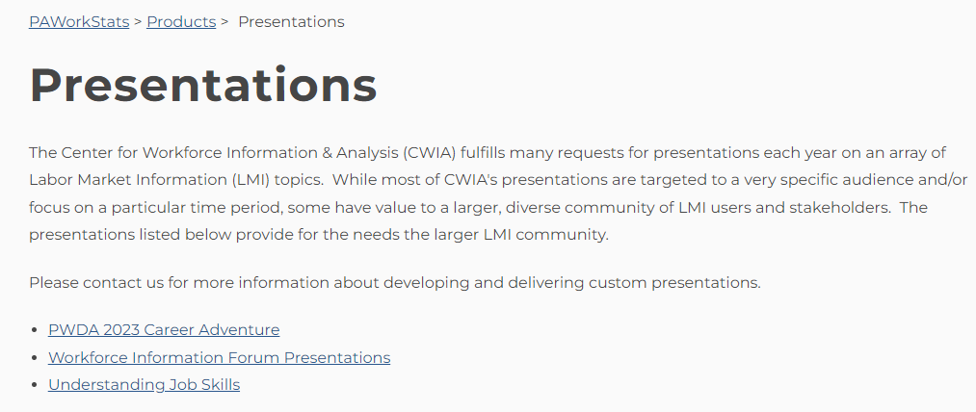
Learning Center
Now that you have seen what our website has to offer, we hope you can see why we saved this for last.

Slide 22
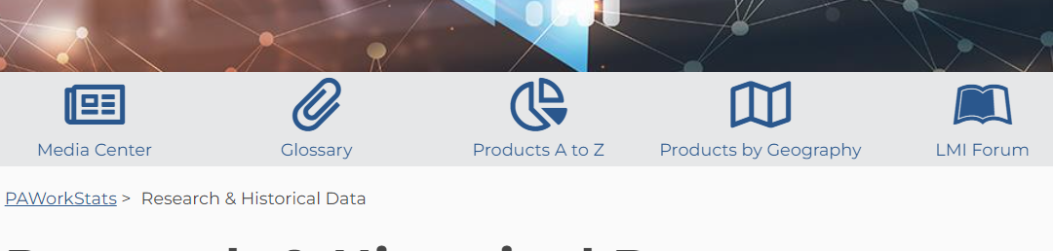
LMI Forum Page
There is even an area of our website dedicated solely to our
LMI Forums where you can find presentations of various CWIA program areas and datasets.
This is where you can find details for upcoming forums such as flyers and agendas as well as the PowerPoint slides from presentations from previous events.

Slide 23
How Do I Stay in Touch With CWIA?
Website: www.workstats.dli.pa.gov
Customer Response Contact Information:
877-493-3282 (877-4WF-Data)
Hours: 8:00 am – 4:00 pm
Email: workforceinfo@pa.gov
Sign up for our E-mail Distribution List!
We maintain an e-mail distribution list that we use to announce the
release of statewide and local area data, new products, upcoming
LMI Forums, etc. Please contact us to be added to the list.

Slide 24

Questions?
Questions?
Kim DeLellis (kdelellis@pa.gov)
Shelli Long (shellong@pa.gov)
Nick Reighard (nreighard@pa.gov)
Jim Studt (jstudt@pa.gov)

