Slide 1
Time-Saving
Labor Market Information Webtools
Tim McElhinny and Nick Reighard
Center for Workforce Information & Analysis
November 20, 2019

Slide 2
Goal of Presentation
Introduce data users to advanced labor market information products by the Center for Workforce Information & Analysis:
Top 50 Industries
Industries of Interest
Areas of Interest
Top 50 Jobs Skills
Job Skills Projections 2016-2026
Job Skills Tools

Slide 3
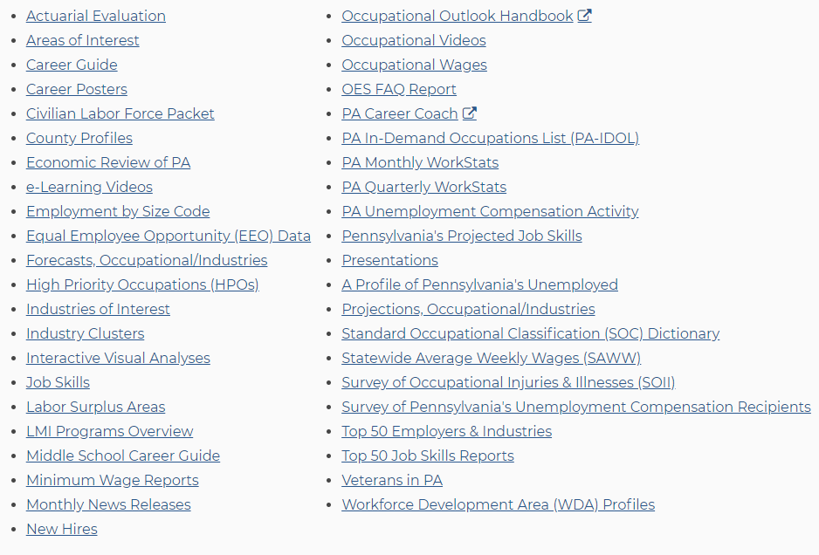
Where to Find These Products
Products A to Z: https://www.workstats.dli.pa.gov/Pages/ProductsAtoZ.aspx

Slide 4
Top 50 Industries
4

Slide 5
Top 50 Industries
Highlights the top industries in a region:
On second page of Top 50 Employers Report.
A listing of the 50 largest industries by employment at the state or WDA levels.
Done at the 4-digit NAICS industry level.
Use as a quick resource to see the industrial make-up of your area.
Compare your area to state and neighboring areas to see differences – what is new and what has dropped off.
Use with Employer Database or CWIA’s Employer Search feature to find companies.

Slide 6
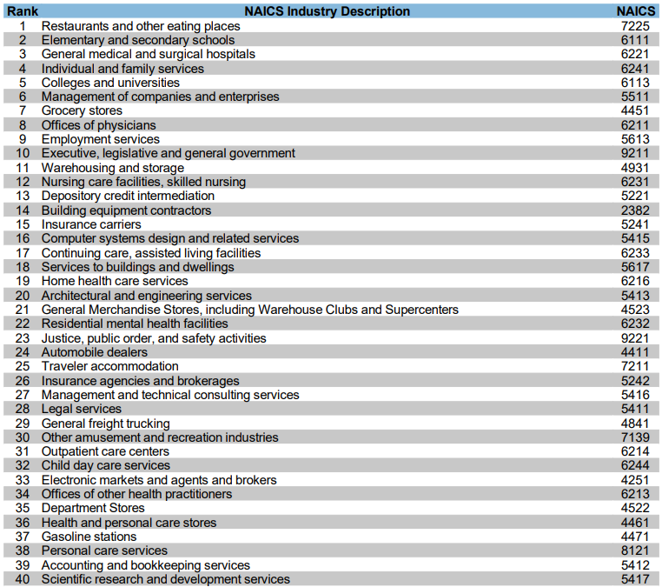
Top PA Industries

Slide 7
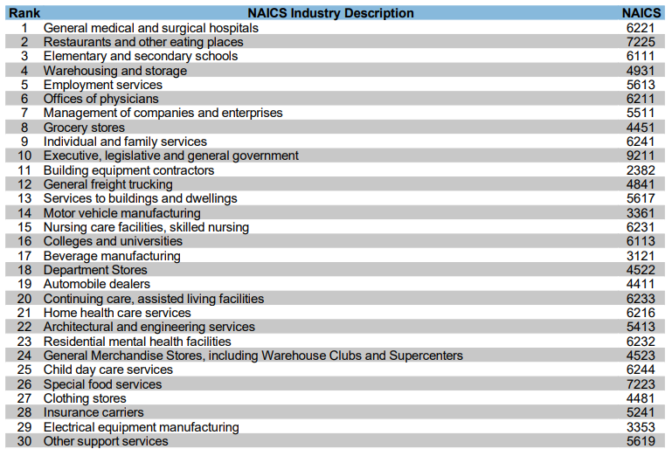
Top Lehigh County Industries
State
11
31
>50
>50
>50

Slide 8
Industries of Interest
8

Slide 9
Industries of Interest
Highlights growing or declining industries in PA or by region:
Growth/Decline – year-over-year employment growth or decline of at least 5%
Long-Term Growth/Long-Term Decline – four consecutive quarters of year over year employment growth or decline totaling at least 5%
In both cases there must be a net employment gain/loss >= 25
IOIs created from three different sources:
Quarterly Census of Employment and Wages
New Hires data
Help Wanted online job postings

Slide 10
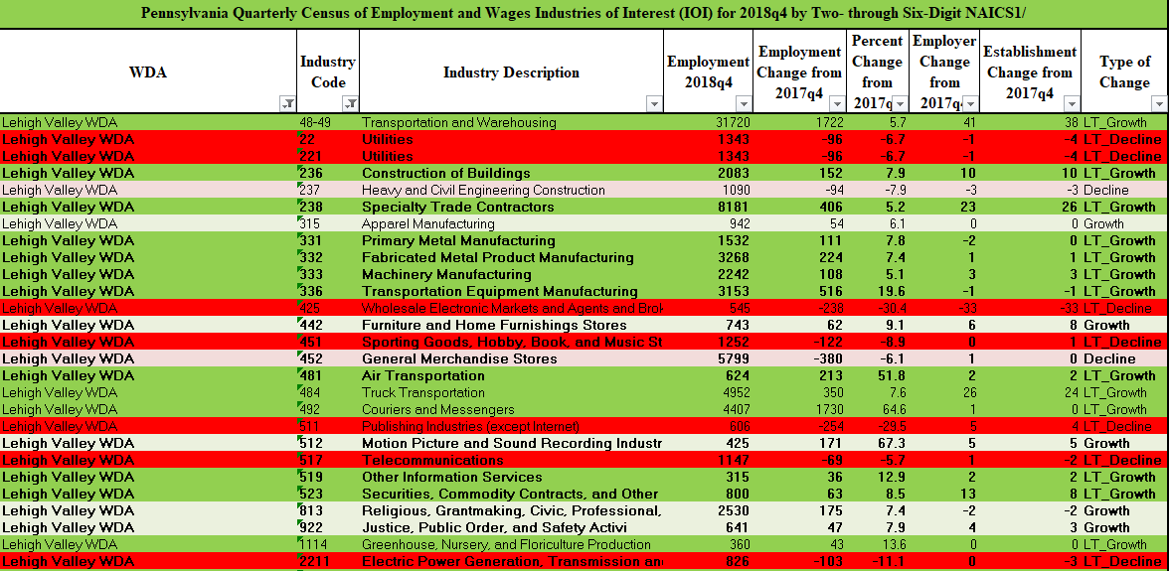
Industries of Interest

Slide 11
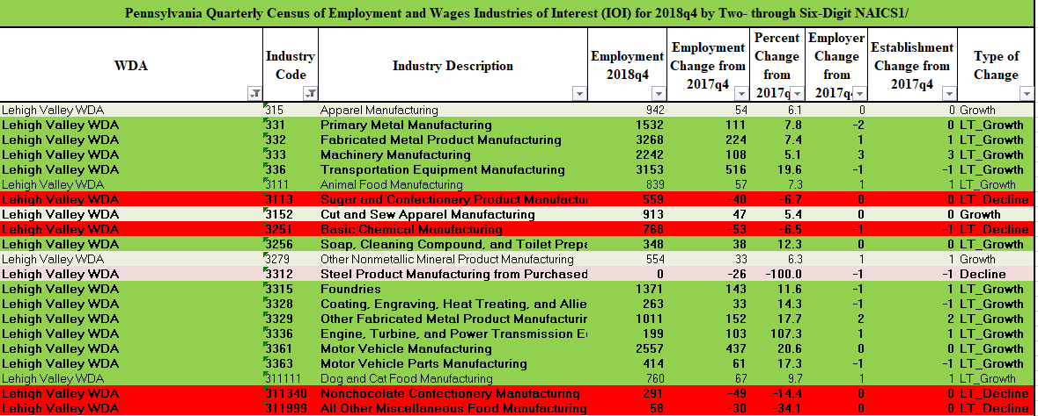
Industries of Interest

Slide 12
Industries of Interest
Results by Industry for PA or a WDA:
Pennsylvania:
Lehigh Valley WDA:
Code Level | Total | Cut to | LT Growth | Growth | LT Decline | Decline
2 - digit | 20 | 3 | 2 | 1 | 0 | 0
3 - digit | 97 | 11 | 5 | 4 | 2 | 0
4 - digit | 307 | 51 | 32 | 15 | 3 | 1
6 - digit | 1,018 | 249 | 135 | 61 | 33 | 20
Code Level | Total | Cut to | LT Growth | Growth | LT Decline | Decline
2 - digit | 20 | 2 | 1 | 0 | 1 | 0
3 - digit | 95 | 23 | 11 | 5 | 5 | 2
4 - digit | 281 | 70 | 31 | 12 | 20 | 7
6 - digit | 791 | 122 | 58 | 10 | 46 | 8

Slide 13
Industries of Interest
Additional points:
Updated quarterly.
Use for economic or workforce development purposes.
Use in combination with PA Employer database or CWIA’s Employer Search website feature to find employers in these industries by inputting industry codes into the tools.
Use historical IOI for trend analysis.
Cut down list of 1,000 industries to 250.

Slide 14
Areas of Interest
14

Slide 15
Areas of Interest
Highlights growing or declining geographic areas:
Purpose is to highlight sub-county areas (MCDs) in the state that exhibit growth or decline in employment.
Same metrics as Industries of Interest.
Generated from QCEW.
Available for PA, WDAs and counties
Can be viewed on an interactive dashboard in addition to Excel and PDFs.

Slide 16
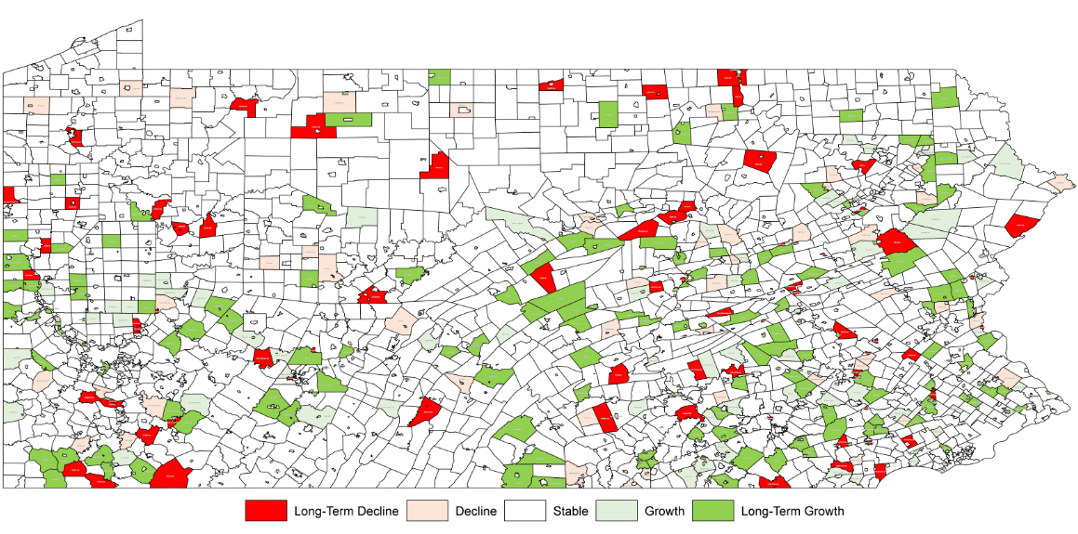
Areas of Interest

Slide 17
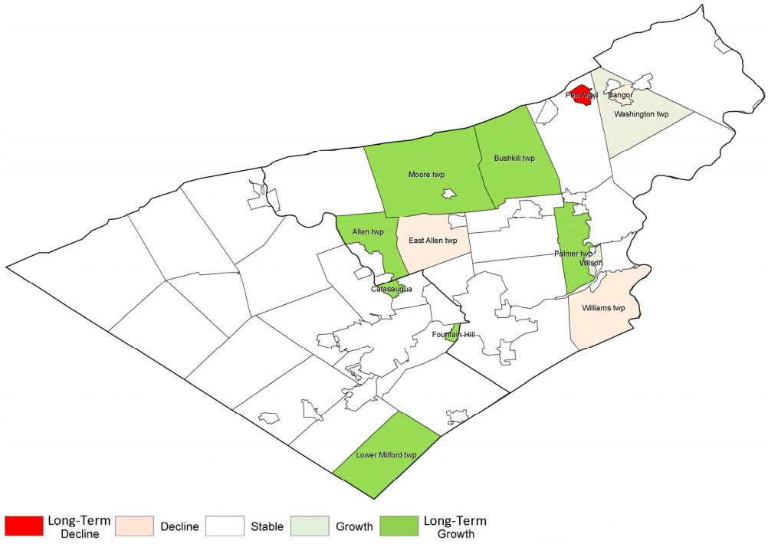
WDA Areas of Interest

Slide 18
Areas of Interest
Results by Industry for PA, WDA or County:
Pennsylvania:
Lehigh Valley WDA:
Total | Cut to | LT Growth | Growth | LT Decline | Decline
2,572 | 444 | 186 | 98 | 85 | 75
Total | Cut to | LT Growth | Growth | LT Decline | Decline
63 | 13 | 7 | 2 | 1 | 3
Lehigh County:
Total | Cut to | LT Growth | Growth | LT Decline | Decline
52 | 3 | 3 | 0 | 0 | 0

Slide 19
Areas of Interest
Additional points:
Traditional employment analysis focuses on industry and occupations
Areas of Interest provides an additional dimension to consider for workforce and economic developers
Workforce developers can refer jobseekers to growing areas for job prospects
Economic developers can identify regions experiencing growth to build upon it and refer new businesses, or to implement intervention strategies in those areas experiencing decline

Slide 20
Job Skills
20

Slide 21
Top 50 Job Skills
Highlights the job skills most likely to be required in the workforce over the next 10 years.
Job skills are personal abilities that help workers carry out job-related tasks.
Two types of Jobs Skills in the report:
Detailed Work Activities - Types of specific job behaviors or duties particular to an occupation (e.g. use computers to enter, access, or retrieve data).
Tools & Technologies - Machines, equipment, tools, and information technologies that one could be expected to use in a particular occupation (e.g. Microsoft Access).
Report shows the projected employment and the annual demand needing the skill.
Done for PA and WDAs.

Slide 22
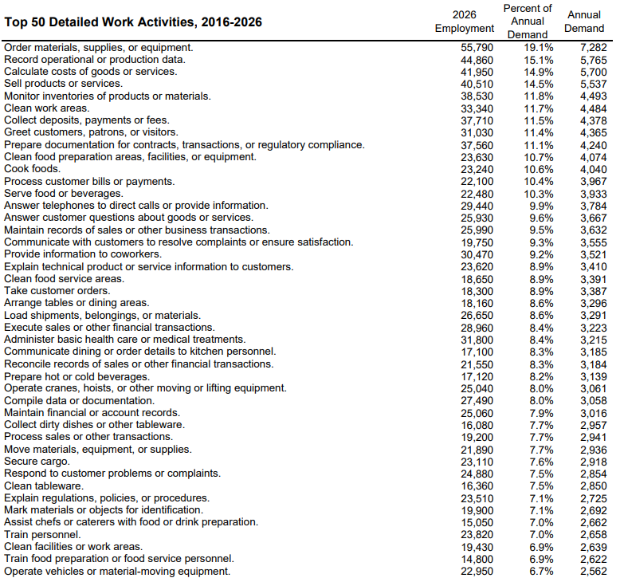
Top 50 Job Skills - Lehigh Valley
State
49
>50
>50
>50
>50

Slide 23
Top 50 Job Skills
Additional points:
Traditional employment analysis focuses on industry and occupations.
Industry data tells where the jobs are, occupational data tells what the jobs are, and skills data tells how to train for the jobs.
They are tangible and attainable skills that someone can acquire through training and education, often at local community colleges or technical schools.
Building blocks for similarities across all occupations.
Data source - The Occupational Information Network (O*NET) and Occupational Projections. Updated every two years to stay current.

Slide 24
Job Skills Projections
24

Slide 25
Job Skills Projections
Using the Pennsylvania and Workforce Development Area 2016-2026 occupational projections and the U.S. Department of Labor’s O*NET database, CWIA analyzed the job skills for each occupation.
Summarized each job skill's occurrence across all occupations to determine its projected total, growth and separations employment demand.
The technology, “spreadsheet software,” is used in 640 occupations whose total annual projected employment demand is 640,757 of which 30,116 is due to annual growth demand.
The number of employed needing this skill will be 5.9 million in 2026, or 90 percent of all employment.
This information can be used to determine those skills most needed across all occupations and those that are growing or declining in demand by area.

Slide 26
Job Skills Projections
Job Skills:
Tangible and attainable skills that can be trained for utilizing postsecondary or technical schools.
A Knowledge Area is a key educational or experience requirement for an occupation (e.g. Computers and Electronics).
General Work Activities are types of job behaviors that occur across multiple occupations (e.g. interacting with computers).
Detailed Work Activities are types of specific job behaviors or duties particular to an occupation (e.g. use computers to enter, access or retrieve data).
Tools & Technologies are machines, equipment, tools, and information technologies that one could be expected to use in a particular occupation (e.g. Microsoft Access).
Building blocks for similarities across all occupations.

Slide 27
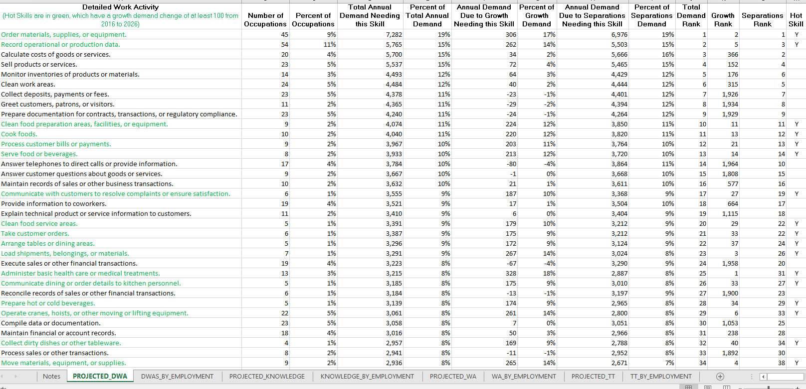
Job Skills - Lehigh Valley

Slide 28
The Big Picture
Knowledge and General Work Activities are education categories and job behaviors that occur across multiple occupations.
Knowledge Most prevalent | General Work Activities Most prevalent
English Language | Getting Information
Customer and Personal Service | Communicating with Supervisors, Peers, or Subordinates
Administration and Management | Interacting With Computers
Mathematics | Performing for or Working Directly with the Public
Education and Training | Establishing and Maintaining Interpersonal Relationships
Public Safety and Security | Making Decisions and Solving Problems
Computers and Electronics | Identifying Objects, Actions, and Events
Clerical | Documenting/Recording Information
Personnel and Human Resources | Organizing, Planning, and Prioritizing Work
Sales and Marketing | Updating and Using Relevant Knowledge

Slide 29
LV DWAs – Little Picture
Detailed Work Activities are types of specific job behaviors or duties particular to an occupation (e.g., use computers to enter, access or retrieve data)
Total Demand Most prevalent | Growth Increasing in importance
Order materials, supplies, or equipment. | Administer basic health care or medical treatments.
Record operational or production data. | Order materials, supplies, or equipment.
Calculate costs of goods or services. | Load shipments, belongings, or materials.
Sell products or services. | Move materials, equipment, or supplies.
Monitor inventories of products or materials. | Record operational or production data.
Clean work areas. | Operate cranes, hoists, or other moving or lifting equipment.
Collect deposits, payments or fees. | Secure cargo.
Greet customers, patrons, or visitors. | Mark materials or objects for identification.
Prepare documentation for contracts, transactions, or regulatory compliance. | Collect biological specimens from patients.
Clean food preparation areas, facilities, or equipment. | Clean food preparation areas, facilities, or equipment.

Slide 30
Useful Job Skills Tools
https://www.workstats.dli.pa.gov/Products/JobSkills/Pages/default.aspx
Website tools available to:
Find an occupation’s job skills
Find related occupations
Determine Career Pathways by wage or education
Determine skill gaps when moving from occupation to occupation
Determine the value of a job skill
Job Skill Ladders

Slide 31
CWIA Contact Information
Customer Response Line: 877-493-3282 or
877-4WF-Data
Email: workforceinfo@pa.gov
On the web: www.workstats.dli.pa.gov

