Slide 1
Building Blocks
Center for Workforce Information & Analysis (CWIA)

Slide 2
Industry & Labor Force Data

Slide 3
What is LMI?
Labor market information, or LMI, refers to a variety of data associated with the supply and demand for workers. This includes information on the labor force, employers, industries, occupations, wages, and skills…just to name a few!
Labor force = supply of workers and their characteristics
Employers = types of businesses/industries that employ workers in PA
Occupations = jobs found in different industries
Wages = what workers current make and employers can expect to pay
Skills = education and training requirements for different occupations
Labor Market = Labor Force + Employers + Occupations + Wages + Skills

Slide 4
Data Types
Place of Work: Industry | Place of Work: Occupation | Place of Residence
Jobs (CES) | Wages | Unemployed (LAUS)
Employment (QCEW) | Projections | New Hires
Claims (Unempl. Compensation) | Injuries & Illnesses (SOII) | Demographics
Projections
Injuries & Illnesses (SOII)
New Hires
Much of CWIA’s data is assigned by industry or occupation. While these terms are often used interchangeably, they are in fact very different when it comes to data.
Industry refers to the type of business/organization/employer where an individual works
Occupation refers to the job duties that an individual actually performs at their place of work

Slide 5
Objectives
To discuss three different measures of employment:
Quarterly Census of Employment and Wages (QCEW)
Current Employment Statistics (CES)
Local Area Unemployment Statistics (LAUS)
What does this data measure?
How is this data alike? How is it different?
Where/when can this data be found?
Examples of each data set

Slide 6
QCEW
The Quarterly Census of Employment and Wages (QCEW) is the most complete count of monthly jobs and quarterly wages we have.
PA Employers subject to Unemployment Insurance (UI) laws are required to submit monthly UI covered employment totals
Roughly 97% of all PA employment captured
Available about 5 months after quarter ends - Q4 2021 preliminary and Q3 2021 final data were released the week of March 9th
Counts the number of JOBS (not workers)
Based on LOCATION OF JOB (not residence of worker)
Referred to as the “universe” because it is a census of all UI covered employers and serves as the basis for other programs’ samples

Slide 7
QCEW, continued
Quarterly jobs totals available by different levels of detail:
Total Jobs
Industry Sectors (manufacturing, retail trade, etc.)
Down to six-digit NAICS detail when passes confidentiality
Totals by ownership and size class also available
Limitations
Time lag (about 5 months)
Data is not adjusted for seasonality
NOT a time series: Administrative changes applied annually
Most complete count of employment and establishment data, so used by most other BLS programs
Sample frame
Benchmarking

Slide 8
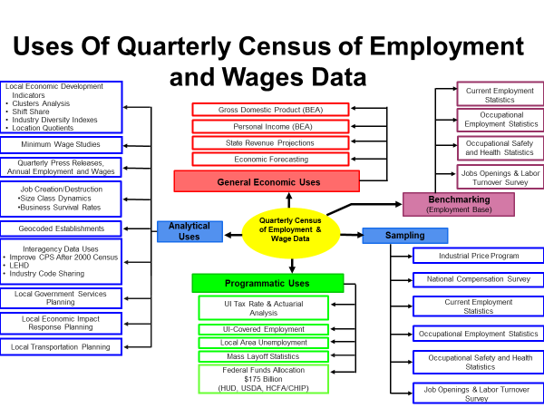
QCEW Uses

Slide 9
QCEW Data Example
Montgomery County
Industry | NAICS | Establishments | Jan Emp | Feb Emp | Mar Emp | Avg Weekly Wage
Agriculture, Forestry, Fishing & Hunting | ‌11 | 63 | 266 | 271 | 316 | $643
Mining, Quarrying, and Oil & Gas Extrtn | ‌21 | 16 | 236 | 239 | 236 | $1,451
Utilities | ‌22 | 25 | 2,409 | 2,506 | 2,491 | $4,496
Construction | ‌23 | 2,504 | 23,709 | 23,729 | 24,699 | $1,594
Manufacturing | ‌31-33 | 1,009 | 44,036 | 44,187 | 44,900 | $2,585
Wholesale Trade | ‌42 | 1,516 | 22,087 | 22,105 | 22,314 | $2,742
Retail Trade | ‌44-45 | 2,938 | 50,264 | 49,774 | 49,718 | $747
Transportation and Warehousing | ‌48-49 | 514 | 12,722 | 12,591 | 12,568 | $898
Information | ‌51 | 516 | 9,002 | 8,957 | 9,008 | $2,239
Finance and Insurance | ‌52 | 1,972 | 33,517 | 33,468 | 33,381 | $3,863
Real Estate and Rental and Leasing | ‌53 | 1,156 | 7,394 | 7,459 | 7,496 | $2,061
Professional, Scientific, & Tech Svcs | ‌54 | 4,269 | 56,577 | 56,795 | 57,105 | $2,985
Mgmnt of Companies and Enterprises | ‌55 | 521 | 15,226 | 15,251 | 15,351 | $3,416
First quarter 2022 Quarterly Census of Employment and Wages
Private Ownership; All data are preliminary
https://www.workstats.dli.pa.gov/Research/Pages/default.aspx

Slide 10
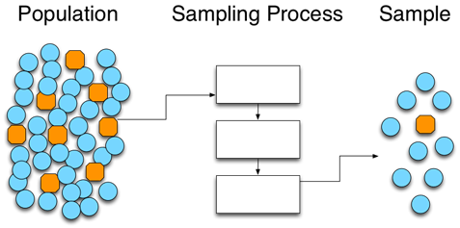
Current Employment Statistics (CES)
Current Employment Statistics (CES) is a monthly payroll survey of nonfarm establishments used to estimate jobs
PA sample consists of about 25,000 business establishments.
Monthly estimates produced roughly one month after the reference month (September 2022 data is released in October 2022)
Counts the number of JOBS (not workers)
Based on LOCATION OF JOB (not residence of worker)
BLS produces monthly estimates for the US, States, and MSAs
CWIA produces estimates for 32 non-MSA counties

Slide 11
CES, continued
Monthly nonfarm jobs estimates are produced for different industry detail:
Total Nonfarm, Private and Public industry totals
Goods-producing and Service-providing totals
Sectors (manufacturing, retail trade, etc.)
Subsector detail for some industries
Advantages
Frequency
Seasonal Adjustment – allows for comparison of different months
Statewide seasonally adjusted at sector level
MSAs seasonally adjusted only for total nonfarm jobs
Time Series – data comparable across different years

Slide 12
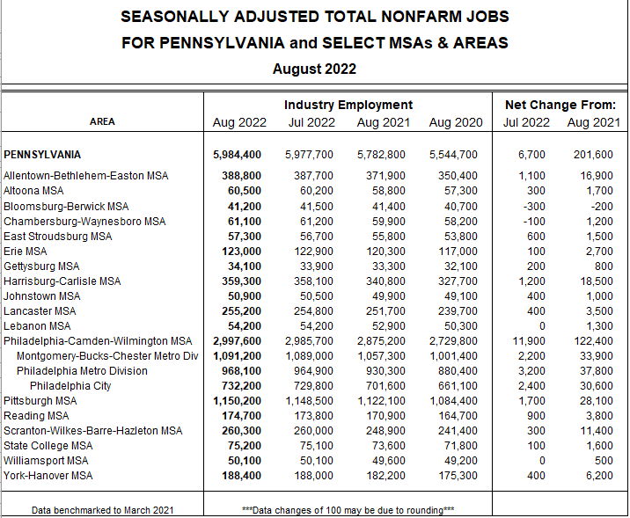
CES Data Example

Slide 13
Jobs: CES vs. QCEW
CES Jobs Data
Estimate of Jobs
Available following month
Includes non-covered jobs
Available at MSA level (not all counties)
QCEW Jobs Data
Census (count) of Jobs
Available about 5 months after end of quarter
UC covered employment only
Available at county level

Slide 14
Local Area Unemployment Statistics (LAUS)
Local Area Unemployment Statistics (LAUS) program estimates the number of persons working or available for work in a given area.
Consists of four primary measures
Civilian Labor Force
Employment
Unemployment
Unemployment Rate
Current Population Survey (CPS) – a survey of approx. 60,000 U.S. households (PA sample is ~2,000) that is a key input into the model used to produce state labor force estimates.
Other inputs include CES jobs and UI claims

Slide 15
Local Area Unemployment Statistics (LAUS)
Employment = a count of PERSONS (not jobs)
Data based on where people LIVE (not where they work)
Multiple Job holder counted just once in LAUS

Slide 16
LAUS, continued
LAUS employment estimates are produced for different areas:
United States
States
Metropolitan Statistical Areas
Counties
Selected Minor Civil Divisions (cities, townships, boroughs)
Other groupings (WDAs, LMAs, Combined MSAs, Metro Divisions)
Seasonal Adjustment done for all data elements
All areas seasonally adjusted except for Minor Civil Divisions
Limitations
Small sample size for CPS
Not available by industry or ownership
Labor Force data undergoes monthly revisions and annual processing similar to the CES benchmark

Slide 17
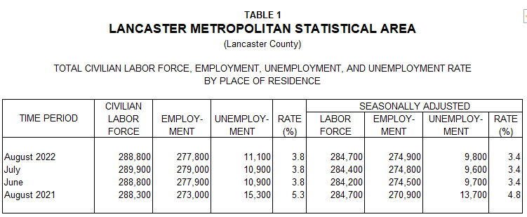
LAUS Data Example

Slide 18
CES vs LAUS Employment
CES (Jobs Data)
Count of jobs
By place of work
Survey of establishments
Excludes self-employed
Multiple job holders – each job is counted
Detailed industry data
LAUS (Employment)
Count of persons
By place of residence
Survey of households
Includes self-employed
Multiple job holders – person counted only once
No industry data

Slide 19
Objectives – Part 2 (NAICS)
To discuss the basics of the North American Industry Classification System (NAICS) and its changes
OMB makes changes every 5 years (2012, 2017, 2022)
Definitional differences
More digits means more detailed
23 – Construction
236118 – Residential Remodelers

Slide 20
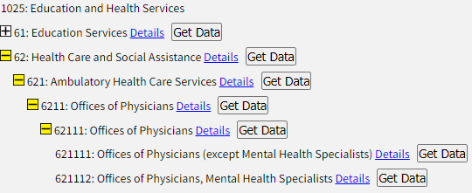
Example of the NAICS structure

Slide 21
NAICS Changes
Why does the NAICS system change every 5 years?
To ensure the accuracy, timeliness, and relevance of industry classifications
Older/Less significant industries - Pay phone mfg
Newer/Emerging industries – typically new technology
The major change in NAICS 2022 – no distinction between store vs non-store retailers

Slide 22
Occupational Data

Slide 23
Objectives
Occupational Wages
Occupational Projections
O
W
P

Slide 24
Food for Thought
Occupational data uses Standard Occupational Classification (SOC) codes, which follow a hierarchical structure
Major
43-0000 - Office & Administrative Support Occupations
43-5000 - Material Recording, Scheduling, Dispatching and Distributing Workers
43-5030 – Dispatchers
43-5031 - Public Safety Telecommunications
43-5032 – Dispatchers, Except police, Fire, and Ambulance
Minor
Broad
Detailed
Two primary data sets – projections and wages – are “Cross Industry”
41-2011 - Receive and disburse money in establishments other than financial institutions. May use electronic scanners, cash registers or related equipment. May process credit or debit card transactions and validate checks.
Excludes “Gambling Change Persons and Booth Cashiers” 41-2012
Equal across all industries - Cashier in Health Care = Cashier in Retail
Wages and projections use SOC codes
Projections can be a step behind in the SOC structure that is being used.

Slide 25
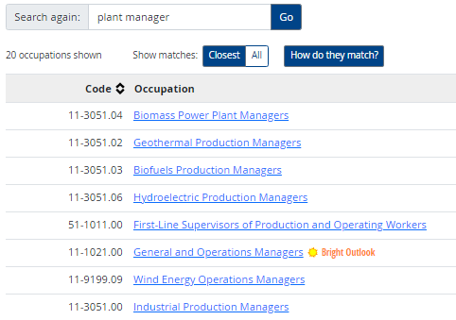
Food for Thought
Similar to BLS, but not exactly the same as, O*NET (https://www.onetonline.org/)
11-3051 Industrial Production Managers
Plan, direct or coordinate the work activities and resources necessary for manufacturing products in accordance with cost, quality, and quantity specifications.
Illustrative examples: Manufacturing Director, Plant Manager, Production Control Manager.
BLS

Slide 26
Occupational Wages

Slide 27
Occupational Wages
Important
Non-mandatory survey of employers (45,000 to 50,000 in PA)
Three years sample (six semi-annual panels)
Released annually; usually in April
Produced uniformly nationwide - allows for comparisons across state borders and among regions within the state
Pennsylvania
Metropolitan Statistical Areas (MSAs)
Workforce Development Areas (WDAs) and Counties – unique for PA
Included in wage:
Excluded from wage:
Base rate
Commissions
Tips
Bonuses
Overtime pay
Back Pay
Information on occupational wages can be found at:
https://www.workstats.dli.pa.gov/Documents/Occupational%20Wages/Wages_Guide.pdf

Slide 28
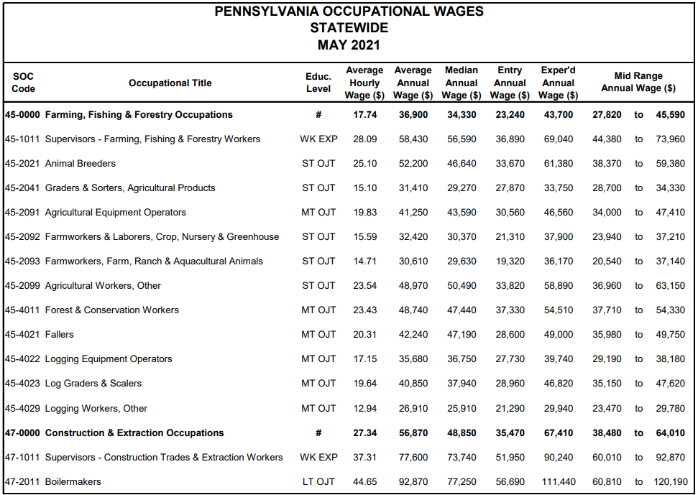
Occupational Wages
Publish Entry, Average & Experienced-level wages for 800-plus occupations
Minimum educational attainment levels for each occupation
On-the-Job Training (short or moderate-term)
Long-Term Training
High School diploma plus work experience
Postsecondary training or apprenticeship
Associate degree
Bachelor’s degree
Master’s degree
Doctoral or Professional degree
Statewide Data Example
Source: Occupational Wages, May 2021;
https://www.workstats.dli.pa.gov/Products/Occupational%20Wages/Pages/default.aspx

Slide 29
Occupational Projections

Slide 30
Employment Projections
Developed in collaboration with the Employment & Training Administration (ETA)
Based largely on information from two Bureau of Labor & Statistics (BLS) programs
Estimated employment levels and 10-year demand for specific industries and occupations
Industry: Quarterly Census of Employment & Wages (QCEW)
Occupational: Occupational Employment & Wage Statistics (OEWS)
Employment growth or industry expansion
Need to replace workers who transfer to a different occupation or exit the workforce entirely
Estimates reflect number of jobs, not number of persons
Full- and part-time workers, includes agriculture, private household, and self-employed
The 4-digit North American Industry Classification System (NAICS) level is used for the industries.
Completed every 2 years for the State, MSAs and WDAs

Slide 31
Occupational Outlook
Pennsylvania 2020-2030 Long Term Occupational Projections
Statewide Data Example
00-0000 Total, All Occupations
Source: Long-Term Occupational Employment Projections, 2020-2030 https://www.workstats.dli.pa.gov/Products/employment-projections/Pages/default.aspx

Slide 32
CWIA Website
Best way to find data!
www.workstats.dli.pa.gov

Slide 33
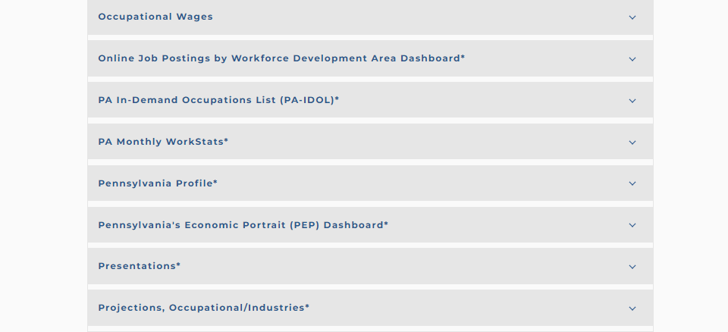
CWIA Website
W
Q
P

Slide 34
Unemployment Compensation Data

Slide 35
Unemployment Compensation (UC)
Social Security Act of 1935
Federal/State system
Financed by employer taxes
Amount and duration of benefits established by states

Slide 36
Characteristics of UC Data
Only includes persons who request/receive benefits
Statewide or county of residence
Industry Sector of previous employment – not occupation
Demographics (age, race, gender, education level, income)
Weekly, monthly, annual, or custom time period
Not seasonally adjusted

Slide 37
Definitions
Initial Claim | Any notice of unemployment filed to request determination of UC eligibility.
Continued Claims | Subsequent weeks of unemployment for which benefits are paid if claimant meets requirements.
First Payment | Payment received for the first week for which a claimant files a claim and meets requirements.
Weeks Compensated | Weeks for which a claimant receives benefit payments.
Final Payment | Last payment a claimant receives because they have exhausted their full entitlement of benefits.

Slide 38
Other Measures
Recipients | Individuals who received at least one payment
Exhaustees | Individuals who receive a final payment
Average Duration | Length in weeks of average claim
Exhaustion Rate | Percent of claimants that receive a final payment

Slide 39
CWIA Data Sources
Benefits Modernization System (BenMod)
Pennsylvania’s new benefit system launched in June of 2021
Source for claims and payment data
Overpayments, determinations and appeals for federal reporting
New Hire Data Mart (NHDM)
Wage records
Used to determine industry sector
Unemployment Compensation Management System (UCMS)
Tax records

Slide 40
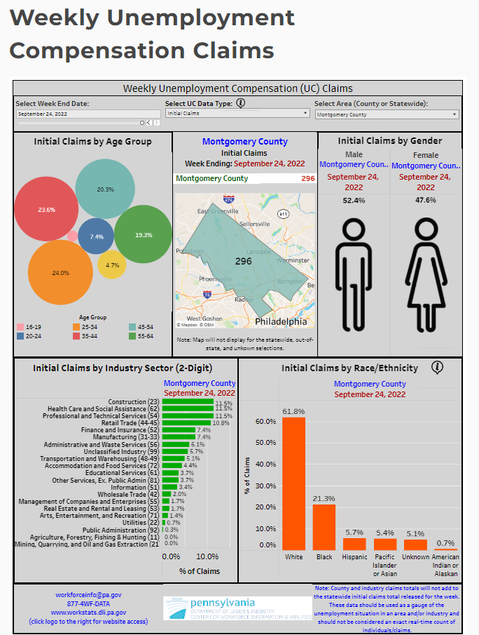
UC Dashboard
Weekly data beginning January 2020
Statewide or county
Initial or continued claims
Exhaustees
Demographic breakdown

Slide 41
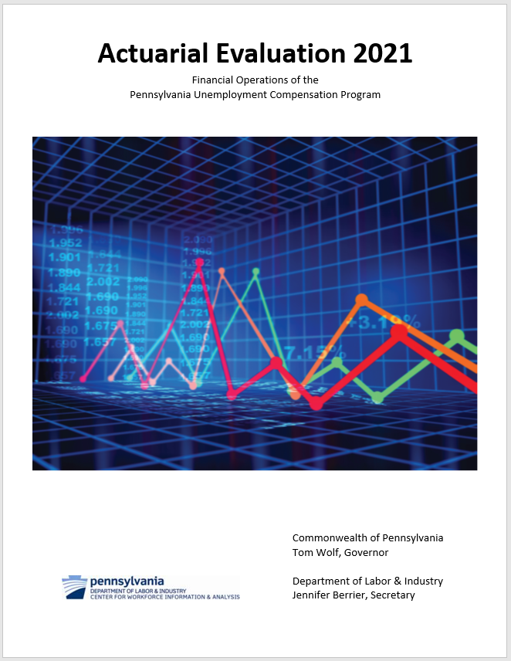
UC Reports and Information
Federal Reports
Taxes
Claims and benefits paid
Appeals
Overpayments
Employment and Training Administration (ETA) Website

Slide 42
Pennsylvania New Hire Reporting Program Data

Slide 43
PA New Hire Reporting Program
Personal Responsibility and Work Opportunity Reconciliation Act (PRWORA)
Also known as Welfare Reform
Employers are required to report information on newly hired employees
20 days from date of hire
Pennsylvania CareerLink® website
States’ Responsibilities
5 business days to enter data into State Directory of New Hires (SDNH)
After data is loaded into SDNH,
2 business days to match child support cases and take action
3 business days to forward to National Directory of New Hires (NDNH)

Slide 44
Uses of New Hire Data
Identify persons with child support obligations
Unemployment Compensation and Workers’ Compensation fraud detection and recovery
Labor Market Information

Slide 45
Reporting Requirements
For Employees
Name
Address
Social Security Number (SSN)
Date of Hire
For Employers
Name
Address
Federal Employer Identification Number (FEIN)
Name and Phone Number of Point of Contact

Slide 46
Reporting Requirements
States can require additional data
PA includes birth date for employees if available
Employers can report to any state where they hire
Federal Government and Military report directly to NDNH

Slide 47
Results
PA is 4th-5th largest state by number of records submitted annually
3.67 million records in calendar year 2021
Over 62 million records since 1998
Child Support Payments
$665 million from 1998 through December 2021
$28.9 million per year average
UC Fraud Overpayment Recovery
More than 103,000 fraud overpayments identified since 1998
$48.9 million recovered
$2.1 million per year average

Slide 48
Labor Market Information
New Hires by Place of Work
New Hires by Place of Residence
Top 50 New Hires
Industries of Interest by New Hires Dashboard
Available for PA and Workforce Development Area (WDA)

Slide 49
Potential Uses
Determine where and in which industries employers are hiring
Over-the-year change reveals increases or declines in hiring
Focus and priorities for re-employment and training programs

Slide 50
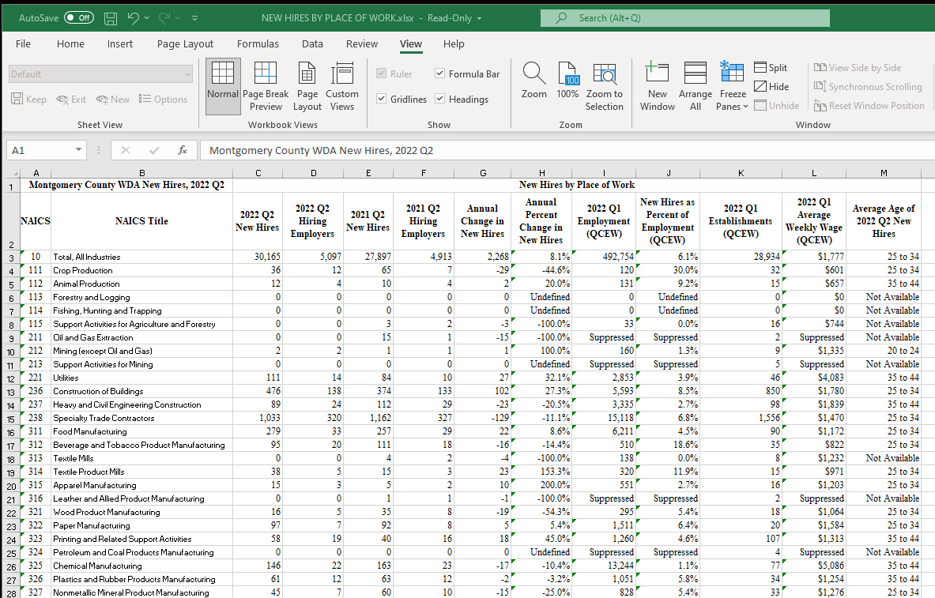
New Hires by Place of Work

Slide 51
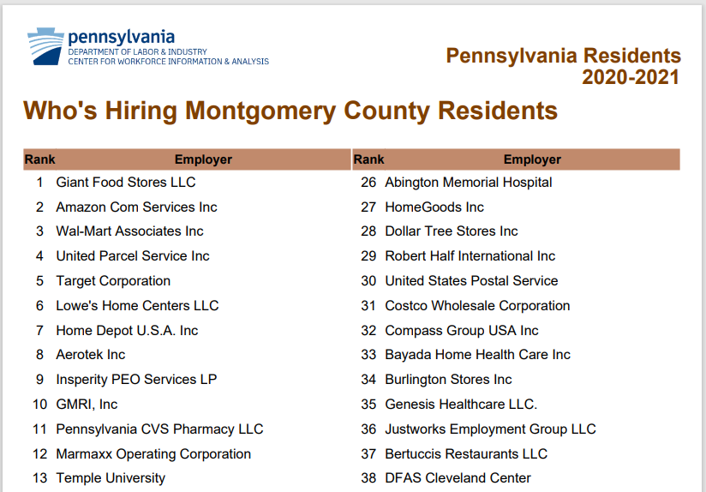
Top 50 Employers

Slide 52
Survey of Occupational Injuries & Illnesses (SOII)
S
O
II

Slide 53
What is SOII?
This mandatory survey is designed to estimate the number of work related injuries and illnesses and measures the frequency (rate) at which they occur.
Surveyed over 6,000 worksites in PA for CY 2021
For cases that involve one or more days away from work, case circumstances and characteristics of the affected worker are provided
The best and most comprehensive measure to capture this information in American workplaces
Conducted by BLS and cooperating states

Slide 54
Construction

Slide 55
Manufacturing

Slide 56
SOII Recordable Cases - OSHA Guidelines
Nonfatal recordable workplace injuries & illnesses are those that result in any one or more of:
Loss of consciousness
Days away from work (DAFW)
Restricted work activity or job transfer (DJTR)
Medical treatment beyond first-aid
Needlestick injury or cut from a sharp object that is contaminated with another person's blood
Tuberculosis (TB) diagnosed after exposure to a known case of TB
Significant work-related injuries diagnosed by a physician
Workplace fatalities – CFOI survey

Slide 57
SOII Employer Input
Employer inputs data about the injured employee:
Race/Ethnicity (optional)
Age -or- Date of Birth
Date hired -or- Length of service
Gender
Emergency room visit? Or Overnight stay?
Start of work shift, and time of incident
DAFW and/or DJTR

Slide 58
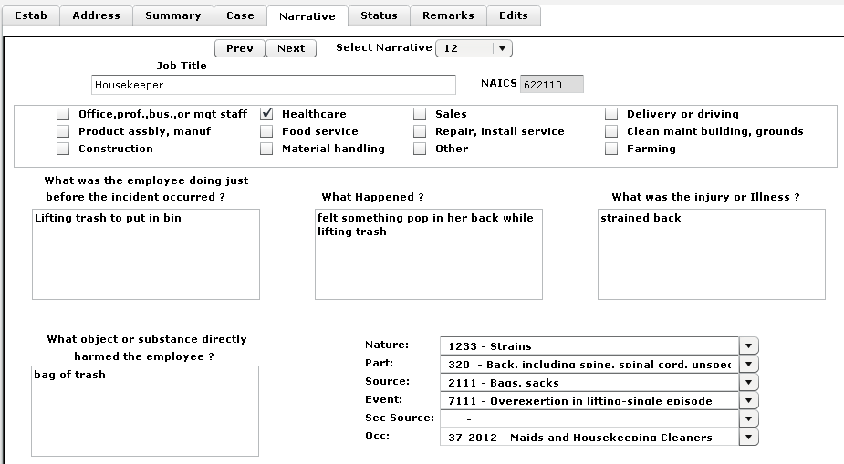
SOII Data Collection System

Slide 59
Uses of SOII
Important uses of SOII data
Identifying and correcting hazards in the workplace
Informing national and state policy makers on occupational safety and health conditions across industries and occupations
Designing and evaluating safety and health programs and improving safety equipment
Reality TV Shows…

Slide 60
SOII/CFOI Data

Slide 61
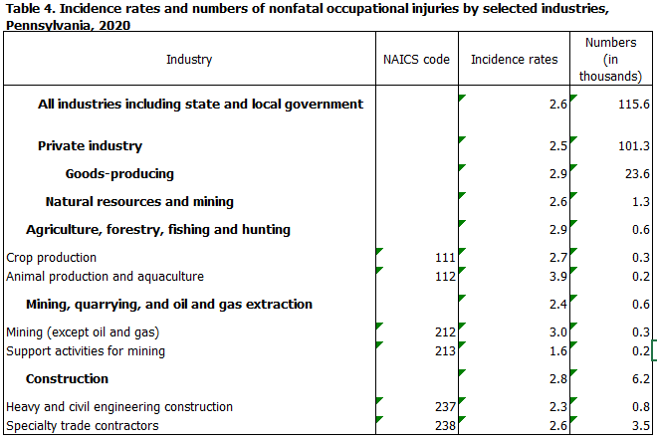
SOII Data Publication

Slide 62
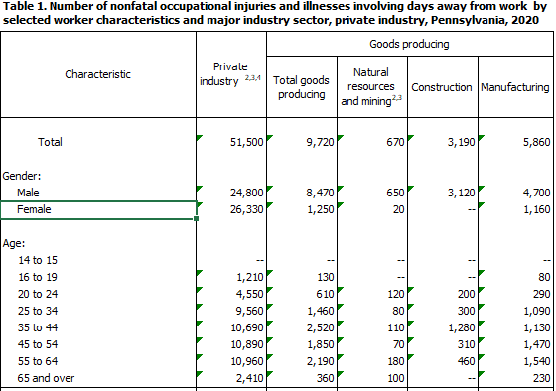
SOII Data Publication

Slide 63
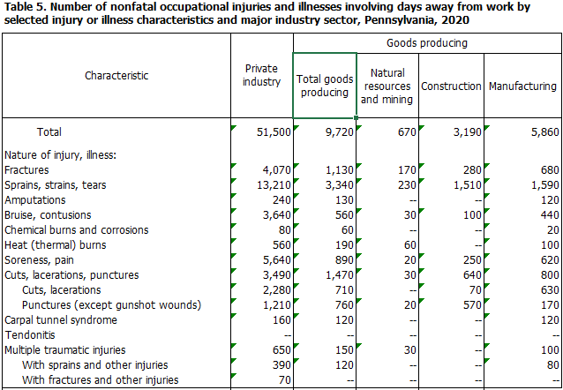
SOII Data Publication

Slide 64
Questions?

