Slide 1
Keeping Score with Dashboards Getting “board” with data tables? Let’s take a 7th inning stretch and get interactive with CWIA’s visual dashboards!
2023 Workforce Information Forum
October 2023

Slide 2
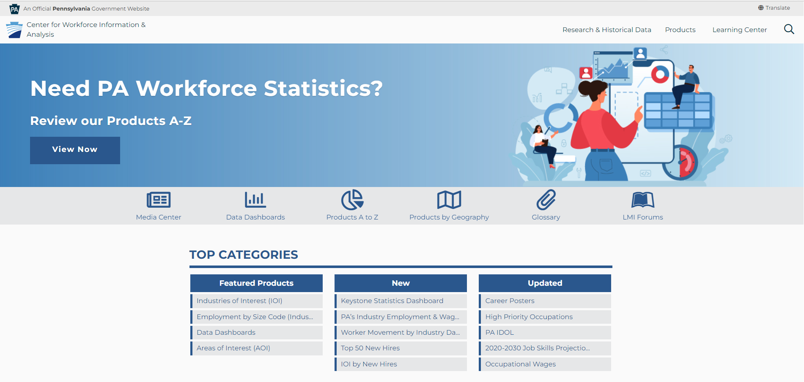
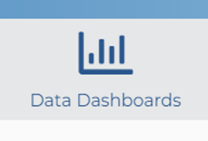
www.workstats.dli.pa.gov

Slide 3
Older Workers
by
Industry
Dashboard

Slide 4
Older Worker Dashboard
Default setting orientation
Pennsylvania Total in upper left corner
All NAICS Sectors
Reset Button
++

Slide 5
Tooltip
Function
Appears on hover or click
Displays additional information
Information updates when filters change

Slide 6
Filters: Sector
Change from All NAICS to Manufacturing
PA Total Updates
Info in Tooltip Updates

Slide 7
Filters: Subsector
Change from null to Plastics and Rubber Products Manufacturing
PA Total Updates
Info in Tooltip Updates

Slide 8
Filters: Industry
Change from null to Plastics Product Manufacturing
PA Total Updates
Info in Tooltip Updates

Slide 9
Top 10 Sectors
Default
Single color map
Bar graph by county in alphabetical order
Then ordered by highest percentage to lowest, limited to 10 sectors per county

Slide 10
Top 10 Sectors: Lycoming
Upon Click of County
Tooltip appears with number of workers
Chart below displays Top 10 Sectors in order of highest percentage of older workers to lower for Lycoming

Slide 11
Top Sector
Bar Graph Tooltip
Displays percentage of older workers in that sector and county

Slide 12
Top Subsector
Subsector functions the same way as sector

Slide 13
Top Industry
Industry Functions the Same Way as Sector and Subsector
90.9% of Paper and Paper Product Merchant Wholesalers workers are 55-years-old and over in Lycoming County…

Slide 14
Number of Older Workers Paper Wholesalers
Go Back to Original Page/Map
…Only 10 workers in Paper and Paper Product Merchant Wholesalers workers are 55-years-old!
This industry is not a statistically significant part of workforce in Lycoming

Slide 15
Keystone Statistics
(KeyStats)
Dashboard

Slide 16
KEYstone STATistics
CWIA has developed a new dashboard that focuses on key economic indicators
Employment Indicators (includes monthly statistics for PA and US)
Labor force, labor force participation rate, unemployment rate, quit rate, unemployed per job ratio, average weekly wage
Economic Indicators
Real GDP (PA & US)
Federal Funds Rate (interest)
Macroeconomic Indicators (US numbers)
Consumer data (CPI, PCE, retail sales)
Production data (ISM, PPI, durable goods)
Housing data (Starts & permits, home sales, pricing index)

Slide 17
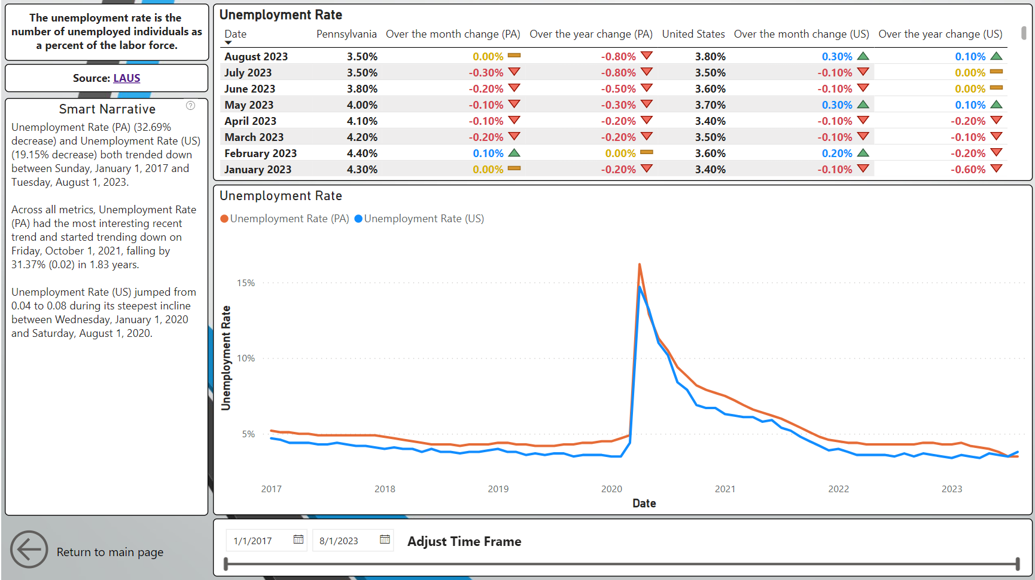
KEYstone STATistics

Slide 18
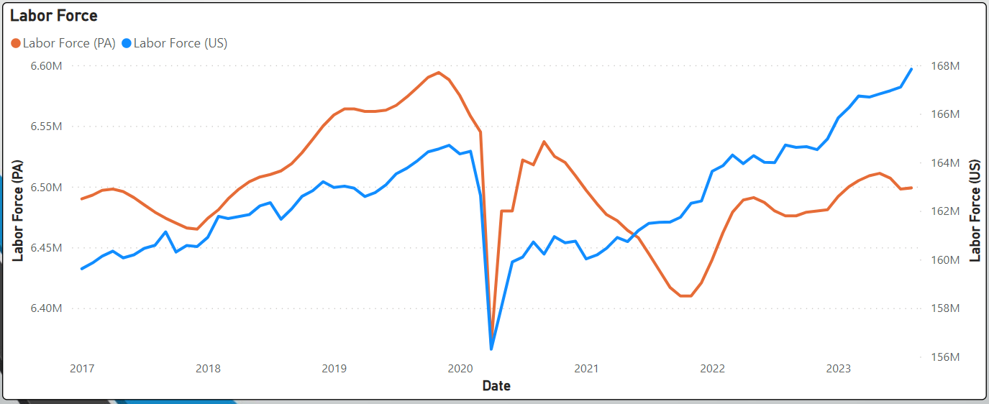
KEYstone STATistics
The Labor Force is the number of individuals who are either employed or unemployed, but willing to work.
The US labor force has experienced strong recovery since the Pandemic began, but PA is still about 100,000 below its 2019 level

Slide 19
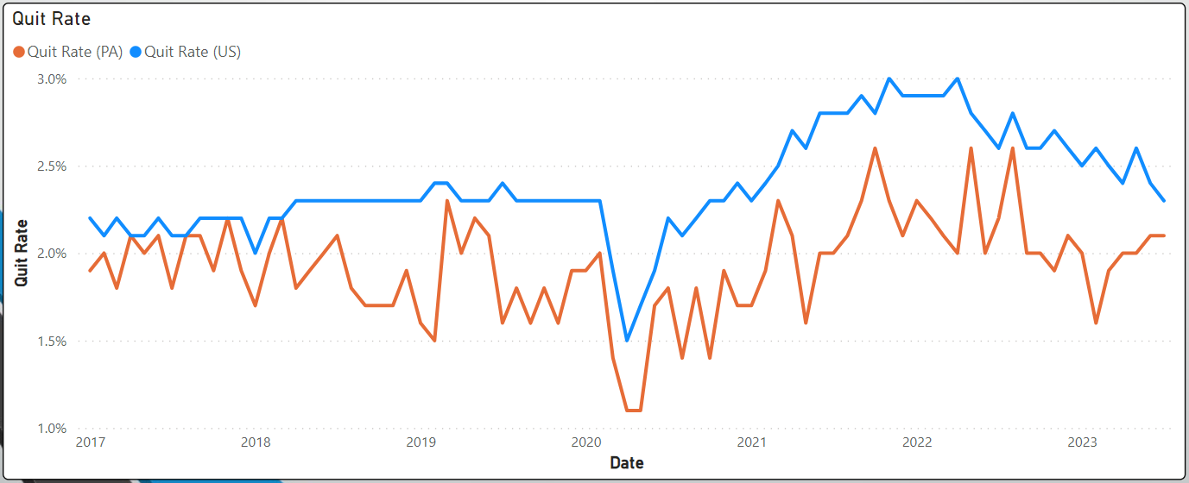
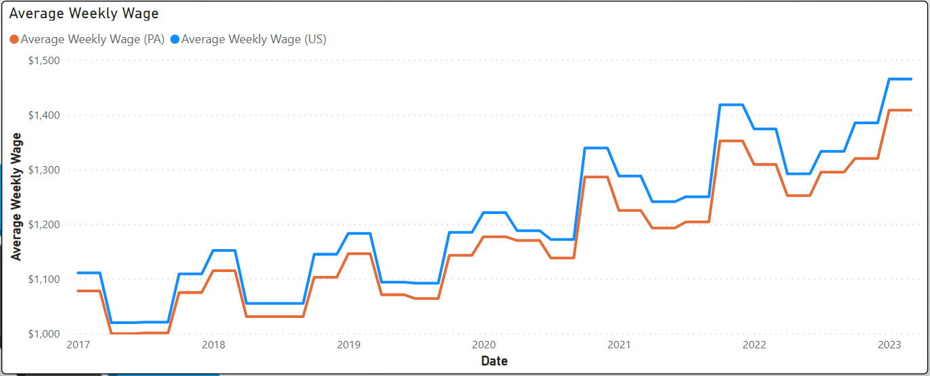
KEYstone STATistics
While PA’s quit rate has generally been lower than the nation, it is much more volatile in comparison.
While PA’s average weekly wage is generally lower than the nation, it does closely follow the same trajectory.

Slide 20
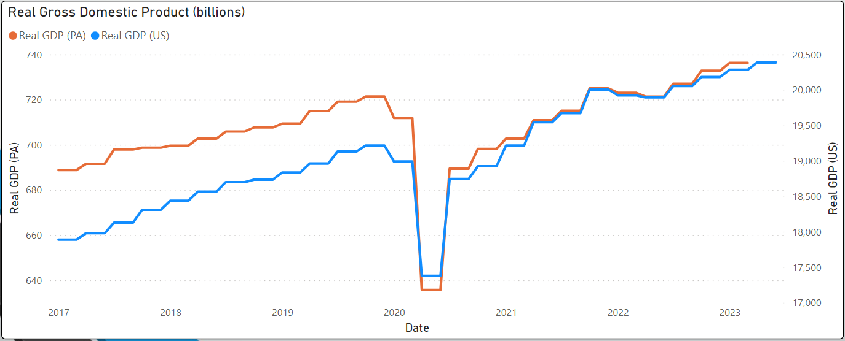
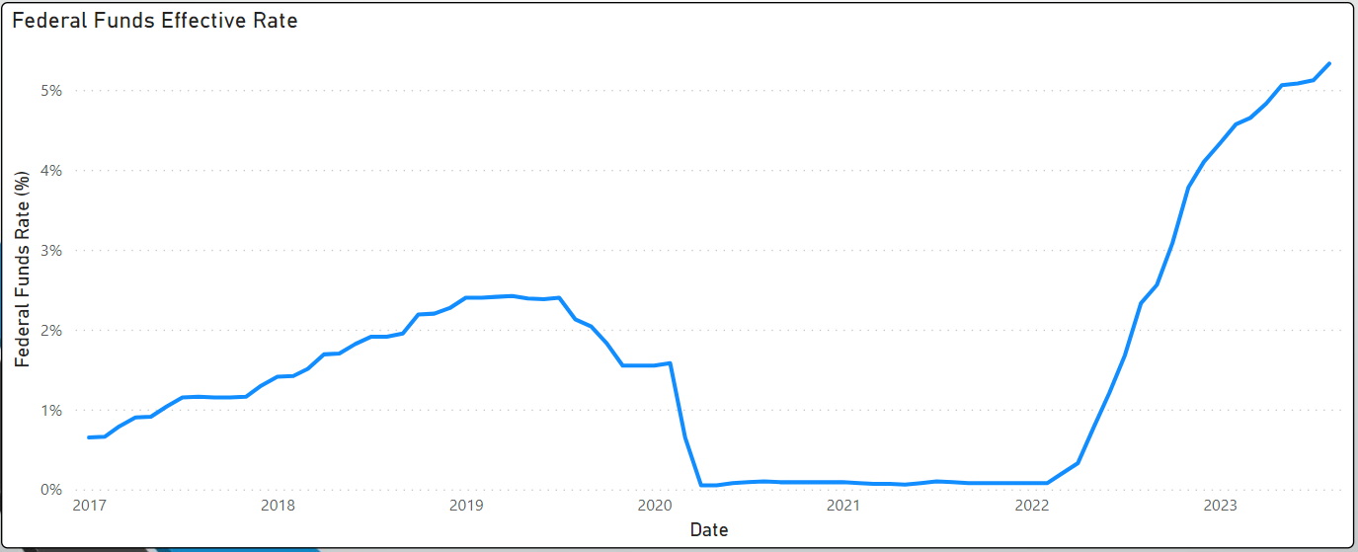
Economic Data
KEYstone STATistics
Pennsylvania’s real GDP has shown recovery since the pandemic albeit a bit slower than the rest of the nation. Real GDP accounts for inflation.
The Federal Funds interest rate remained virtually unchanged for almost 2 years during the pandemic.

Slide 21
Consumer Data
KEYstone STATistics
Consumer sentiment is a survey on how consumers feel about the economy, personal finances, business conditions, and buying conditions
Inflation is the measure of percent changes in Consumer Price Index (CPI)
The growth rate in Personal Consumption Expenditure is one of the Federal Reserve’s top tools to measure consumer inflation

Slide 22
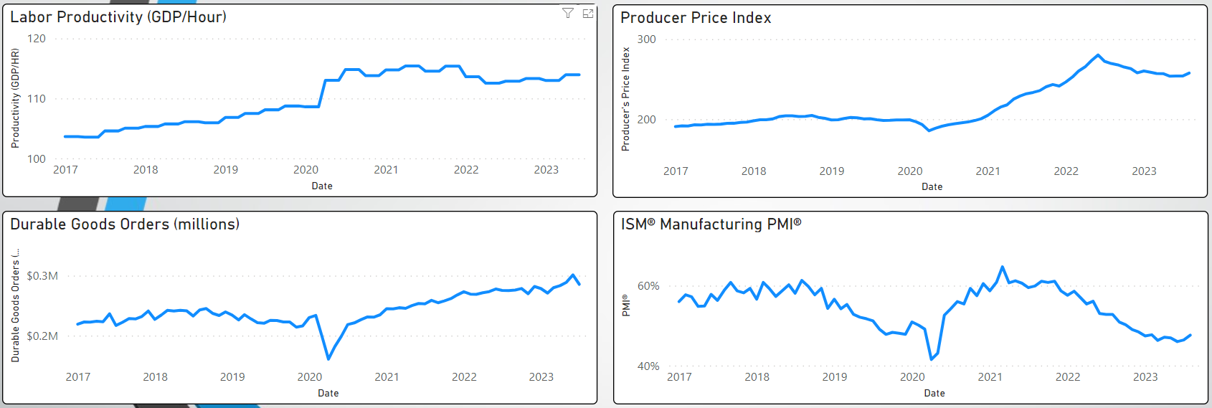
Production Data
KEYstone STATistics
The growth rate of Producer Price Index is known as the wholesale inflation rate
Durable goods represent products that last three years or more
The Purchasing Manager’s Index (PMI) indicates an expansion in manufacturing for levels above 50% and a contraction when below 50%

Slide 23
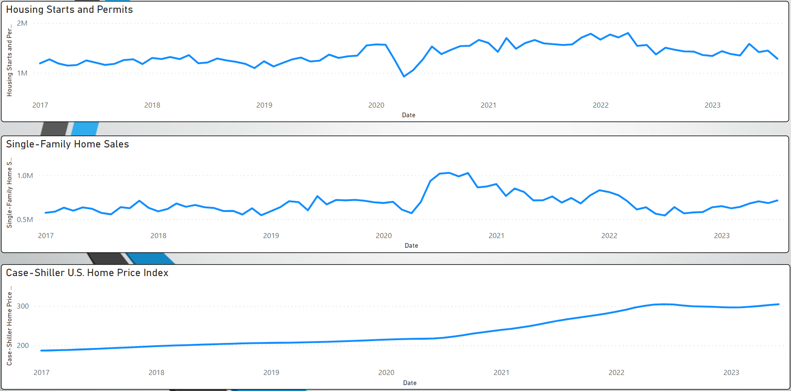
Housing Data
KEYstone STATistics
Home sales increased directly after the pandemic, but at the cost of rising prices.

Slide 24
Weekly Unemployment Compensation Claims Dashboard

Slide 25
Why was the UC claims dashboard created?
High demand for Unemployment Claims (UC) data
Extreme spikes in UC claims resulted from the business closures that occurred during the COVID-19 mitigation efforts
CWIA began publishing weekly claims data
A large amount of federal funding has been directed toward Unemployment Compensation which has increased the interest in UC claims

Slide 26
Dashboard Selection Options:
Week Ending Date: Data available starting with the week ending January 4, 2020
Claim Type: see next slide for more details
Area Type: data available by county and for Pennsylvania

Slide 27
Claim Types Explained:

Slide 28
What questions can this dashboard help answer?
How did the number of claims vary across age groups ?
Did more men or women apply for benefits?
What industries were impacted the most by the pandemic?
Did one race/ethnicity suffer more than the others?
How did my area compare to the state as a whole?

Slide 29
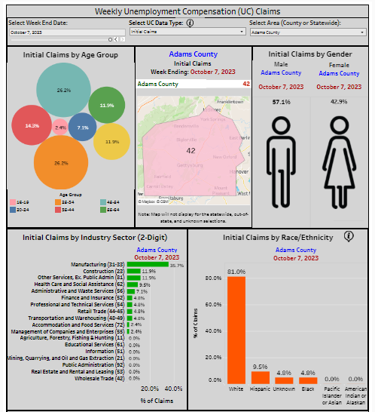

Slide 30
Online Job Postings
Dashboard

Slide 31
Online Job Postings Dashboard Overview:
Data Source: The Conference Board - LightCast - Help Wanted OnLineTM
The Conference Board uses their technology to spider job postings from a long list of online job boards including the PA CareerLink© System
Job Postings data is de-duplicated and ads are broken out into two categories – new ads and total ads (see next slide for details)
Data is available by industry and occupation
Information on skills and certifications is also available

Slide 32
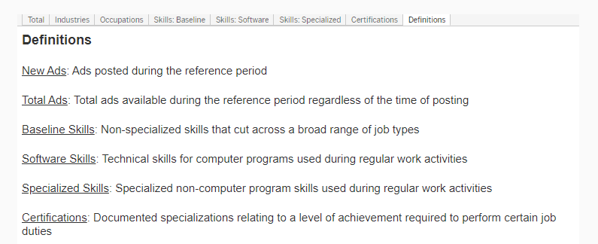
Job Postings Data - Definitions

Slide 33
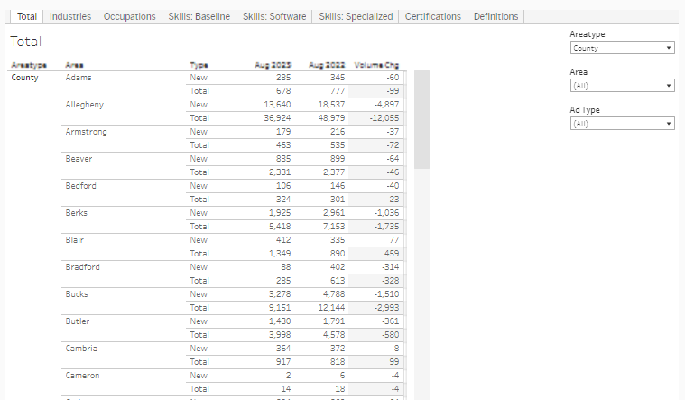
Dashboard Homepage – New versus Total Ads

Slide 34
Lycoming County – Top Industries found in Online Job Postings

Slide 35
Lycoming County – Top Specialized Skills found in Online Job Postings

Slide 36
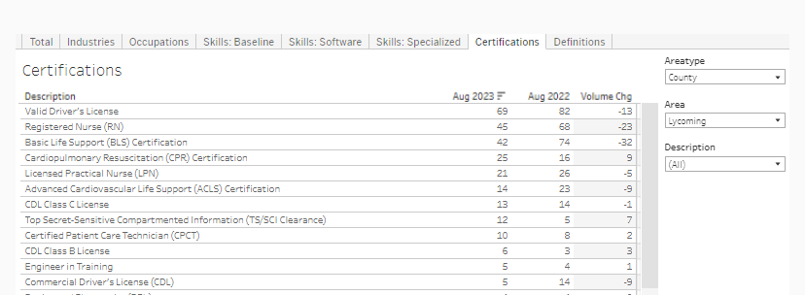
Lycoming County – Top Certifications found in Online Job Postings

Slide 37
Thank you! Questions?

