Slide 1
Make the Most of Your At Bat
2023 Workforce Information Forum
October 2023

Slide 2
Career Exploration Data

Slide 3
Food for Thought
CWIA’s data is assigned by industry or occupation, which are often confused
Industry refers to the type of business or organization where an individual works
Occupation refers to the job duties that an individual performs at their work site
Occupational data uses Standard Occupational Classification (SOC) codes, which follow a hierarchical structure
Example: 43-0000 - Office & Administrative Support Occupations
43-3000 - Financial Clerks
43-3031 - Bookkeeping, Accounting & Auditing Clerks
Similar to, but not exactly the same as, O*NET (https://www.onetonline.org/)
Two primary data sets – projections and wages – are “Cross Industry”
Equal across all industries; i.e. Cashier in Health Care = Cashier in Retail
Minimum educational attainment levels for each occupation
On-the-Job Training (short or moderate-term)
Long-Term Training
High School diploma plus work experience
Postsecondary training or apprenticeship
Associate degree
Bachelor’s degree
Master’s degree
Doctoral or Professional degree

Slide 4
Occupational Wages
Gathered semi-annually through a non-mandatory survey of employers
Released annually; usually in April
Includes Entry, Average & Experienced-level wages for more than 800 occupations
Produced uniformly nationwide – compare across state borders and within the state
Available for PA, Metropolitan Statistical Area, Workforce Development Area & County
Minimum educational attainment levels shown for each occupation

Slide 5
Occupational Outlook
Estimated industry and occupational employment levels now and in the future
Developed in collaboration with Federal partners; consistency across states
Released every two years; PA is June and sub-state in December
Available for PA, Metropolitan Statistical Area & Workforce Development Area
Includes full- and part-time workers; even the self-employed

Slide 6
Educational Requirements for Jobs
Career Options:
TODAY
Slightly more than half of all jobs can be entered directly after high school graduation (or GED completion) and require no more than one year of on-the-job training.
Projected to grow at a much slower rate (6.9%) than the state overall (7.6%). Segment contribution to total employment has been steadily declining.
TOMORROW
More than one out of every five jobs will require some extended period of formal training, an apprenticeship, industry-recognized certification, or completion of an Associate degree for entry.
Jobs requiring an Associate degree are projected to grow at a faster rate (10.3%) than the state.
FUTURE
Roughly one out of every four jobs in the state require a bachelor’s degree or higher.
Highest growth rates expected for those with advanced degrees (10.7%).
Today
Additional education may be required to retain employment and/or to qualify for promotional opportunities.
Source: Long-Term Occupational Employment Projections, 2020-30; https://www.workstats.dli.pa.gov/Products/employment-projections/Pages/LTOPWorkforceDevelopmentAreaData.aspx

Slide 7
Jobs
By Volume Growth:
Home Health & Personal Care Aides
Fast Food & Counter Workers
Cooks, Restaurant
Laborers & Material Movers
Registered Nurses
Waiters & Waitresses
Stockers & Order Fillers
Software Developers & QA Analysts
Passenger Vehicle Drivers
Hairdressers, Hairstylists & Cosmetologists
By Percent Growth:
Ushers & Lobby Attendants
Amusement & Recreation Attendants
Cooks, Restaurant
Gaming Dealers
Manicurists & Pedicurists
Fitness Trainers & Aerobics Instructors
Massage Therapists
Statisticians
Lifeguards, Ski Patrol & Rec Protective Svc
Physical Therapist Assistants
Annual Demand:
Fast Food & Counter Workers
Home Health & Personal Care Aides
Cashiers
Laborers & Material Movers
Retail Salespersons
Stockers & Order Fillers
Office Clerks, General
Waiters & Waitresses
Customer Service Representatives
Janitors & Cleaners
Traditional
Emerging
Foundational
[Min. employment level of 1,000 (PA) or 250 (WDB)]
Green = Today
Red = Tomorrow
Blue = Future
Source: Long-Term Occupational Employment Projections, 2020-30; https://www.workstats.dli.pa.gov/Products/employment-projections/Pages/LTOPWorkforceDevelopmentAreaData.aspx

Slide 8
Occupational Products

Slide 9
PA Career Guide – 26th Edition
Includes information on:
Interest assessment
Wage and job outlook information
Spotlight articles – sports, entertainment & healthcare
Budget worksheet
To-do list for High School students
Sources for Financial Aid
Alternative options to college
Tips for marketing yourself as a jobseeker
Information on PA CareerLink® Offices
Contact information for state agencies
Hard copies available upon request

Slide 10
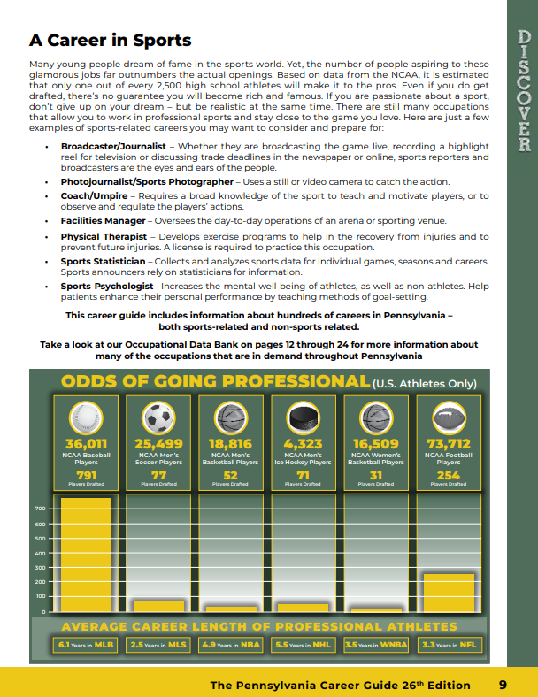

Slide 11
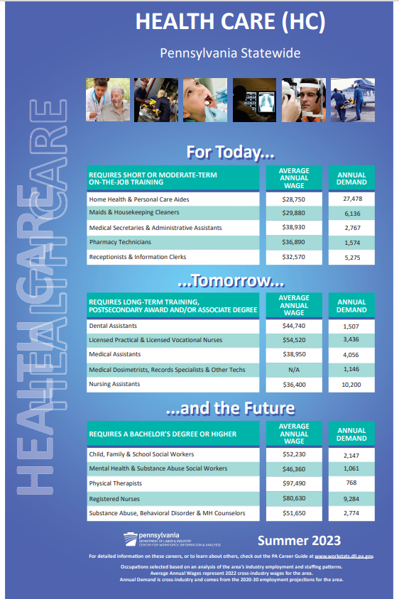
Career Posters
Now Available
Hard copies printed upon request

Slide 12
PA IDOL versus HPOs
 | PA IDOL | HPOs
Goal: | Career exploration tool to identify occupations that are in-demand | Targeted list of occupations used to align local workforce training funding to best fit job prospects
Geography: | Statewide | Local Workforce Development Areas
Timeframe: | Released annually, with HPOs | Annual, Effective August 1-July 31
Data focus: | Employment growth and demand, existing supply | Employment growth and demand, wages and wage change, unemployment, and completers
Coverage: | All occupations – Today, Tomorrow & Future | Occupations of focus for workforce – high and low end often excluded
Adding occupations: | No formal process in place | Petition process through local Boards
Relevance for CTE: | Anything through PDE, including equipment grants, industry-recognized credentials, etc. | Anything through PA CareerLink® - eligible training provider list, mostly adult programs

Slide 13
CIP-SOC Connection
Classification of Instructional Program (CIP) Codes are used by educational training providers to define and classify their curriculum.
Standard Occupational Classification (SOC) Codes are used to group occupations and determine employment projections and wages.
A national crosswalk exists to relate the skills learned through a program (CIP) to the jobs that require them (SOC).
PA has developed a dynamic version of the CIP-SOC crosswalk which incorporates programs specific to Pennsylvania as well as programs impacting emerging occupations and technology.
National version had a lot “missed” and questionable connections
Codes change and may not always align between data sets
CTE uses a subset of CIP codes (about 110 of more than 1,600)
Due to the nature of CTE programs, CIP codes ending in “0000” or “9999” (aka the “catch-all’s”) are often applied but crosswalk defaulted to only residual SOC codes resulting in misalignments

Slide 14
Thank you! Questions?

