Slide 1
New Hire Program Data: Who has been called up to the big leagues?
2023 Workforce Information Forum
October 2023

Slide 2
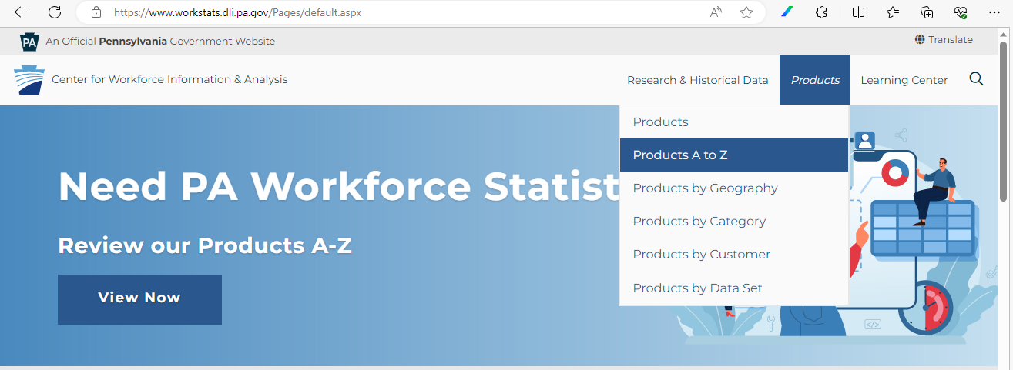
New Hire Program Data - Find the Reports

Slide 3
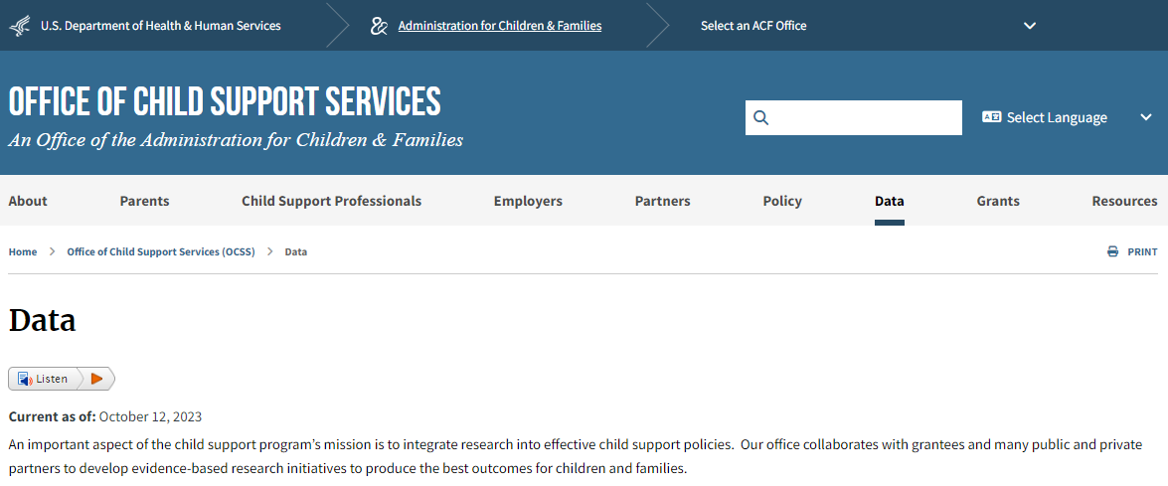
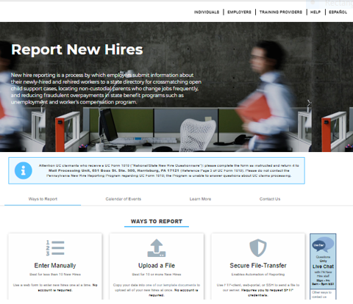
New Hire Program Data - Where do they come from?
Federal data from the
National Directory of New Hires:
https://www.acf.hhs.gov/css ....
Pennsylvania data from PA CareerLink:
https://www.pacareerlink.pa.gov/jponline

Slide 4
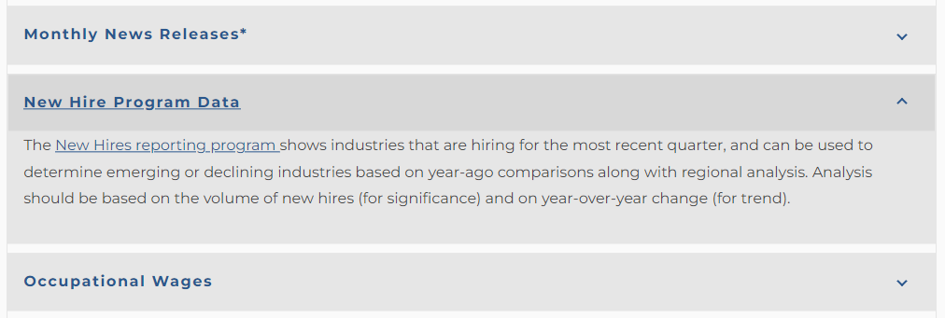
New Hire Program Data - at PAWorkstats
(https://www.workstats.dli.pa.gov)

Slide 5
National New Hire Data

Slide 6
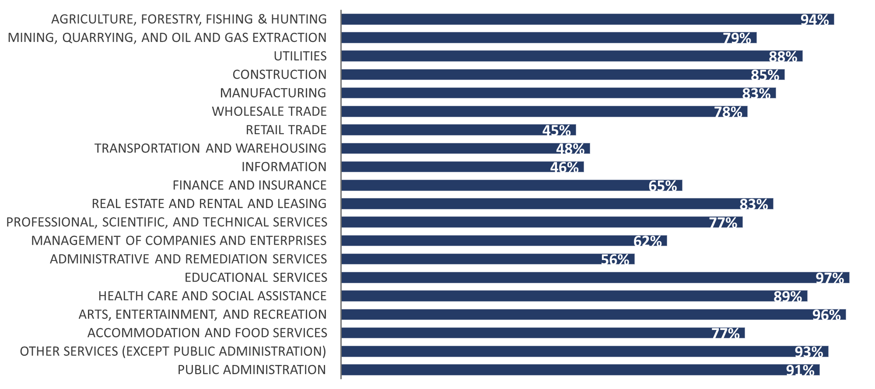
National New Hire Data -Collection Rates in Pennsylvania

Slide 7
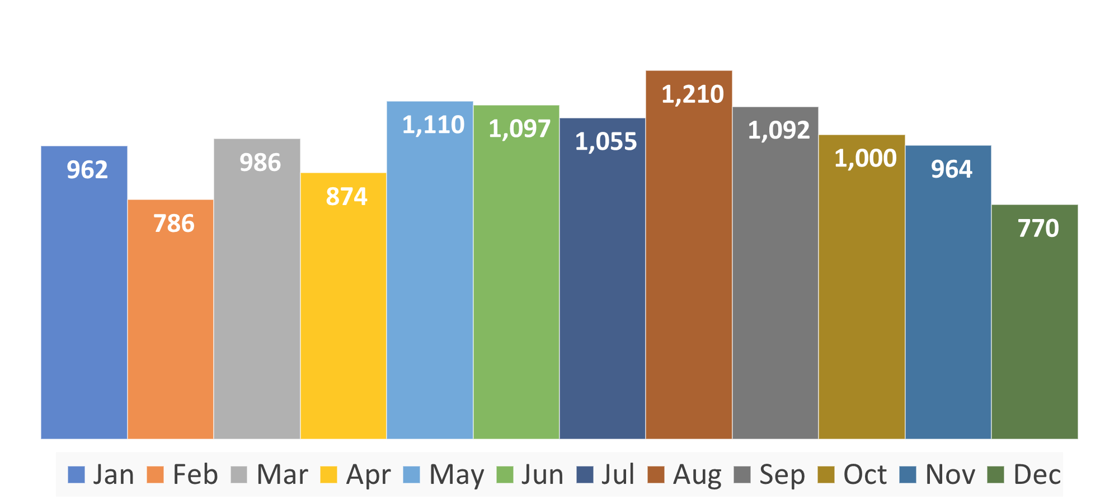
National New Hire Data -Seasonal Variation over the Year

Slide 8
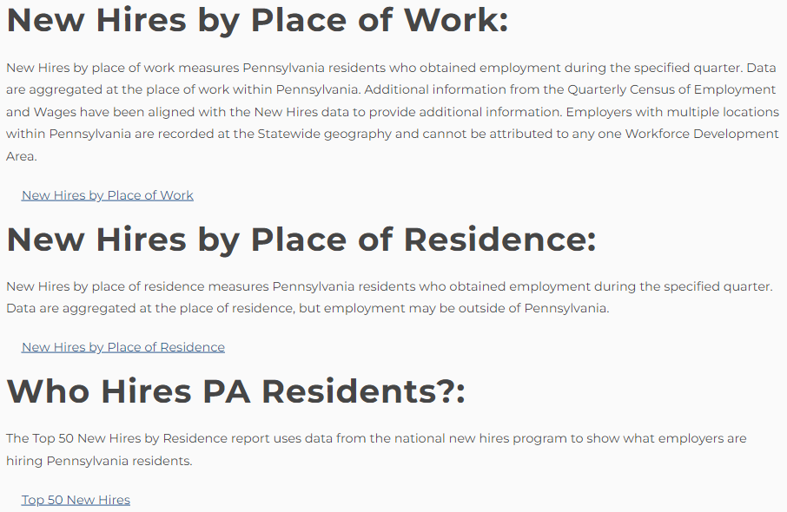
New Hire Program Data - Find the Reports
Pennsylvania Residents only;
New Hires by Place of Work and Residence are New Hires reported to PA only:
70% of PA New Hires;
National New Hire office provides employer totals of PA resident New Hires; and
Top 50 New Hires are 100% PA resident New Hires.

Slide 9
“Top 50” Employer Lists

Slide 10
Top 50 Employers (“traditional LMI”) - Have you seen this?
1 | Federal Government
2 | State Government
3 | Wal-Mart Associates Inc
4 | Trustees of the University of PA
5 | Giant Food Stores LLC
6 | City of Philadelphia
7 | Pennsylvania State University
8 | United Parcel Service Inc
9 | Amazon.com Services Inc
10 | School District of Philadelphia

Slide 11
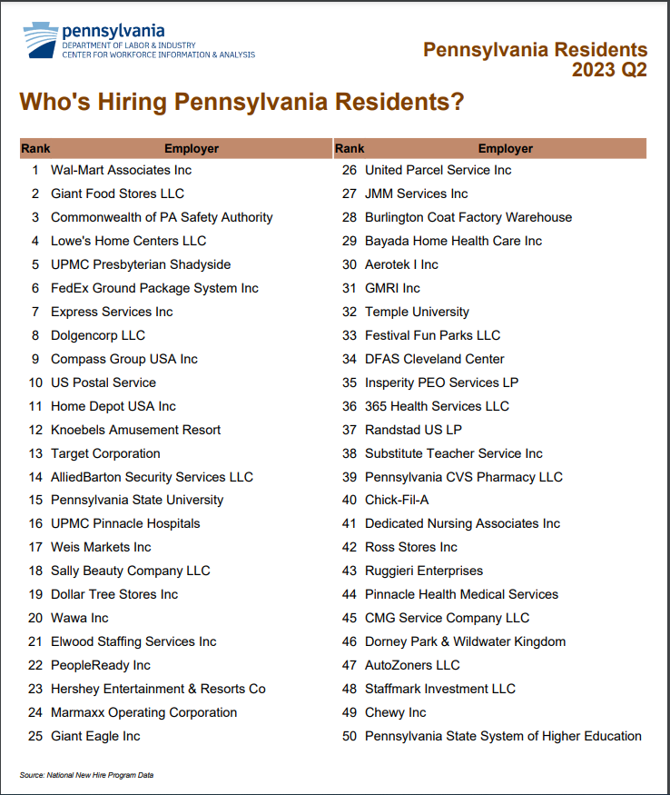
Top 50 New Hires
(“new LMI”) - Have you seen this?
 | By Employees | By New Hires
1 | Federal Government | Wal-Mart Associates
2 | State Government | Giant Food Stores
3 | Wal-Mart Associates | Commonwealth of PA
4 | Trustees of the University of PA | Lowe’s Home Centers
5 | Giant Food Stores | UPMC Presbyterian Shadyside

Slide 12
National New Hires - National New Hire vs. QCEW Counts
Industry | New Hires | QCEW Employment | Hires per Employment
Total, All Industries | 2,951,425 | 5,871,268 | One hire per 2.0 jobs
Finance and Insurance | 60,448 | 271,723 | One hire per 4.5 jobs
Health Care and Social Assistance | 480,850 | 1,087,471 | One hire per 2.3 jobs
Accommodation and Food Services | 376,431 | 444,898 | One hire per 1.2 jobs
Administrative and Remediation Services | 339,747 | 296,352 | More hires than jobs

Slide 13
New Hires by Workforce Development Area (WDA)

Slide 14
New Hires by WDA - 2023 Q1
NAICS | NAICS Title | New Hires | Prior Year | Annual Change | Percent Change | Average Age
Pennsylvania
10 | Total, All Industries | 472,014 | 512,080 | -40,066 | -7.8% | 25 to 34
722 | Food Services and Drinking Places | 56,176 | 59,324 | -3,148 | -5.3% | 25 to 34
561 | Administrative and Support Service | 41,239 | 49,546 | -8,307 | -16.8% | 35 to 44
624 | Social Assistance | 33,670 | 32,362 | 1,308 | 4.0% | 35 to 44
Central Workforce Development Area
10 | Total, All Industries | 18,576 | 20,222 | -1,646 | -8.1% | 25 to 34
722 | Food Services and Drinking Places | 2,153 | 2,229 | -76 | -3.4% | 25 to 34
611 | Educational Services | 1,935 | 1,928 | 7 | 0.4% | 25 to 34
622 | Hospitals | 1,740 | 2,594 | -854 | -32.9% | 35 to 44

Slide 15
New Hire Dashboard

Slide 16
New Hire Dashboard - What is it?
Combines three existing datasets into a new one
New Hire Program: SSN, FEIN, hire date, date of birth, and place of residence;
Quarterly Census of Employment and Wages: FEIN, place of work, and NAICS; and
Wage Records: SSN, FEIN, total weeks worked, and total wages.
You get New Hires and their wages by place of residence, place of work, industry, and age.

Slide 17
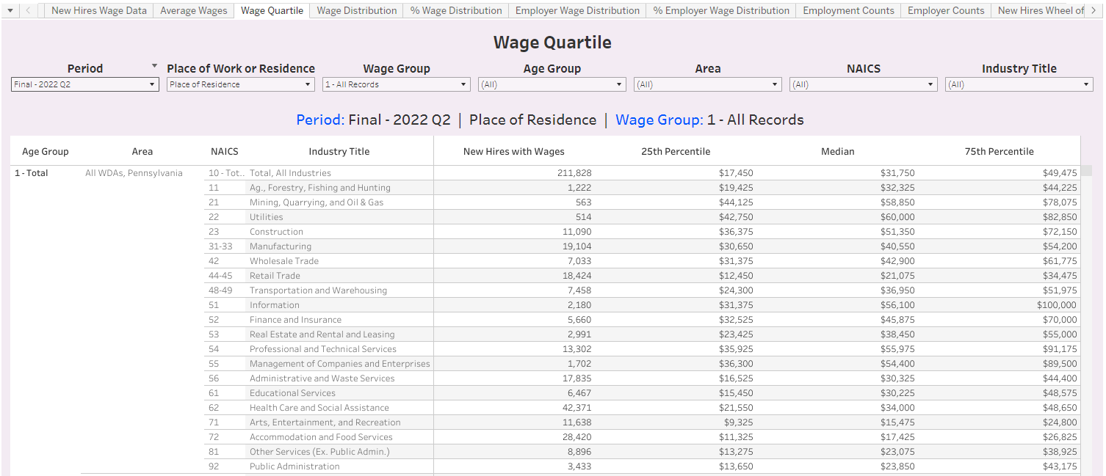
New Hire Dashboard - Work in Progress

Slide 18
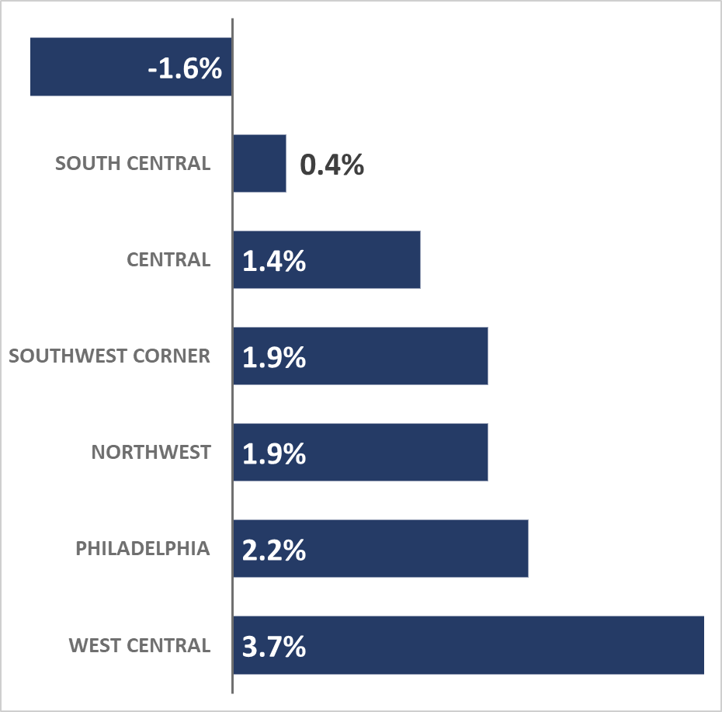
New Hire Dashboard - Counts by WDA
Area | New Hires | Diff. | % Diff.
Pennsylvania | 2,134,678 | -35,745 | -1.6%
South Central | 262,996 | 979 | 0.4%
Central | 83,887 | 1,172 | 1.4%
Northwest | 74,814 | 1,403 | 1.9%
Southwest Corner | 66,630 | 1,228 | 1.9%
Philadelphia | 309,131 | 6,629 | 2.2%
West Central | 29,751 | 1,067 | 3.7%
Pennsylvania

Slide 19
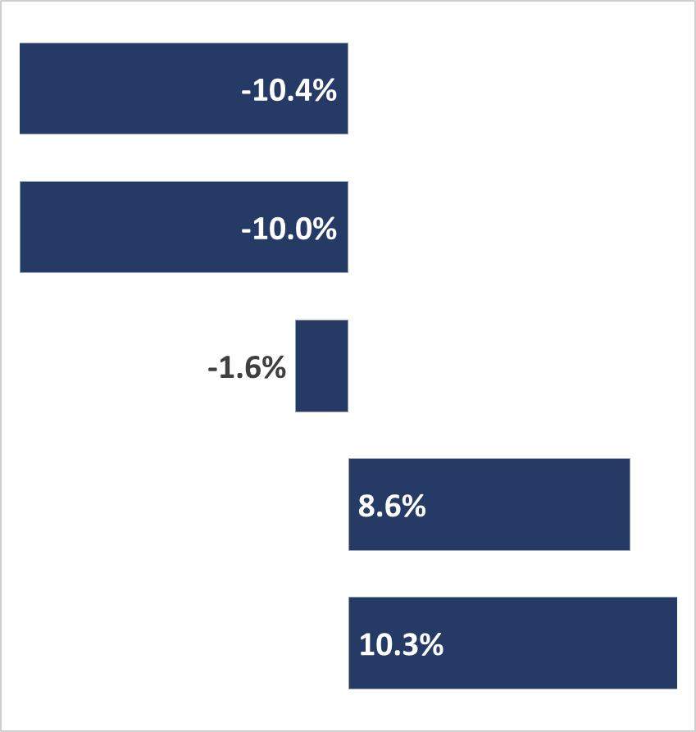
New Hire Dashboard - Counts by Industry
Industry | New Hires | Diff. | % Diff.
Wholesale Trade | 50,447 | -5,856 | -10.4%
Administrative and Remediation Services | 197,318 | -21,837 | -10.0%
Total, All Industries | 2,134,678 | -35,745 | -1.6%
Arts, Entertainment, and Recreation | 84,250 | 6,670 | 8.6%
Public Administration | 24,157 | 2,265 | 10.3%
Wholesale Trade
Administrative and Remediation Services
Total, All Industries
Arts, Entertainment, and Recreation
Public Administration

Slide 20
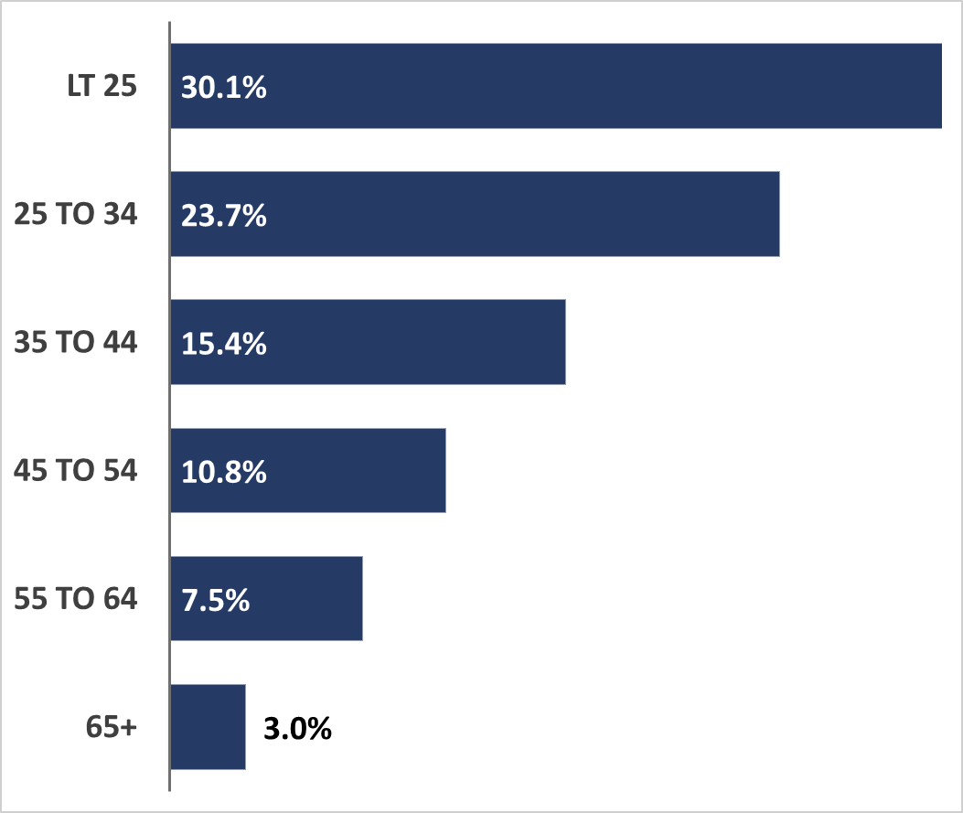
New Hire Dashboard - Counts by Age
Age Group | New Hires | Diff. | % Diff.
Total | 2,134,678 | -35,745 | -1.6%
Less than 25 | 643,165 | -15,112 | -2.3%
25 to 34 | 506,802 | -11,509 | -2.2%
35 to 44 | 328,886 | 8,819 | 2.8%
45 to 54 | 229,993 | -4,083 | -1.7%
55 to 64 | 160,677 | -6,515 | -3.9%
65 and Older | 63,020 | 1,577 | 2.6%

Slide 21
New Hire Dashboard - Counts by All Three
Age Group | Industry | New Hires | Diff. | % Diff.
35 to 44 | Health Care and Social Assistance | 3,597 | 372 | 11.5%
Less than 25 | Educational Services | 4,640 | 349 | 8.1%
Central WDA largest volume increases
35 to 44 years old hired to Healthcare and Social Assistance jobs increased by 372 or 11.5% over the year
Age Group | Industry | New Hires | Diff. | % Diff.
Less than 25 | Manufacturing | 2,221 | -349 | -13.6%
Less than 25 | Accommodation and Food Services | 6,138 | -738 | -10.7%
Central WDA largest volume decreases;
Less than 25 years old hired to Accommodation and Food Services jobs decreased by 738 or 10.7% over the year.

Slide 22
New Hire Dashboard - Wages
The New Hire must be hired to an employer where they did not have existing employment in the prior quarter;
The New Hire must have at least 10 weeks worked in the current or following quarter at the hiring employer;
You get wage distribution showing 25th, median, and 75th percentiles;
Average wages with confidence intervals; and
Wage brackets showing the number of hires per wage group.

Slide 23
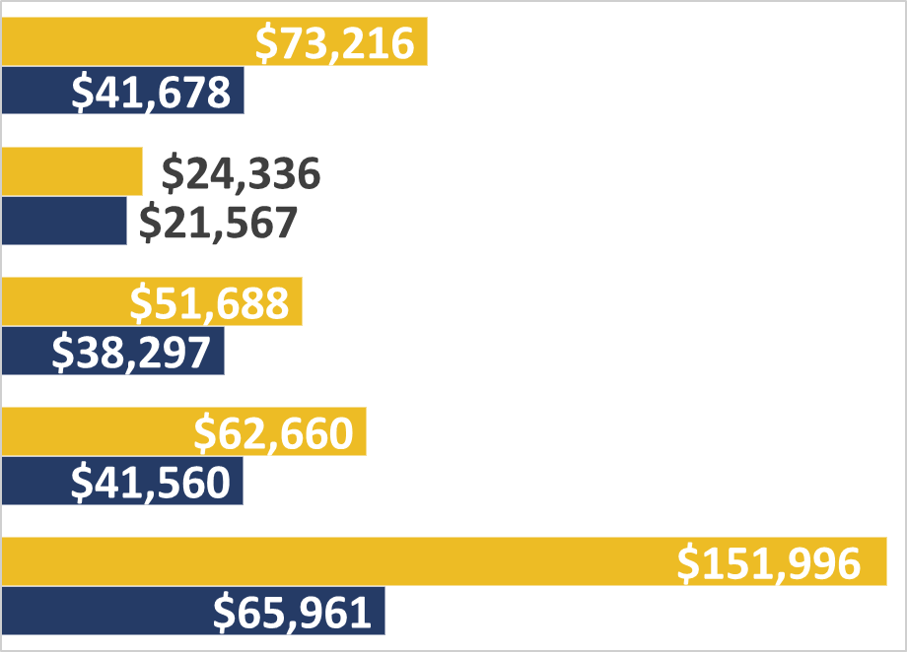
New Hire Dashboard -”New Hire” Wages vs. QCEW Wages
Industry | “NH” Wage | QCEW Wage
Total, All Industries | $41,678 | $73,216
Accommodation and Food Services | $21,567 | $24,336
Administrative and Remediation Services | $38,297 | $51,688
Health Care and Social Assistance | $41,560 | $62,660
Finance and Insurance | $65,961 | $151,996
QCEW Wage
“New Hire” Wage

Slide 24
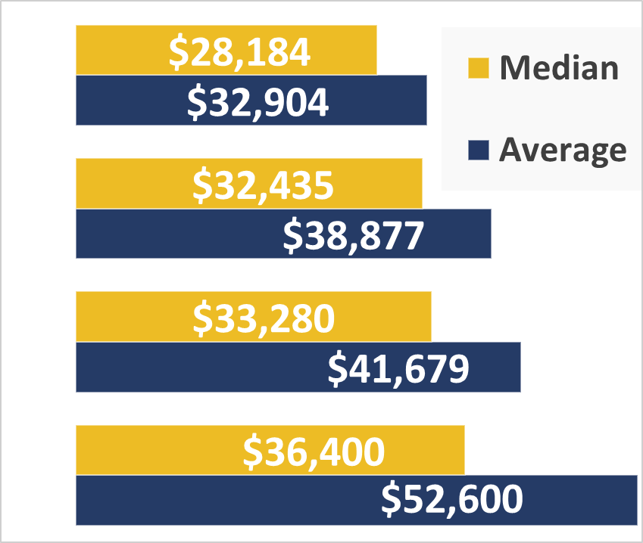
New Hire Dashboard - Starting Wages by WDA
Area | Average | Change | Median | Change
Northwest | $32,904 | $2,472 | $28,184 | $2,428
Central | $38,877 | $1,156 | $32,435 | $1,599
Pennsylvania | $41,679 | $1,296 | $33,280 | $1,442
Chester | $52,600 | $1,231 | $36,400 | $724

Slide 25
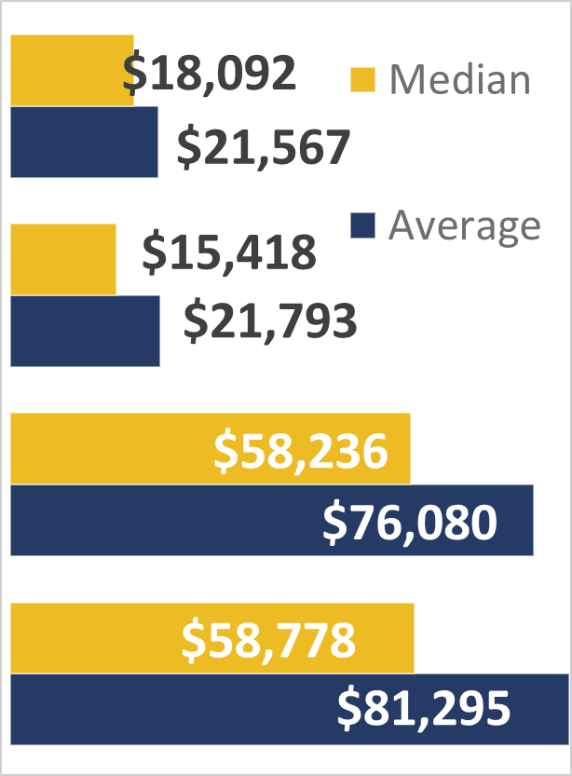
New Hire Dashboard - Starting Wages by Industry
Industry | Average | Change | Median | Change
Accommodation and Food Services | $21,567 | $718 | $18,092 | $876
Arts, Entertainment, and Recreation | $21,793 | $114 | $15,418 | $650
Professional, Scientific, and Technical Services | $76,080 | $3,301 | $58,236 | $3,615
Management of Companies and Enterprises | $81,295 | $1,551 | $58,778 | $4,611

Slide 26
New Hire Dashboard - Starting Wages by Age
Age Group | Average | Median
Less than 25 | $26,934 | $22,864
25 to 34 | $45,441 | $38,216
35 to 44 | $51,621 | $39,936
45 to 54 | $53,959 | $40,392
55 to 64 | $51,296 | $37,756
65 and Older | $34,283 | $21,805
Total | $41,679 | $33,280

Slide 27
New Hire Dashboard - Starting Wages by All Three
Age Group | Area | NAICS Title | Less Than $15,080 | $15,080 to $31,200 | $31,200 to $50,000 | $50,000 to $100,000 | $100,000 to $150,000 | $150,000 or More
Total | Pennsylvania | Total, All Industries | 19% | 27% | 28% | 20% | 4% | 2%
45 to 54 | Chester County | Management of Companies | 3% | 4% | 3% | 21% | 23% | 47%
LT 25 | Northwest WDA | Accommodation and Food | 70% | 28% | 2% | 0% | 0% | 0%

Slide 28
Thank you! Questions?

