Slide 1
No Seriously…People Use This Stuff
2023 Workforce Information Forum
October 2023

Slide 2
Potential Real World LMI Uses

Slide 3
Can I bring LMI together to assess my local area?
What marketing materials can be developed for career awareness?
Where can a new business find info about a potential workforce?
How does a company closure impact my local area?
Workforce
Economic
Is data available to analyze a new or evolving industry?
What Kind of Questions can be Answered?

Slide 4
Actual Customer Requests

Slide 5
Local Plan Data Package
Industry Employment (QCEW) – most recent by 2-digit NAICS and year-ago for comparison
Industry Cluster Statistics – recent key statistics by industry cluster, with a look back five years
Industry Projections – employment outlook by industry, including totals by sector and fastest growing (volume and percent)
Occupations Projections – employment outlook by occupation, including totals by major occupational group, “top jobs” (volume change, percent growth, annual demand), and educational attainment (distribution and change)
Labor Force (LAUS) – previous years’ annual average and current year monthly labor force data elements
Unemployment Claims – an industry distribution of continued claims for most recent month
Commuters – most recent worker inflow/outflow numbers
Census Tables – residence-based data for educational attainment and by various barriers (language, poverty, disability, and single parent status) relevant to WIOA

Slide 6
Career Awareness
Developed in collaboration with the Westmoreland-Fayette WDB
Funded by grant monies the WDB received to promote oil & gas careers at the start of Marcellus Shale
Series of one-page handouts on key careers for the industry with data from O*Net and CWIA
Resources color-coded based on the educational requirements of the jobs

Slide 7
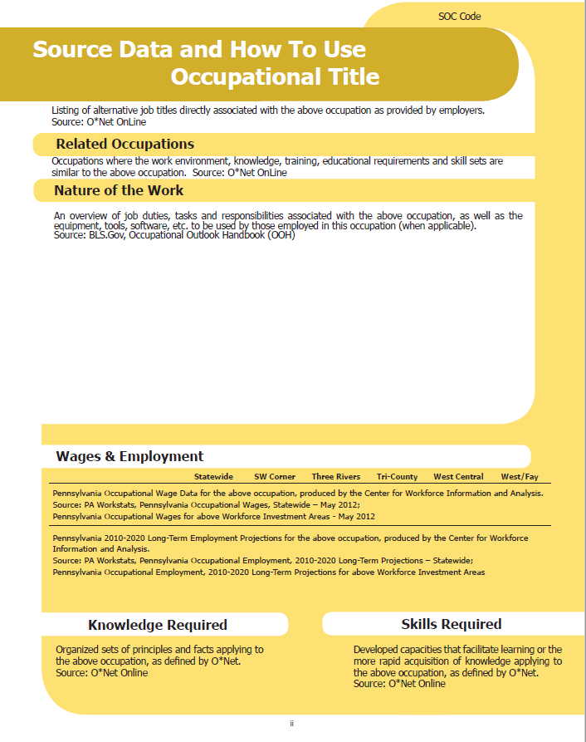
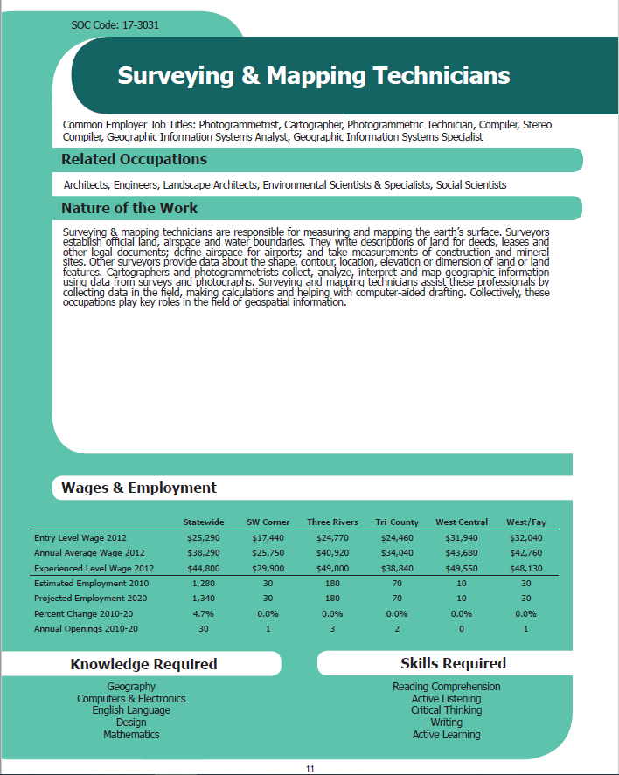
Career Awareness

Slide 8
Employer Assistance
LMI, in most cases, comes directly from employers, but it can also help employers make informed decisions in numerous ways.
New company relocating to, or opening a new location in, a particular area
Existing company have trouble attracting workers
Troubled company faced with downsizing or closure
Child Day Care Occupations commonly found in Child Day Care Services (NAICS 6244)
Occupational Code | Occupational Title | Harrisburg-Carlisle, PA MSA |  |  | Pennsylvania
 |  | Average Annual Wages ($) |  |  | Average Annual Wages ($)
 |  | Entry | Average | Experienced | Entry | Average | Experienced
39-9011 | Childcare Workers | 21,300 | 26,100 | 28,470 | 21,390 | 27,330 | 30,250
25-2011 | Preschool Teachers, Except Special Education | 26,180 | 32,220 | 35,200 | 26,230 | 33,120 | 36,510
25-9045 | Teaching Assistants, Non-Postsecondary | 22,450 | 30,480 | 34,430 | 23,010 | 30,980 | 34,900
11-9031 | Education & Childcare Administrators, Preschool | 37,930 | 54,850 | 63,190 | 37,290 | 51,800 | 58,950
39-1022 | Supervisors - Personal Service Workers | 32,320 | 43,770 | 49,410 | 30,740 | 44,640 | 51,480
35-2012 | Cooks, Institution & Cafeteria | 26,560 | 33,970 | 37,610 | 25,510 | 33,990 | 38,170
43-9061 | Office Clerks, General | 29,750 | 41,790 | 47,720 | 27,620 | 41,880 | 48,900
21-1021 | Child, Family, & School Social Workers | 38,580 | 54,080 | 61,710 | 36,170 | 52,230 | 60,140
37-2011 | Janitors & Cleaners | 24,230 | 32,390 | 36,400 | 24,660 | 33,550 | 37,920
13-1131 | Fundraisers | 31,540 | 57,030 | 69,580 | 40,240 | 62,460 | 73,410
11-1021 | General & Operations Managers | 53,150 | 115,890 | 146,800 | 52,860 | 121,750 | 155,680
53-3051 | Bus Drivers, School | 25,020 | 41,850 | 50,150 | 24,360 | 42,310 | 51,160
43-6014 | Secretaries & Administrative Assistants | 30,990 | 42,160 | 47,660 | 29,380 | 41,310 | 47,190
43-4171 | Receptionists & Information Clerks | 23,980 | 32,220 | 36,270 | 23,300 | 32,570 | 37,130
25-9031 | Instructional Coordinators | 53,930 | 73,860 | 83,680 | 45,880 | 71,150 | 83,600
Source: Long-Term Occupational Employment Projections (2020-2030) and Occupational Employment & Wage Statistics (2022)
Note: Harrisburg-Carlisle, PA MSA includes Cumberland, Dauphin and Perry Counties

Slide 9
Business Layoffs/Closures: Workforce Impact
Pre-COVID analysis for the PA Turnpike Commission
Impacting about 800 workers across 27 different occupational titles
Crosswalk PennDOT job titles to SOC codes to gather data
Evaluate local and statewide reemployment prospects for workers in all occupations; ID alternative options for ‘difficult’ jobs
Provide employment and wage data for impacted occupations and possible alternative jobs
Can include economic impact analysis

Slide 10
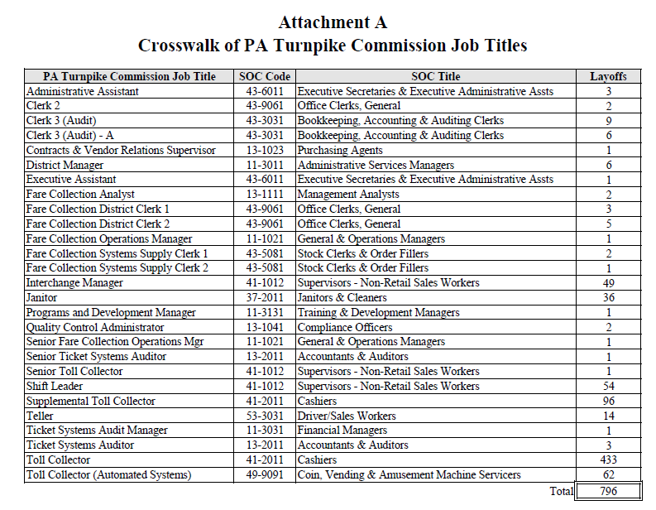
Business Layoffs/Closures: Workforce Impact

Slide 11
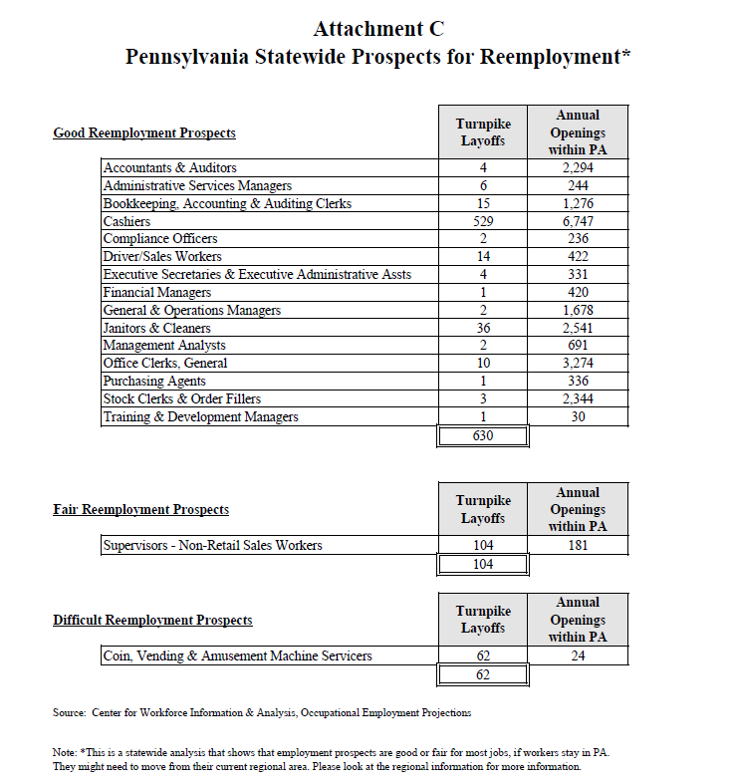
Business Layoffs/Closures: Workforce Impact

Slide 12
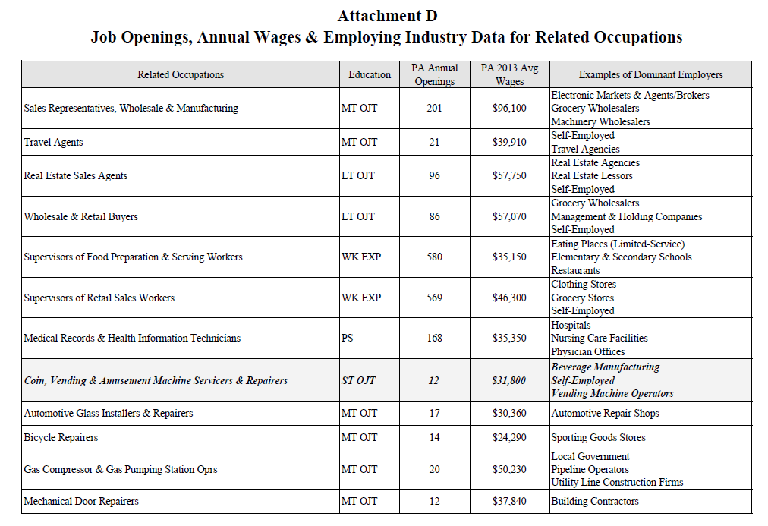
Business Layoffs/Closures: Workforce Impact

Slide 13
Business Layoffs/Closures: Economic Impact
Changes to the economic base of an area can have varying ‘ripple effects’ locally depending on the industry involved. Numerous modeling tools exist that allow users to assess the economic impact of a financial investment or change in employment volume. CWIA uses IMPLAN to do such economic impact analysis.
 | Estimated Job Loss | Jobs Multiplier | Jobs Lost per 100 | Total Jobs Lost | State and Local Tax Loss
Hahnemann | 2,500 | 2.1 | 211 | 5,283 | 30 million
PES | 1,000 | 13.5 | 1,345 | 13,451 | 240 million
Wood-Mode | 900 | 1.9 | 186 | 1,673 | 8 million
Riverbend Foods | 400 | 3.9 | 388 | 1,550 | 13 million
Reading Eagle Co. | 200 | 1.7 | 170 | 339 | 1.9 million
LEDVANCE | 175 | 3.1 | 310 | 543 | 2.7 million
IMPLAN calculates direct, indirect, and induced impacts on employment, labor income (wages), Gross State Product, production, and revenue. An ‘impact multiplier’ is the total impact including direct, indirect, and induced components.
Direct – effect in the same industry as the business/investment
Indirect – effect in industries related to the direct industry, such as suppliers
Induced – effect in other industries impacted by spending patterns of individuals working in direct and indirect jobs

Slide 14
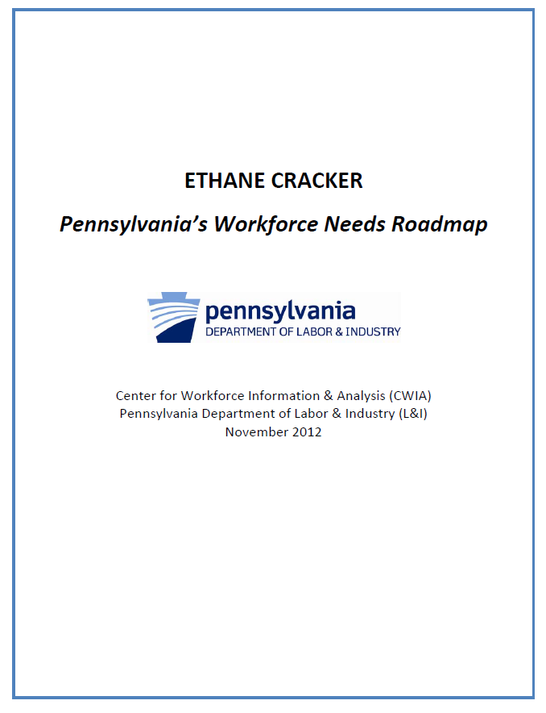
New or Evolving Industries
CWIA was approached to evaluate the economic and workforce situation regarding a new ethane cracker plant related to byproducts of Marcellus Shale drilling activities.
Analysis was hindered by a lack of local data or understanding of industry needs in PA – had to look to other states.
Project analysis was split into two phases – construction and operation.
Focused on financial investments in each phase to estimate the projected employment needs for, as well as other workforce and economic impacts of, the proposed plant.

Slide 15
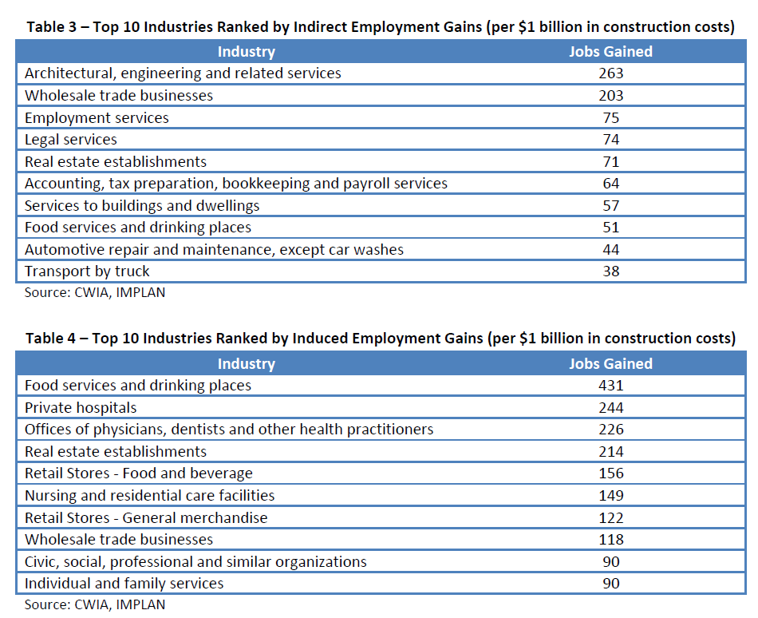
New or Evolving Industries

Slide 16
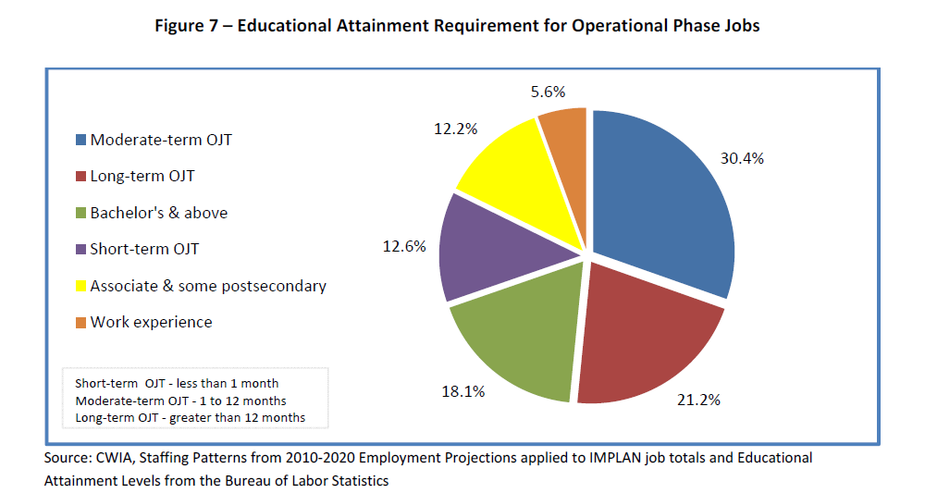
New or Evolving Industries

Slide 17
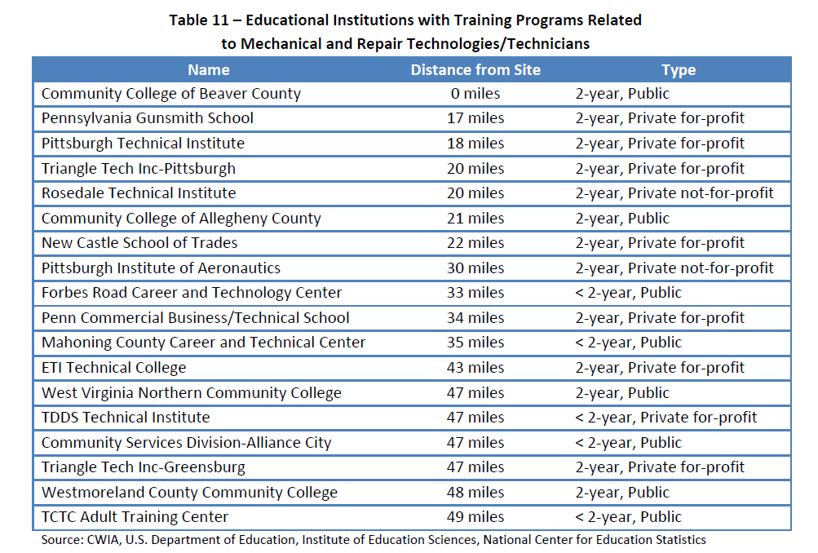
New or Evolving Industries

Slide 18
Thank you! Questions?

