Slide 1
The Benefits of Being Unlucky
A look at the Unemployment Compensation and Survey of Occupational Injuries and Illnesses Programs
2023 Workforce Information Forum
October 2023

Slide 2
Unemployment Compensation
Inception
History
Social Security Act of 1935
U.S. Department of Labor oversees the system
Each state administers its own program
Employment and Training Administration (ETA) provides oversight
Objectives
Provide temporary and partial wage replacement to involuntarily unemployed workers
Help stabilize the economy during recessions

Slide 3
Unemployment Compensation
Financing
Employer and employee taxes
Contributory and reimbursing employers
$10,000 taxable wage base
UC Trust fund
  $3.4 billion at the end of CY2019
  $6.6 billion total benefits paid in 2020
  $2.5 billion of federal loans borrowed in total since 2020
  Current balance as of September 2023 is $1 billion with no federal loans

Slide 4
Sources: Pennsylvania Department of Labor & Industry
IHS Markit September 2023 Baseline Forecast for Pennsylvania
U.S. Bureau of Public Debt

Slide 5
Pennsylvania’s Benefits Overview
Covers most nonfarm employment
  Does not include all unemployed workers
  Average covered employment for 2022 was 5,764,247
260,000 claimants received UC in 2022
  Peaked at 1.4 million in 2020
  Previous peak was 926,000 in 2009
Weekly payments of $68-$594 in 2022
  Average payment in 2022 was $432.67
  Maximum payment increased to $605 for 2023
18-26 weeks duration
  Average duration 14.4 weeks in 2022

Slide 6
UC – Key Terms
Initial Claims: Any notice of unemployment filed to request determination of UC eligibility.
  Includes New, Additional, and Transitional
Continued Claims: Subsequent weeks of unemployment for which benefits are paid if claimant meets requirements.
  Includes waiting weeks and any disqualification periods being served
Final Payments: Last regular benefit payment a claimant receives because they have exhausted the full amount of benefits to which they are entitled.
  Does not include those that draw a final payment due to their benefit year expiring

Slide 7
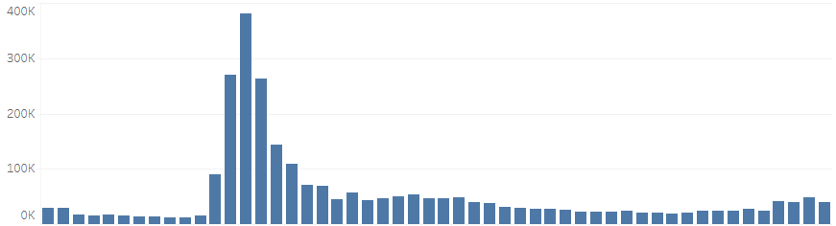
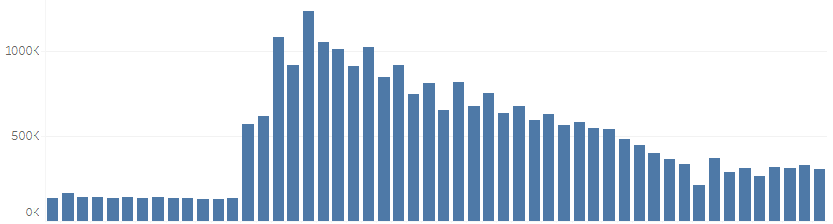
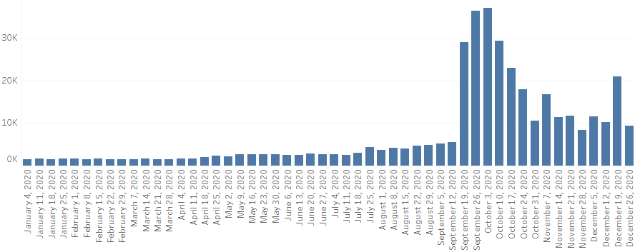
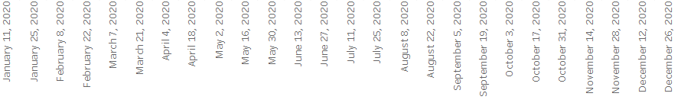
2020 Claims & Final Payments
Initial Claims
Continued Claims
Final Payments

Slide 8
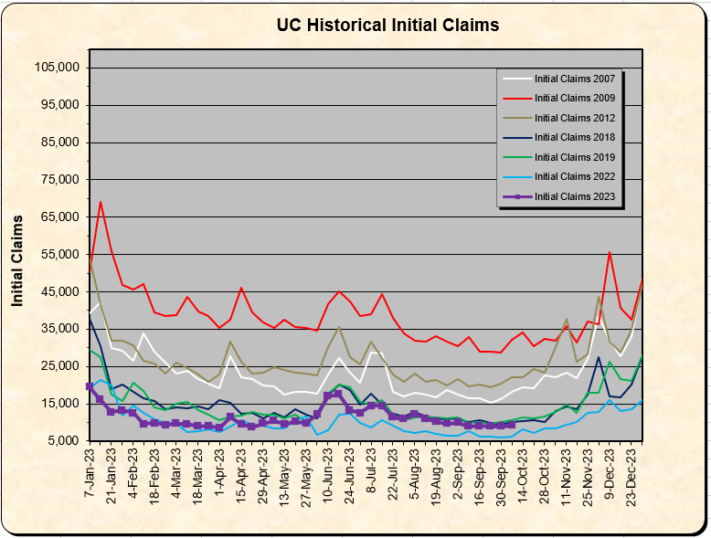
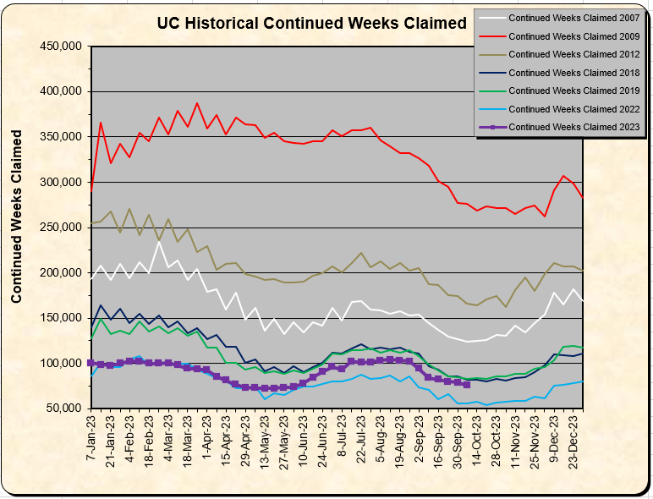
Historical Claims

Slide 9
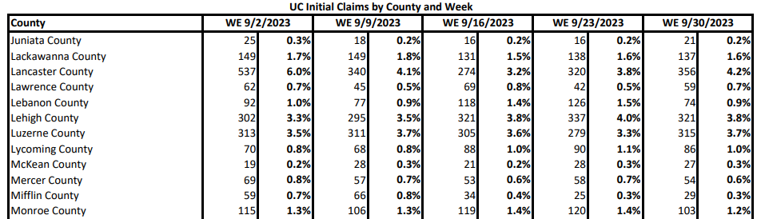
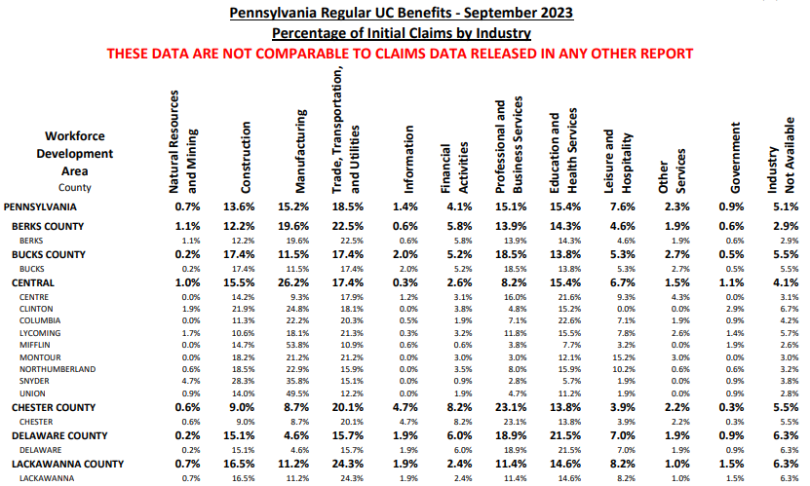
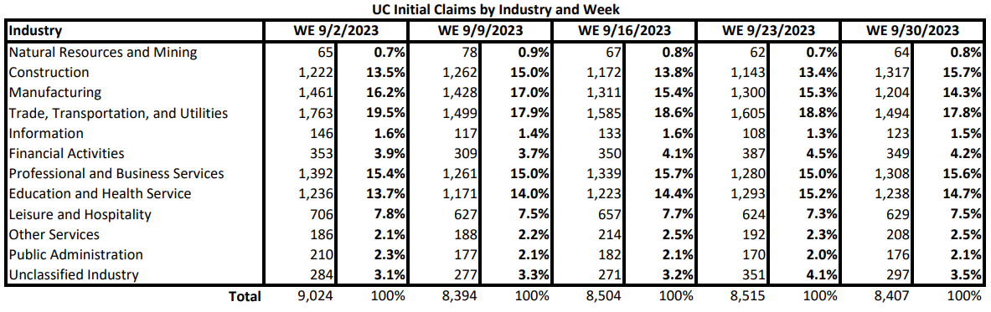
Weekly and Monthly reports available on CWIA’s website

Slide 10
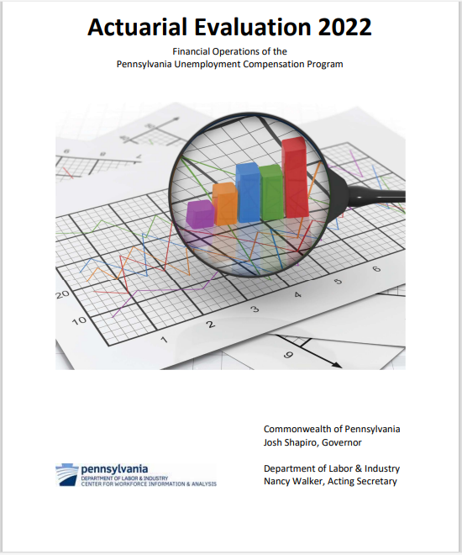
Actuarial Evaluation
  Annual report required by PA UC law
  UC trust fund analysis and forecasts
  Historical UC data
  State Comparisons
Notes:
Every year, we produce the UC Actuarial evaluation which has been required by UC law since 1985. Digital copies are available on our website going back to 2007.
It provides an in-depth analysis of the factors impacting the UC Trust Fund, including projections of UC tax contributions and benefit costs based on latest economic forecasts.
The state comparisons include unemployment rates, total benefits, average weekly benefit, as well as tax wage bases and rates

Slide 11
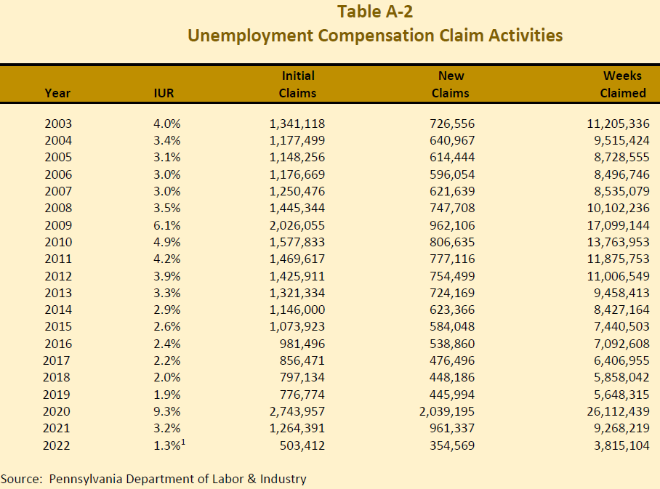
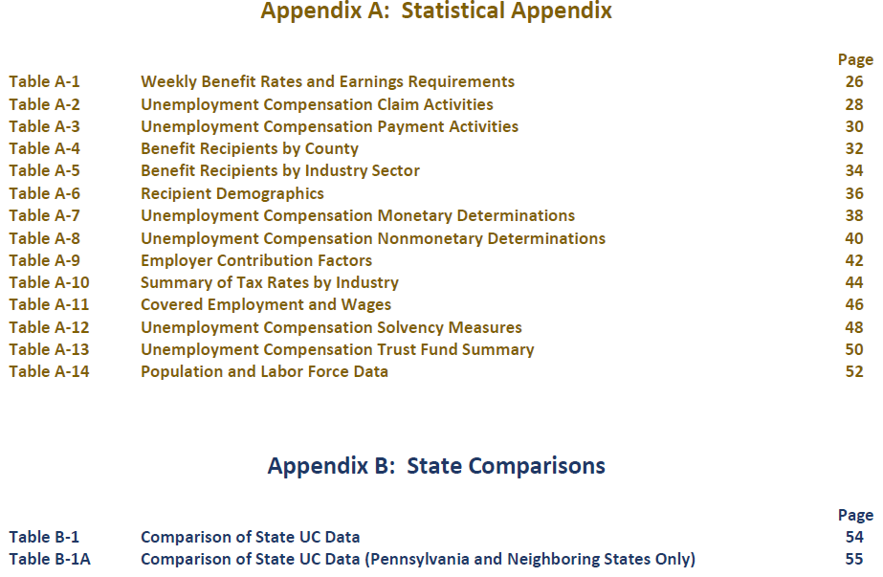
Actuarial Evaluation:
Historical Claims
Notes:
There are 20 years of historic data except for Tables A-4, A-5, A-6, and A-10.
The footnote for 2022 is that the number is preliminary given there were only 9 months of data available due to the lag in QCEW.
IUR is insured unemployment rate. Earlier you may have seen the LAUS unemployment rate which was 4.4 in 2022 which includes people who are not eligible for UC benefits.
New is just a subset of Initial, initial can also include additional and transitional claims.

Slide 12

RESEA
Re-Employment Services and Eligibility Assessment (RESEA)
  Seminars for assisting claimants in searching for re-employment
  Failure to comply with RESEA results in loss or delay of unemployment benefits
    Penalty for failing to comply varies from state to state
  Reported on the federal ETA-9128
  Profiling model selects claimants who are most likely to exhaust benefits
  The program was momentarily paused from March 2020 through January 2021 due to pandemic
Even an aspiring latex salesman needs to show proof of job seeking.

Slide 13

Survey of
Occupational
Injuries and
Illnesses

Slide 14
What is SOII?
An annual, mandatory, sample-based survey conducted by the BLS and cooperating states
Measures occupational injuries and illnesses in business establishments
Used to produce estimates of the number of injuries and illnesses and injury/illness rates
Respondents are asked to keep safety records using OSHA recordkeeping guidelines

Slide 15
What data is collected?
Each establishment in the survey is asked to report:
  Average annual employment and total hours worked
  A summary of reportable work-related injuries/illnesses (if any)
  Detailed reporting of cases with Days Away From Work (DAFW) or Days of Job Transfer or Restriction (DJTR)

Slide 16

Uses of SOII Data
Used as an indicator of occupational safety and health issues and trends
Helps measure the effectiveness of programs designed to reduce work-related injuries and illnesses
Evaluation and implementation of safety programs
Designing safety equipment
Reality television……..

Slide 17
SOII Case Rates – PA vs. US
* Rates = per 100 Full-Time Equivalent Workers

Slide 18
2021 Case Rates by State
PA :
Higher than US rate of 2.7/100 FTE workers in 2021
Highest injury/illness rate among neighboring states in 2021
Ranked tied for 24th out of the 41 participating states

Slide 19
2021 PA Case Rates by Industry
Other industries with traditionally high rates include:
Warehousing and storage
General merchandise stores
Furniture and related product mfg
Food manufacturing

Slide 20
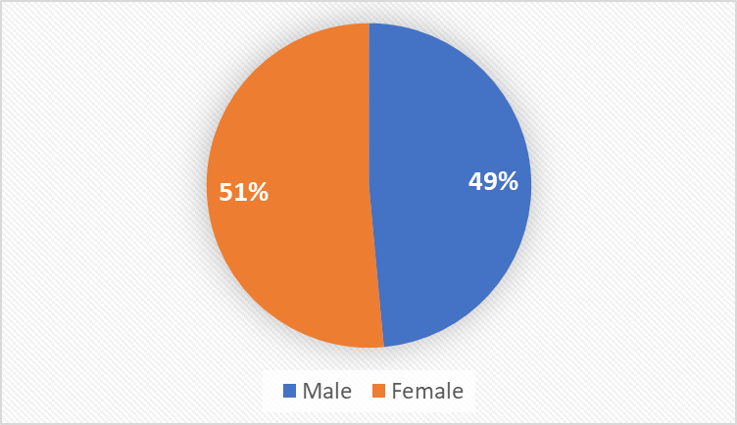
Injuries by Gender
* Expressed as percentage of all injuries/illnesses

Slide 21
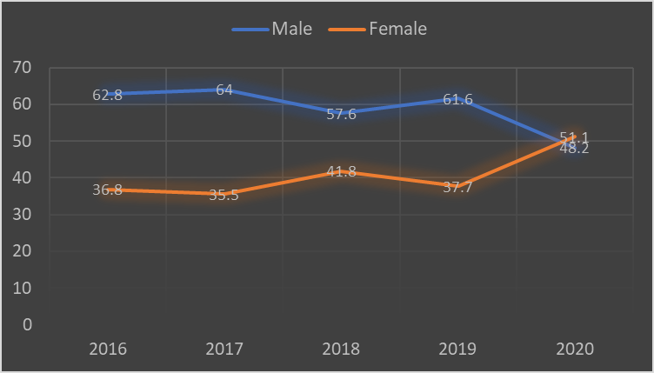
Injuries by Gender
* Expressed as percentage of all injuries/illnesses

Slide 22
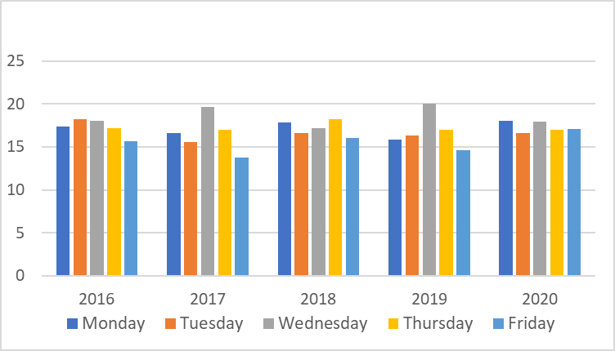
On what day of the week do most workplace injuries/illnesses occur?
* Expressed as percentage of all injuries/illnesses

Slide 23
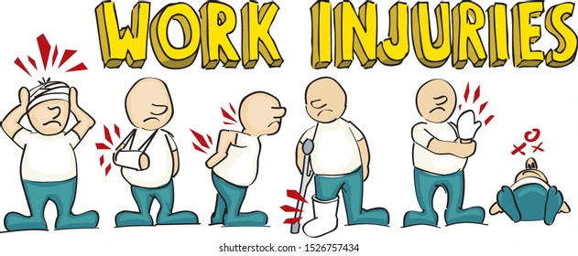
Most Common Nature of Injury

Slide 24
Most Common Nature of Injury

Slide 25
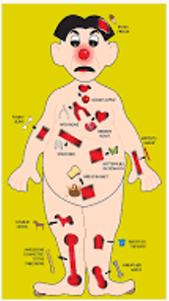
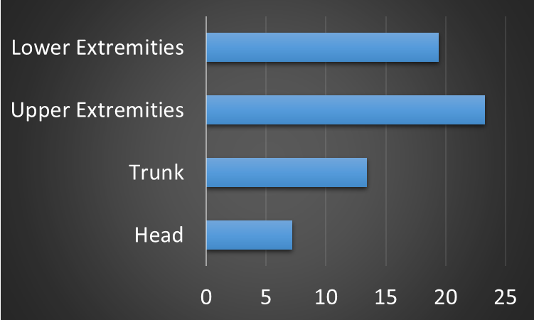
Most Common Part of Body Affected?

Slide 26
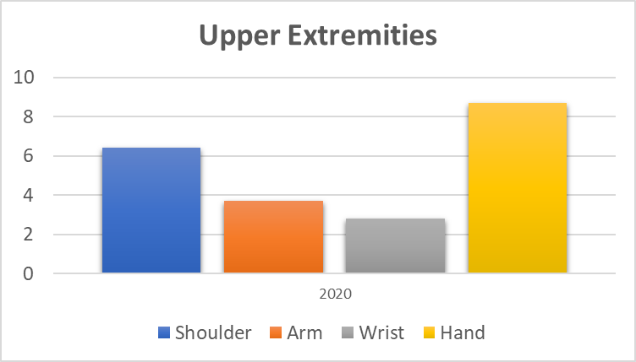
Most Common Part of Body Affected?
* Expressed as percentage of all injuries/illnesses

Slide 27
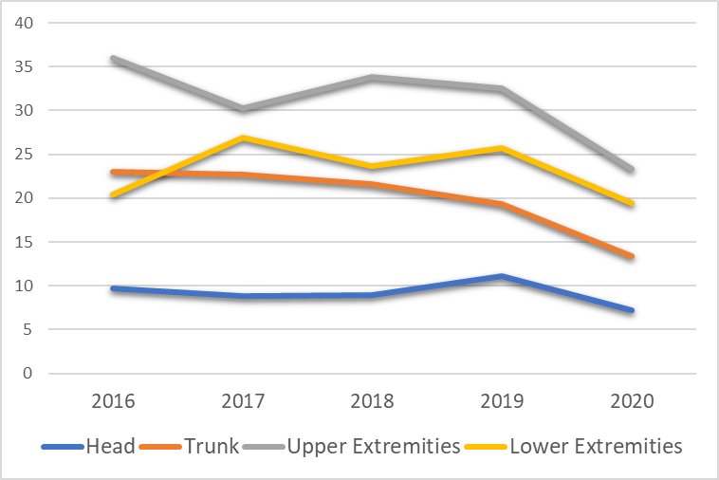
Most Common Part of Body Affected?

Slide 28
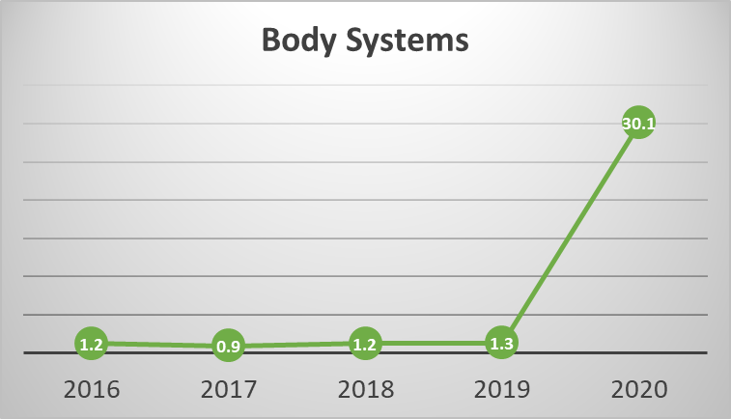
Most Common Part of Body Affected?

Slide 29

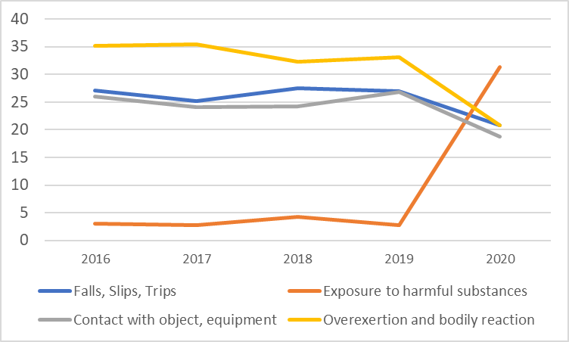


What Event was Attributed to most Injuries/Illnesses?

Slide 30
Top 5 Sources of Workplace Injuries and Illnesses

Slide 31

Thank you! Questions?

