Slide 1
Welcome to Our Ballpark!
Labor Market Legends
Labor Market Information Forum:
2023 Workforce Information Forum
October 2023

Slide 2
Welcome to
CWIA Ballpark
Home of the Labor Market Legends
2023 Website Stats
1,097 PDFs
532 Excel Files
26 PowerPoint presentations
12 interactive dashboards

Slide 3
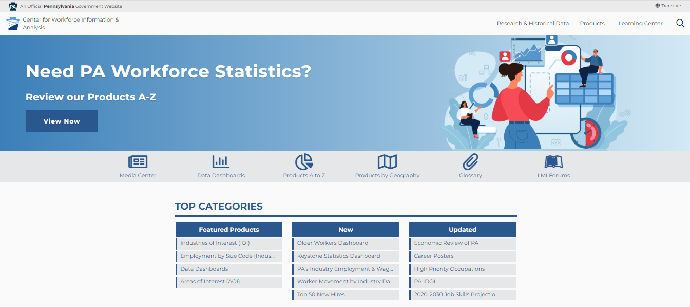
www.workstats.dli.pa.gov

Slide 4
Home Page – Top Navigation
The menu located in the top right-hand corner of our website contains three main areas:
Research & Historical Data
Products
Learning Center
These three areas will provide access to the contents of our entire website.

Slide 5
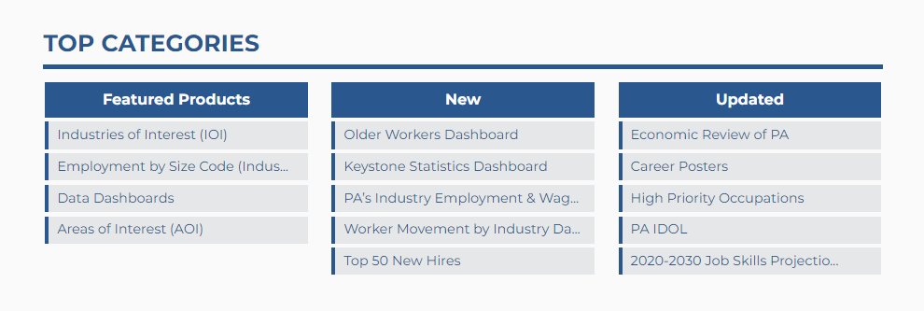
Home Page – Top Categories
On the homepage you will find content boxes that highlight featured, new, and recently updated information.

Slide 6
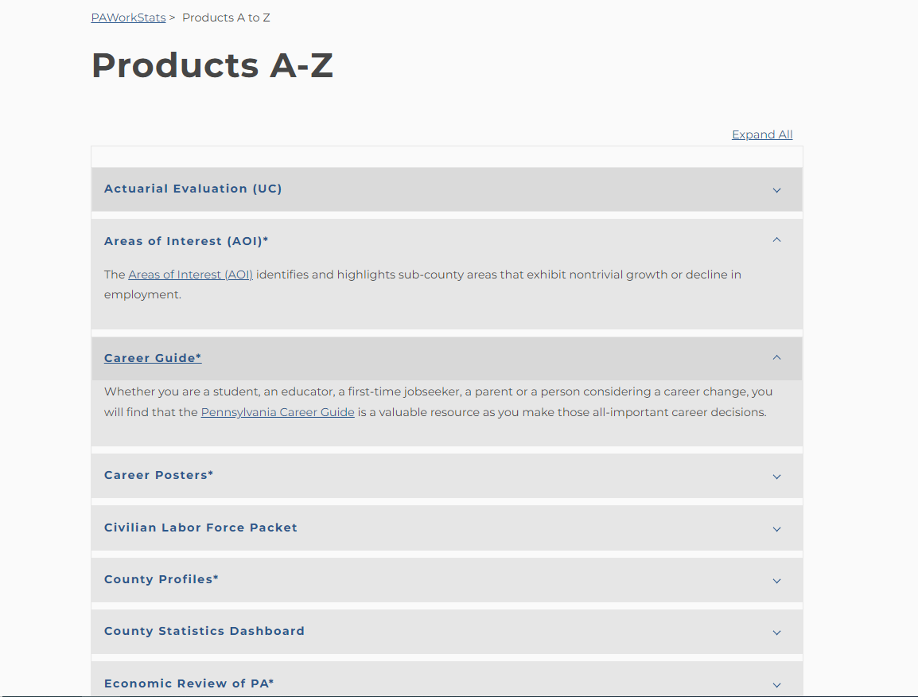
Products A to Z
An alphabetical listing of all products located on the website:

Slide 7
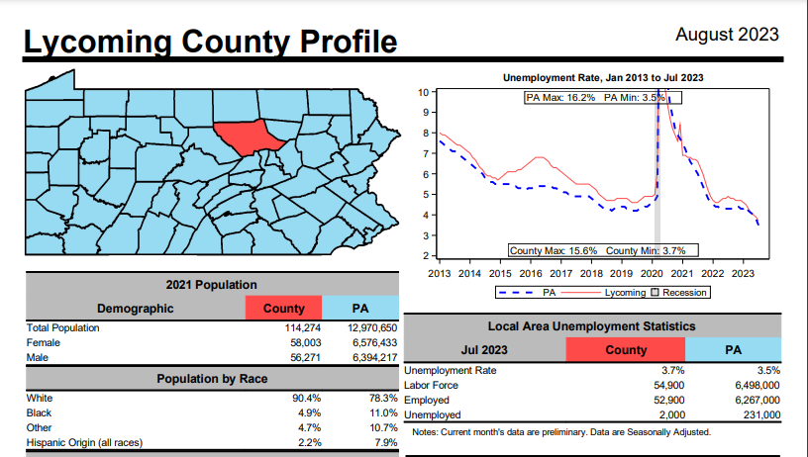
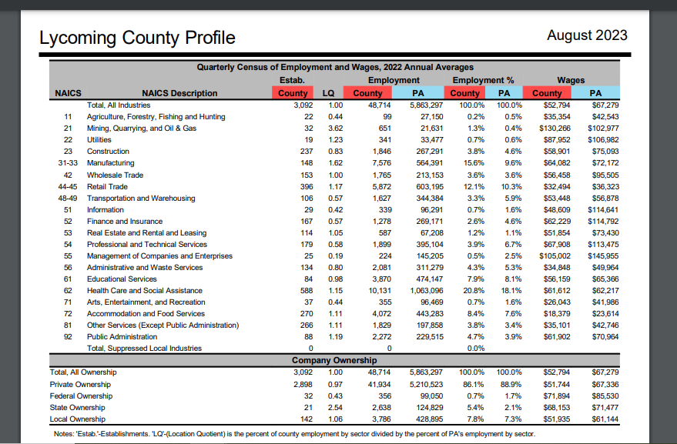
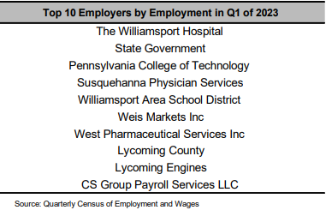
Products A to Z
County Profile
QCEW

Slide 8
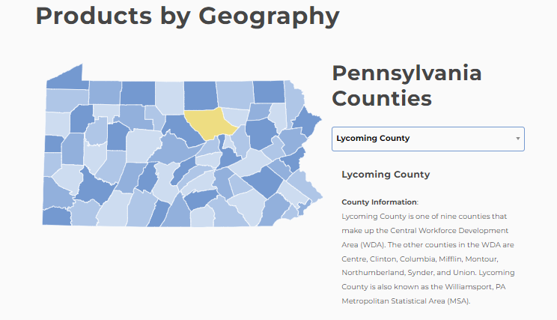
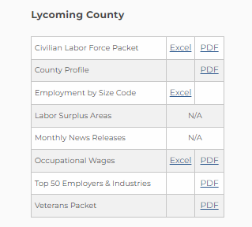
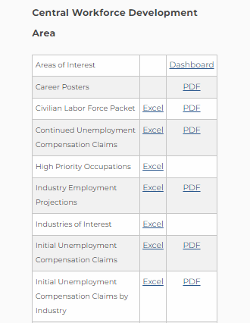
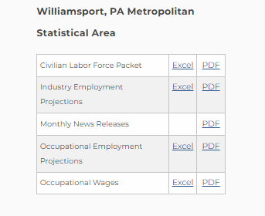
Products by Geography
A customized listing of all products containing data for your county, workforce development area (WDA), and metropolitan statistical area (MSA)
https://www.workstats.dli.pa.gov/Products/Pages/Products%20By%20Geography.aspx

Slide 9
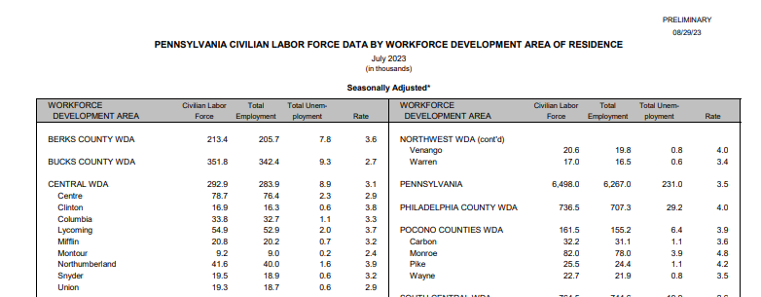
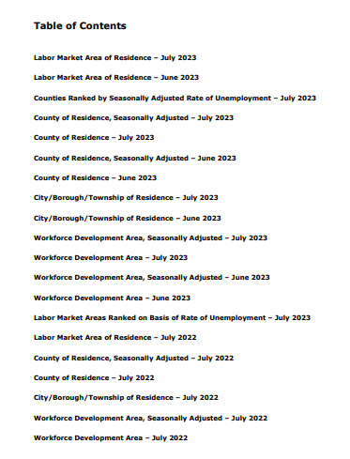
Products by Geography
Civilian Labor Force Packet
LAUS

Slide 10
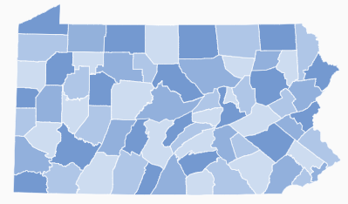
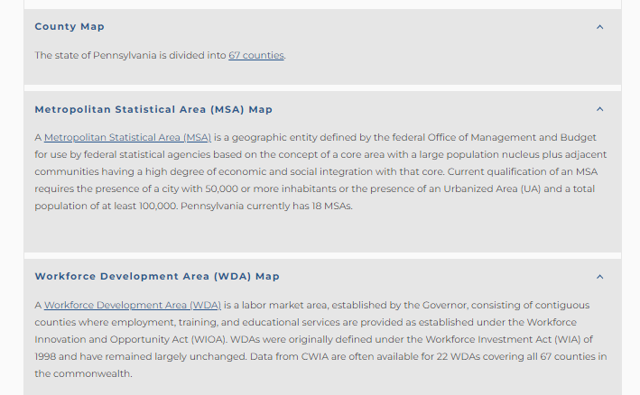
Products by Geography
Maps

Slide 11
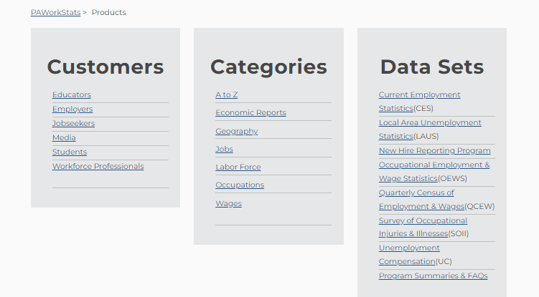
Products by Category
https://www.workstats.dli.pa.gov/Products/ByCategory/Pages/default.aspx

Slide 12
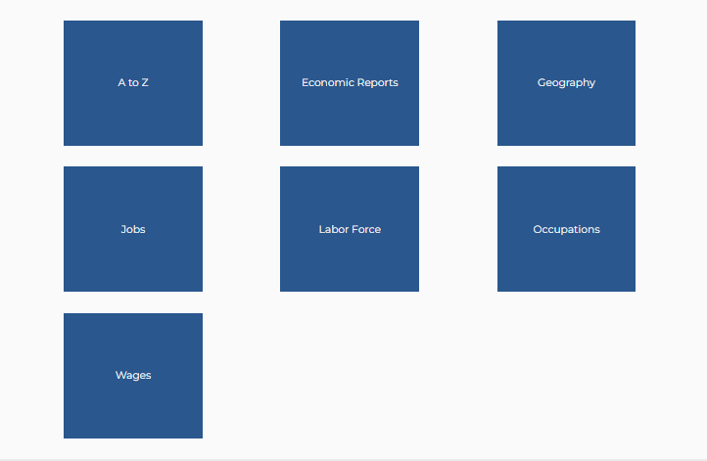
Products by Category
https://www.workstats.dli.pa.gov/Products/ByCategory/Pages/default.aspx

Slide 13
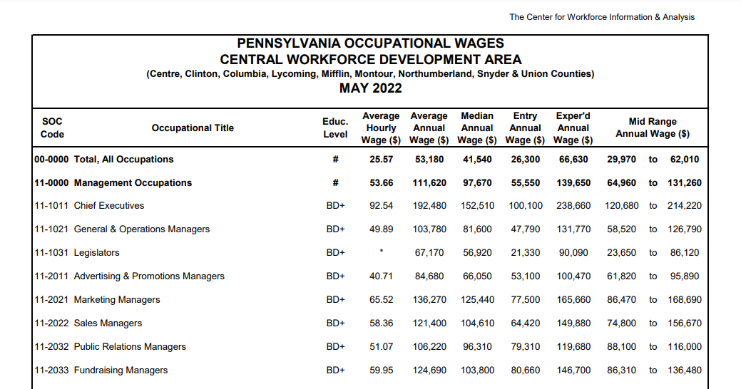
Products by Category
Occupations
Occupational Wages
OEWS

Slide 14
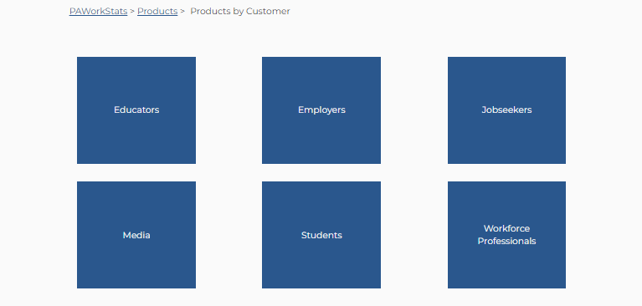
Products by Customer
An attempt to align products with customer groups – products overlap customer groups and are included in each
https://www.workstats.dli.pa.gov/Products/ByCustomer/Pages/default.aspx

Slide 15
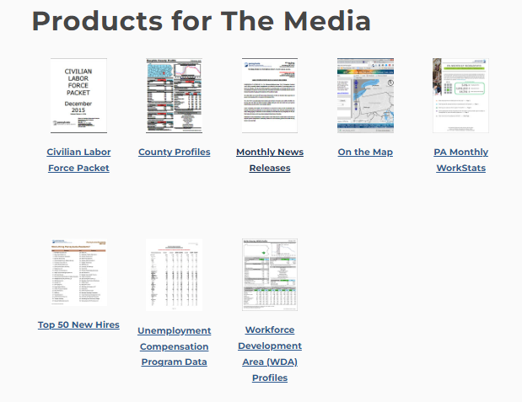
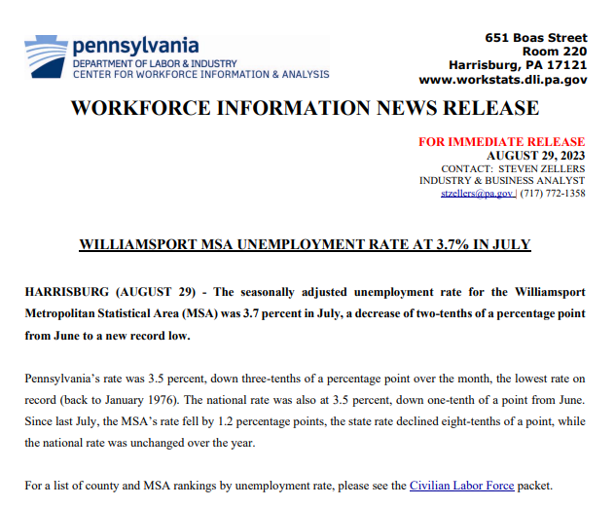
Products by Customer
Media
Monthly News Release
News Releases available by:
Metropolitan Statistical Area (MSA)
Micropolitan Statistical Area (mSA)
Labor Market Area
CES

Slide 16
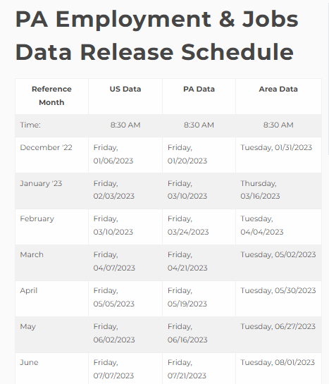
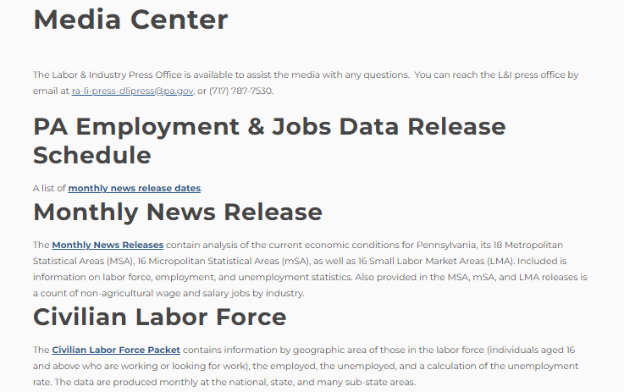
Media Center – Employment & Jobs Data Release Schedule
https://www.workstats.dli.pa.gov/MediaCenter/Pages/ReleaseSchedule.aspx

Slide 17
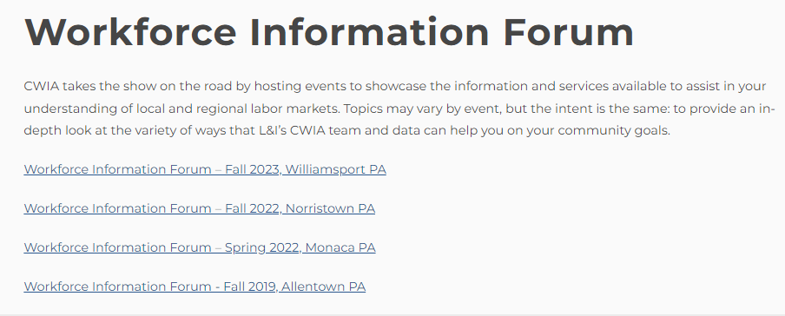
LMI Forum Page
https://www.workstats.dli.pa.gov/Products/Presentations/Pages/LMI-Forum-Presentations.aspx

Slide 18
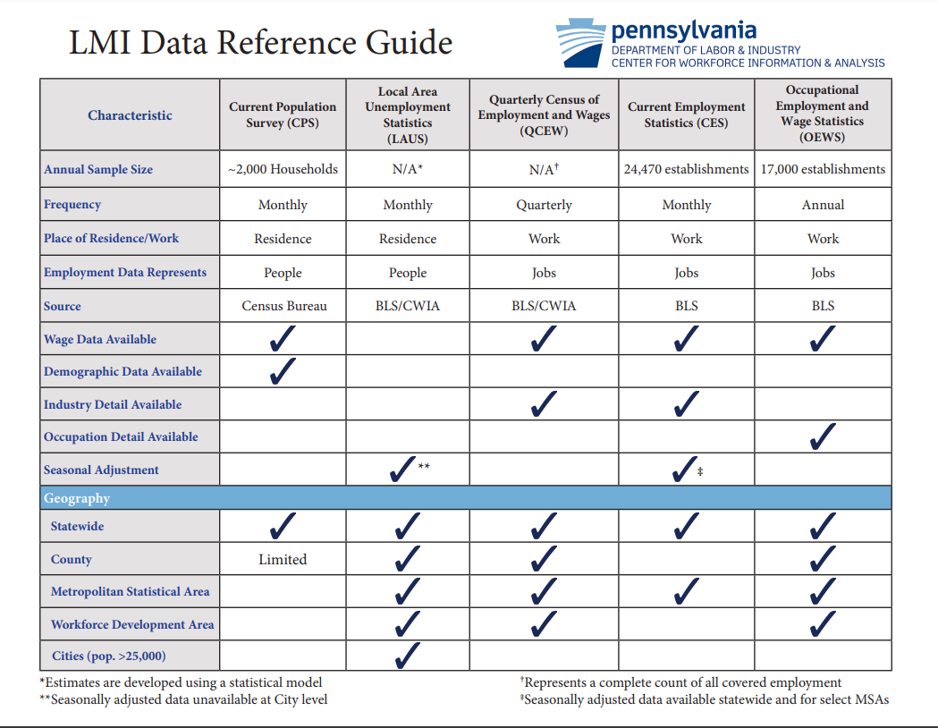

Slide 19
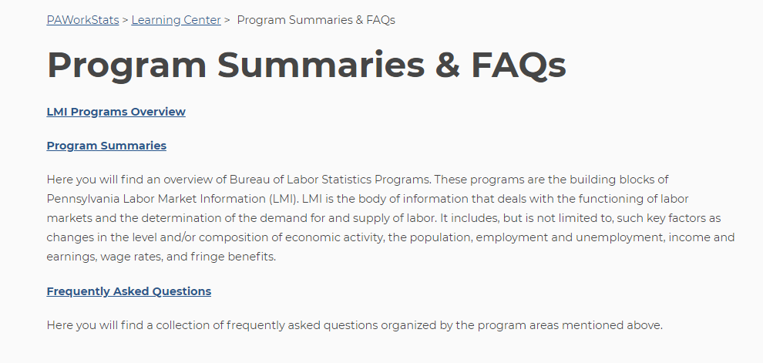
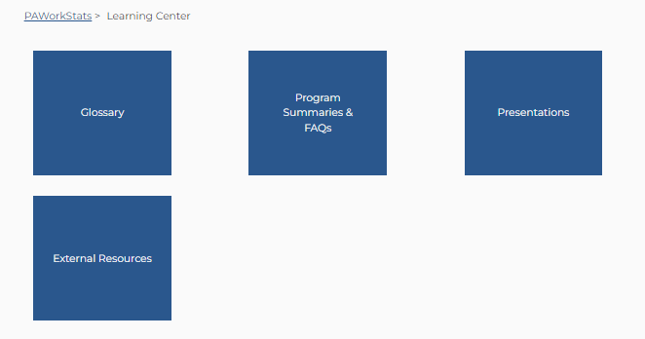
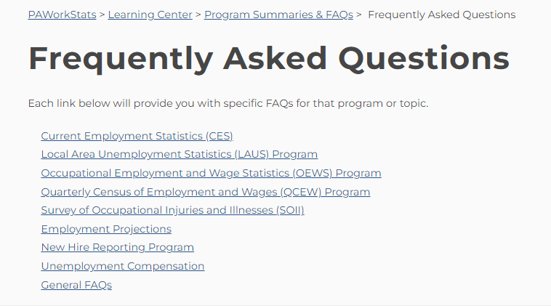
Learning Center

Slide 20
Sign up for our E-mail Distribution List!
We maintain an e-mail distribution list that we use to announce the
release of statewide and local area data, new products, upcoming
LMI Forums, etc.
Please contact us at workforceinfo@pa.gov or 877-493-3282 to be added to the list.
If you remember receiving e-mails from us but haven’t received any recently, please reach out so we can figure out if we need to update your e-mail address or if there may be another issue.

Slide 21
Customer Response: 877-493-3282 (877-4WF-Data)
Hours: 8:00 am – 4:00 pm
Email: workforceinfo@pa.gov
Online: www.workstats.dli.pa.gov
A “Contact Us” button appears in the gray footer of every page on the website. The Contact Us page lists our phone number and e-mail address and includes a form that you can fill out and send to us with your questions.

Slide 22
Thank you!
Questions?

