Slide 1
The Building Blocks of LMI
Scott Meckley, Facilitator
Ryan Horner, QCEW
Dave Hand, CES
Shelli Long, LAUS
Jacob Wise, OEWS
Workforce Information Forum April 2024

Slide 2
QCEW
Quarterly Census of
Employment and Wages
CES
Current Employment Statistics
Define Your Acronym
LAUS
Local Area
Unemployment Statistics
OEWS
Occupational Employment and Wage Statistics

Slide 3
QCEW
A count of jobs by industry
CES
An estimate of jobs by industry
What do you mean by “employment”
LAUS
An estimate of people that are working (or not working)
OEWS
An estimate of jobs by occupation

Slide 4
QCEW
Employment/Wages by Industry (regardless of occupation)
CES
Employment/Wages by Industry
(no occupational data)
Industry vs. Occupation
LAUS
Does not include industry or occupational info
OEWS
Employment/Wages by Occupation (regardless of the industry)

Slide 5
QCEW
Data at the county level
Also aggregated to higher levels
CES
Data at Statewide and MSA level
Geographic Detail
LAUS
Multiple geographic levels
Only data available at some sub-county levels
OEWS
Statewide and MSA level data

Slide 6
QCEW
Monthly data, collected quarterly
Available approx 5 months from end of quarter
CES
Monthly data
Available about 2-3 weeks after reference month
Time Frame / Frequency
LAUS
Monthly data
Available about 2-3 weeks after reference month
OEWS
Annual data
Available around April of the following year

Slide 7
QCEW
Preliminary quarterly data revised with following quarter’s publication
Once “final”, data is not revised
CES
Preliminary monthly data revised after the following month’s publication
At end of year, estimates for past 21 months replaced (benchmarked)
How often is your data revised
LAUS
Preliminary monthly data revised after the following month
At end of year, estimates for past 12 months revised
OEWS
Annual data produced one time and does not get revised

Slide 8
CES
Data is seasonally adjusted
Allows for better comparison of monthly data
QCEW
Data is NOT seasonally adjusted
Seasonal Adjustment
LAUS
Data is seasonally adjusted
Allows for better comparison of monthly data
OEWS
Data is annual – no need for seasonal adjustment

Slide 9
Uses of your data
Popular Products

Slide 10
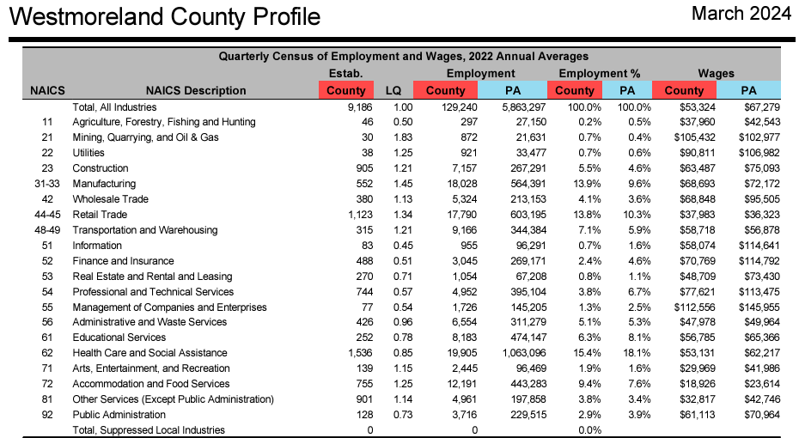
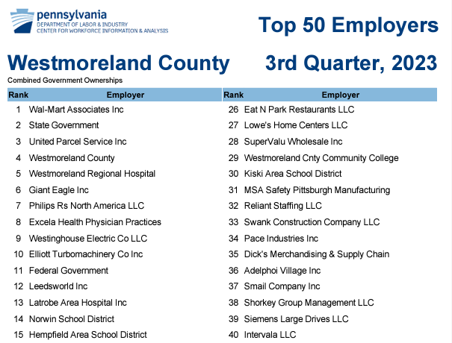
QCEW

Slide 11
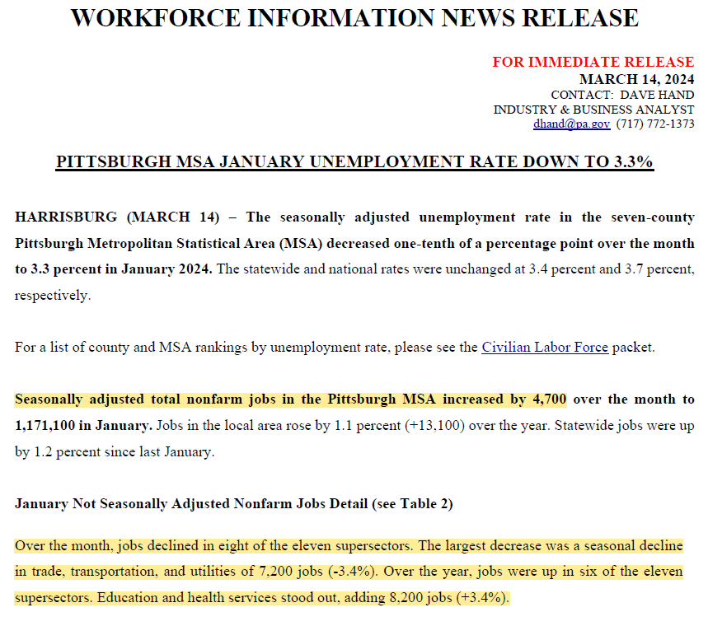
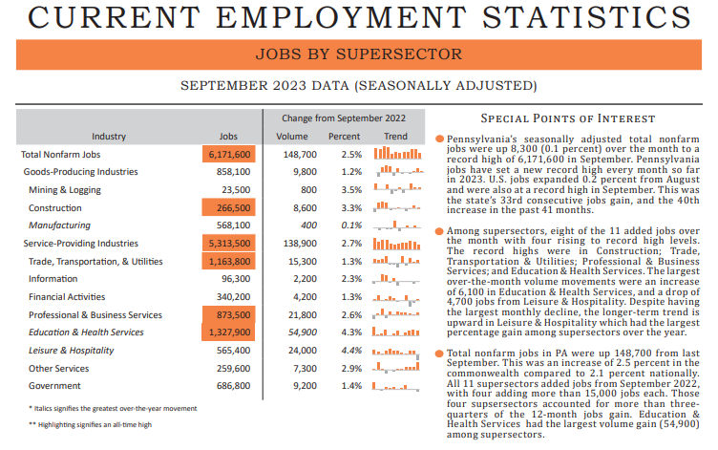
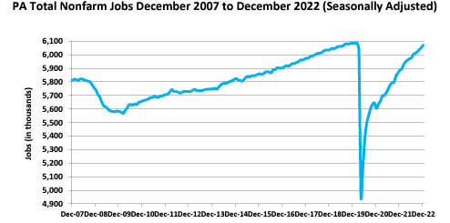
CES

Slide 12
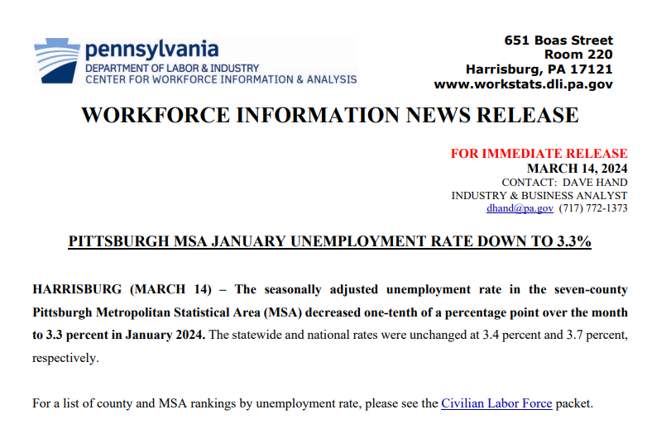
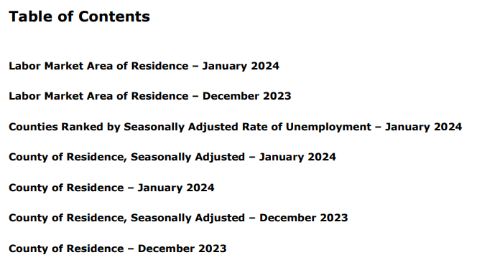
LAUS
Plus more!

Slide 13
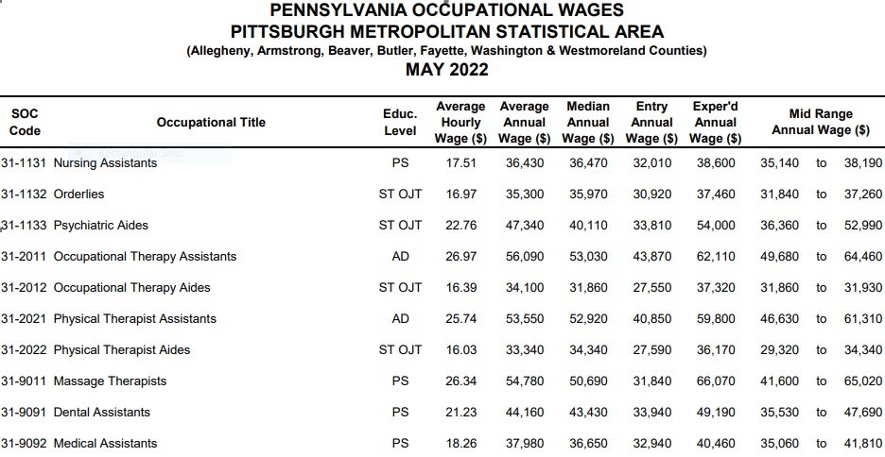
OEWS

Slide 14
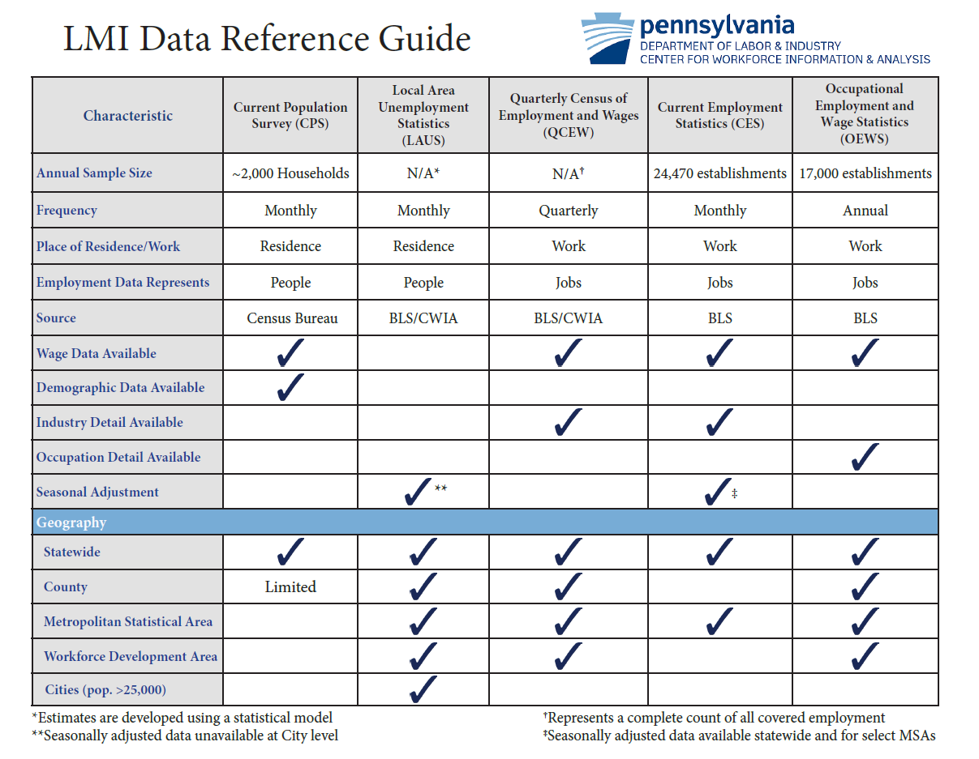

Slide 15
Thank you!
Questions?

