Slide 1
Understanding Demand in a Neighborhood of Make-Believe
Workforce Information Forum
April 2024

Slide 2
Overview – Projections
Estimated employment levels and 10-year demand for specific industries and occupations
Developed in collaboration with the United States Department of Labor’s Employment & Training Administration (ETA)
Based largely on information from two Bureau of Labor & Statistics (BLS) programs
Industry: Quarterly Census of Employment & Wages (QCEW)
Occupational: Occupational Employment & Wage Statistics (OEWS)
Full- and part-time workers, includes agriculture, private household, and self-employed
Completed every 2 years for the State, MSAs and WDAs
PA release is in June and sub-state in December
Used to predict where demand for workers will be in the future, to develop/modify training programs to meet that demand, and to help educate job seekers of both today and tomorrow as to where those opportunities will be.

Slide 3
Projections Publications
https://www.workstats.dli.pa.gov

Slide 4
Industry Outlook
Pennsylvania
Industry Employment
2020-2030 Long-Term Projections
 |  |  |  |  |  | Avg
 |  | Employment* |  | Change |  | Annual
NAICS | Industry Title | 2020 | 2030 | Level | Percent | Change
 | TOTAL ALL INDUSTRIES | 5,923,090 | 6,374,810 | 451,720 | 7.6% | 45,172
62 | Health Care & Social Assistance | 1,013,100 | 1,144,420 | 131,320 | 13.0% | 13,132
621 | Ambulatory Health Care Services | 329,860 | 385,580 | 55,720 | 16.9% | 5,572
6211 | Offices of Physicians | 116,760 | 128,610 | 11,850 | 10.1% | 1,185
6212 | Offices of Dentists | 30,170 | 34,210 | 4,040 | 13.4% | 404
6213 | Offices of Other Health Practitioners | 39,980 | 49,140 | 9,160 | 22.9% | 916
6214 | Outpatient Care Centers | 44,450 | 54,050 | 9,600 | 21.6% | 960
6215 | Medical & Diagnostic Laboratories | 10,000 | 11,700 | 1,700 | 17.0% | 170
6216 | Home Health Care Services | 66,350 | 82,770 | 16,420 | 24.7% | 1,642
6219 | Other Ambulatory Health Care Services | 22,160 | 25,100 | 2,940 | 13.3% | 294
Total, All Industries
Sector (Two-Digit)
Subsector (Three-Digit)
Industry Group (Four-Digit)

Slide 5
Occupational Outlook
Pennsylvania
Occupational Employment
2020-2030 Long-Term Projections
SOC Code | Occupational Title | Educ. Level | Employment Outlook |  |  | Annual Demand
 |  |  | Estimated | Projected | Percent | Due to | Due to | Due to | Total
 |  |  | 2020 | 2030 | Change | Growth^{1/} | Exits^{2/} | Transfers^{3/} | Demand^{4/}
00-0000 | Total, All Occupations | N/A | 5,923,090 | 6,374,810 | 7.6% | 45,172 | 265,279 | 401,647 | 712,098
31-0000 | Healthcare Support Occupations | N/A | 323,520 | 383,090 | 18.4% | 5,957 | 21,206 | 21,284 | 48,447
31-1100 | Nursing, Psychiatric, & Home Health Aides | N/A | 254,670 | 301,880 | 18.5% | 4,720 | 17,815 | 15,756 | 38,291
31-1120 | Home Health & Personal Care Aides | ST OJT | 175,140 | 214,740 | 22.6% | 3,960 | 12,480 | 11,038 | 27,478
31-1131 | Nursing Assistants | PS | 74,810 | 82,140 | 9.8% | 733 | 5,024 | 4,443 | 10,200
31-1132 | Orderlies | ST OJT | 2,590 | 2,750 | 6.2% | 16 | 171 | 151 | 338
31-1133 | Psychiatric Aides | ST OJT | 2,130 | 2,250 | 5.6% | 12 | 140 | 124 | 276
Total, All Occupations
Major Group
Minor Group
Broad Group
Detailed Occupation

Slide 6
Total Demand by Example
Laborers and Material Movers
Demand due to growth: John receives his high school diploma and enters the workforce by taking a full-time job as a dock worker at a newly constructed warehouse nearby while he is taking night classes at a community college.
Demand due to exits: Megan is expecting her first born in two weeks and decides she wants to quit her job as a warehouse worker and leave the labor force and become a full-time stay-at-home mom.
Demand due to transfers: Sally leaves her job as a receiving associate once she finishes her bachelor’s degree in business management and begins working as a business analyst for an insurance company.
NAICS | Industry Title | Employment |  | Change |  | Avg Annual Change
 |  | 2020 | 2030 | Level | Percent
4931 | Warehousing & Storage | 98,030 | 111,890 | 13,860 | 14.1% | 1,386
SOC Code | Occupational Title | Educ. Level | Employment Outlook |  |  | Annual Demand
 |  |  | Estimated | Projected | Percent | Due to | Due to | Due to | Total
 |  |  | 2020 | 2030 | Change | Growth | Exits | Transfers | Demand
53-7062 | Laborers & Freight, Stock & Material Movers | ST OJT | 137,610 | 151,530 | 10.1% | 1,392 | 6,326 | 12,579 | 20,297
Total Demand = Employment Growth + Separations (Exits + Transfers)

Slide 7
Educational Requirements for Jobs (2030)
Career Options:
TODAY
Slightly more than half of all jobs can be entered directly after high school graduation (or GED completion) and require no more than one year of on-the-job training.
Projected to grow at a much slower rate (6.9%) than the state overall (7.6%). Segment contribution to total employment has been steadily declining.
TOMORROW
More than one out of every five jobs will require some extended period of formal training, an apprenticeship, industry-recognized certification, or completion of an Associate degree for entry.
Jobs requiring an Associate degree are projected to grow at a faster rate (10.3%) than the state.
FUTURE
Roughly one out of every four jobs in the state require a bachelor’s degree or higher.
Highest growth rates expected for those with advanced degrees (10.7%).
Today
Additional education may be required to retain employment and/or to qualify for promotional opportunities.
Source: Long-Term Occupational Employment Projections, 2020-30; https://www.workstats.dli.pa.gov/Products/employment-projections/Pages/LTOPWorkforceDevelopmentAreaData.aspx

Slide 8
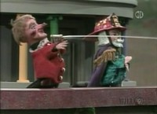
Westmoreland Fayette WDA Hot Jobs
By Volume Growth:
Cooks, Restaurant
Home Health & Personal Care Aides
Fast Food & Counter Workers
Laborers & Material Movers
Waiters & Waitresses
Hairdressers & Cosmetologists
Fitness Trainers & Aerobics Instructors
Bartenders
Stockers & Order Fillers
Heavy & Tractor-Trailer Truck Drivers
By Percent Growth:
Cooks, Restaurant
Fitness Trainers & Aerobics Instructors
Bartenders
Hairdressers & Cosmetologists
Hosts & Hostesses
Software Developers & QA Analysts
Supervisors – Food Prep and Serving Workers
Industrial Machinery Mechanics
Dishwashers
Waiters & Waitresses
Annual Demand:
Fast Food & Counter Workers
Cashiers
Laborers & Material Movers
Home Health & Personal Care Aides
Retail Salespersons
Waiters & Waitresses
Stockers & Order Fillers
Cooks, Restaurant
Office Clerks, General
Heavy & Tractor-Trailer Truck Drivers
Traditional
Emerging
Foundational
Min. employment level of 500 for WDA
Green = Today
Red = Tomorrow
Blue = Future

Slide 9
Projections Demand Overview
Westmoreland and Fayette Counties WDA
Occupational Employment
2020-2030 Long-Term Projections
SOC Code | Occupational Title | Educ. Level | Employment Outlook |  |  | Annual Demand
 |  |  | Estimated | Projected | Percent | Due to | Due to | Due to | Total
 |  |  | 2020 | 2030 | Change | Growth1/ | Exits 2/ | Transfers 3/ | Demand 4/
35-2014 | Cooks, Restaurant | MT OJT | 2,130 | 3,090 | 45.1% | 97 | 154 | 223 | 474
39-9031 | Fitness Trainers & Aerobics Instructors | ST OJT | 560 | 810 | 44.6% | 25 | 40 | 65 | 130
15-1256 | Software Developers & QA Analysts | BD | 540 | 640 | 18.5% | 10 | 14 | 29 | 53
39-5012 | Hairdressers, Hairstylists & Cosmetologists | PS | 1,540 | 1,910 | 24.0% | 37 | 91 | 96 | 224
49-9041 | Industrial Machinery Mechanics | LT OJT | 1,080 | 1,270 | 17.6% | 19 | 36 | 63 | 118
35-3011 | Bartenders | ST OJT | 770 | 1,010 | 31.2% | 24 | 40 | 108 | 172
35-1012 | Supervisors - Food Preparation & Serving Workers | WK EXP | 840 | 990 | 17.9% | 15 | 41 | 93 | 149
35-9021 | Dishwashers | ST OJT | 600 | 700 | 16.7% | 10 | 49 | 54 | 113
31-1120 | Home Health & Personal Care Aides | ST OJT | 5,690 | 6,380 | 12.1% | 69 | 386 | 342 | 797
35-9031 | Hosts & Hostesses: Restaurant, Lounge & Coffee Shop | ST OJT | 550 | 660 | 20.0% | 11 | 72 | 68 | 151
35-3031 | Waiters & Waitresses | ST OJT | 3,000 | 3,440 | 14.7% | 44 | 236 | 384 | 664
53-7062 | Laborers & Freight, Stock & Material Movers | ST OJT | 5,650 | 6,180 | 9.4% | 52 | 259 | 515 | 826
53-3032 | Heavy & Tractor-Trailer Truck Drivers | PS | 3,530 | 3,750 | 6.2% | 22 | 149 | 247 | 418
35-3023 | Fast Food & Counter Workers | ST OJT | 5,470 | 6,110 | 11.7% | 64 | 561 | 612 | 1,237
53-7065 | Stockers & Order Fillers | ST OJT | 3,170 | 3,410 | 7.6% | 24 | 187 | 320 | 531
41-2031 | Retail Salespersons | ST OJT | 4,970 | 5,010 | 0.8% | 4 | 279 | 412 | 695
41-2011 | Cashiers | ST OJT | 5,410 | 5,080 | -6.1% | -33 | 446 | 502 | 915
43-9061 | Office Clerks, General | ST OJT | 4,290 | 4,040 | -5.8% | -25 | 227 | 247 | 449

Slide 10
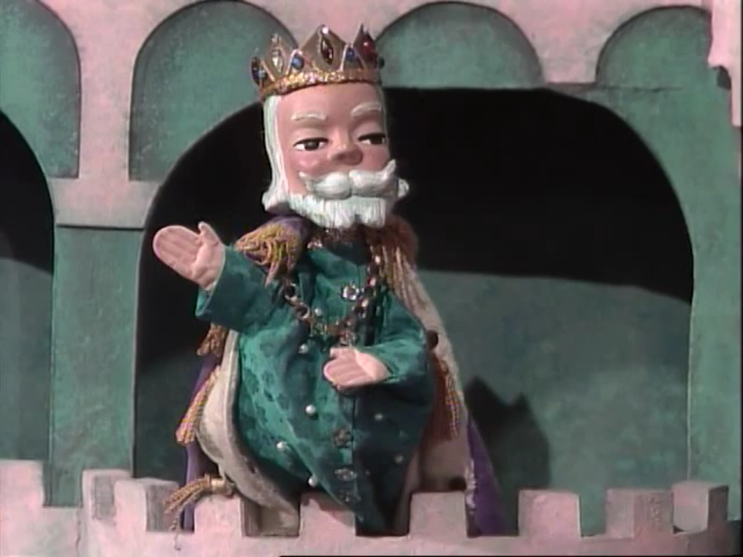
How do I understand the current demand of the labor market?

Slide 11
Online Job Postings Dashboard Overview:
Data Source: The Conference Board - LightCast - Help Wanted OnLineTM
The Conference Board uses their technology to spider job postings from a long list of online job boards including the PA CareerLink® System
Job Postings data is de-duplicated and ads are broken out into three categories – new, existing and total ads
Available by industry and occupation
Also presents information on skills and certifications

Slide 12
Utilizing Job Postings
Westmoreland and Fayette Counties WDA
Occupational Outlook
SOC Code | Occupational Title | Educ. Level | Annual Demand |  |  |  | Job Postings
 |  |  | Due to | Due to | Due to | Total | February | February | Volume
 |  |  | Growth | Exits | Transfers | Demand | 2023 | 2024 | Change
35-2014 | Cooks, Restaurant | MT OJT | 97 | 154 | 223 | 474 | 36 | 32 | -4
39-9031 | Fitness Trainers & Aerobics Instructors | ST OJT | 25 | 40 | 65 | 130 | 7 | 7 | 0
15-1256 | Software Developers & QA Analysts | BD | 10 | 14 | 29 | 53 | 42 | 30 | -12
39-5012 | Hairdressers, Hairstylists & Cosmetologists | PS | 37 | 91 | 96 | 224 | 12 | 23 | 11
49-9041 | Industrial Machinery Mechanics | LT OJT | 19 | 36 | 63 | 118 | 3 | 11 | 8
35-3011 | Bartenders | ST OJT | 24 | 40 | 108 | 172 | 18 | 31 | 13
35-1012 | Supervisors - Food Preparation & Serving Workers | WK EXP | 15 | 41 | 93 | 149 | 37 | 65 | 28
35-9021 | Dishwashers | ST OJT | 10 | 49 | 54 | 113 | 26 | 43 | 17
31-1120 | Home Health & Personal Care Aides* | ST OJT | 69 | 386 | 342 | 797 | 219 | 302 | 83
35-9031 | Hosts & Hostesses: Restaurant, Lounge & Coffee Shop | ST OJT | 11 | 72 | 68 | 151 | 13 | 18 | 5
35-3031 | Waiters & Waitresses | ST OJT | 44 | 236 | 384 | 664 | 53 | 70 | 17
53-7062 | Laborers & Freight, Stock & Material Movers* | ST OJT | 52 | 259 | 515 | 826 | 80 | 119 | 39
53-3032 | Heavy & Tractor-Trailer Truck Drivers* | PS | 22 | 149 | 247 | 418 | 61 | 91 | 30
35-3023 | Fast Food & Counter Workers* | ST OJT | 64 | 561 | 612 | 1,237 | 84 | 122 | 38
53-7065 | Stockers & Order Fillers* | ST OJT | 24 | 187 | 320 | 531 | 82 | 93 | 11
41-2031 | Retail Salespersons* | ST OJT | 4 | 279 | 412 | 695 | 328 | 328 | 0
41-2011 | Cashiers | ST OJT | -33 | 446 | 502 | 915 | 30 | 47 | 17
43-9061 | Office Clerks, General | ST OJT | -25 | 227 | 247 | 449 | 33 | 34 | 1
Among the TOP 20 in terms of posting count in Feb. 2024

Slide 13
Thank you! Questions?

