Slide 1


Selecting the Right Sweater & Shoes
Workforce Information Forum
April 2024

Slide 2

Industry vs. Occupation
Much of CWIA’s data is assigned a classification code:
  Industry: North American Industry Classification System (NAICS) code
  Occupation: Standard Occupational Classification System (SOC) code
While these terms are often confused and used interchangeably, they are in fact very different when it comes to selecting the right data
  Industry refers to the type of business or organization where an individual works
  Occupation refers to the job duties that an individual actually performs at their place of work
An industry has workers in various occupations while a single occupation can be found in many different industries
  Industry: Hospital or Candy Manufacturer
  Occupation: Registered Nurse or Packaging Machine Operator
Example: In the LMI world, Information Technology (IT) is NOT an industry. Rather it is a set of computer-related occupations that are found across many different industries.

Slide 3

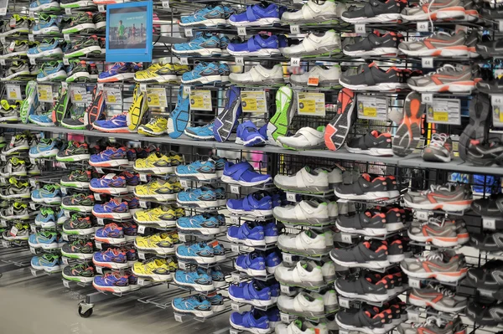


Slide 4
Employment

Slide 5

How many people were employed in PA in 2022?
5,810,560
5,863,300
5,984,100
6,196,000
6,289,310
– Occupational Employment & Wage Statistics (OEWS)
– Quarterly Census of Employment & Wages (QCEW)
– Current Employment Statistics (CES)
– Local Area Unemployment Statistics (LAUS)
– Employment Projections
All are correct…but HOW?

Slide 6
OEWS
PA focuses on wage data output from OEWS but employment also available
Non-mandatory survey of employers (45,000 to 50,000 in PA) pulled from QCEW
Three years sample (six semi-annual panels)
Point in time estimates – not a time-series and not adjusted for seasonality
Based on where the work is being performed
Individuals counted for each job held
Data released annually for the previous year; usually in May
Presented down to the six-digit SOC level, when releasable
Produced uniformly nationwide - allows for comparisons across state borders and among sub-state regions
  Pennsylvania and Metropolitan Statistical Areas (MSAs)
  Workforce Development Areas (WDAs) and Counties – unique for PA

Slide 7
QCEW
Referred to as the “universe”
  Census of all Unemployment Insurance (UI) covered employers
  Roughly 96% of all PA employment captured
Serves as the basis for other programs’ samples
Can compare to same quarter previously, but not adjusted for seasonality
Based on where the work is being performed
Individuals counted for each job held
Data available about 5 months after quarter ends
Presented down to the 6-digit NAICS level, when releasable
Available by ownership and size class
Produced uniformly nationwide - allows for comparisons across state borders and among sub-state regions (i.e. Metropolitan Statistical Areas (MSAs), Workforce Development Areas (WDAs) and Counties)

Slide 8
CES
Monthly payroll survey of about 25,000 nonfarm establishments pulled from QCEW
Time-series and seasonally-adjusted estimates allow for comparisons between different months
Based on where the work is being performed
Individuals counted for each job held
Data released monthly; roughly one month after the reference month
Presented down to the sector level; some sub-sector detail
Produced uniformly nationwide - allows for comparisons across state borders and among sub-state regions
  Pennsylvania and Metropolitan Statistical Areas (MSAs)
  32 Non-MSA Counties – unique for PA

Slide 9
LAUS
Key input: Current Population Survey (CPS), a survey of ~60,000 U.S. households (PA sample is ~2,000)
  CES jobs and Unemployment Insurance (UI) claims also inputs
Time-series and seasonally-adjusted estimates allow for comparisons between different months
Based on where the individual resides
Individuals counted only once
Data released monthly; roughly one month after the reference month
No industry, occupational, or ownership detail
Produced uniformly nationwide - allows for comparisons across state borders and among sub-state regions
  Pennsylvania
  Metropolitan Statistical Areas (MSAs) and Workforce Development Areas (WDAs)
  Counties
  Selected Minor Civil Divisions (cities, townships, boroughs)
  Other groupings (i.e., Labor Market Areas, Combined MSAs, Metro Divisions)

Slide 10
Employment Projections
Key inputs: QCEW (industry) and OEWS (occupational) data
More complete measure – includes agriculture, private household, self-employed
Point in time estimates – not a time-series and not adjusted for seasonality
Based on where the work is being performed
Individuals counted for each job held
Data released every two years
Presented down to the 4-digit NAICS and 6-digit SOC level, when releasable
Produced using a national model - allows for comparisons across state borders and among sub-state regions
  Pennsylvania
  Metropolitan Statistical Areas (MSAs)
  Workforce Development Areas (WDAs)

Slide 11
Summary Matrix
Characteristic | OEWS | QCEW | CES | LAUS | Projections
Sample Size | ~50,000 estabs | Census | ~25,000 estabs | Census | N/A
Coverage | UC-covered | UC-covered | Non-farm | All* | All*
Frequency | Annual | Quarterly | Monthly | Monthly | Bi-annually
Timeliness | One year | Six months | One month | One month | Two years
Representation | Jobs | Jobs | Jobs | People | Jobs
Multiple Job Holders | All | All | All | Once | All
Location | Work | Work | Work | Residence | Work
Industry/Occupation | Occupation | Industry | Industry | Neither | Both
Seasonal Adjustment | No | No | Yes | Yes | No
Geography
Statewide | X | X | X | X | X
MSA | X | X | X | X | X
WDA | X | X |  | X | X
County | X | X |  | X
Cities (Pop. >25,000) |  |  |  | X

Slide 12
Scenarios
Scenario | Employment Type
A reporter is doing a story on the current state of their local economy and wants to include a focus on “workers”. | LAUS – looks at people who live in the area CES – ‘real-time’ assessment of filled jobs in local industry
An educator is collaborating with workforce developers and employers in their area to evaluate current, and plan future, training program offerings at their institution. | Projections – indication of those currently employed in an occupation, which can be aligned to a training program, as well as future demand for similar workers
Economic developers are wooing a company to build their new establishment, or expand an existing presence, in the region. | QCEW – more complete picture of industry trends over time to evaluate market competition Projections – industry/occupational outlook of the potential employer as well as related sectors
Another government agency is asking about the status of childcare workers since the pandemic. | OEWS – more current occupational picture, and possibly some data on wage variations by industry, but less complete employment picture – especially regarding the self-employed.
Scenario | Employment Type
A reporter is doing a story on the current state of their local economy and wants to include a focus on “workers”. | LAUS – looks at people who live in the area CES – provides a ‘real-time’ assessment of jobs
Scenario | Employment Type
A reporter is doing a story on the current state of their local economy and wants to include a focus on “workers”. | LAUS – looks at people who live in the area CES – ‘real-time’ assessment of filled jobs in local industry
An educator is working with workforce developers and employers in their area to evaluate current, and plan future, training program offerings at their institution. | Employment Projections – indication of those currently employed in an occupation, which can be aligned to a training program, as well as future demand for similar workers
Scenario | Employment Type
A reporter is doing a story on the current state of their local economy and wants to include a focus on “workers”. | LAUS – looks at people who live in the area CES – ‘real-time’ assessment of filled jobs in local industry
An educator is collaborating with workforce developers and employers in their area to evaluate current, and plan future, training program offerings at their institution. | Projections – indication of those currently employed in an occupation, which can be aligned to a training program, as well as future demand for similar workers
Economic developers are wooing a company to build their new establishment, or expand an existing presence, in the region | QCEW – more complete picture of industry trends over time to evaluate market competition Projections – industry/occupational outlook of the potential employer as well as related sectors

Slide 13

Unemployment vs.
Unemployment

Slide 14
How many unemployed persons were there in PA in February 2024?
220,000 – Unemployment from Local Area Unemployment Statistics (LAUS)
10,469 – Initial Claims for week ending 2/17/24
119,990 – Continued Claims for week ending 2/17/24
3.4% – Unemployment Rate
62.5% - Labor Force Participation Rate (Percentage of the population that is either working or actively looking for work)
60.4% - Employment to Population Ratio (Percentage of the population that is currently working)
Note: Doesn’t include those “not in the labor force”, often referred to as ‘discouraged workers”.

Slide 15
LAUS Math Class
Civilian Labor Force = Employed + Unemployed
Unemployment Rate
=
Unemployment
Labor Force
Labor Force
Total Non-Institutional Civilian Population
Labor Force Participation Rate
=
Employed
Total Non-Institutional Civilian Population
Employment to Population Ratio
=

Slide 16
Unemployment Compensation
Pulled directly from the Unemployment Compensation (UC) system
Only includes persons who request/receive UC benefits
Point in time counts – data are not adjusted for seasonality
Data released weekly, the week following the reference period
Industry and demographic details (i.e., age, race, gender, etc.) available
Available statewide or by county of residence
Initial Claim | Any notice filed to request determination of UC eligibility.
Continued Claims | Subsequent weeks for which benefits are paid if claimant meets requirements.
First Payment | Payment rec’d the first week for which a claimant files a claim & meets req’s.
Weeks Compensated | Weeks for which a claimant receives benefit payments.
Final Payment | Last payment a claimant receives because they have exhausted their full entitlement of benefits.

Slide 17
Wages

Slide 18
Industry Wages - CES
Estimated and released monthly through a non-mandatory survey of employers
Includes average hourly earnings, average weekly earnings, and average weekly hours for private industry workers as well as for statewide manufacturing production workers
All Employees A&E: PA and Metropolitan Statistical Areas Production Workers H&E: PA only
Produced uniformly nationwide – comparable within and across state borders
Not benchmarked

Slide 19
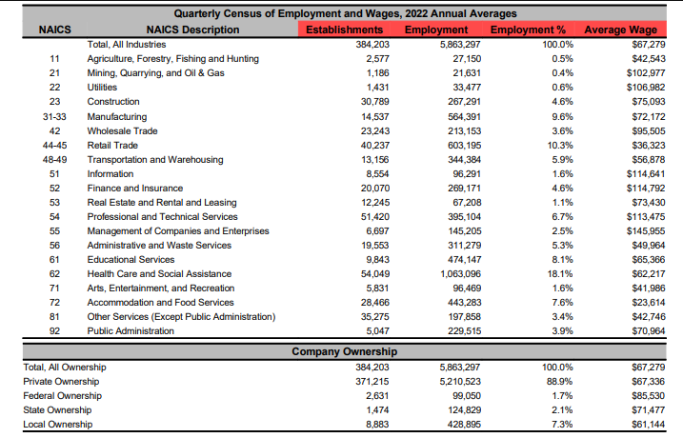
Industry Wages - QCEW
Gathered quarterly from Unemployment Insurance (UI) Tax Returns of employers
Released quarterly…Published quarterly and as an annual average
Includes all UI taxable compensation, including bonuses, stock options, severance pay, profit distributions, tips and other gratuities paid during the quarter
Produced uniformly nationwide – comparable across state borders and within the state
Available for PA, County, Metropolitan Statistical Areas & Workforce Development Areas

Slide 20
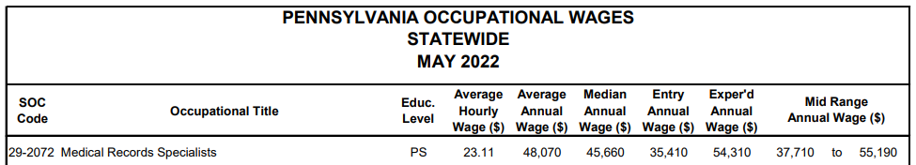
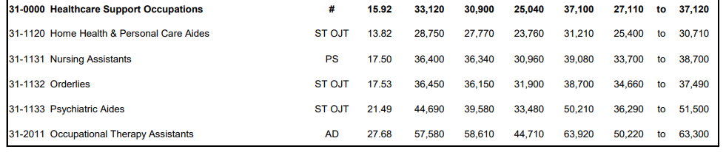
Occupational Wages
Gathered semi-annually through a non-mandatory survey of employers
Released annually; usually in April
Includes Entry, Average & Experienced-level wages for more than 800 occupations
Produced uniformly nationwide – compare across state borders and within the state
Available for PA, Metropolitan Statistical Area, Workforce Development Area & County
Minimum educational attainment levels shown for each occupation

Slide 21
Customers Choice?
Customer Group | CES | QCEW | OEWS
Employer |  | X | X
Jobseeker |  |  | X
Educator |  |  | X
Economic Developer | X | X | X
Student |  |  | X
Media | X | X | X
Government | X | X | X
Grant Writers |  | X | X

Slide 22
Demand

Slide 23
In-Demand Jobs
What jobs are “in-demand” in my area?
Projections
  Recent employment counts and future demand for workers
  Industry and occupation
  Delayed availability (two-year lag, 10-year outlook)
  National, statewide and sub-state coverage
On-line Job Postings (HWOL)
  Recent job postings
  Industry, occupation, skills, and certifications
  Timely availability (previous month and one-year ago)
  Statewide and sub-state coverage
Job Openings and Labor Turnover Survey (JOLTS): https://www.bls.gov/jlt/
  Openings, hires and separation rates
  Unemployed persons per opening ratio
  Totals (some industry data for nation)
  Timely availability (~two-month lag; historical data available)
  National and statewide (limited)

Slide 24

Thank you! Questions?

