Slide 1
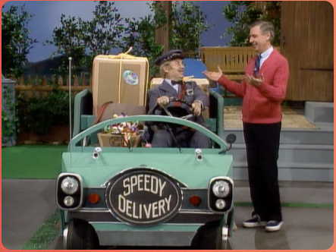
Speedy Delivery: Delivering your Neighborhood News via CWIA’s website
Labor Market Information Forum:
Workforce Information Forum
April 2024

Slide 2
2

Slide 3
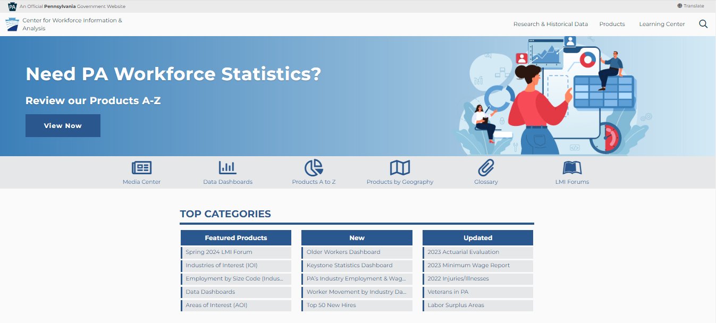
www.workstats.dli.pa.gov

Slide 4
Home Page – Top Navigation
The menu located in the top right-hand corner of our website contains three main areas:
Research & Historical Data
Products
Learning Center
These three areas will provide access to the contents of our entire website.
4

Slide 5
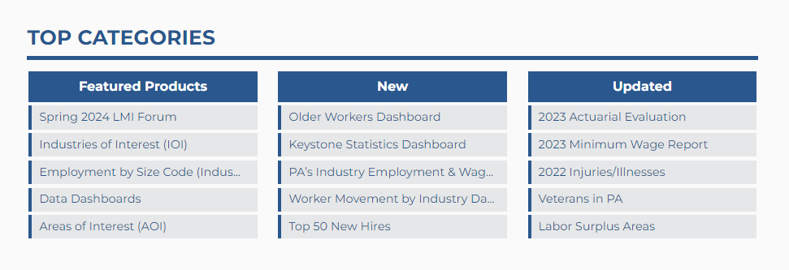
Home Page – Top Categories
On the homepage you will find content boxes that highlight featured, new, and recently updated information.
5

Slide 6
Products Menus

Slide 7
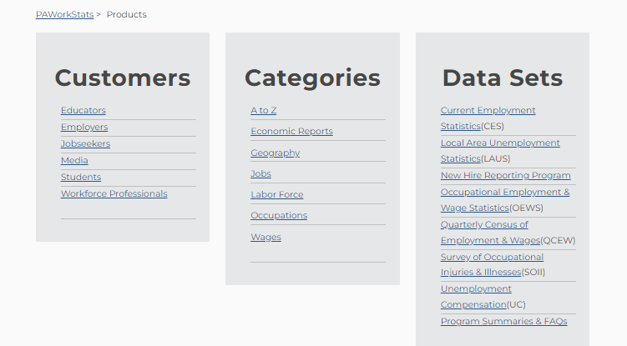
Products by Category
https://www.workstats.dli.pa.gov/Products/ByCategory/Pages/default.aspx

Slide 8
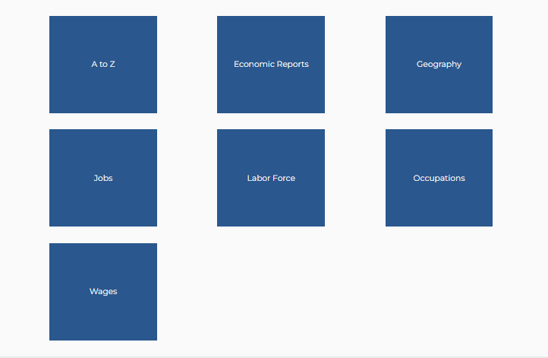
Products by Category
https://www.workstats.dli.pa.gov/Products/ByCategory/Pages/default.aspx

Slide 9
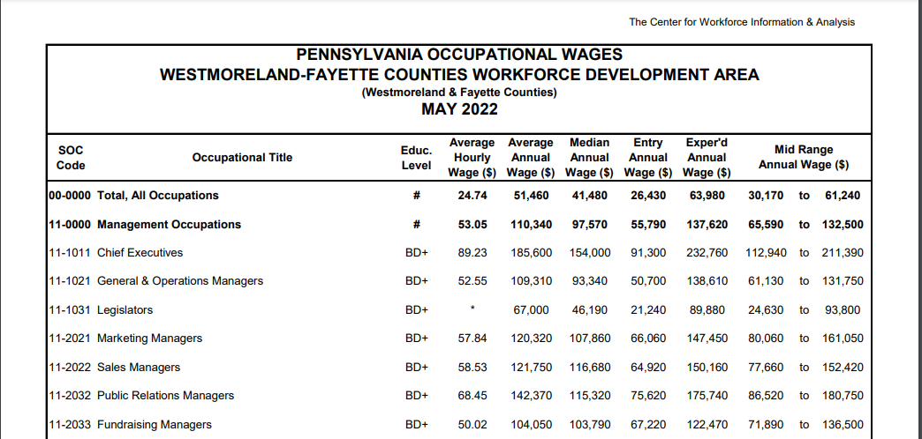
Products by Category
Occupations
Occupational Wages

Slide 10
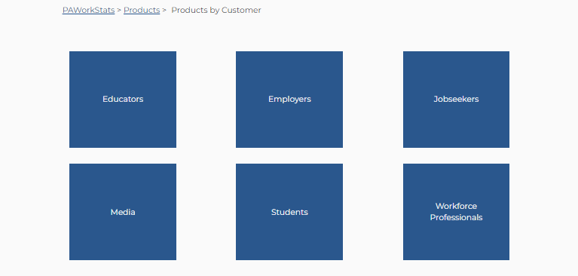
Products by Customer
An attempt to align products with customer groups – products overlap customer groups and are included in each
https://www.workstats.dli.pa.gov/Products/ByCustomer/Pages/default.aspx

Slide 11
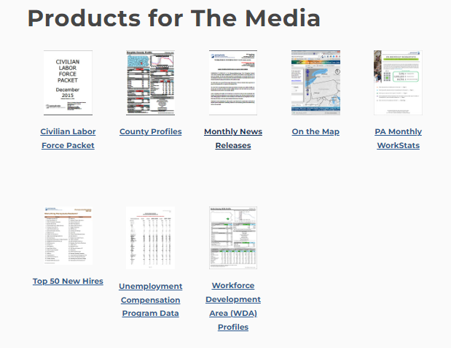
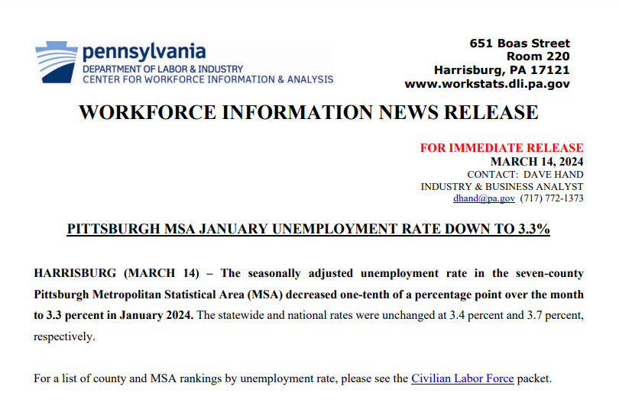
Products by Customer
Media
Monthly News Release
News Releases available by:
Metropolitan Statistical Area (MSA)
Micropolitan Statistical Area (mSA)
Labor Market Area

Slide 12
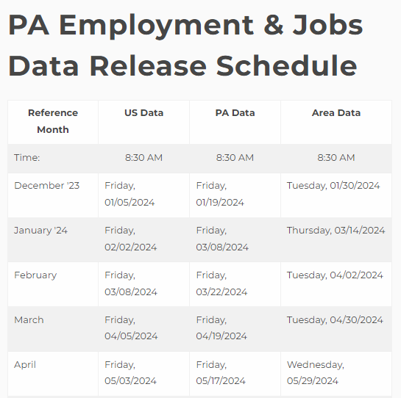
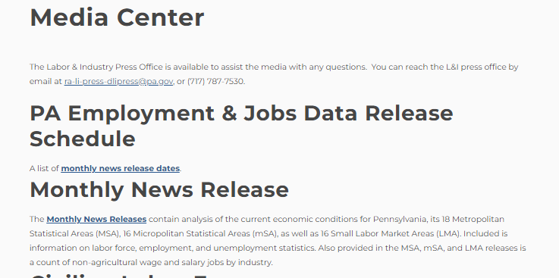
Media Center – Employment & Jobs Data Release Schedule
https://www.workstats.dli.pa.gov/MediaCenter/Pages/ReleaseSchedule.aspx

Slide 13
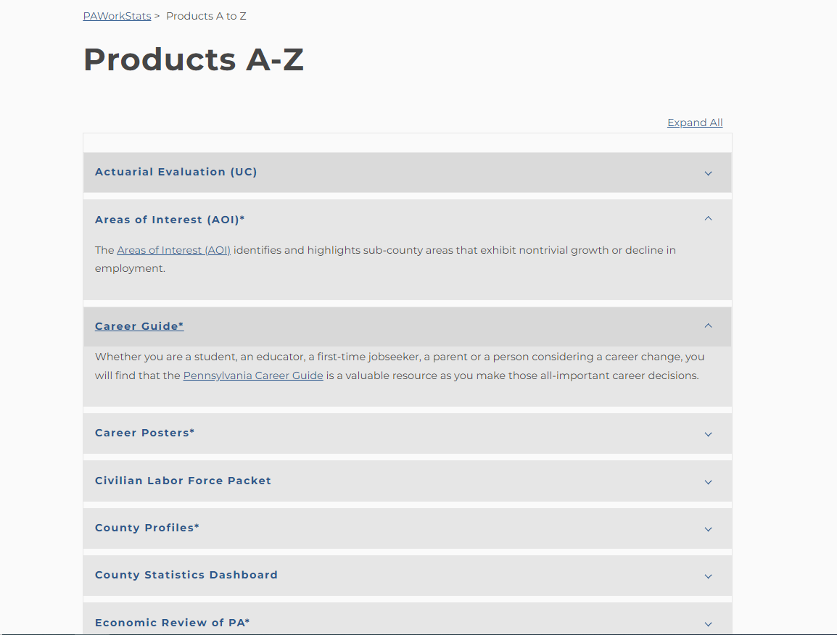
Products A to Z
An alphabetical listing of all products located on the website:

Slide 14
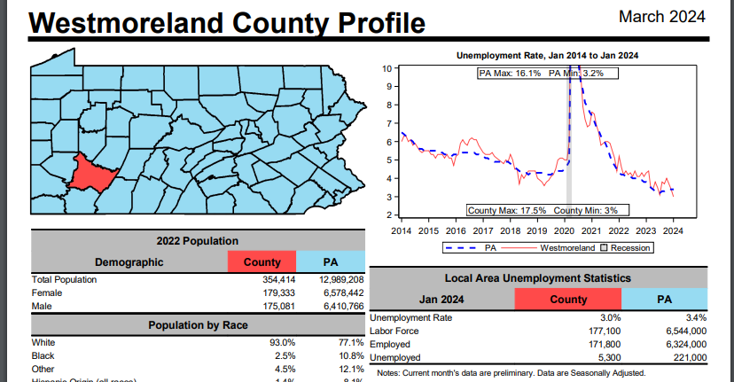
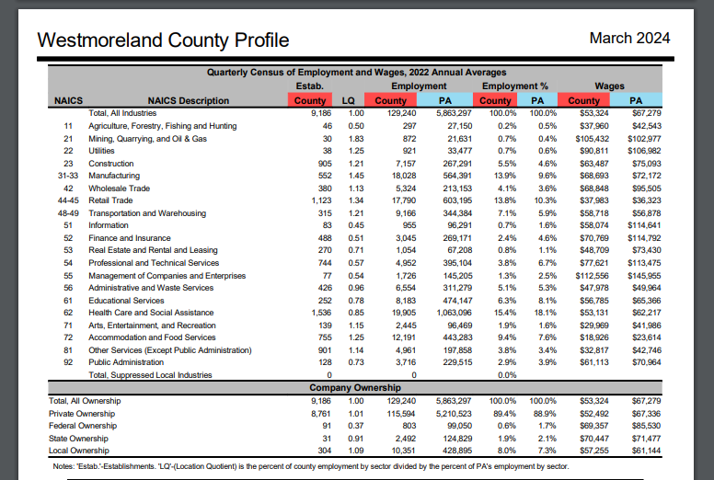
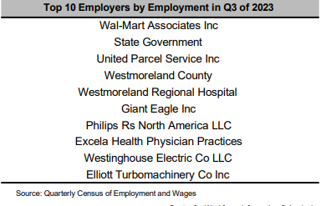
Products A to Z
County Profile

Slide 15
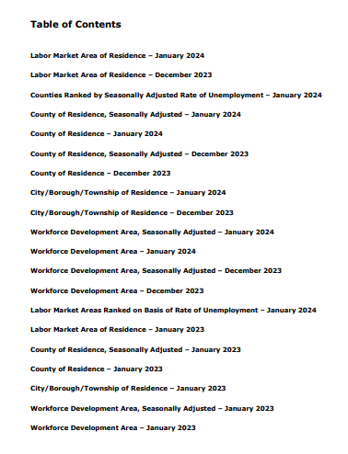
Products by Geography
Civilian Labor Force Packet

Slide 16
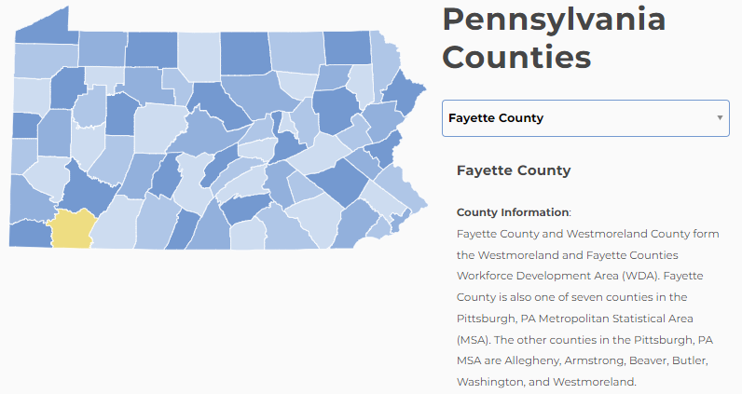
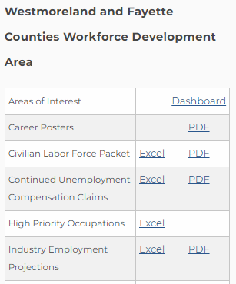
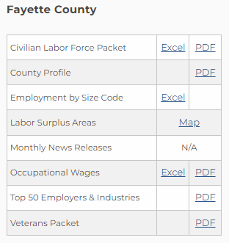
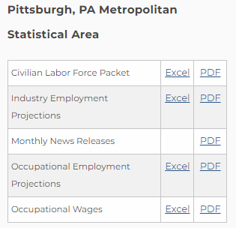
Products by Geography
A customized listing of all products containing data for your county, workforce development area (WDA), and metropolitan statistical area (MSA)
https://www.workstats.dli.pa.gov/Products/Pages/Products%20By%20Geography.aspx

Slide 17
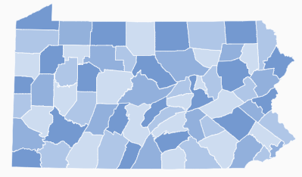
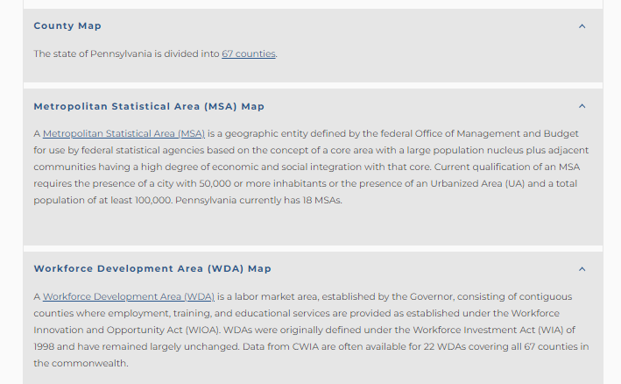
Products by Geography
Maps

Slide 18
Research & Historical Data
Menu

Slide 19
Research & Historical Data
The “Research & Historical Data” portion of our website allows you to download historical occupational, industry, and labor force data for analysis.
Today, we are going to demonstrate with just one of these three types of data because the process is similar for each. We will demonstrate the Quarterly Census of Employment & Wages (QCEW) data.
The slides that follow use screenshots to walk you through the menus that you will see and the clicks you will need to make in order to access the QCEW data. As mentioned above, you can use these same clicks to access CES, OEWS and LAUS data as well. Remember that these are our four “core data sets” that we like to refer to as our “building blocks.”
We’ve also included some tips for the “dos and don’ts” of this area of our website.
19

Slide 20
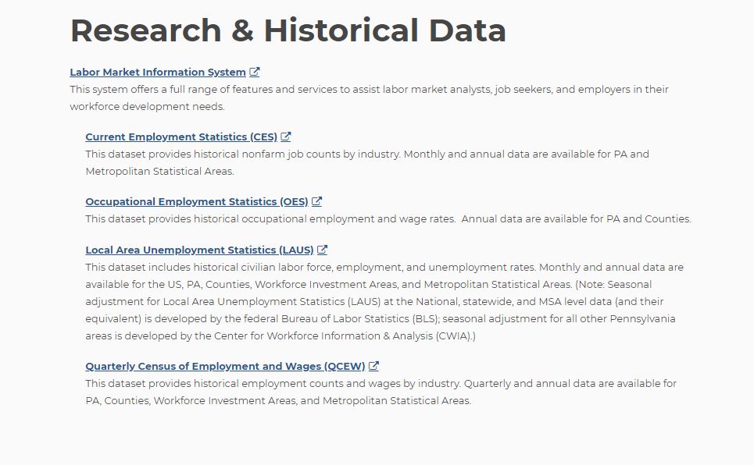
Research & Historical Data
These links can and should be bookmarked for future use and direct access to historical data
20

Slide 21
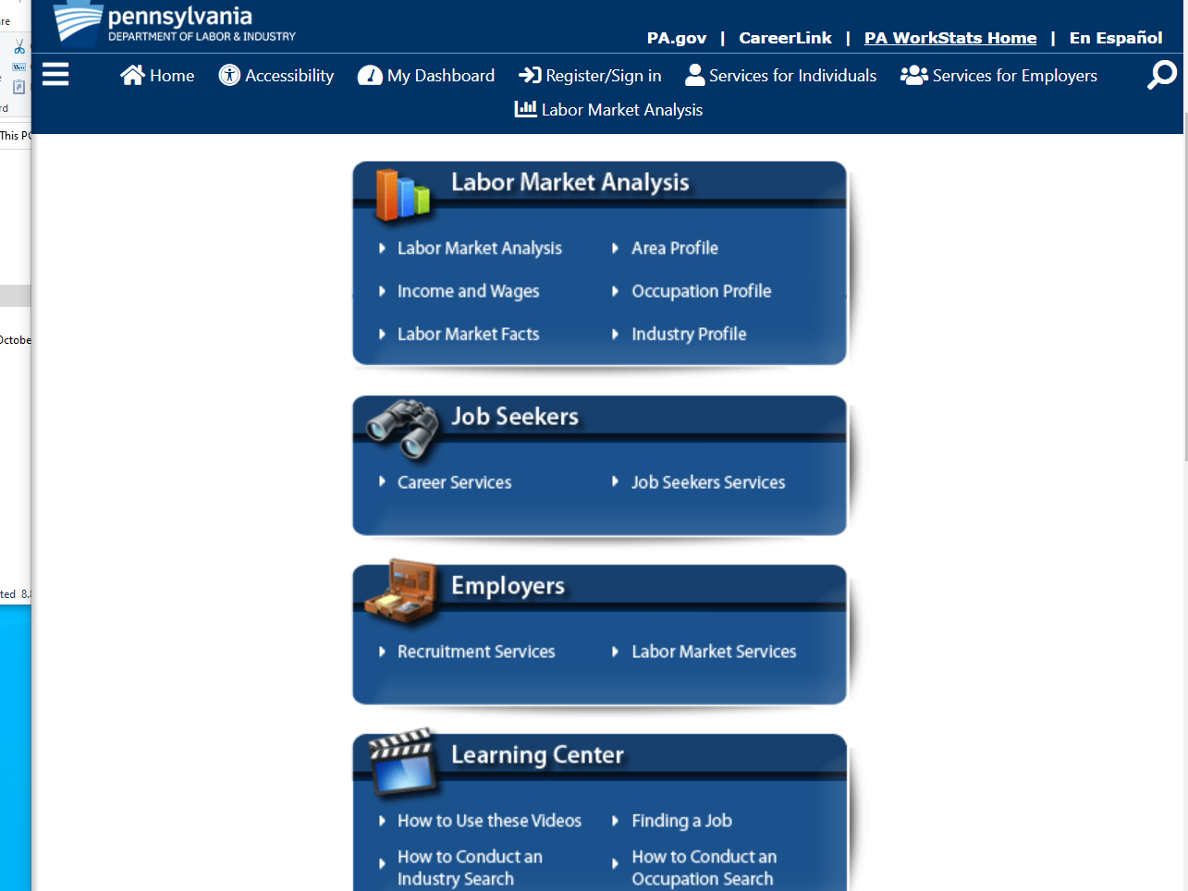
Research & Historical Data
Click the triple bar or “hamburger” symbol (labeled menu if on a large enough screen) to expand a menu of options
21

Slide 22
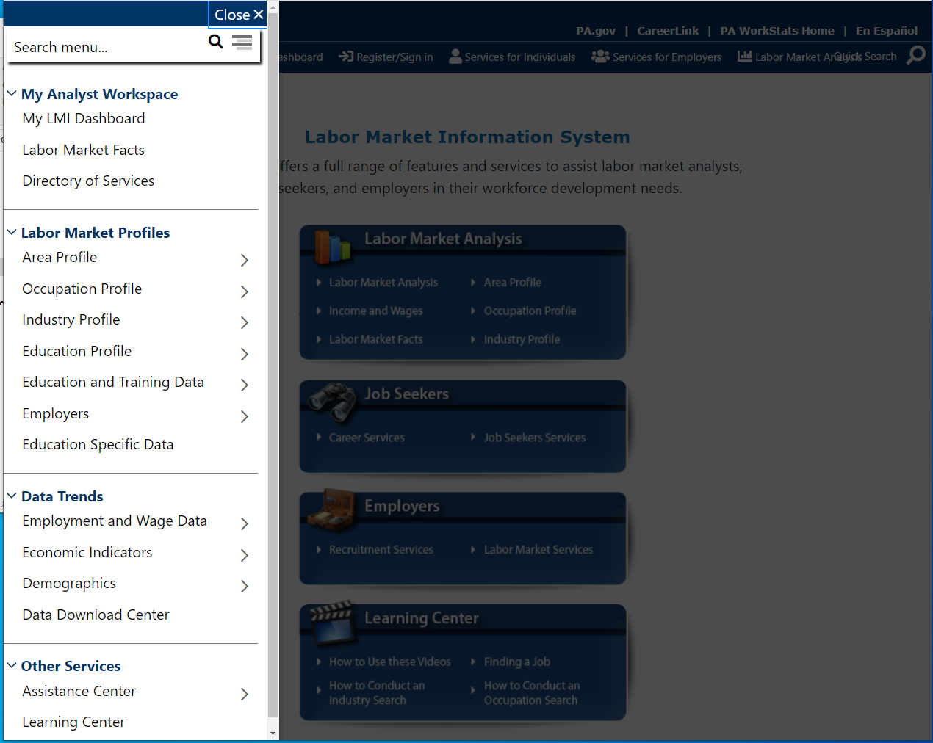
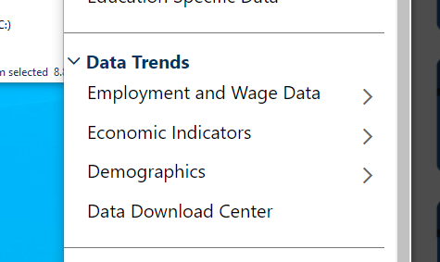
Research & Historical Data
The “Data Trends” menu is the most important area of this portion of our website
Here you can access and download historical data.
22

Slide 23
Research & Historical Data
From here the menus that follow will look different depending on what you click but you will arrive at the same information.
If you click on the actual text you will see menus like those depicted on the next slide (slide 24)
If you click on the arrow icons (>) you will see menus like those depicted on slide 25
23

Slide 24
Research & Historical Data - QCEW Data
If you click on the actual text in the “Data Trends” menu you will see menus formatted like the ones below.
24

Slide 25
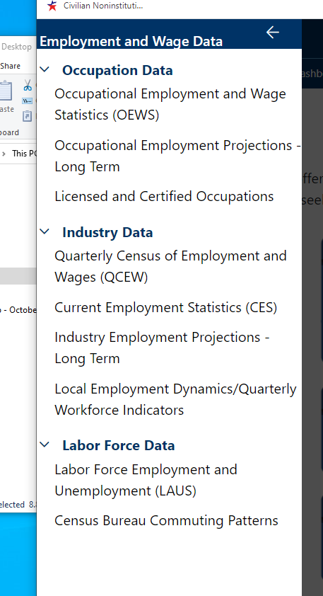
Research & Historical Data – QCEW Data
If you click on the arrow icons (>) you will see menus formatted like the one to the right rather than the ones shown on the previous slide
25

Slide 26
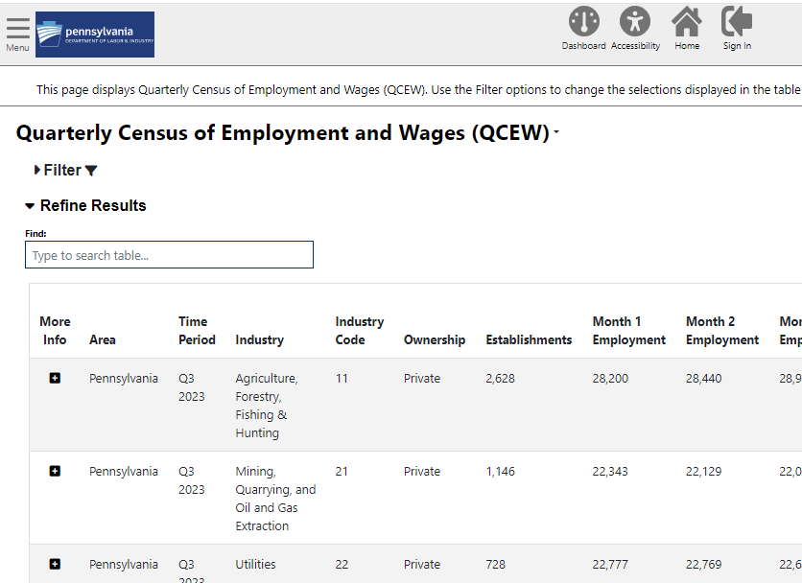
Research & Historical Data – QCEW Data
To view and download data, click the filter button to expand a menu of choices
26

Slide 27
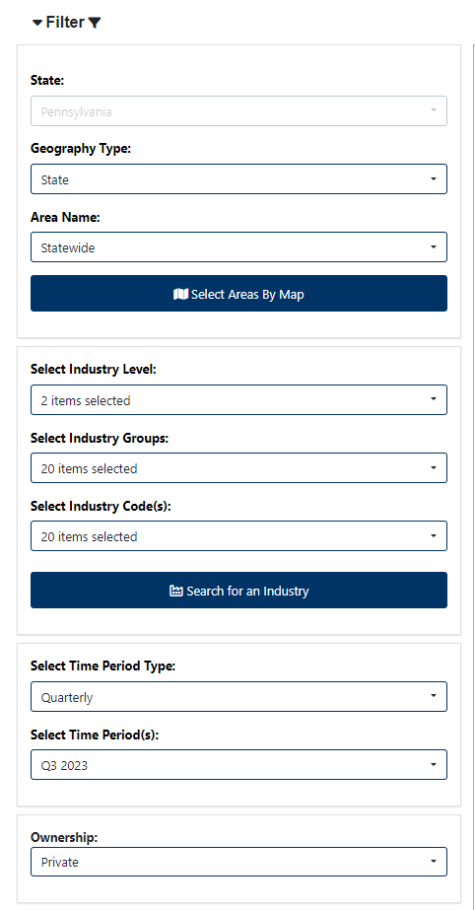
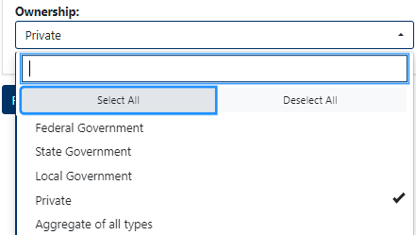
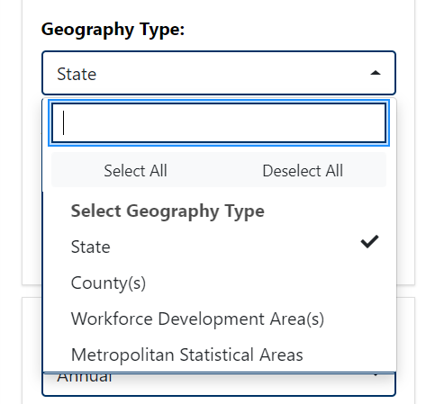
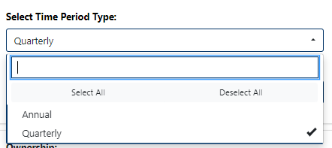
Research & Historical Data – QCEW Data
Expand the filters to the left to view choices for geography, industry (NAICS) level, time period, ownership etc.
The number of results displayed can be adjusted below the table and there are multiple options for downloading the data
27

Slide 28
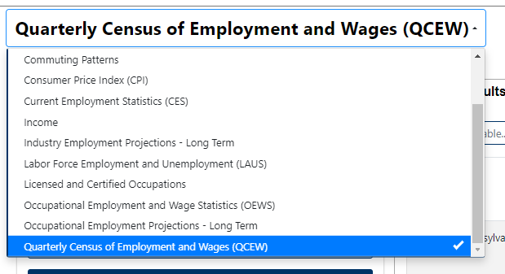
Research & Historical Data – Data Download Center
Shortcut for navigating between data sets:
Use the drop-down menu at the top of the page to switch from one dataset to another. This will save you from having to go back to the menu on the left and making several clicks.
28

Slide 29
Research & Historical Data – Data Download Center
The “Data Download Center” is another way to access historical data.
29

Slide 30
Research & Historical Data – Data Download Center
30

Slide 31
Research & Historical Data
Access through Research & Historical side:
Access through WorkStats side
(less clicks – can bookmark these links):
31

Slide 32
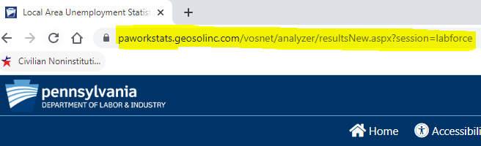
Research & Historical Data
Links copied from the Research side of the website can’t be bookmarked
Links copied from the WorkStats side of the website CAN be bookmarked:
https://paworkstats.geosolinc.com/vosnet/analyzer/resultsNew.aspx?session=labforce
Right-click the link and click “copy link address” to copy/save the link
https://paworkstats.geosolinc.com/altentry.asp?action=lmiguest&whereto=LABFORCEDATA
32

Slide 33
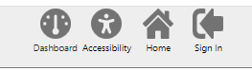
Research & Historical Data – Returning to WorkStats Website
Q: How do I return to the “WorkStats” side of the website after I’m finished on the “Research & Historical Data” side?
A: When you open the “Research & Historical Data” link it should open in a new browser leaving the “WorkStats” area of the website untouched. If the browser tab is still open, you can simply click on the other tab to return to the WorkStats website.
If for some reason you’ve closed the other tab, you can return to the WorkStats area by first clicking the “home” button to return to the homepage for “Research & Historical Data” and then clicking the “PA WorkStats Home” button found in the top right-hand corner of the “Research & Historical Data” area.
33

Slide 34
Learning Center

Slide 35
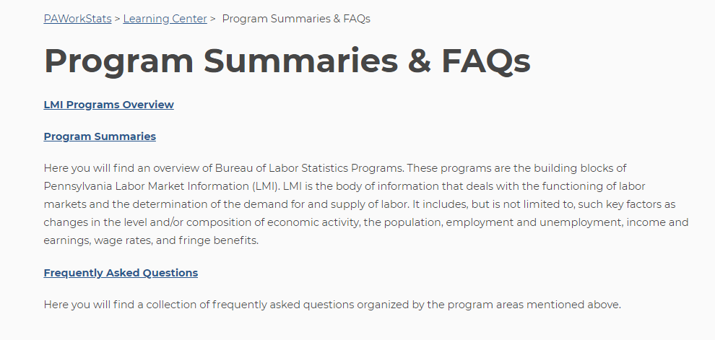
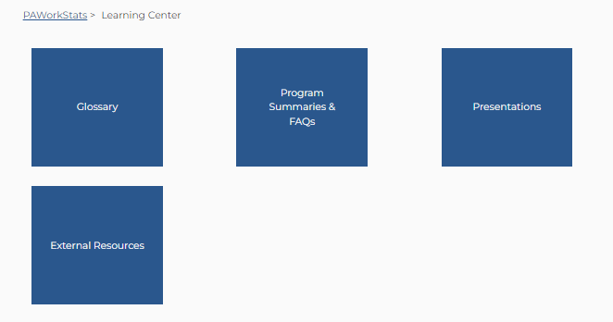
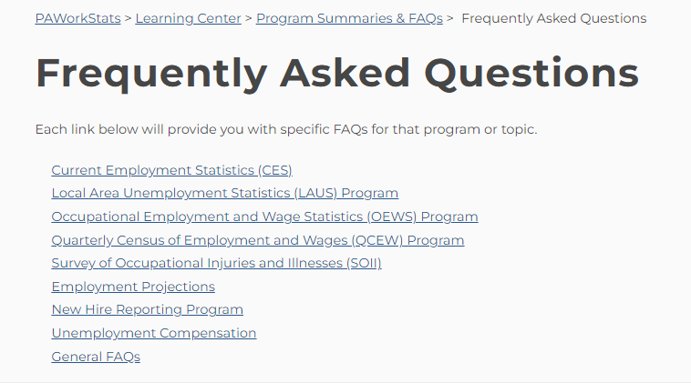
Learning Center – Program Summaries & FAQs

Slide 36
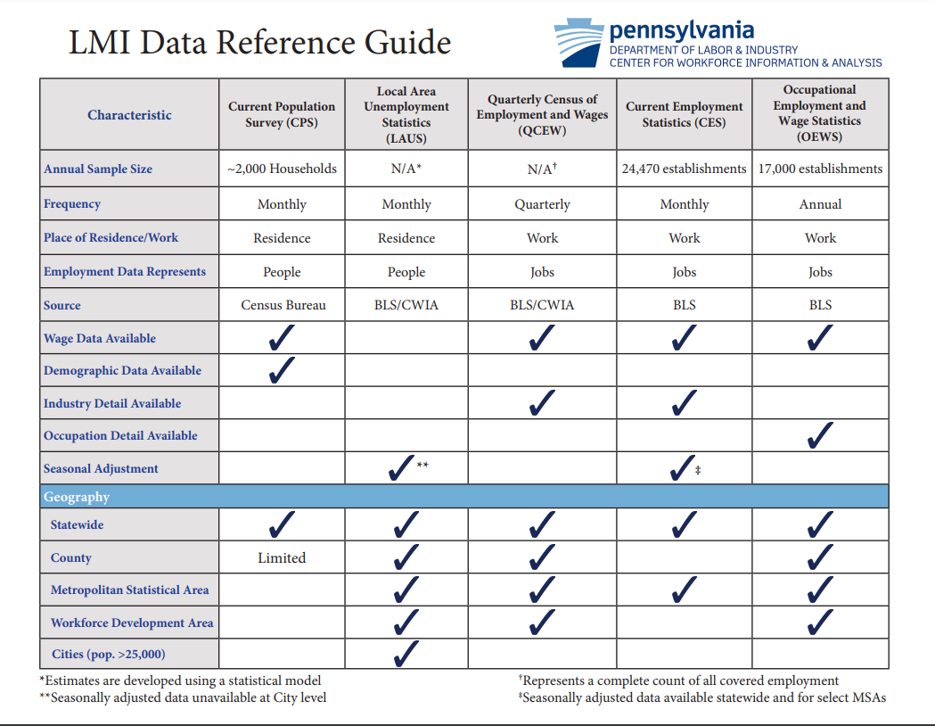

Slide 37
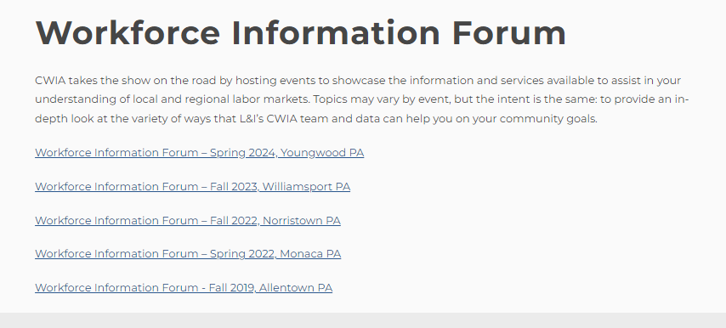
Presentations – Workforce Information Forums Page
https://www.workstats.dli.pa.gov/Products/Presentations/Pages/LMI-Forum-Presentations.aspx

Slide 38
Sign up for our E-mail Distribution List!
We maintain an e-mail distribution list that we use to announce the
release of statewide and local area data, new products, upcoming
LMI Forums, etc.
Please contact us at workforceinfo@pa.gov or 877-493-3282 to be added to the list.
If you remember receiving e-mails from us but haven’t received any recently, please reach out so we can figure out if we need to update your e-mail address or if there may be another issue.
38

Slide 39
Customer Response: 877-493-3282 (877-4WF-Data)
Hours: 8:00 am – 4:00 pm
Email: workforceinfo@pa.gov
Online: www.workstats.dli.pa.gov
A “Contact Us” button appears in the gray footer of every page on the website. The Contact Us page lists our phone number and e-mail address and includes a form that you can fill out and send to us with your questions.
39

Slide 40
Thank you!
Questions?
40

