Slide 1
Learn What Your Neighbors Do
Workforce Information Forum
April 2024

Slide 2
Occupational Products
Career Posters

Slide 3
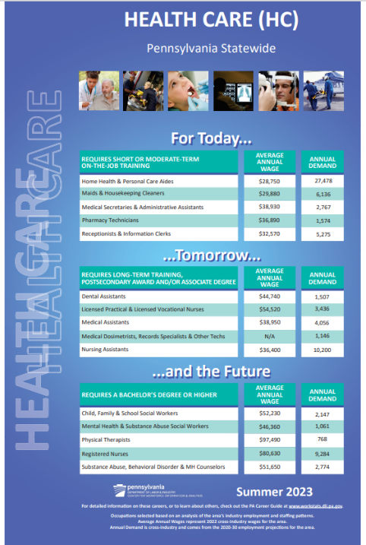
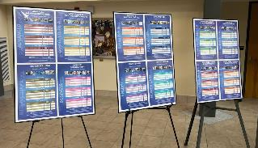
Career Posters
Now Available
Hard copies printed upon request

Slide 4
Occupational Products
PA Career Guide

Slide 5
PA Career Guide – 27th Edition
Includes information on:
Interest assessment
Wage and job outlook information
To-do list for High School students
Alternative options to college- Job Corps, CTE, RAs
Tips for marketing yourself as a jobseeker
Information on PA CareerLink® Offices
Contact information for state agencies
Budget worksheet
Spotlight articles – sports, entertainment & healthcare
Available THIS SUMMER
Hard copies available upon request

Slide 6
PA Career Guide – highlights
Keystone Job Corps Center
Philadelphia Job Corps Center
Pittsburgh Job Corps Center
Red Rock Job Corps Center

Slide 8
Occupational Products
PA IDOL

Slide 9
PA IDOL
What are the goals of the PA IDOL?
Focus career exploration on a subset of more than 800 occupations
Showcase data to help job seekers make informed decisions
Identify careers that are in-demand in Pennsylvania
Highlight viable career choices at all education/training levels – careers for Today, Tomorrow, and the Future
How do occupations get included on the PA IDOL?
Included if they meet all established demand and outlook criteria
No process exists to add occupations to the PA IDOL
How does Career & Technical Education (CTE) use PA IDOL?
Starting with PY2017, CTE rarely uses the HPO list. Previous uses, including equipment grant approvals and connection to industry-recognized credentials, are now evaluated using the PA IDOL
HPO lists come into play for the Eligible Training Provider List (ETPL) and/or work with PA CareerLink® offices (adult training programs)

Slide 10
PA IDOL
www.workstats.dli.pa.gov

Slide 11
Occupational Products
HPOs

Slide 12
High Priority Occupations
What is the purpose of the High Priority Occupation (HPO) list?
Effectively target local workforce training investments in occupations that are in demand by employers, provide family-sustaining wages ($42,004 for the 2024 list), and have higher skill needs
How do occupations get included on HPO lists?
Included if they meet all established demand and outlook criteria in the local Workforce Development Area (WDA):
annual demand & employment change
average wages & wage change
unemployment in occupation
training completers
Opportunity exists for local Workforce Development Board (WDB) and partner customization via a petition process
must come through the WDB
submitted in the designated petition period
adhere to one of the three justification options
Approved petitioned occupations stay on the HPO list for three years

Slide 13
Westmoreland-Fayette 2023 HPO List
www.workstats.dli.pa.gov

Slide 14
Website
www.workstats.dli.pa.gov/
Products
Products by customer
Jobseekers

Slide 15
PA IDOL versus HPOs
 | PA IDOL | HPOs
Goal: | Career exploration tool to identify occupations that are in-demand | Targeted list of occupations used to align local workforce training funding to best fit job prospects
Geography: | Statewide | Local Workforce Development Areas
Timeframe: | Released annually, with HPOs | Annual, Effective August 1-July 31
Data focus: | Employment growth and demand, existing supply | Employment growth and demand, wages and wage change, unemployment, and completers
Coverage: | All occupations – Today, Tomorrow & Future | Occupations of focus for workforce – high and low end often excluded
Adding occupations: | No formal process in place | Petition process through local Boards
Relevance for CTE: | Anything through PDE, including equipment grants, industry-recognized credentials, etc. | Anything through PA CareerLink® - eligible training provider list, mostly adult programs

Slide 16
CIP-SOC Connection
Classification of Instructional Program (CIP) Codes are used by educational training providers to define and classify their curriculum.
Standard Occupational Classification (SOC) Codes are used to group occupations and determine employment projections and wages.
A national crosswalk exists to relate the skills learned through a program (CIP) to the jobs that require them (SOC).
PA has developed a dynamic version of the CIP-SOC crosswalk which incorporates programs specific to Pennsylvania as well as programs impacting emerging occupations and technology.
National version had a lot “missed” and questionable connections
Codes change and may not always align between data sets
CTE uses a subset of CIP codes (about 110 of more than 1,600)
Due to the nature of CTE programs, CIP codes ending in “0000” or “9999” (aka the “catch-all’s”) are often applied but crosswalk defaulted to only residual SOC codes resulting in misalignments

Slide 17
HPOs Continued
In what ways are HPOs connected to the ETPL?
Training programs must meet certain eligibility criteria to appear on the statewide Eligible Training Provider List (ETPL)
Applications are submitted through a local WDA; does not have to be the one in which the provider is located
For approval, the training program must be aligned to an HPO in the WDA through which the provider submitted their application
Pennsylvania’s CIP-SOC crosswalk is basis for this alignment
CIP codes, used by educational providers, classify curriculum.
SOC codes, used to group occupations, determine projections and wages.
Once a training program is on the ETPL, PA CareerLink® and local WDB staff can refer interested customers to that training - even if it is not for an HPO in their area - to cover/supplement training costs
All Registered Apprenticeships can be added to the ETPL automatically

Slide 18
Thank you! Questions?

