Slide 1

Let’s Take the Trolley into the Neighborhood of Performance
Workforce Information Forum
April 2024

Slide 2
Standard Quarterly Report

Slide 3

Objectives
Background
  Who is counted
  Which data do we use
  Why is the data important
Alternate Uses
Frequently Asked Questions

Slide 4

Who is counted in Performance?
Participants
Reportable Individuals
Not Captured in Reporting
Who are you?

Slide 5
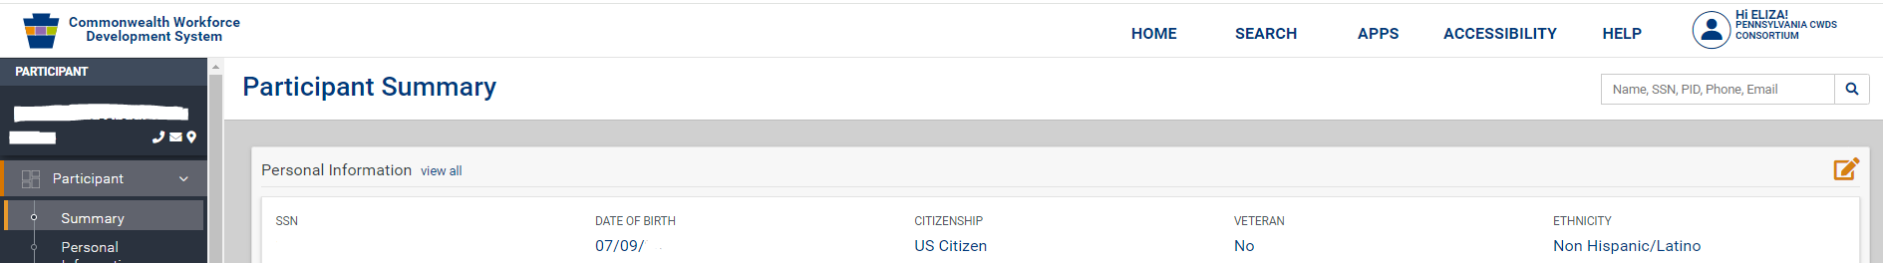
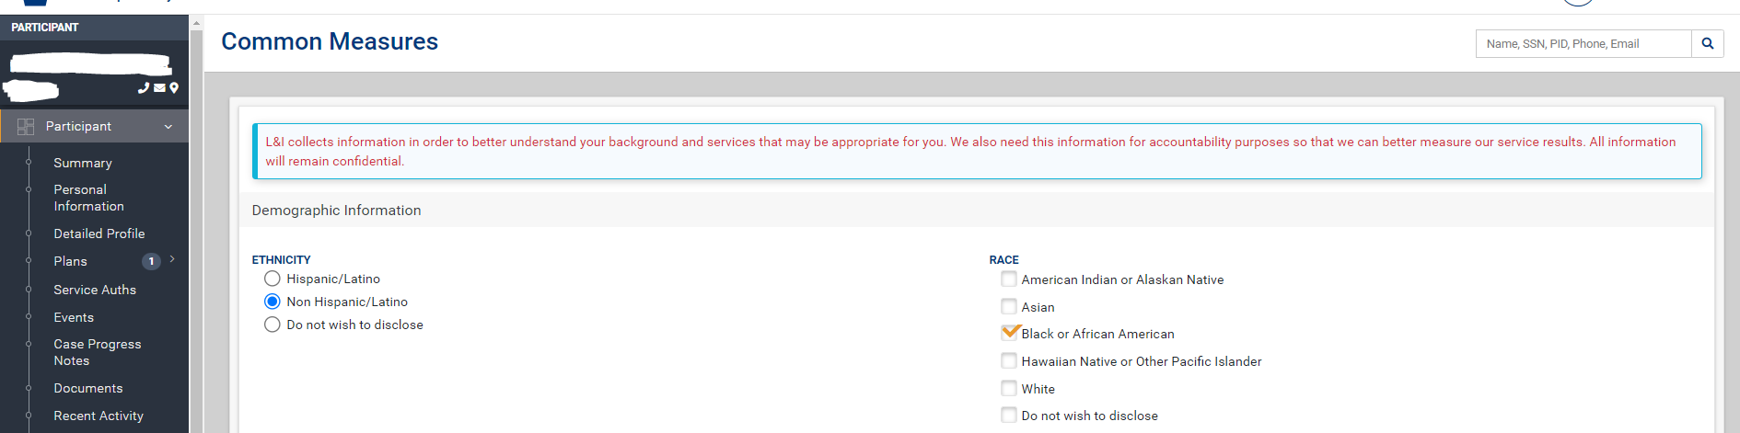
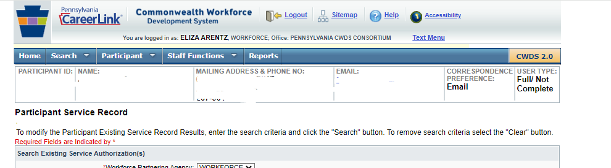
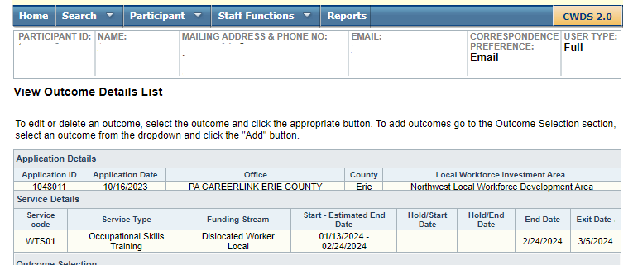
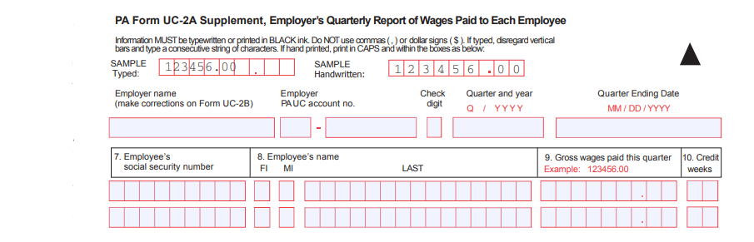
Where does the data in the reports come from?

Slide 6



Who uses all this info and why is it important?
State Program Administrators
Employment & Training Administration
United States Congress

Slide 7

What can I do with all this info?
Improve Program Design
Analyze Impact of Outreach Initiatives
Apply for Grants
Tell the workforce story
Keep L&I Workforce honest

Slide 8

Question:
Do all types of employment get counted towards Performance?

Slide 9

What if someone exits for a reason other than employment?
Is there a benefit to adding their employment info if you find out they are employed later?

Slide 10

The median earnings on the report seems low.
Can I receive the raw data to do my own research?

Slide 11

My Title I Provider indicated the participant reports seem to be missing 2 people who completed WIOA Title I service last year.
Why don’t I see them in the reports?

Slide 12
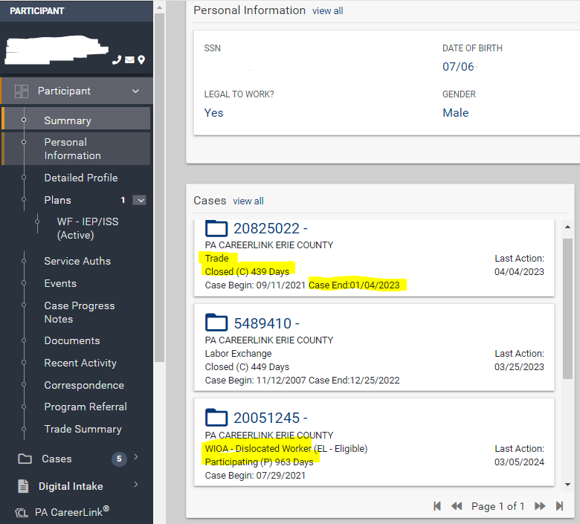
What are some ways I can tell if someone is co-enrolled and the outcomes achieved will be delayed?

Slide 13
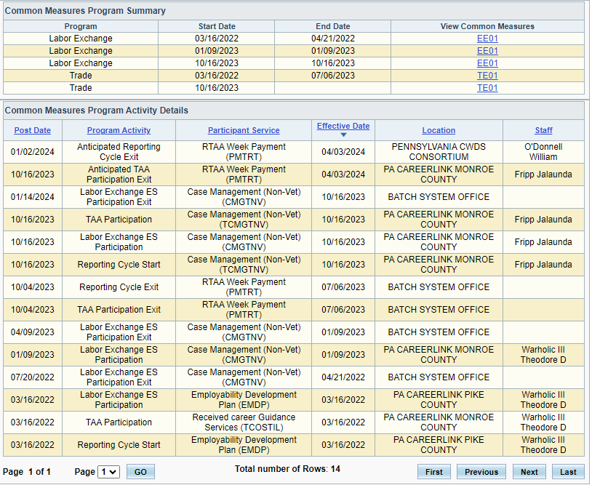

Common Measures Activity Log

Slide 14
What are the data ranges for data validation?
Program Year 20xx
Participants who have a participation date that falls between July 1, 20xx and June 30, 20xx + 1
Exiters who have a common measures exit date between January 1 and December 30, 20xx – 1

Slide 15

There are several people on my MSG report who have gains entered in the system that aren’t reflected in the report.
Why is that?

Slide 16
What can YOU do to ensure the data tells the best story?
  Accurate data entry
    Disability
    School Status and Education Level
    Address Information
    Training Completion
  Let outcomes happen naturally
  TIMELY DATA ENTRY is Key!

Slide 17

Any questions for us?

