Slide 1
Donkey Hodie’s Data: New Hires and Wage Records Donkey Hodie is new to the neighborhood! See what we know about her.
Workforce Information Forum
April 2024

Slide 2
Background: What are Wage Records? What are New Hires?

Slide 3
What are Wage Records?
Quarterly required reporting by employers for Unemployment Compensation (UC) covered jobs
Data are reported on the UC-2 form for employer data and UC-2A form for employee data
Wage records are designed for tax collection purposes, not labor market information.

Slide 4
What employer data are in Wage Records?
Unemployment Insurance Account Number
Federal Employer Identification Number (FEIN)
Employer name
Physical and mailing addresses
Ownership type
Industry
Sales? Assets? EEO? – No.

Slide 5
What personal data are in Wage Records?
Social Security Number
Complete name
Total gross wages paid per quarter
Total credit weeks per quarter
Hours worked? Days worked weekly? Hourly wage?
Occupation? Benefits? Vacation? Seniority?– No.

Slide 6
What are New Hires?

Slide 7
What are New Hires?
Continuously required reporting for all employers with new hires regardless of unemployment compensation
A National Department of Health & Human Services program for the purpose of enforcing child support payments
Employers can report to any state where they have an establishment even if the hire did not occur in the state.

Slide 8
What employer data are in New Hires?
Federal Employer Identification Number (FEIN)
Employer name
The FEIN is used to assign employer information
Ownership type
Industry
Physical address

Slide 9
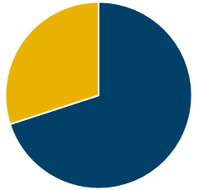
What personal data are in New Hires?
Pennsylvania reported new hires (70% of all new hires)
Social Security Number
Resident address
Date of Hire
Date of Birth
National New Hires (100% of New Hires)
Detailed employer data with limited employee data
No social security number or date of birth

Slide 10
Working with limitations – Wage Records
Only UC covered jobs are reported
Only quarterly total gross wages
Only credit weeks for time worked
Employers with multiple establishments across PA
Do not have a county assigned to them
Are assigned an industry based on their primary activity
Are a small portion of employers, but employ nearly half of all employment

Slide 11
Working with limitations – New Hires
Employers with multiple establishments across PA
No sub-state location and one primary NAICS for all locations
Hires can be reported to any state where the employer has an establishment.
We do not have all Pennsylvania hires.
Not all industries are equally represented.
National New Hires data contains hires for all PA residents but does not have detailed employee information.

Slide 12
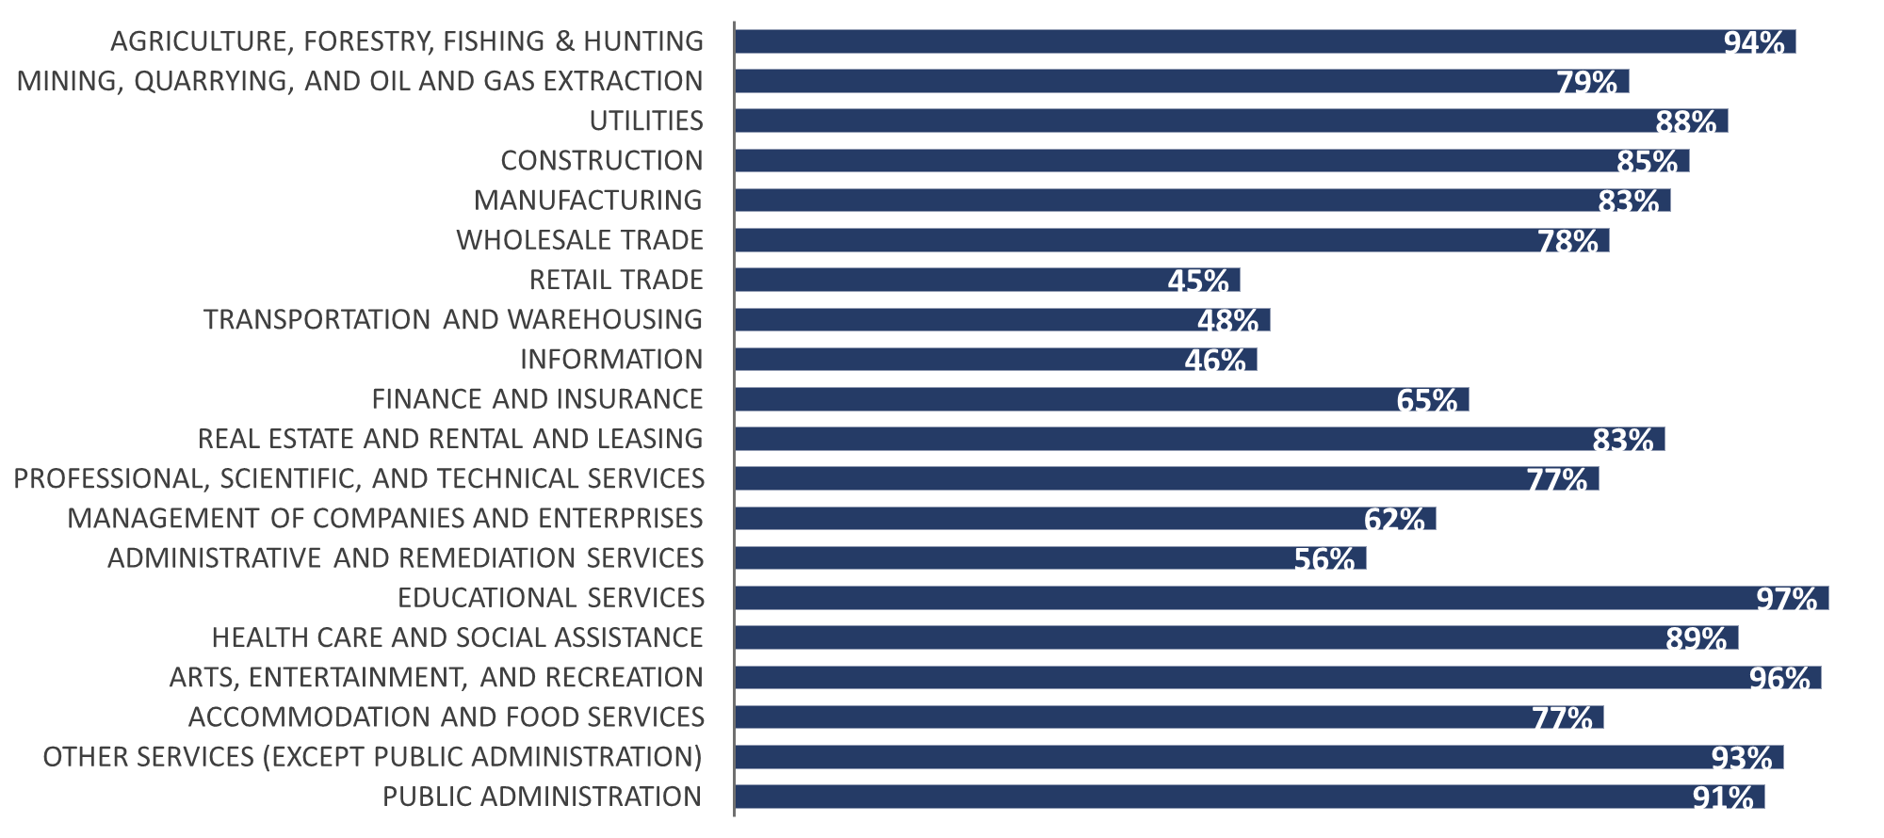
Pennsylvania Vs. National New Hires - Collection Rates by Industry

Slide 13
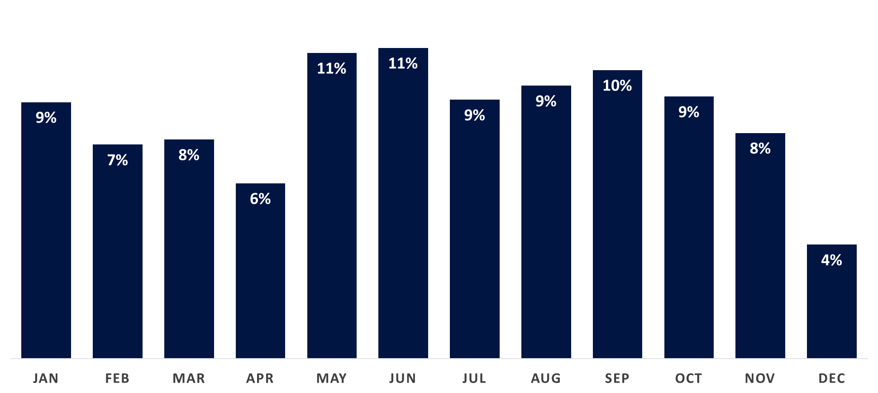
National New Hires Seasonality - Collection Rates, West-Fay WDA, 2023
Q1
Q2
Q3
Q4
Incomplete

Slide 14
What’s on the website?

Slide 15
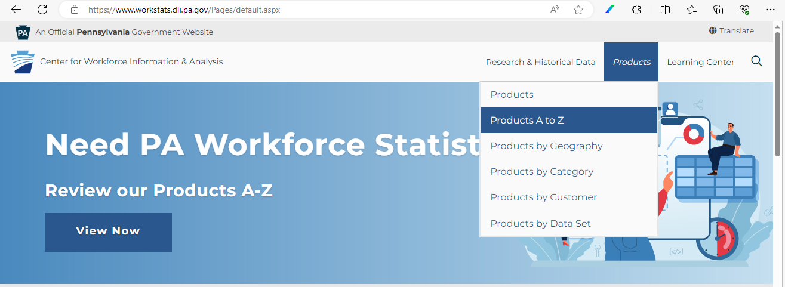
New Hire Program Data - Find the Reports

Slide 16
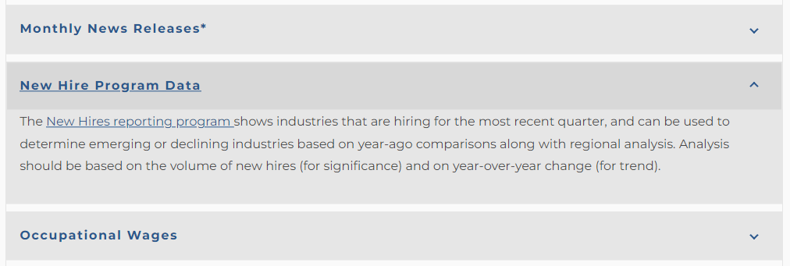
New Hire Program Data - Find the Reports
(https://www.workstats.dli.pa.gov)

Slide 17
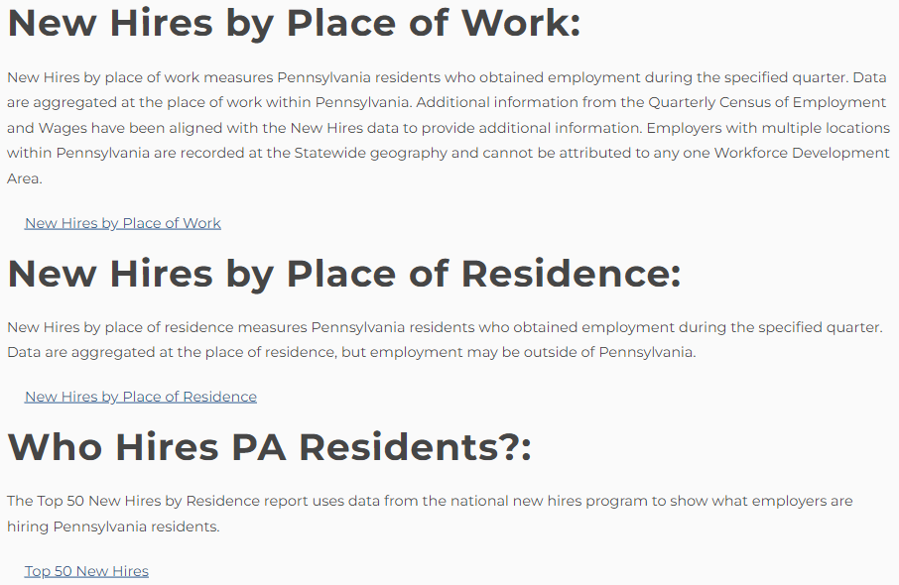
New Hire Program Data - Find the Reports
All reports are for PA residents only
New hires by place of work and residence are new hires reported to PA
70% of all PA resident new hires
National new hires office provides employer totals of all PA resident new hires
Top 50 new hires are 100% PA resident new hires

Slide 18
Pennsylvania New Hires by WDA - Place of Residence - 2023 Q3
NAICS | NAICS Title | New Hires | Prior Year | Annual Change | Percent Change | Average Age
Pennsylvania
10 | Total, All Industries | 543,393 | 571,461 | -28,068 | -4.9% | 25 to 34
722 | Food Services and Drinking Places | 63,337 | 71,202 | -7,865 | -11.0% | 25 to 34
611 | Educational Services | 50,811 | 53,191 | -2,380 | -4.5% | 35 to 44
561 | Administrative and Support Services | 45,310 | 51,770 | -6,460 | -12.5% | 35 to 44
Westmoreland Fayette Workforce Development Area
10 | Total, All Industries | 18,676 | 19,239 | -563 | -2.9% | 35 to 44
722 | Food Services and Drinking Places | 2,331 | 2,441 | -110 | -4.5% | 25 to 34
611 | Educational Services | 1,784 | 1,747 | 37 | 2.1% | 35 to 44
622 | Hospitals | 1,476 | 1,314 | 162 | 12.3% | 35 to 44

Slide 19
Comparing PA Employment Changes - New Hires, Job Postings, & Employment Change
Measure | Current* | Prior Year | Change
New Hires (Place of Work) | 510,995 | 546,578 | -6.5%
HWOL Job Postings (Place of Work) | 6,341 | 7,692 | -17.6%
QCEW Employment (Place of Work) | 5,967,320 | 5,893,767 | 1.2%
New Hires (Residence) | 543,393 | 571,461 | -4.9%
Labor Force Employed (Residence) | 6,339,000 | 6,253,000 | 1.4%
Don’t directly compare these data! They are complements.
This table shows that a decline in new hires or job postings does not result in a decline in employment.
*New Hires and QCEW are 2023 Q3. HWOL job postings and LAUS employed are September 2023.

Slide 20
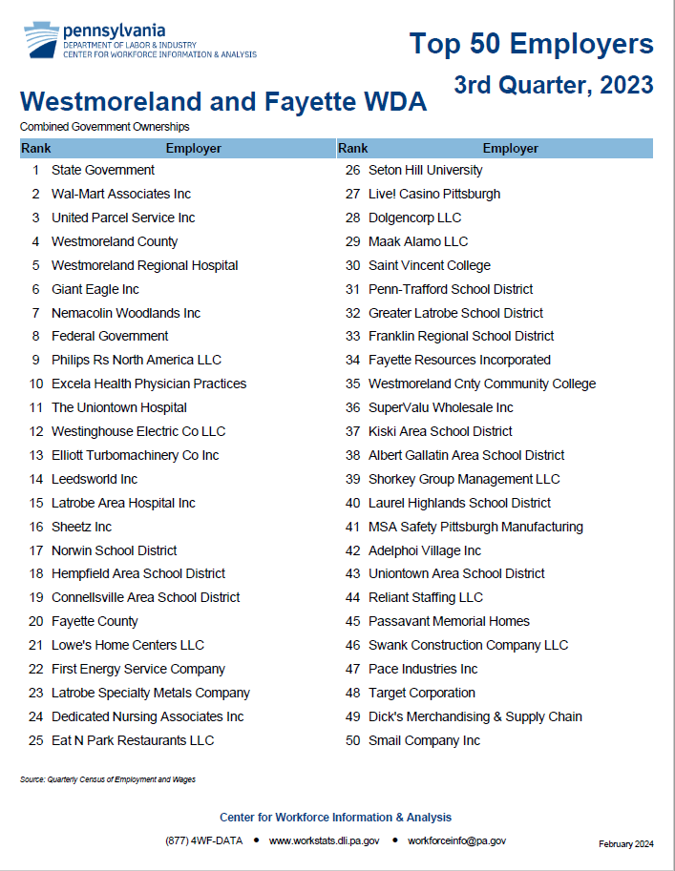
Top 50 Employers (QCEW) - Place of Work
1 | State Government
2 | Wal-Mart Associates Inc
3 | United Parcel Service Inc
4 | Westmoreland County
5 | Westmoreland Regional Hospital
6 | Giant Eagle
7 | Nemacolin Woodlands
8 | Federal Government
9 | Philips Rs North America
10 | Excela Health Physician Practices

Slide 21
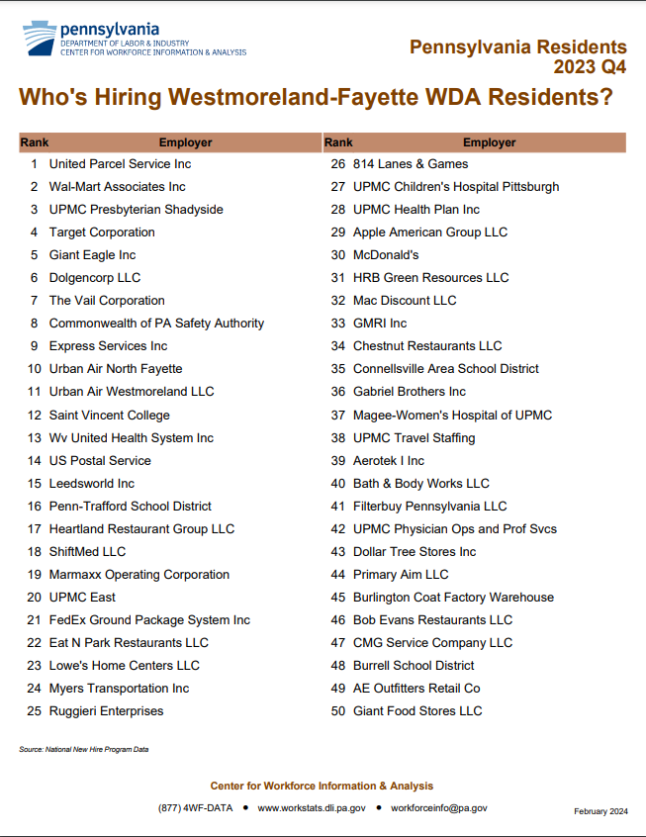
Top 50 Employers (New Hires) - Place of Residence
 | By New Hires (Res.) | By Employees (Work)
1 | United Parcel Service | State Government
2 | Wal-Mart Associates | Wal-Mart Associates
3 | UPMC Shadyside | United Parcel Service
4 | Target | Westmoreland Co.
5 | Giant Eagle | Westmoreland Regional Hospital

Slide 22
What’s not on the website (yet)? Combining New Hires and Wage Records

Slide 23
National New Hires vs. QCEW – Place of Work, 2023 Annual Average
Industry | New Hires | QCEW Employment | Hires per Employment
Total, All Industries | 2,608,878 | 5,967,318 | One hire per 2.3 jobs
Public Administration | 26,204 | 237,917 | One hire per 9.1 jobs
Utilities | 3,896 | 34,290 | One hire per 8.8 jobs
Accommodation and Food Services | 330,690 | 472,513 | One hire per 1.4 jobs
Administrative and Remediation Services | 280,531 | 303,017 | One hire per 1.1 jobs

Slide 24
Pennsylvania New Hires Dashboard - A New View of Pennsylvania New Hires
Create your own reports
Single quarter for timeliness or most recent 4-quarters to eliminate seasonality and increase accuracy
Ability to analyze age groups
Inclusion of wages

Slide 25
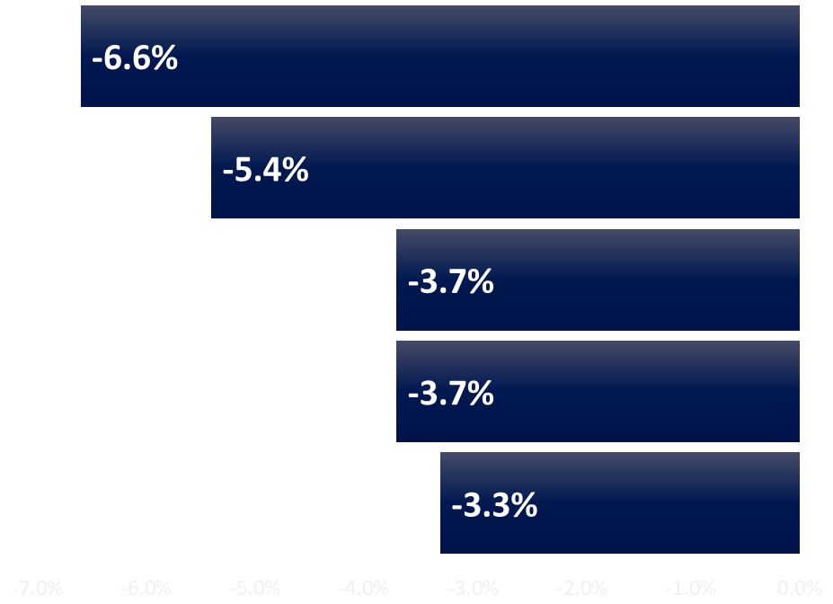
Pennsylvania New Hire Counts by WDA – Place of Residence, 2022 Q4 to 2023 Q3
Area | New Hires | Annual Diff.
West-Fay WDA | 71,647 | -5,032
Southern Alleghenies | 55,835 | -3,193
Tri-County WDA | 49,898 | -1,943
Three Rivers WDA | 260,124 | -9,960
Southwest Corner | 65,949 | -2,280
Percent Change

Slide 26
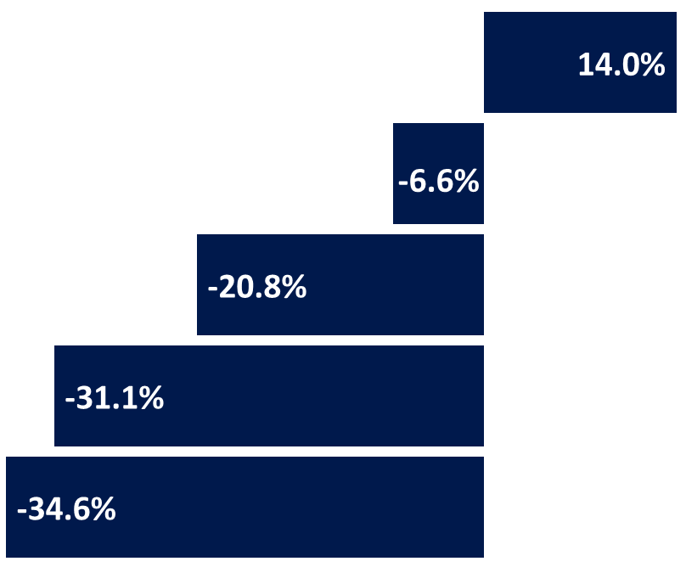
Pennsylvania New Hire Counts by Industry – Place of Residence, 2022 Q4 to 2023 Q3
Industry | New Hires | Annual Diff.
Educational Services | 4,993 | 613
Total, All Industries | 71,647 | -5,032
Transportation and Warehousing | 2,059 | -540
Management of Companies | 279 | -126
Wholesale Trade | 2,084 | -1,102
Westmoreland Fayette WDA
Percent Change

Slide 27
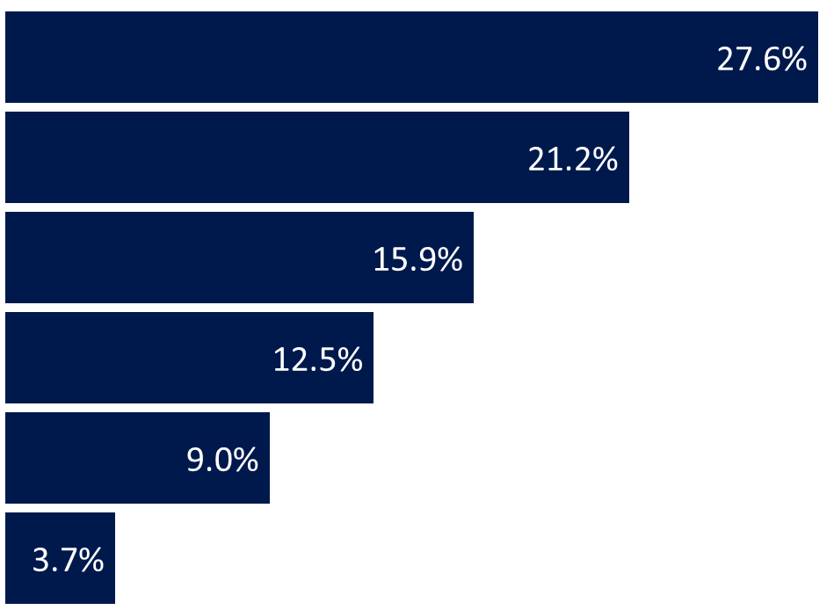
Pennsylvania New Hire Counts by Age – Place of Residence, 2022 Q4 to 2023 Q3
Age Group | New Hires | Annual Diff. | % Diff.
Less than 25 | 19,781 | -1,041 | -5.0%
25 to 34 | 15,180 | -605 | -3.8%
35 to 44 | 11,401 | -877 | -7.1%
45 to 54 | 8,969 | -361 | -3.9%
55 to 64 | 6,440 | -215 | -3.2%
65 and Older | 2,680 | -178 | -6.2%
Westmoreland Fayette WDA
Percent of Total

Slide 28
PA New Hire Counts by Area, Age, & Industry – Place of Residence, 2022 Q4 to 2023 Q3
Age Group | Industry | New Hires | Diff. | % Diff.
55 to 64 | Educational Services | 713 | 206 | 40.6%
25 to 34 | Administrative and Remediation | 1,709 | 196 | 13.0%
Westmoreland Fayette WDA largest volume increases
55 to 64 years old hired to Educational Services increased by 206 or 40.6% over the year
Age Group | Industry | New Hires | Diff. | % Diff.
35 to 44 | Wholesale Trade | 558 | -822 | -60.0%
Less Than 25 | Art, Entertainment, and Recreation | 966 | -264 | -21.5%
Westmoreland Fayette WDA largest volume decreases
35 to 44 years old hired to Wholesale Trade decreased by 822 or 60.0% over the year

Slide 29
Pennsylvania New Hire Wages
The new hire must be hired to an employer where they did not have existing employment in the prior quarter;
The new hire must have at least 10 weeks worked in the current or following quarter at the hiring employer;
Wage distribution showing 25th, median, and 75th percentiles;
Average wages with confidence intervals; and
Wage brackets showing the number of hires per wage group.

Slide 30
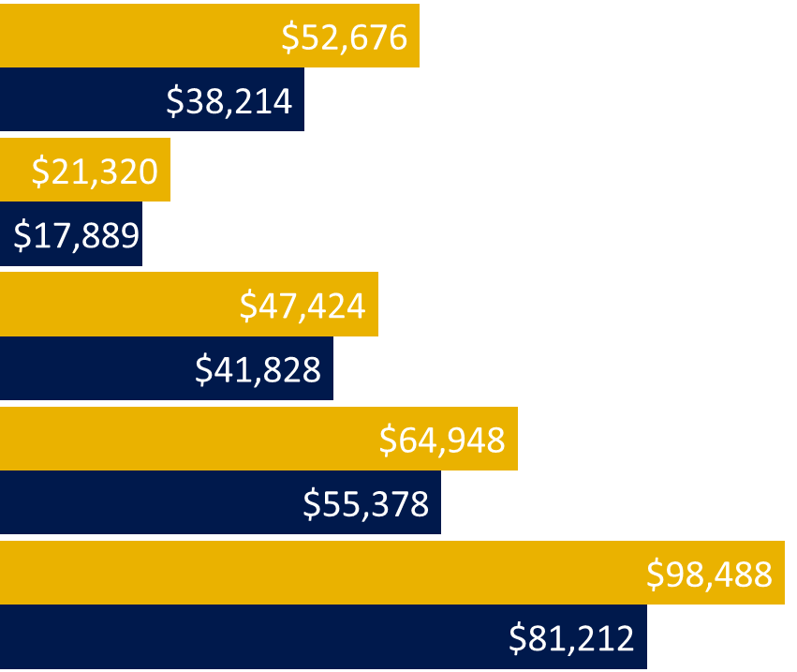
PA New Hire Wages vs. QCEW Wages – Place of Work
Industry | New Hire Wage | QCEW Wage
Total, All Industries | $38,214 | $52,676
Accommodation & Food | $17,889 | $21,320
Administrative and Remediation Services | $41,828 | $47,424
Construction | $55,378 | $64,948
Mining, Oil, & Gas | $81,212 | $98,488
Westmoreland Fayette WDA
QCEW Wage
New Hire Wage

Slide 31
Pennsylvania New Hire Wage Brackets – Place of Residence, 2022 Q4 to 2023 Q3
Age Group | Area | NAICS Title | Less Than $15,080 | $15,080 to $31,200 | $31,200 to $50,000 | $50,000 to $100,000 | $100,000 to $150,000 | $150,000 or More
45-54 | Three Rivers | Management | 1.1% | 3.3% | 16.3% | 26.1% | 17.4% | 35.9%
LT 25 | S. Alleghenies | Art, Entertain., & Rec. | 78.2% | 14.4% | 6.0% | 1.4% | 0.0% | 0.0%
Three Rivers WDA - Management of Companies - 45 to 54 Years Old
Southern Alleghenies WDA - Arts, Entertainment,& Rec. - Less Than 25
Average
$12k
Average
$132k

Slide 32
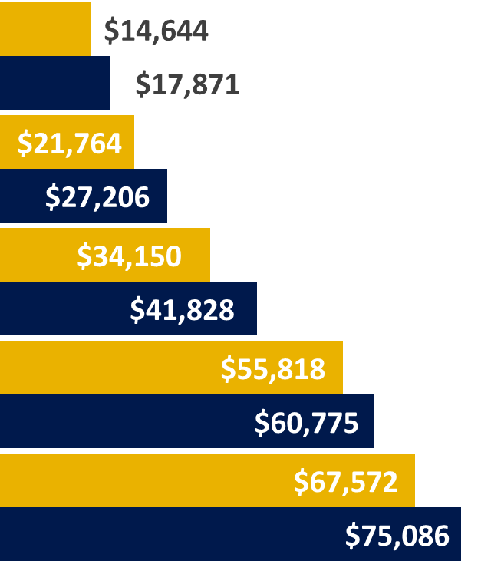
Pennsylvania New Hire Wages by Industry – Place of Residence, 2022 Q4 to 2023 Q3
Industry | Average | Annual Change | Median | Annual Change
Accommodation and Food Services | $17,871 | $938 | $14,644 | $514
Retail Trade | $27,206 | $123 | $21,764 | $525
Administrative and Remediation Svcs. | $41,828 | -$2,624 | $34,150 | -$452
Construction | $60,775 | $4,649 | $55,818 | $4,463
Mining, Oil, & Gas | $75,086 | -$796 | $67,572 | -$3,659
Westmoreland Fayette WDA
Median
Average

Slide 33
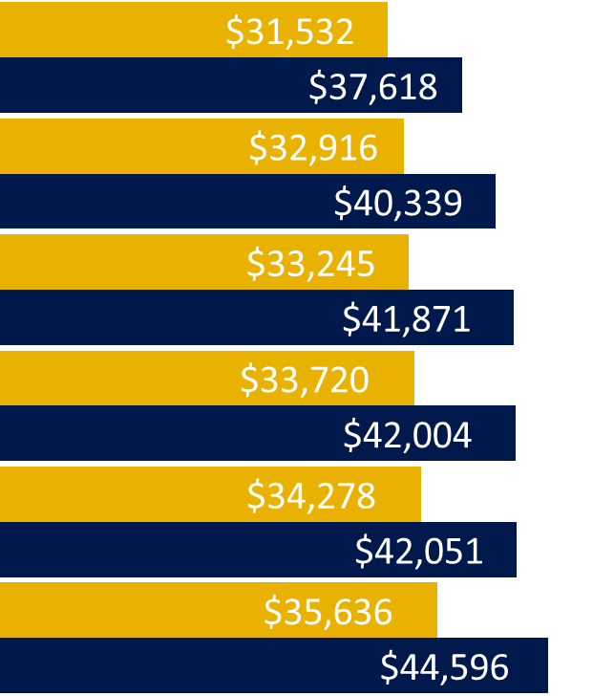
Pennsylvania New Hire Wages by WDA – Place of Residence, 2022 Q4 to 2023 Q3
Area | Average | Annual Change | Median | Annual Change
S. Alleghenies WDA | $37,618 | $1,764 | $31,532 | $2,060
West-Fay WDA | $40,339 | $1,781 | $32,916 | $1,780
Tri-County WDA | $41,871 | $168 | $33,245 | $42
Pennsylvania | $42,004 | $113 | $33,720 | $570
Southwest Corner | $42,051 | $923 | $34,278 | $814
Three Rivers WDA | $44,596 | $611 | $35,636 | $1,165
Median
Average

Slide 34
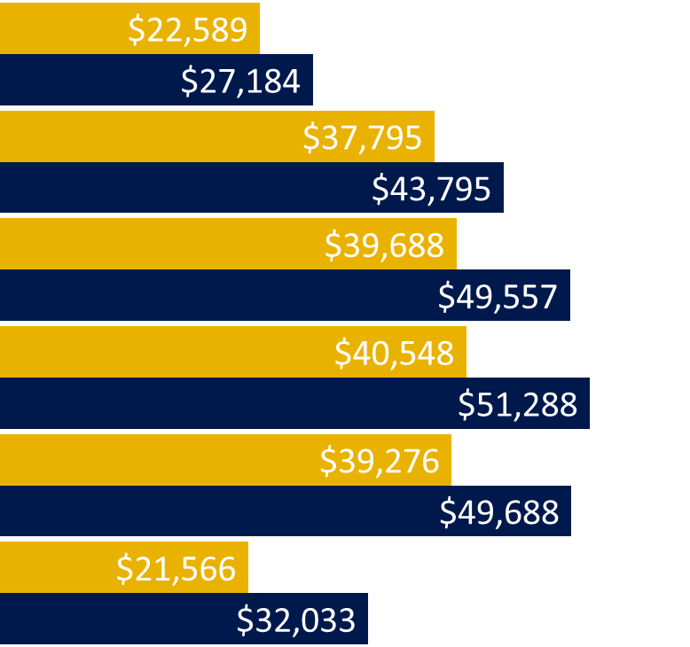
Pennsylvania New Hire Wages by Age – Place of Residence, 2022 Q4 to 2023 Q3
Area | Average | Annual Change | Median | Annual Change
Less than 25 | $27,184 | $1,074 | $22,589 | $647
25 to 34 | $43,795 | $1,172 | $37,795 | $1,980
35 to 44 | $49,557 | $1,320 | $39,688 | $2,047
45 to 54 | $51,288 | $1,920 | $40,548 | $2,189
55 to 64 | $49,688 | $3,332 | $39,276 | $3,901
65 and Older | $32,033 | $3,786 | $21,566 | $342
Westmoreland Fayette WDA
Median
Average

Slide 35
What are we working on?

Slide 36
National New Hires Details - West-Fay WDA, 2023 Annual Average
8.2% of Westmoreland Fayette WDA residents are hired to out-of-state employers or non-UC covered employers
51.3% of Westmoreland Fayette WDA residents are hired to multi-establishment employers.
The largest industry for multi-establishment employers hiring Westmoreland Fayette WDA residents is Retail Trade.
Four of the five top hiring employers are multi-establishment employers, three of the five top hiring employers are Retail Trade.
(1.) UPS (2.) Walmart (3.) UPMC Shadyside (4.) Target (5.) Giant Eagle

Slide 37
National New Hires Details - West-Fay WDA, 2023 Annual Average
Hired From/In | West-Fay Resident Hires (Largest NAICS) | Hires to West-Fay Employers (Largest NAICS) | Net Hires
West-Fay | 21,190 (Food Svcs. 20.6%)
Three Rivers | 7,272 (Health Care 17.1%) | 4,057 (Admin. Svcs. 25.4%) | -3,215
S.W. Corner | 2,476 (Admin. Svcs. 25.7%) | 1,719 (Health Care 30.4%) | -757
Tri-County | 1,125 (Health Care 18.6%) | 1,565 (Construction 16.7%) | 440
S. Alleghenies | 780 (Admin. Svcs. 27.3%) | 1,060 (Trans. & Ware. 19.2%) | 280
Remainder | 1,911 (Health Care 16.1%) | 1,546 (Admin. Svcs. 37.1%) | -365
Total | 13,564 (Health Care 8.2%) | 9,947 (Admin. Svcs. 11.1%) | -3,617

Slide 38
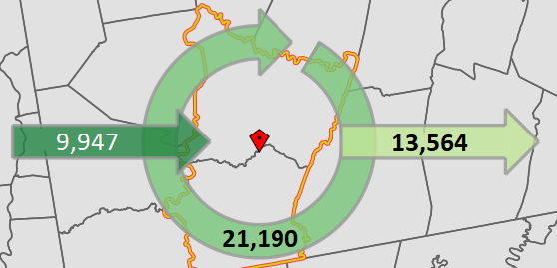
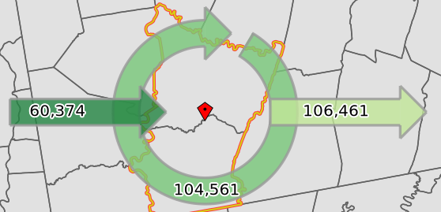
National New Hires Details - West-Fay WDA, 2023 Annual Average
New Hires Flow
Commuting Patterns*
Net Outflow of 3,617 hires.
Ratio of Inflow/Outflow is 0.73
Net Outflow of 46,087 jobs.
Ratio of Inflow/Outflow is 0.57
New Hires Flow is based on where people are hired from.
Commuting Patterns are based on how people travel for their job.
*Source: U.S. Census OnTheMap – 2021 annual average

Slide 39
Thank you! Questions?

