Slide 1
Daniel Tiger’s Data Dashboards Daniel finds the confidence to help King Friday with CWIA’s data dashboards
Spring 2024 Workforce Information Forum
April 2024

Slide 2
King Friday’s Problem
One morning, while King Friday was surveying his kingdom, he noticed a bridge was out on the trolley tracks!
It just so happened that Daniel Striped Tiger was walking past the castle. Maybe he can help King Friday fix the bridge!

Slide 3
Daniel Striped Tiger
Attributes:
Shy
Wise
Intelligent
Always has the time

Slide 4
King Friday
Attributes:
Self-Important
Irrational
Resistant to change
Temperamental
Open-minded enough to listen when told he is wrong

Slide 5
Daniel Striped Tiger, the bridge is out and I don’t know if there is anyone in the kingdom who knows how to fix it, or if there’s someone who even has the time to work on such a project. Can you help me?
I think so, King Friday. There’s this place outside of the land of make-believe called “The Center for Workforce Information and Analysis”. They have all sorts of information to help us better understand who can do that kind of labor.
Let’s check out their data dashboards!

Slide 6
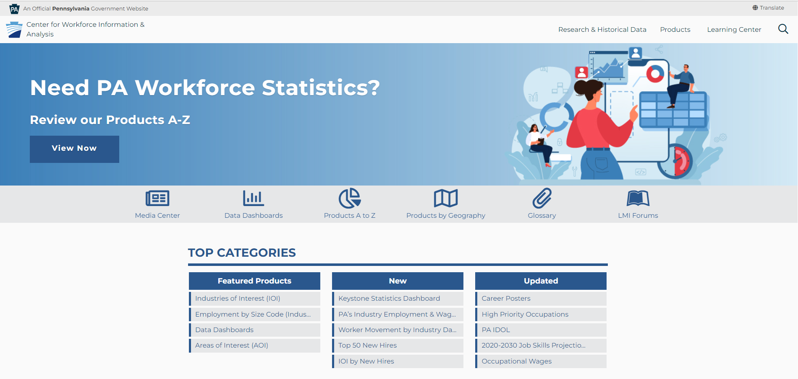
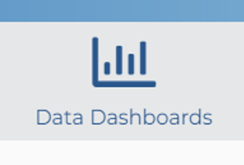
www.workstats.dli.pa.gov

Slide 7
Weekly Unemployment Compensation Claims Dashboard

Slide 8
Why was the UC claims dashboard created?
High demand for Unemployment Claims (UC) data
Extreme spikes in UC claims resulted from the business closures that occurred during the COVID-19 mitigation efforts
CWIA began publishing weekly claims data
A large amount of federal funding has been directed toward Unemployment Compensation which has increased the interest in UC claims

Slide 9
What questions can this dashboard help answer?
How did the number of claims vary across age groups ?
Did more men or women apply for benefits?
What industries were impacted the most by the pandemic?
Did one race/ethnicity suffer more than the others?
How did my area compare to the state as a whole?

Slide 10
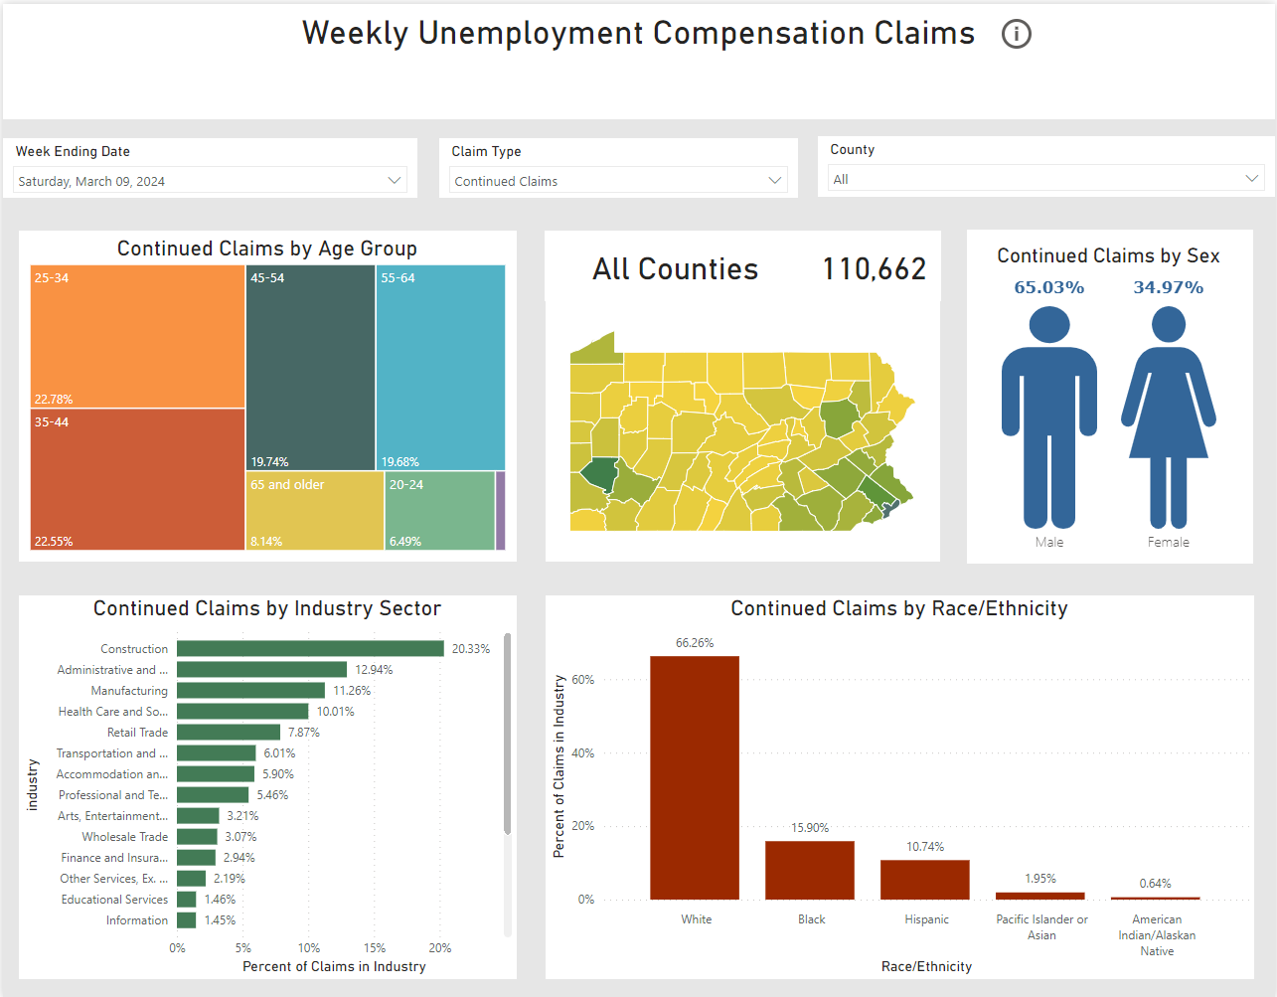

Slide 11
Dashboard Selection Options:
Week Ending Date: Data available starting with the week ending January 4, 2020
Claim Type: see next slide for more details
County: data available by county

Slide 12
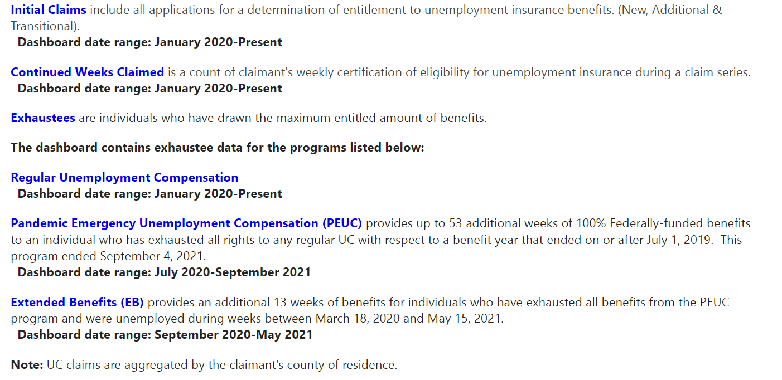
Claim Types Explained:

Slide 13
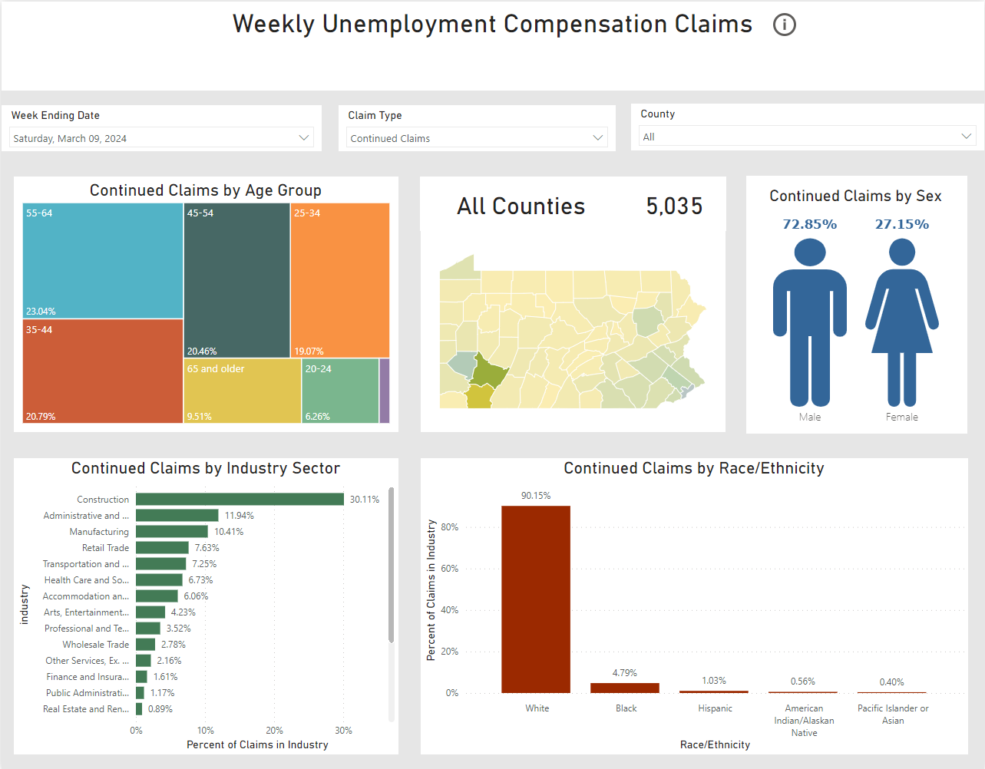

Slide 14
Older Workers
by
Industry
Dashboard

Slide 15
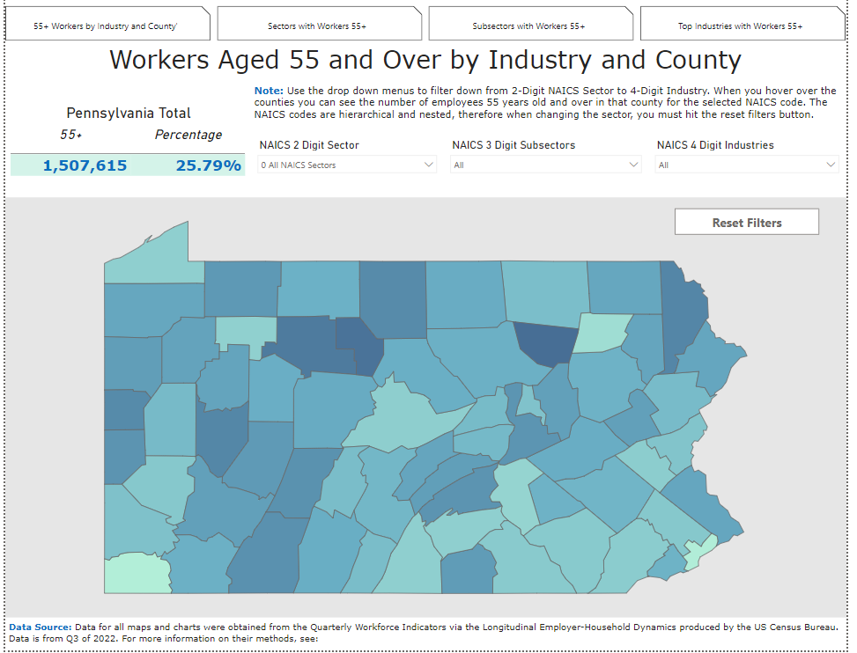
Older Worker Dashboard
Default setting orientation
Pennsylvania Total in upper left corner
All NAICS Sectors
Reset Button
++

Slide 16
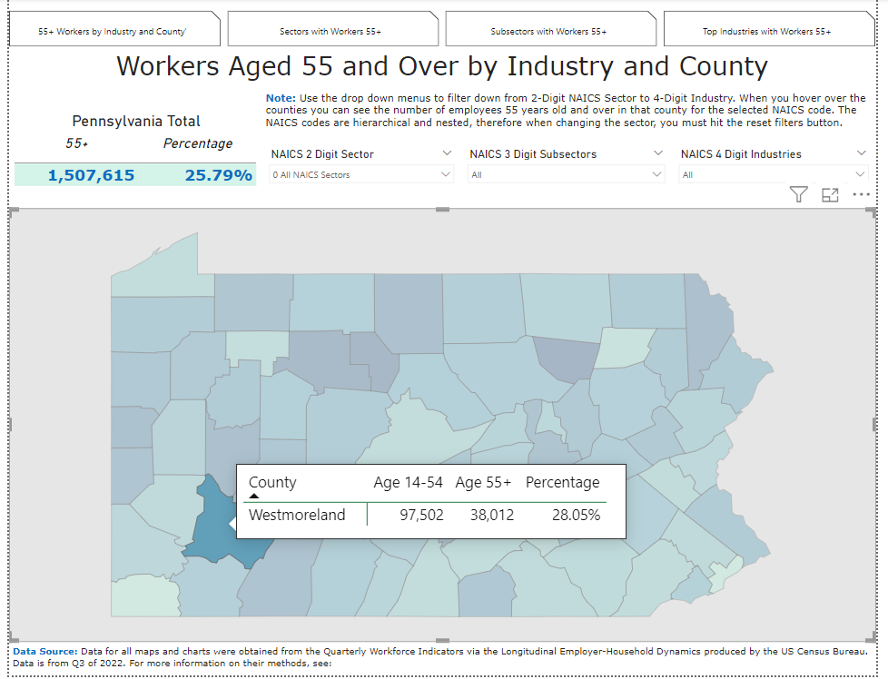
Tooltip
Function
Appears on hover or click
Displays additional information
Information updates when filters change

Slide 17
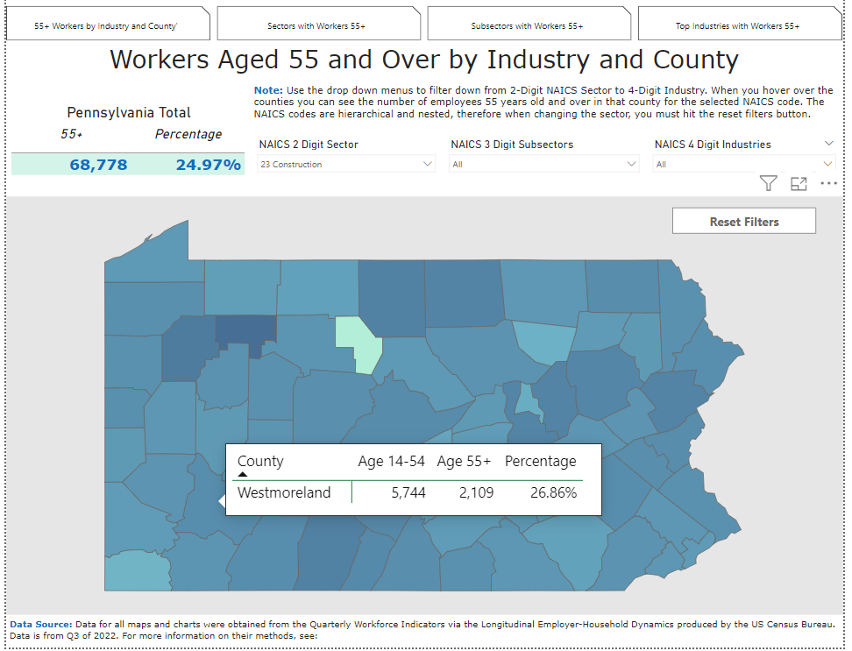
Filters: Sector
Change from All NAICS to Construction
PA Total Updates
Info in Tooltip Updates

Slide 18
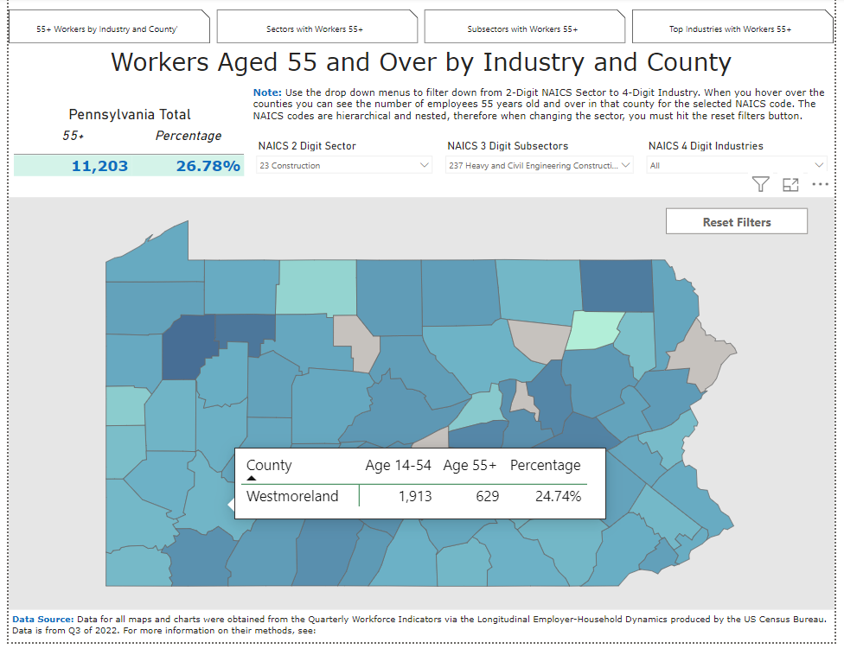
Filters: Subsector
Change from null to Heavy and Civil Engineering Construction
PA Total Updates
Info in Tooltip Updates

Slide 19
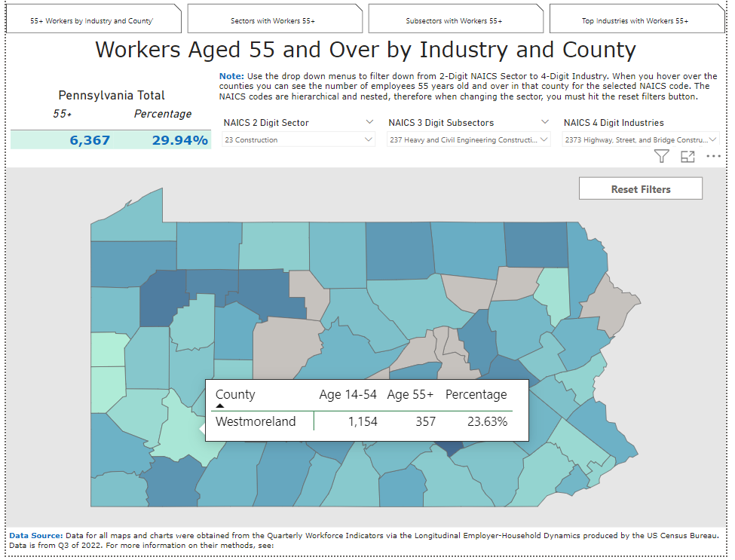
Filters: Industry
Change from null to Highway, Street and Bridge Construction
PA Total Updates
Info in Tooltip Updates

Slide 20
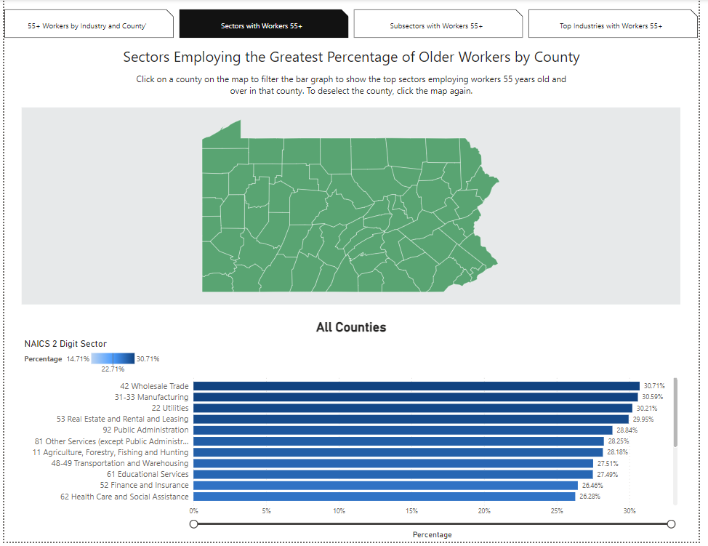
Top Sectors
Default
Single color map
Bar graph by county in alphabetical order
Then ordered by highest percentage to lowest

Slide 21
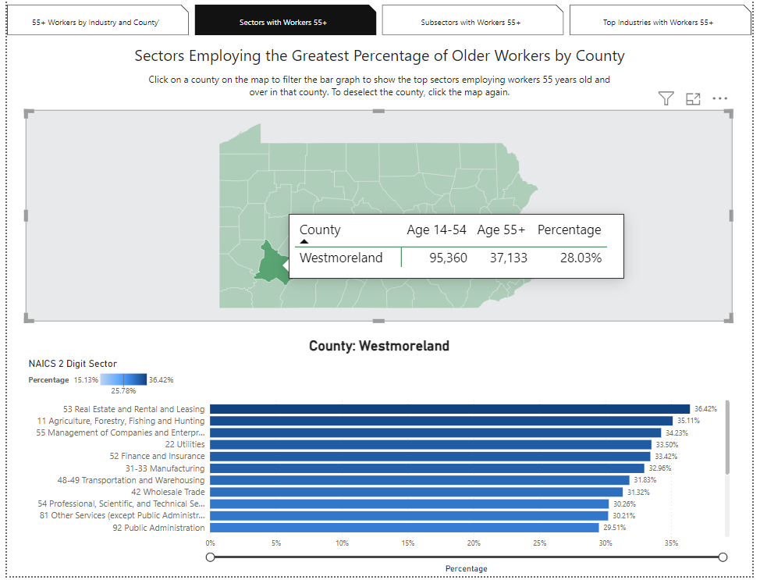
Top Sectors: Westmoreland
Upon Click of County
Tooltip appears with number of workers
Chart below displays Top Sectors in order of highest percentage of older workers to lowest for selected county

Slide 22
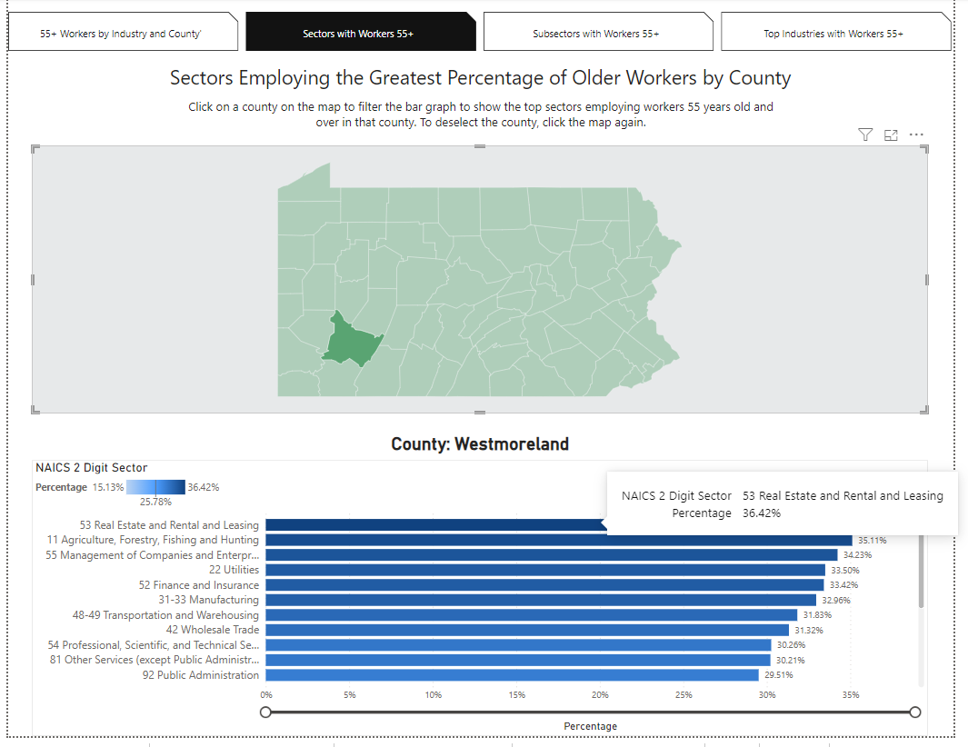
Top Sector
Bar Graph Tooltip
Displays percentage of older workers in that sector and county

Slide 23
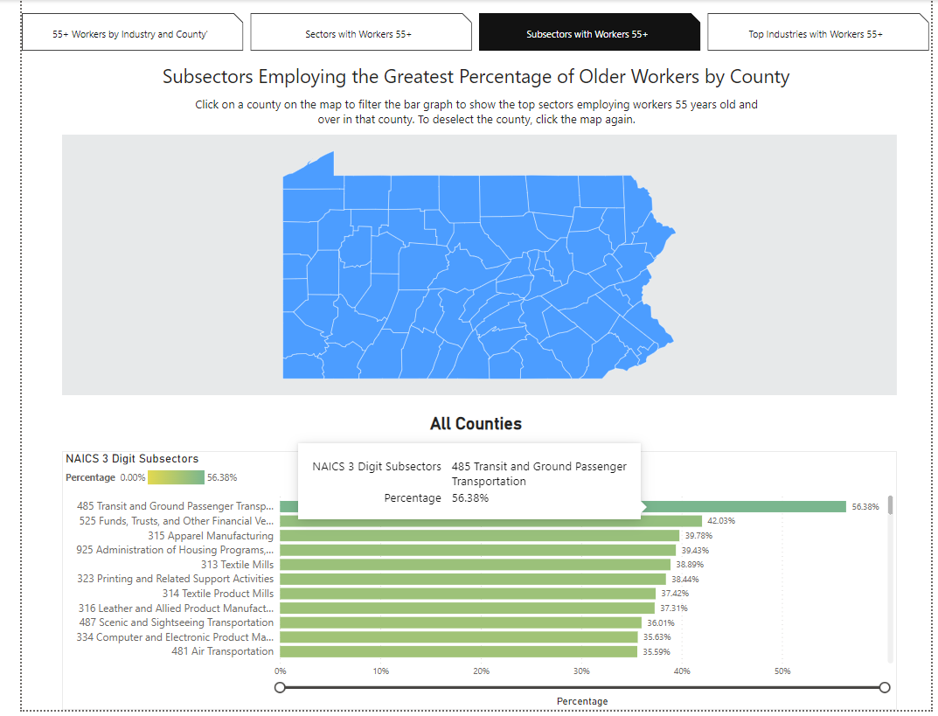
Top Subsector
Subsector functions the same way as sector

Slide 24
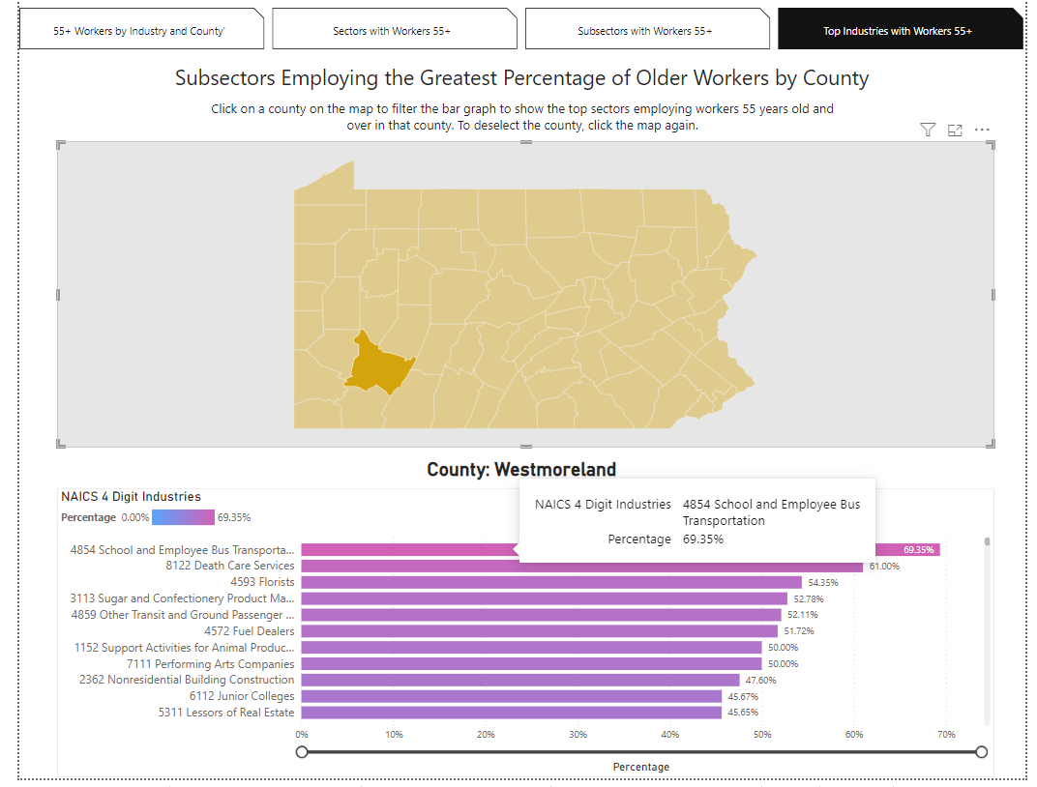
Top Industry
Industry Functions the Same Way as Sector and Subsector
69.35% of Charter Bus Industry workers in are 55-years-old and over

Slide 25
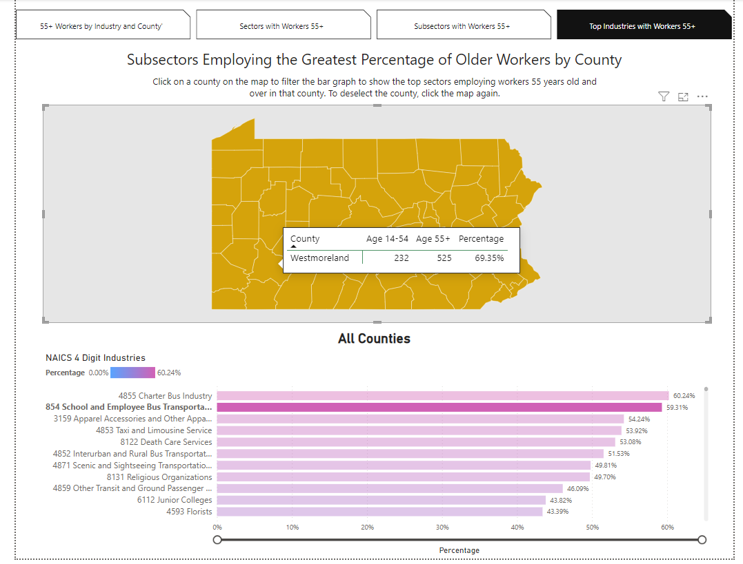
Number of Older Workers Paper Wholesalers
Check the number of employees
525 of the school and employee bus transportation workers are 55 and over
The job is crucial, but the industry is not a statistically significant part of workforce in Westmoreland County

Slide 26
Help Wanted Online (HWOL)
Job Postings
Dashboard

Slide 27
Data Overview:
Data Source: The Conference Board - LightCast - Help Wanted OnLineTM
The Conference Board uses their technology to spider job postings from a long list of online job boards including the PA CareerLink© System
Job Postings data is de-duplicated and ads are broken out into three categories – existing ads, new ads, and total ads (see next slide for definitions & more details)
existing ads + new ads = total ads
Data is available by industry and occupation
Information on skills and certifications is also available

Slide 28
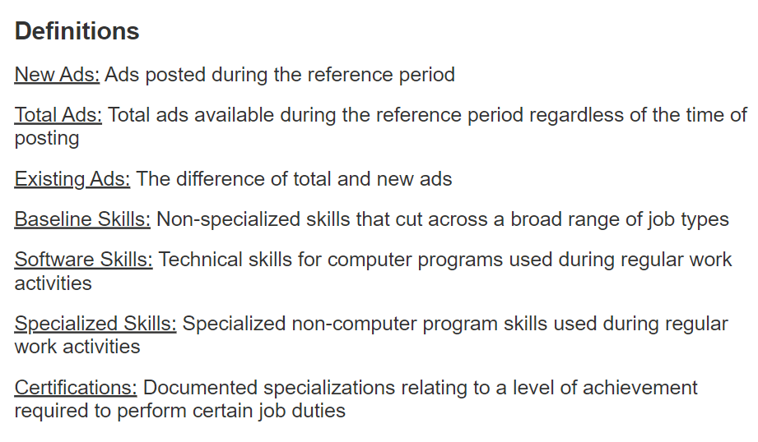
Job Postings Data - Definitions

Slide 29
HWOL Dashboard Home Page

Slide 30
Dashboard Home Page Overview
Dashboard home page used for navigation through the various pages of data
Navigation page divided into two main sections:
Summary Reports by Area
Three report types: Current Month, Annual Growth, Annual Decline
For three area types: Statewide (PA), Workforce Development Area (WDA) & County
Data Visualizations & Data Tables
For each category of data there are two options:
View Charts/Graphs
Download All Data

Slide 31
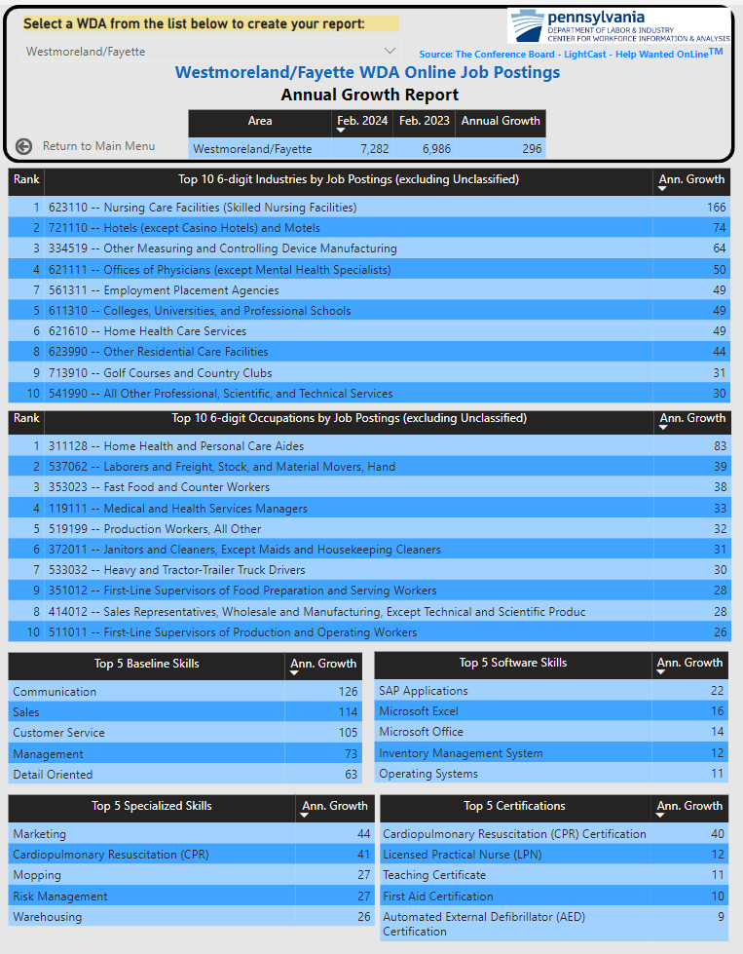
Summary Report Example:
Westmoreland/Fayette WDA: Annual Growth

Slide 32
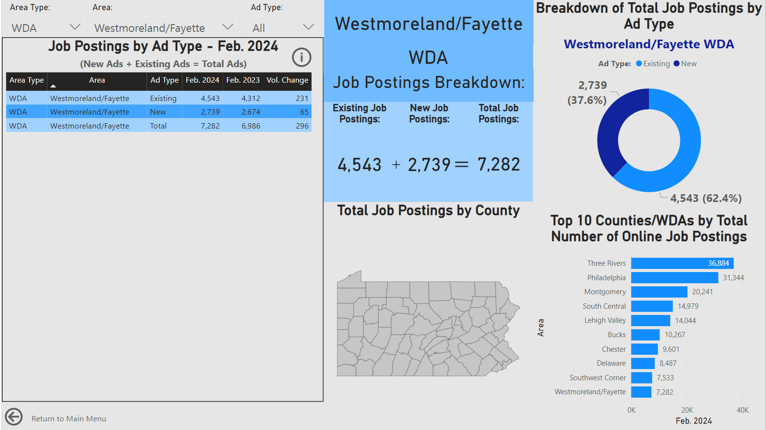
Job Postings by Area & Ad Type –
Westmoreland/Fayette WDA

Slide 33
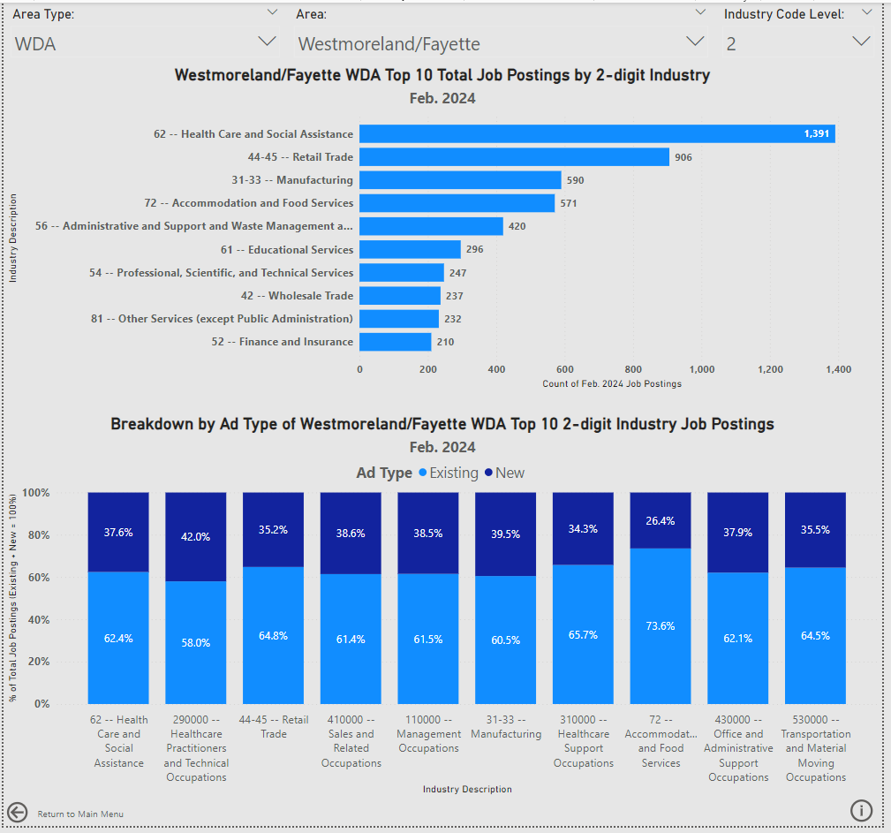
Job Postings by Area & Industry –
Westmoreland/Fayette WDA
The job postings by industry page includes information on the following:
Top 10 Total Job Postings by Industry
Industry data is available at the 2-, 4-, and 6-digit levels
A breakdown of those top 10 industries by ad type (new ads or existing ads - % of total)

Slide 34
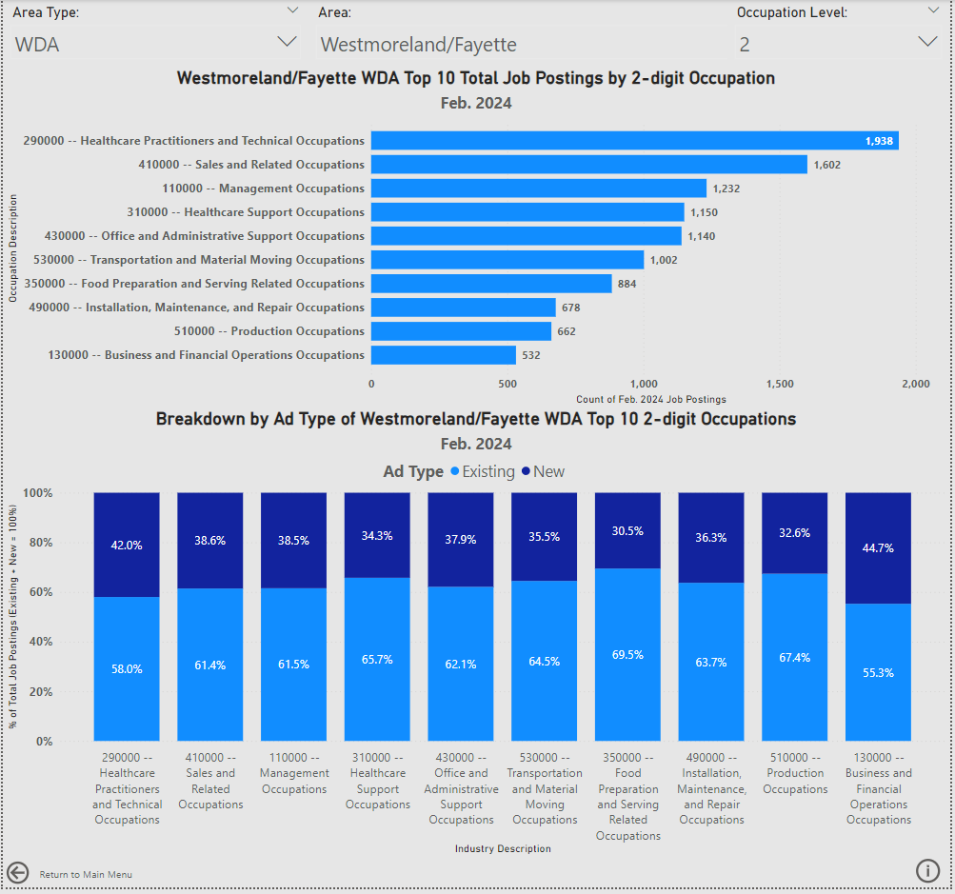
Job Postings by Area & Occupation –
Westmoreland/Fayette WDA
The occupations page is laid out in the same format to the industry page. Information on this page includes:
Top 10 Total Job Postings by Occupation
Occupation data is available at the 2- and 6-digit levels
A breakdown of those top 10 occupations by ad type (new ads or existing ads - % of total)

Slide 35
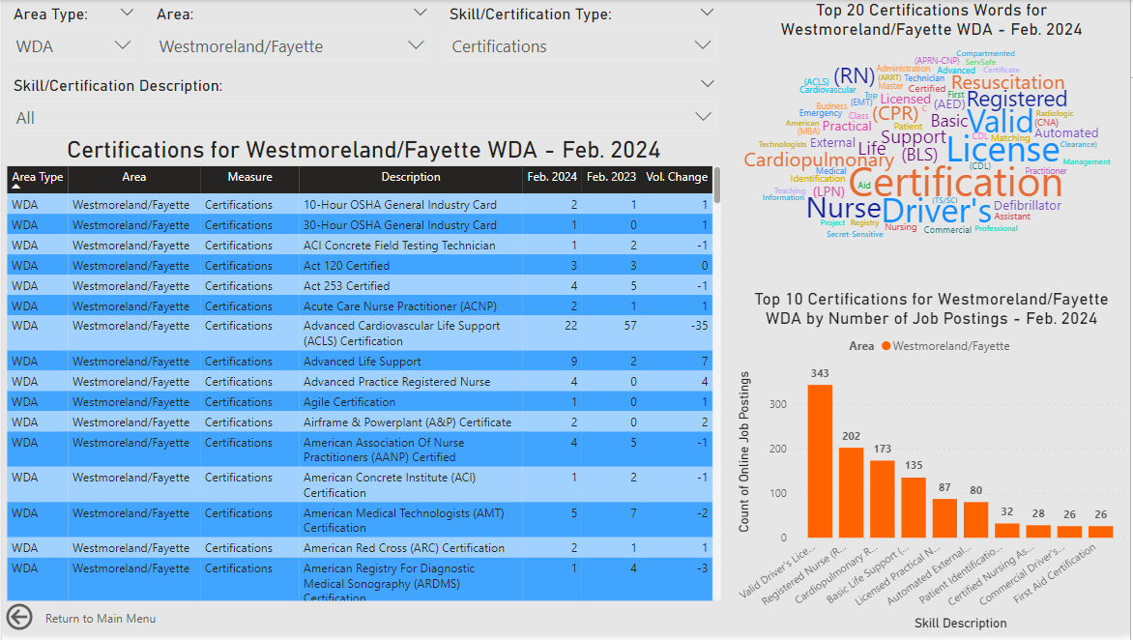
Skills & Certifications by Area –
Westmoreland/Fayette WDA
The skills & certifications page includes the following information:
4 Skill Types:
Certifications
Baseline Skills
Software Skills
Specialized Skills
data table showing all results for the area (can only select one skill type at a time)
word cloud of Top 20 words found in the selected skill titles
List of the Top 10 selected skills type for the selected area

Slide 36
PA Monthly WorkStats
Dashboard

Slide 37
PA Monthly Workstats Dashboard Overview
The PA Monthly Workstats has been a CWIA product for several years. It originally was published in PDF format. We are currently in the process of transitioning this document into a dashboard.
What is familiar?
Color Scheme – the color scheme from the PDF is also present in the dashboard
Labor Force Data – Blue
Jobs Data – Orange
Unemployment Compensation – Green
Press/CWIA Updates – Purple
What is new?
Transition from static hardcopy to interactive dashboard
New and improved visuals/layout
Downloadable data

Slide 38
PA Monthly WorkStats Dashboard Home Page

Slide 39
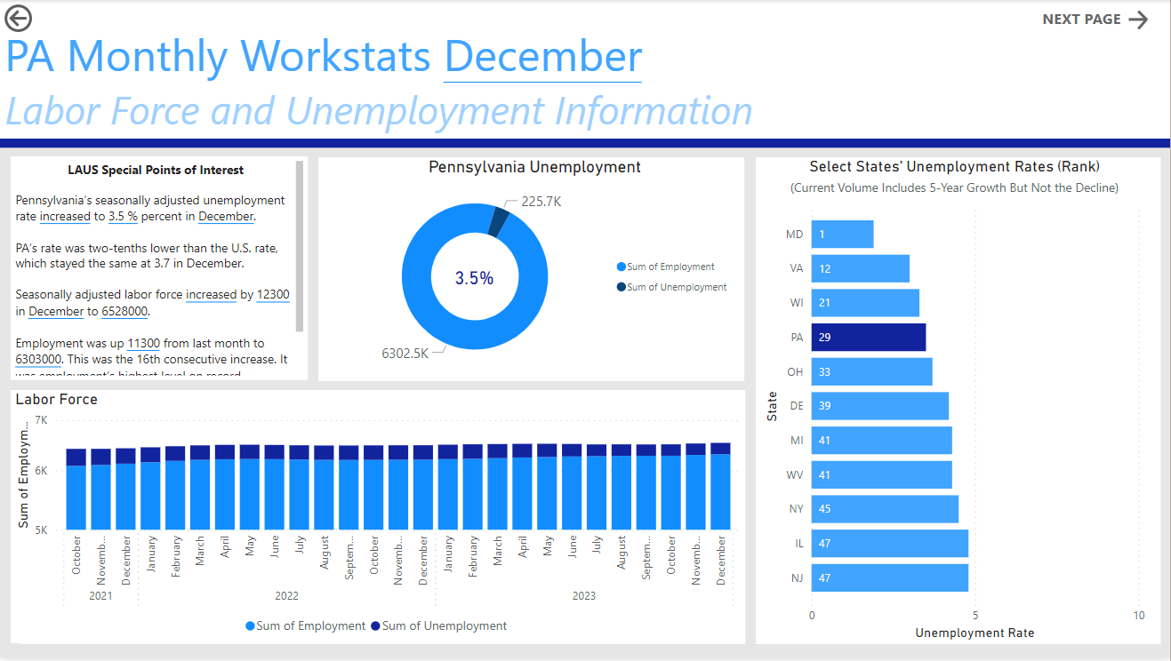
PA Monthly WorkStats Dashboard
Labor Force and Unemployment

Slide 40
PA Monthly WorkStats Dashboard
Jobs by MSA

Slide 41
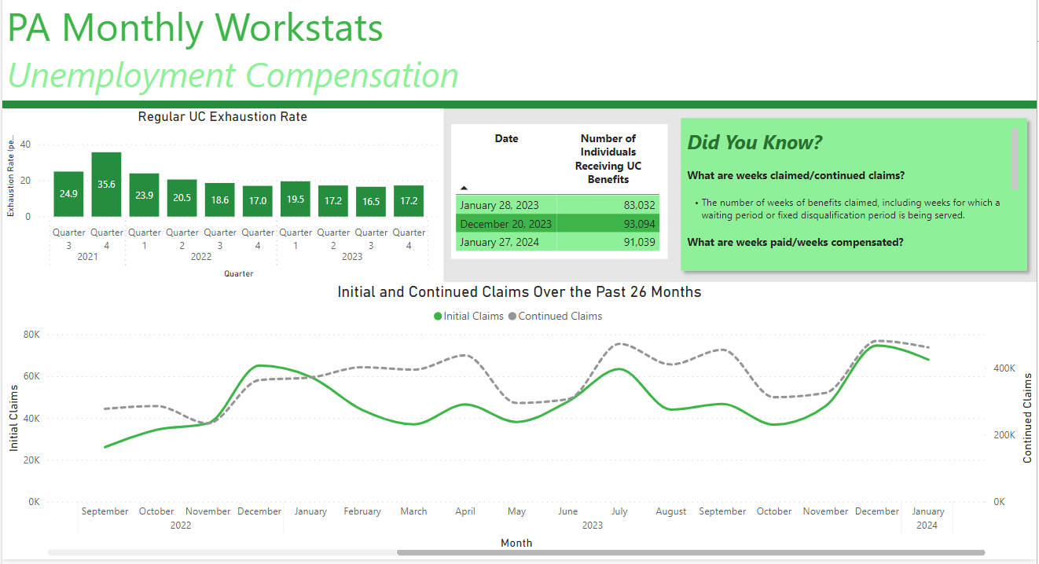
PA Monthly WorkStats Dashboard
Unemployment Compensation

Slide 42
PA Monthly WorkStats Dashboard
Press/CWIA Updates

Slide 46
Thank you! Questions?

Slide 47
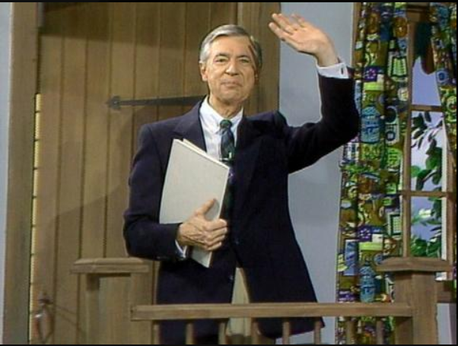
Our LMI Forum may be over, but we’d like to leave you with CWIA’s rendition of Mr. Roger’s “It’s Such a Good Feeling” song
(Weekend Version)”
It's such a good feeling A very good feeling The feeling you know…
That we'll be back…
when the data is new
And we'll have more ideas for you
And you'll have things you'll want to talk about…
We will, too!

