Slide 1
The UC That We See
Unemployment Compensation
Research and Reports

Slide 2
Unemployment Compensation
History
Social Security Act of 1935
U.S. Department of Labor oversees the system
Each state administers its own program
Objectives
Provide temporary and partial wage replacement to involuntarily unemployed workers
Help stabilize the economy during recessions

Slide 3
Financing Overview
Employer and employee taxes
Contributory and reimbursing employers
$10,000 taxable wage base
UC Trust fund
$3.4 billion at the end of CY2019
$6.6 billion total benefits paid in 2020
$28 million at the end of CY2021 with $790 million in federal loans
Federal loan balance peaked at $1.6 billion in mid-2021

Slide 4
Benefits Overview
Covers most nonfarm employment
Does not include all unemployed workers
577,000 claimants received UC in 2021
Peaked at 1.4 million in 2020
Previous peak was 926,000 in 2009
Weekly payments of $68-$583
Average payment $378.83
Maximum payment increased to $594 for 2022
18-26 weeks duration
Average duration 19.2 weeks

Slide 5
Employment & Training Administration (ETA)
Oversees Federal system
Emergency and other special programs
Sets regulations that apply to all states
Provides training and other guidance
Publishes statistics at the national level

Slide 6
Department of Labor & Industry
Operates the state system
Determines tax rates and collects taxes from employers
Takes applications and pays benefits
Resolves disputes through appeals
Investigates fraud

Slide 7
CWIA – UI Research & Reports
ETA Reports – about 44 distinct reports
Taxes
Claims and benefits paid
Appeals
Overpayments
Actuarial Evaluation
Calculate system parameters
Solvency measures
Statewide average weekly wage
Projections
Monthly cash flow simulation
Proposed legislation
Profiling Model for RESEA (Re-Employment Services and Eligibility Assessment)
Ad Hoc Requests

Slide 8
UC – Key Terms
Initial Claims: Any notice of unemployment filed to request determination of UC eligibility.
Includes New, Additional, and Transitional
Continued Claims: Subsequent weeks of unemployment for which benefits are paid if claimant meets requirements.
Includes waiting weeks and any disqualification periods being served
Final Payments: Last regular benefit payment a claimant receives because they have exhausted the full amount of benefits to which they are entitled.
Does not include those that draw a final payment due to their benefit year expiring

Slide 9
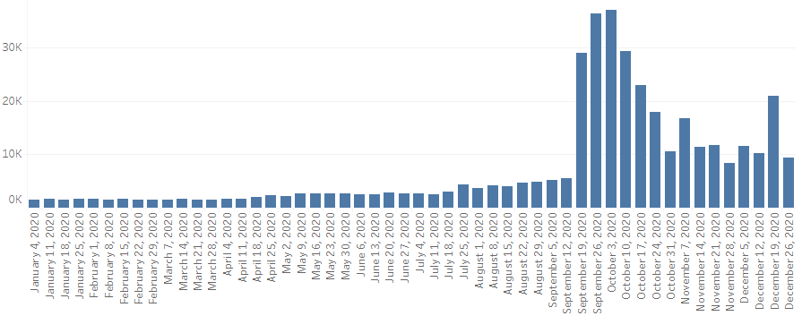
2020 Claims & Final Payments
Initial Claims
Continued Claims
Final Payments

Slide 10
UC Programs
UC – Regular Unemployment Compensation (up to 26 weeks)
UCFE – Unemployment Compensation for Federal Civilian Employees (up to 26 weeks)
UCX – Unemployment Compensation for Ex-Service Members (up to 26 weeks)
STC – Short-Time Compensation (also known as “workshare”) (up to 26 weeks)
Reduced hours instead of being laid off
PEUC – Pandemic Emergency Unemployment Compensation (up to 53 weeks)
PUA – Pandemic Unemployment Assistance (up to 79 weeks)
Available to those that are usually ineligible for UC
EB – Extended Benefits (up to 13 weeks)

Slide 11
RESEA
Re-Employment Services and Eligibility Assessment (RESEA)
Seminars for assisting claimants in searching for re-employment
Failure to comply with RESEA results in loss or delay of unemployment benefits
Penalty for failing to comply varies from state to state
Reported on the federal ETA-9128
Profiling model selects claimants who are most likely to exhaust benefits
The program was momentarily paused from March 2020 through January 2021 due to pandemic
Even an aspiring latex salesman needs to show proof of job seeking.

Slide 12
CWIA Data Sources
Benefits Modernization System (BenMod)
Pennsylvania’s new benefit system launched in June of 2021
Consists of unemployment compensation data
Claims, payments, determinations, overpayments, appeals
Unemployment Compensation Management System (UCMS)
Tax records
Contributory/Reimbursable employers
New Hire Data Mart (NHDM)
Wage records for all PA workers

Slide 13
PA UC Public Data Sources
CWIA Website: www.workstats.dli.pa.gov
Unemployment Compensation Claims Dashboard
Claims/exhaustees by county, industry, age, race, and gender
Unemployment Compensation Program Data
Historical Weekly Claims each quarter
Pennsylvania’s Economic Portrait
Interactive dashboard that can breakout claims/exhaustees data by time period
Visual claims/exhaustees comparisons by industry, age, race, gender
Actuarial Evaluation - Annual summary of the UC program
Historical/Forecast data
Required by law

Slide 14
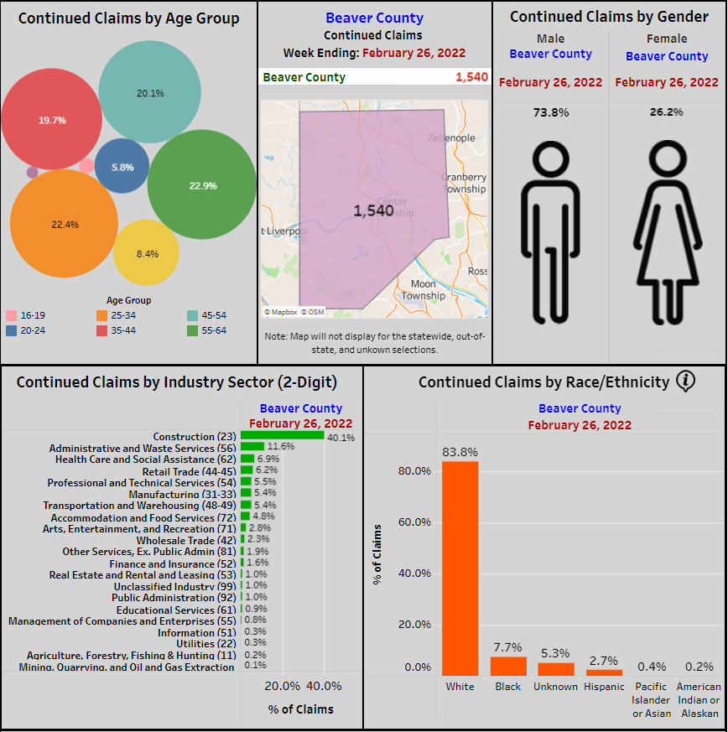
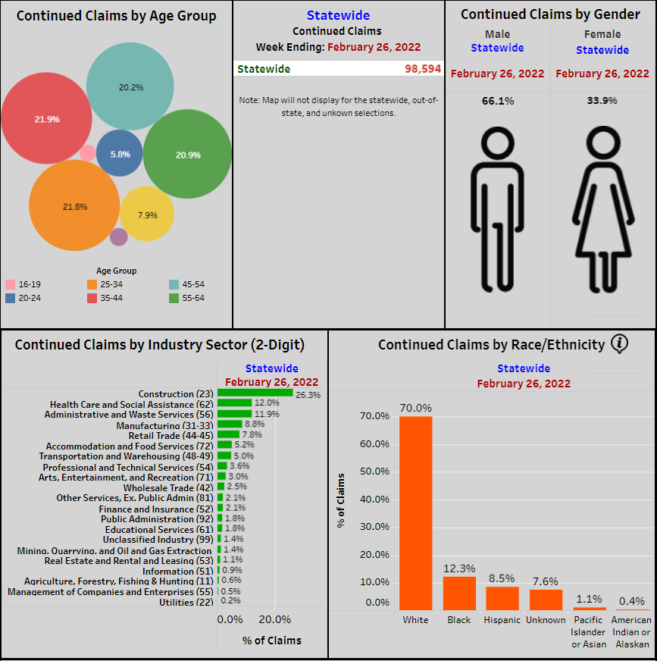
Weekly Unemployment Compensation Claims Dashboard
Beaver County
Statewide

Slide 15
PA Unemployment Compensation Activity
Pennsylvania Unemployment Compensation Program Data
Initial and Continued claims by County and Industry
Available in Excel or PDF

Slide 16
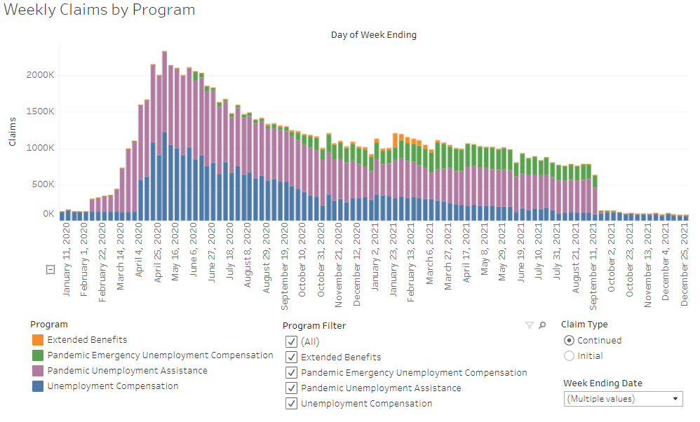
Pennsylvania’s Economic Portrait
Data dashboards are produced with Tableau which allows users to filter the data as they please.

Slide 17
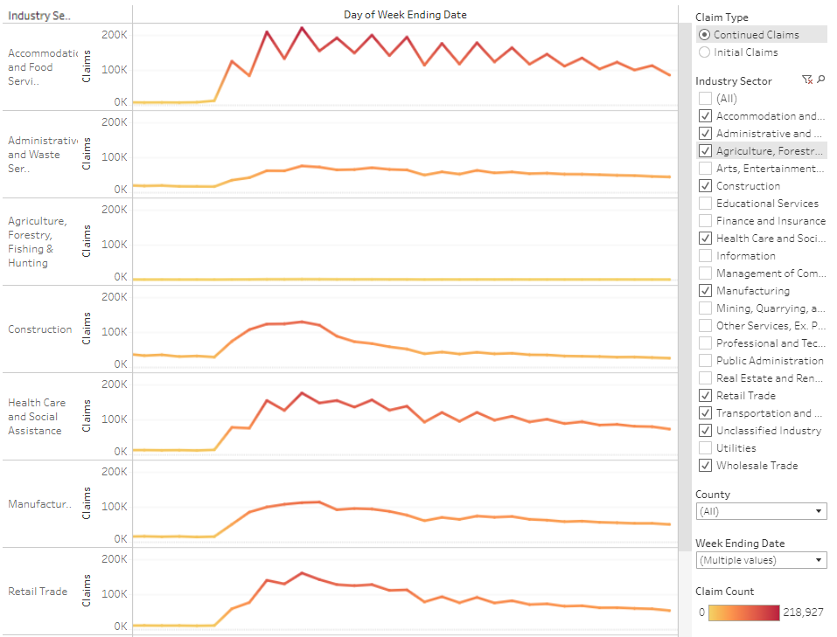
Pennsylvania’s Economic Portrait
Comparison of claims/exhaustions
Industry
County
Age
Race
Gender
The graph shown compares industry continued claims for the first 9 months of 2020.
Jan 2020 Sep 2020

Slide 18
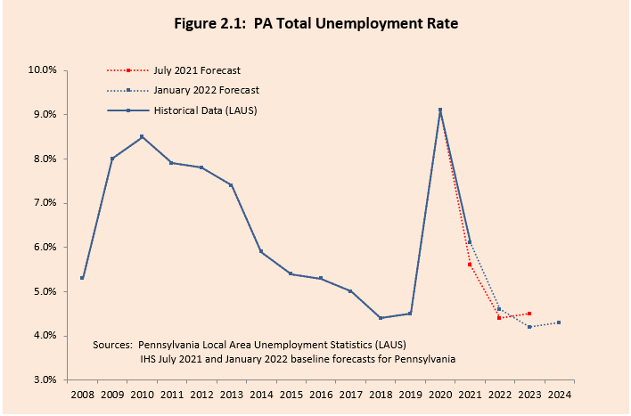
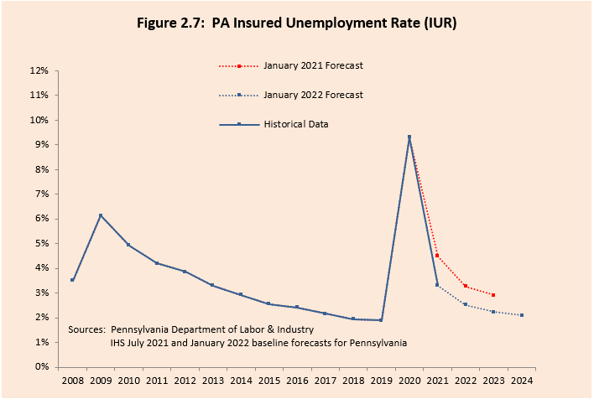
Actuarial Evaluation
(TUR)
Total Unemployed Divided by Civilian Labor Force
(IUR)
Insured Unemployed Divided by Covered Employment
2021 Actuarial Evaluation

Slide 19
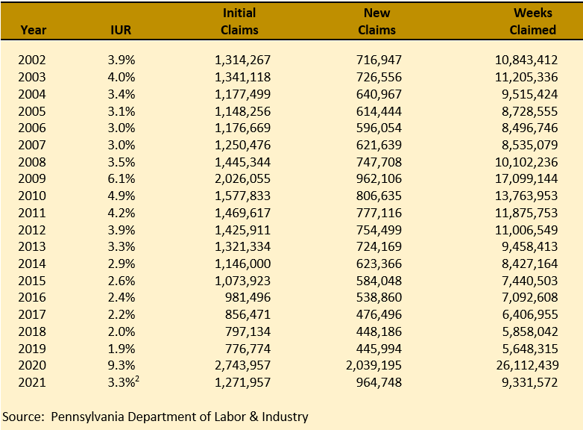
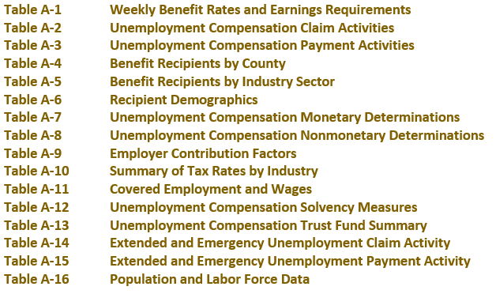
Actuarial Evaluation: Historical Claims
The Actuarial Evaluation includes tables of historical data in the appendix

Slide 20
Pennsylvania Trust Fund
Each state has a UC Trust Fund that is maintained at the U.S. Treasury
Unemployment insurance taxes flow into state UC trust fund accounts which are then used to pay out benefits to claimants.
The majority of UI taxes come from employers, but employees also pay a small tax on their wages
PA taxable wage base for employers: $10,000
PA employee tax: 0.06%
Solvency measures
A trust fund’s solvency is determined by the amount in the trust fund divided by the amount of benefits paid over the past 3 years
Tax rates are determined by each state’s solvency percentage on June 30th of each year
Federal Loans are available to states when benefits exceed Trust Fund balances

Slide 21
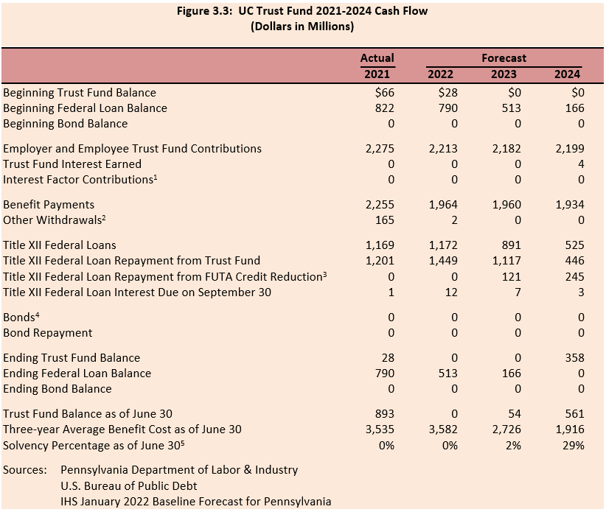
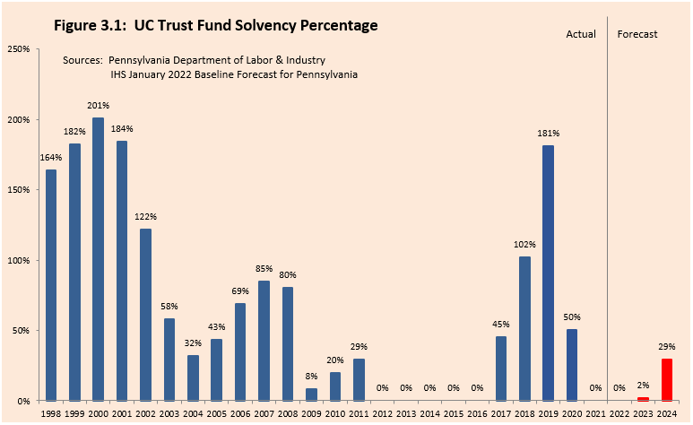
Pennsylvania Trust Fund
The Actuarial Evaluation includes information on Pennsylvania’s UC trust fund.
2021 Actuarial Evaluation

Slide 22
UC Public Data Sources continued…
Employment & Training Administration (ETA) website: https://oui.doleta.gov/unemploy/DataDashboard.asp
Weekly, monthly, quarterly data for all States
Weekly – Initial/Continued Claims
Monthly – First/Final payment counts, benefits paid
Quarterly – Labor force, wages, tax revenue, trust fund, extended benefits, loans
UI laws, regulations, and guidance
Handbooks and updated legislation on UI law
Solvency measures and trigger notices for extended benefits
Federal reports for all states
Data validation information center

Slide 23
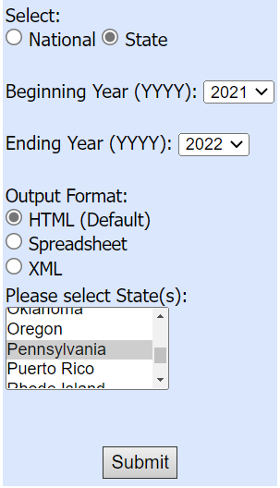
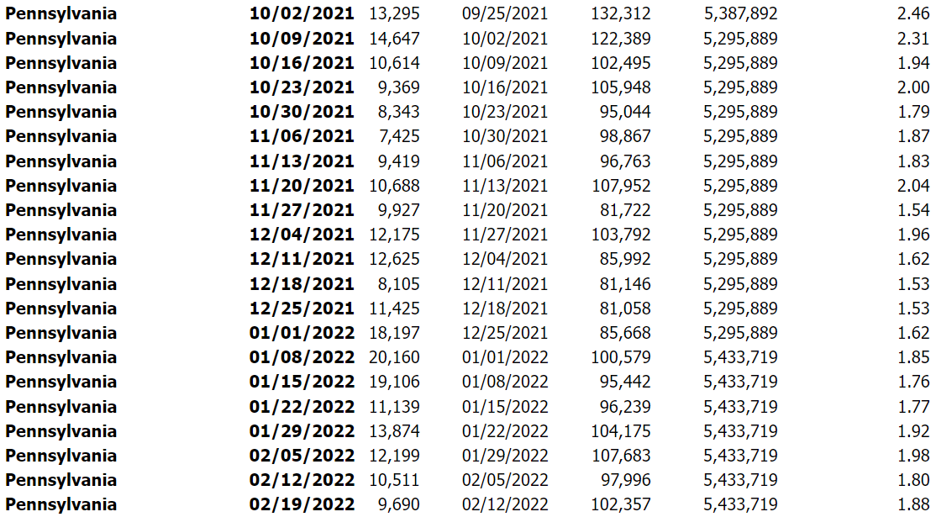
Employment & Training Administration (ETA) Data
Weekly Claims Data
Source: ETA-539

Slide 24
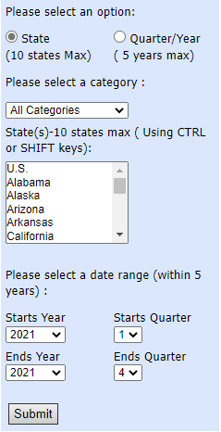
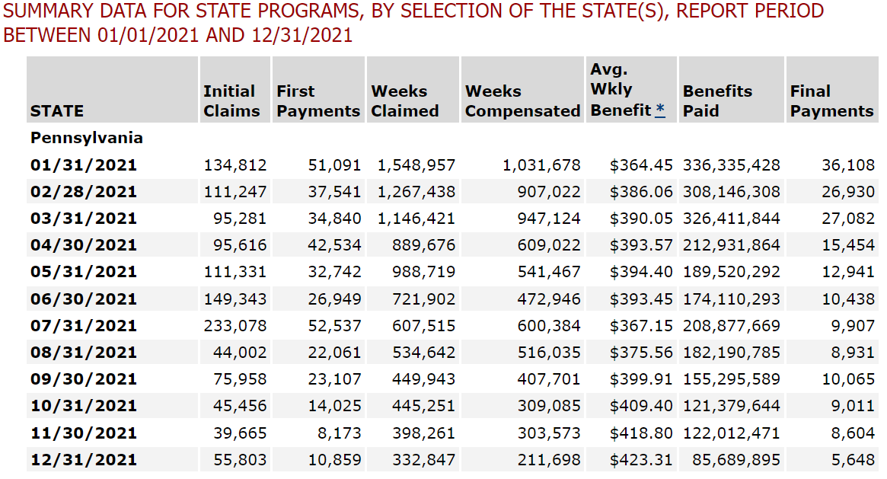
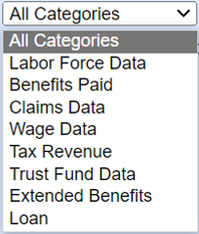
Employment & Training Administration (ETA) Data
Monthly Claims/Benefits
Source: ETA-5159
Quarterly Data

Slide 25
Relating UC Data to LMI
Economic Indicators
Initial/Continued Claims
Unemployment Rate
Insured Unemployment Rate (IUR)
Total Unemployment Rate (TUR)
Duration of benefits
Average number of weeks claimants are unemployed
Predicting Unemployment in the Future
IHS Markit forecast
Employment
Wages
Tax rates & revenue
Unemployment rates

Slide 26
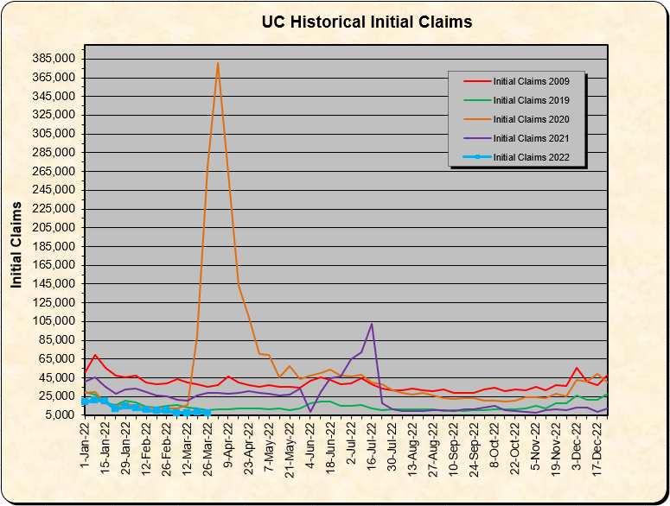
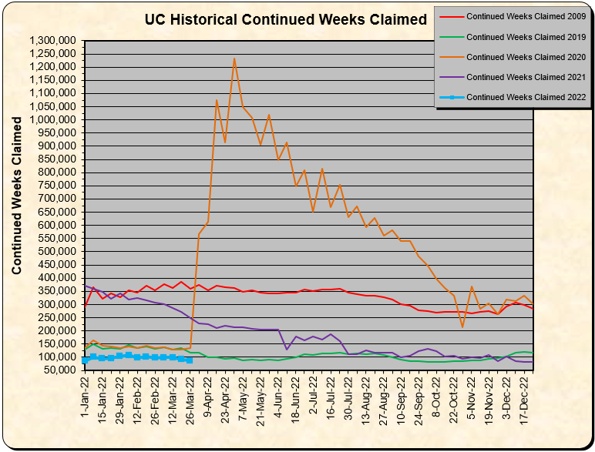
Historical Claims

Slide 27
Data Sources
Data Sources
▪ U.S. Department of Labor (ETA) website
https://oui.doleta.gov/unemploy/DataDashboard.asp
▪ CWIA website
https://www.workstats.dli.pa.gov

Slide 28
Thank you!
Any questions?

