Slide 1
YOUR LOCAL LANDSCAPE
Center for Workforce Information & Analysis (CWIA)

Slide 2
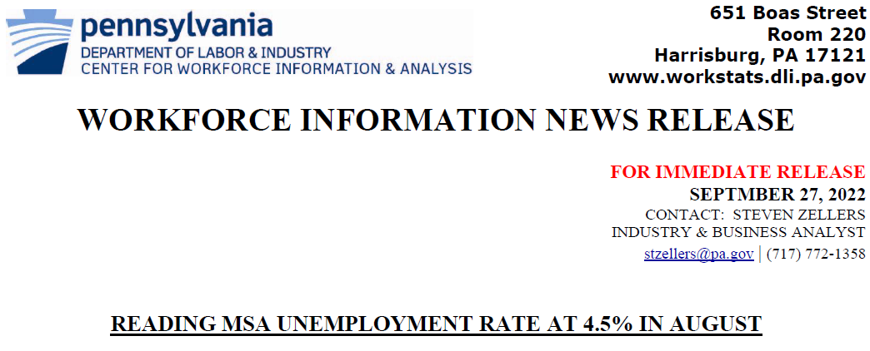
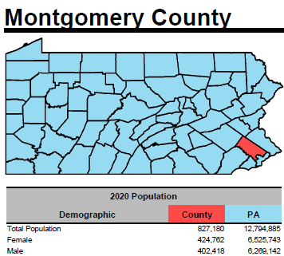
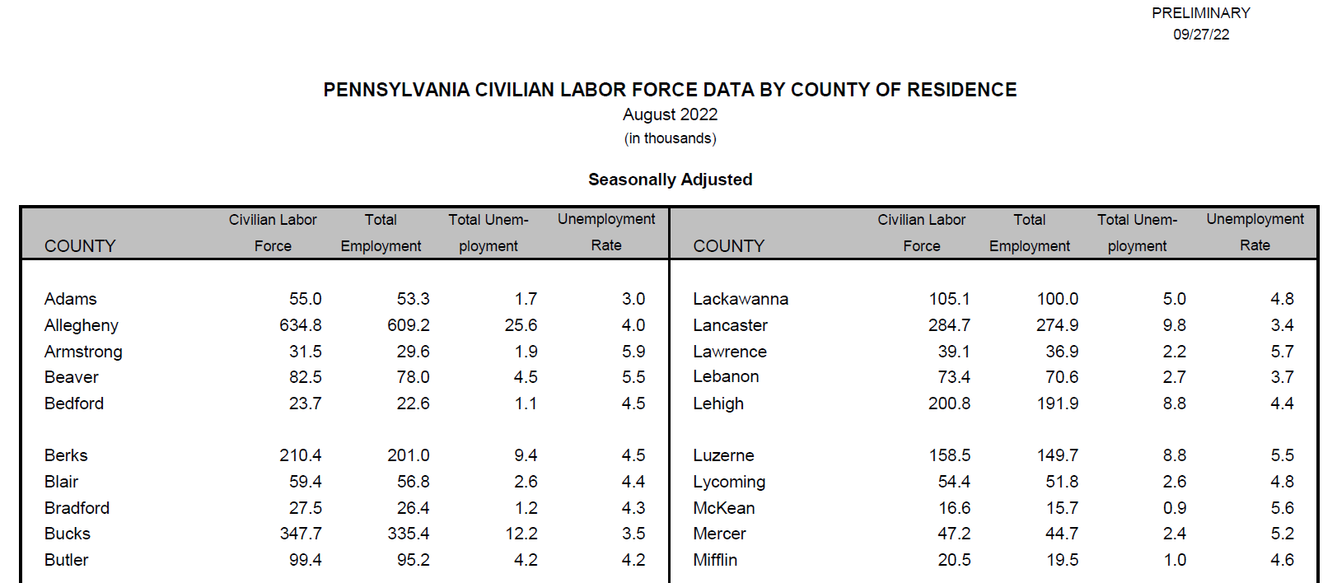
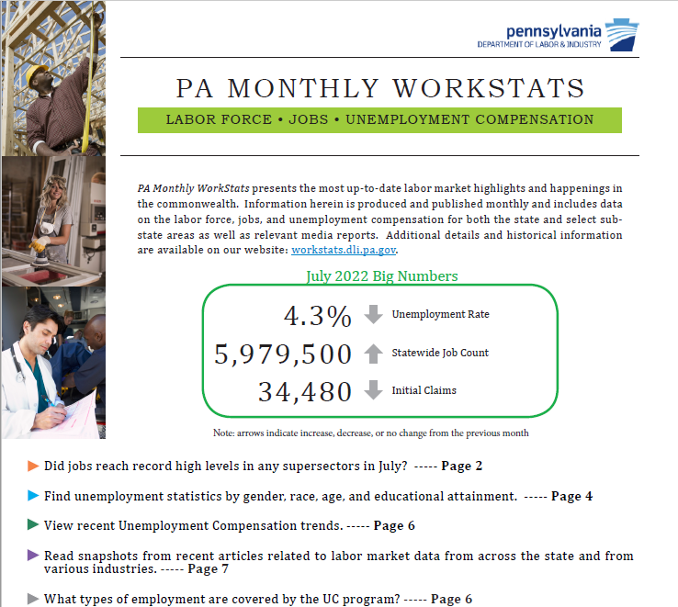
Products
Press Releases
County Profiles
Civilian Labor Force Packet
Monthly Workstats

Slide 3
Products
What do these products have in common?
Use multiple LMI “Building Blocks”
Available for different areas
Variety of data users
Most TIMELY info available

Slide 4
Press Releases
www.workstats.dli.pa.gov/MediaCenter/MonthlyNews/Pages/default.aspx

Slide 5
Press Releases
Target audience
Statistics included
Geographical coverage
Release dates
Where to get them

Slide 6
Audience
Media professionals
Workforce professionals
Employers
Job seekers

Slide 7
Statistics Included
Local Area Unemployment (LAUS)
Current Employment (CES)
Both seasonally adjusted & non-seasonally adjusted

Slide 8
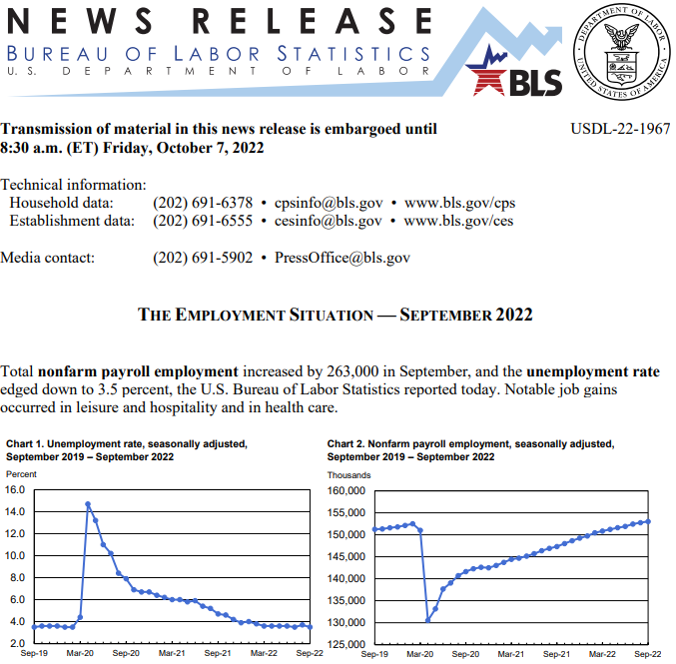
National Release (BLS)

Slide 9
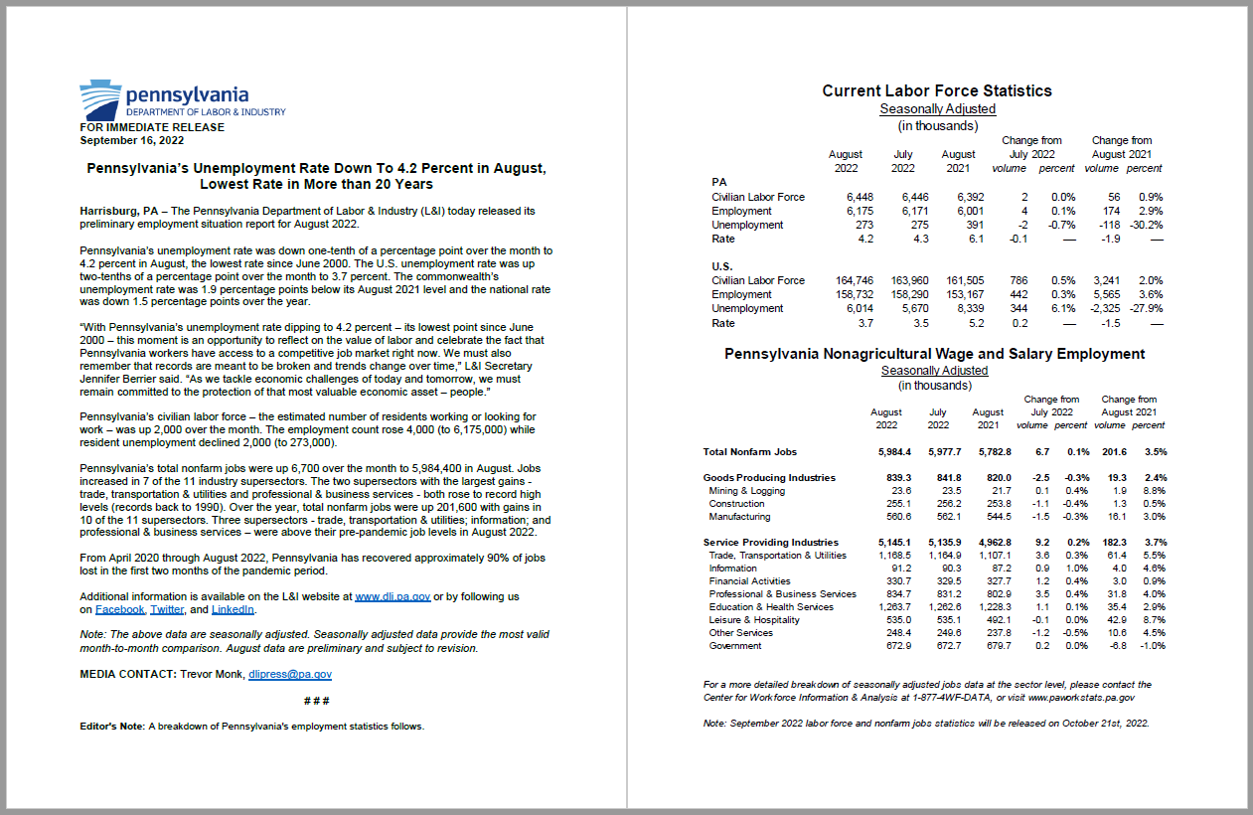
Statewide (Press Office)
https://www.media.pa.gov/pages/labor-and-industry-details.aspx?newsid=726

Slide 10
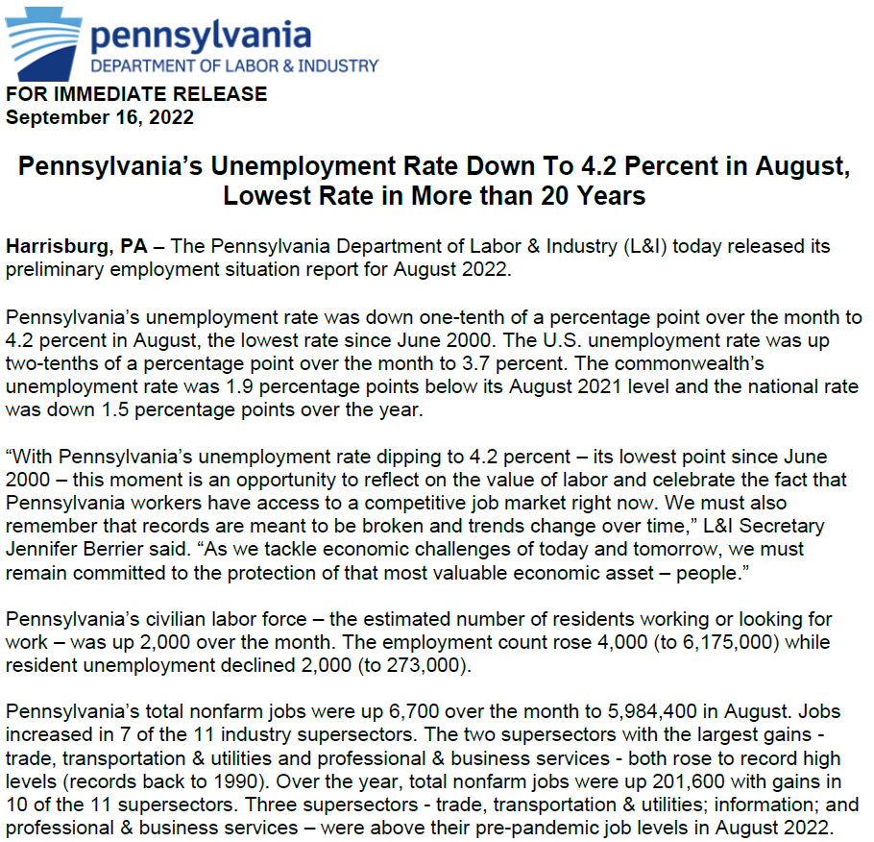
Statewide (Press Office)

Slide 11
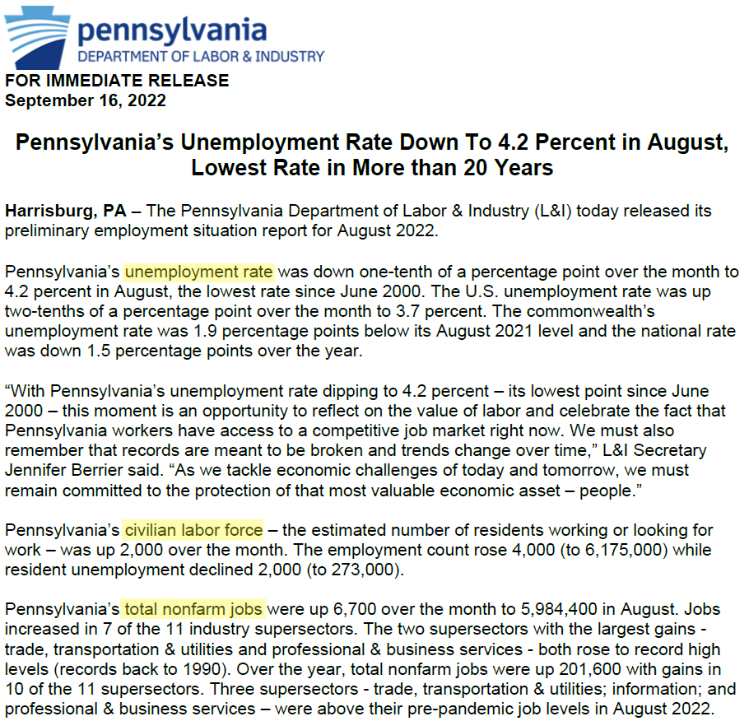
Statewide (Press Office)

Slide 12
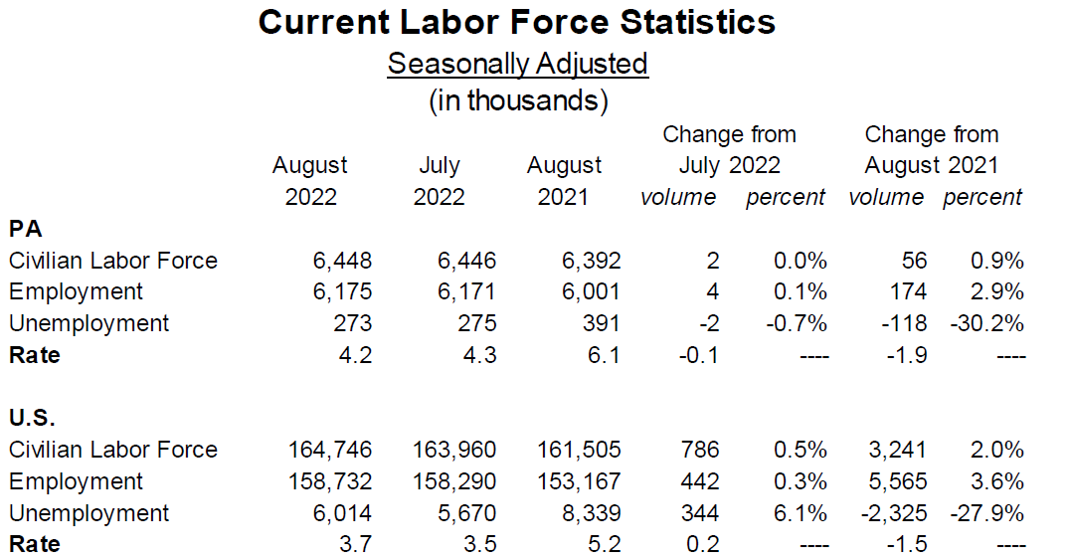
Labor Force (LAUS)

Slide 13
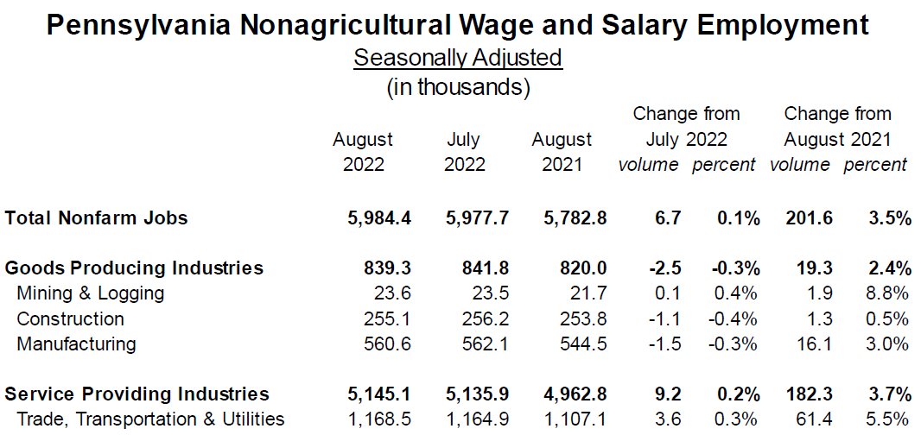
Jobs (CES)

Slide 14
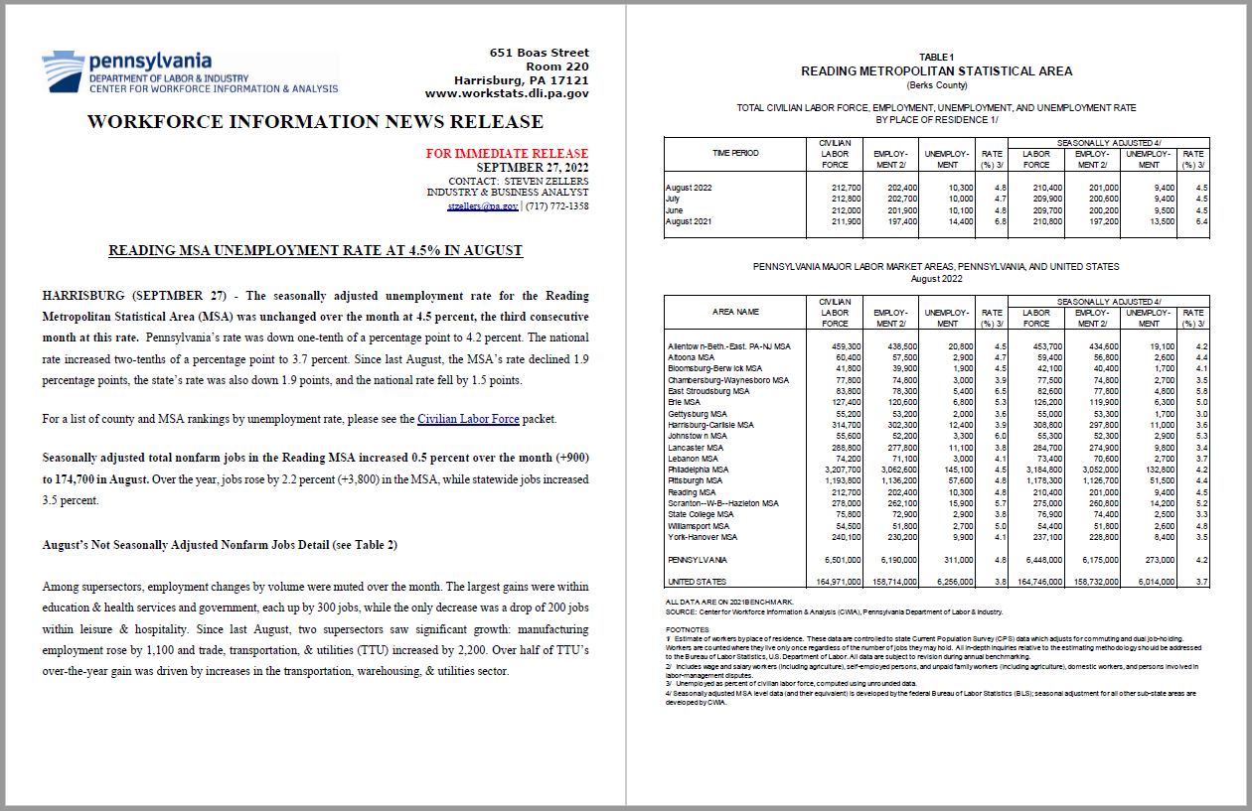
Sub-state Areas
https://www.workstats.dli.pa.gov/Documents/Monthly%20Press%20Releases/rdgmesa_pr.pdf

Slide 15
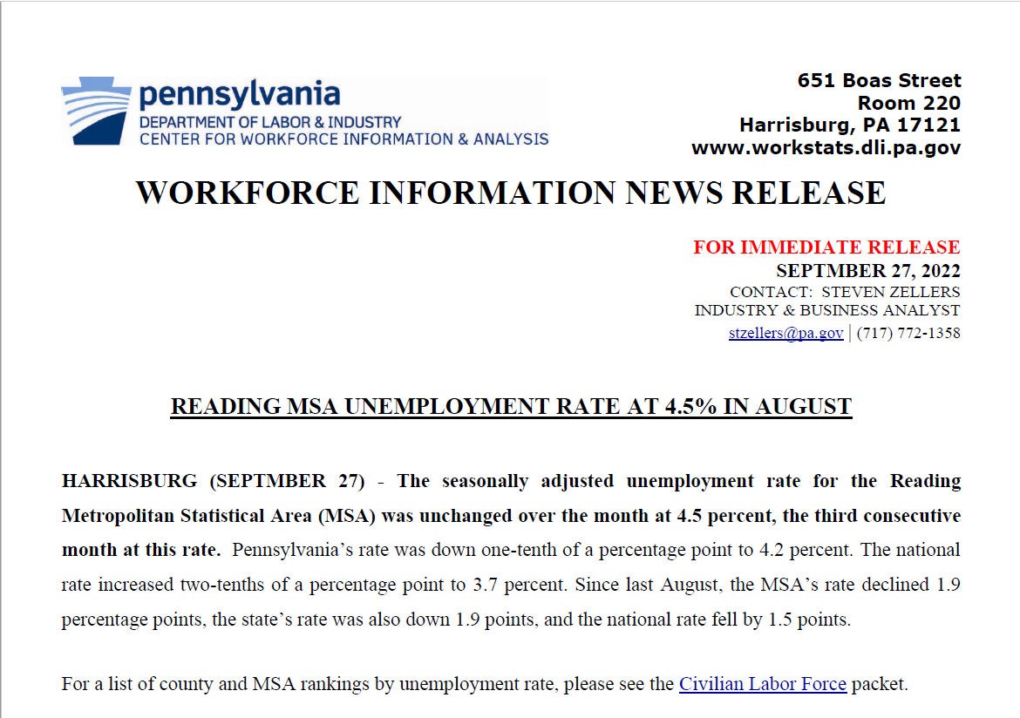
Sub-state Areas

Slide 16
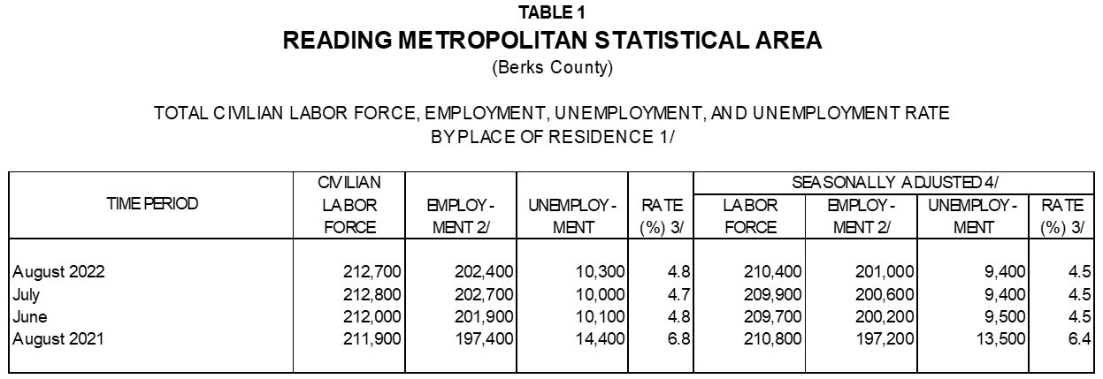
Sub-state Areas

Slide 17
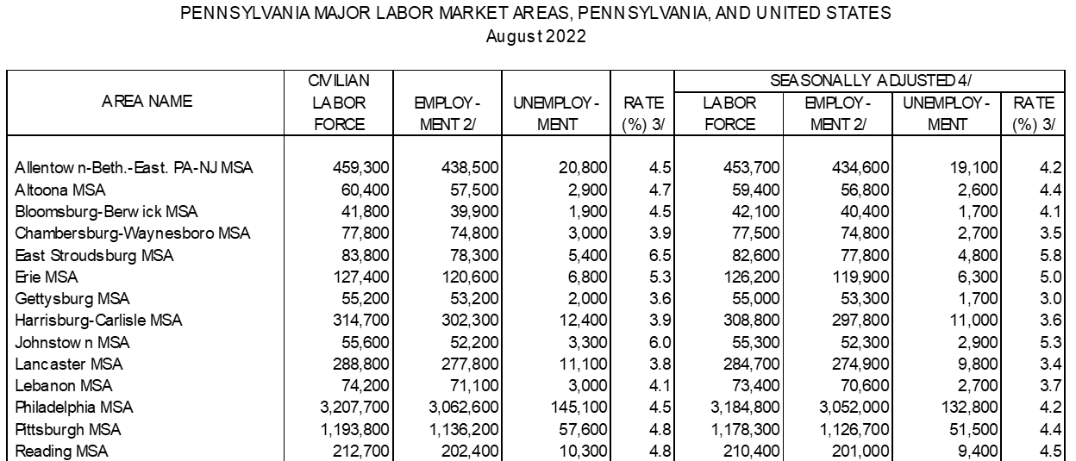
Sub-state Areas

Slide 18
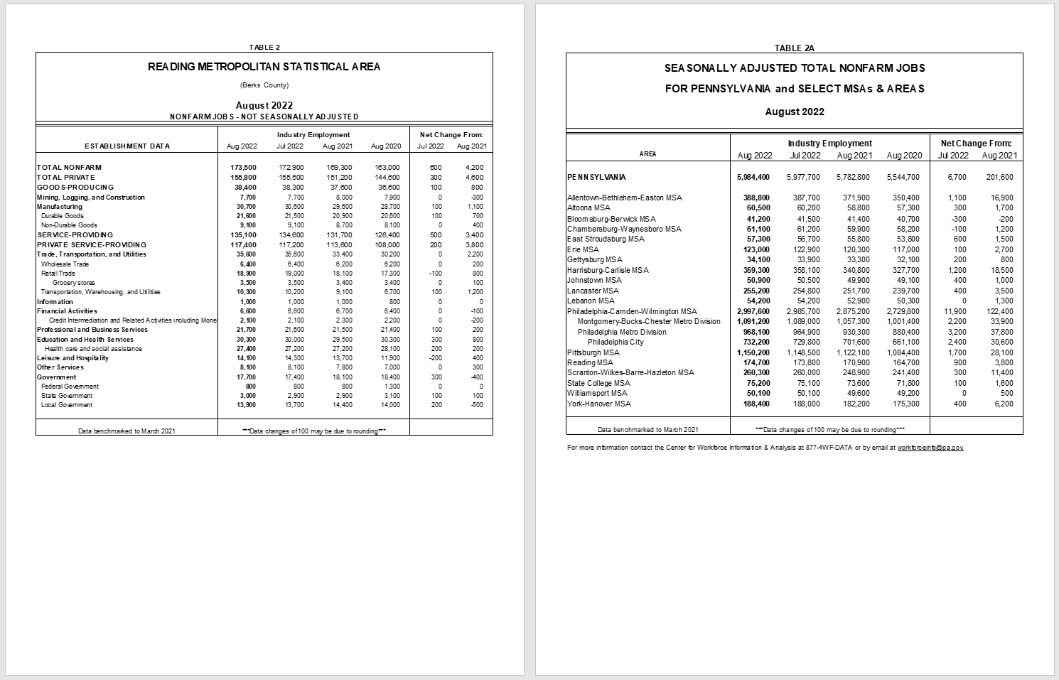
Sub-state Areas

Slide 19
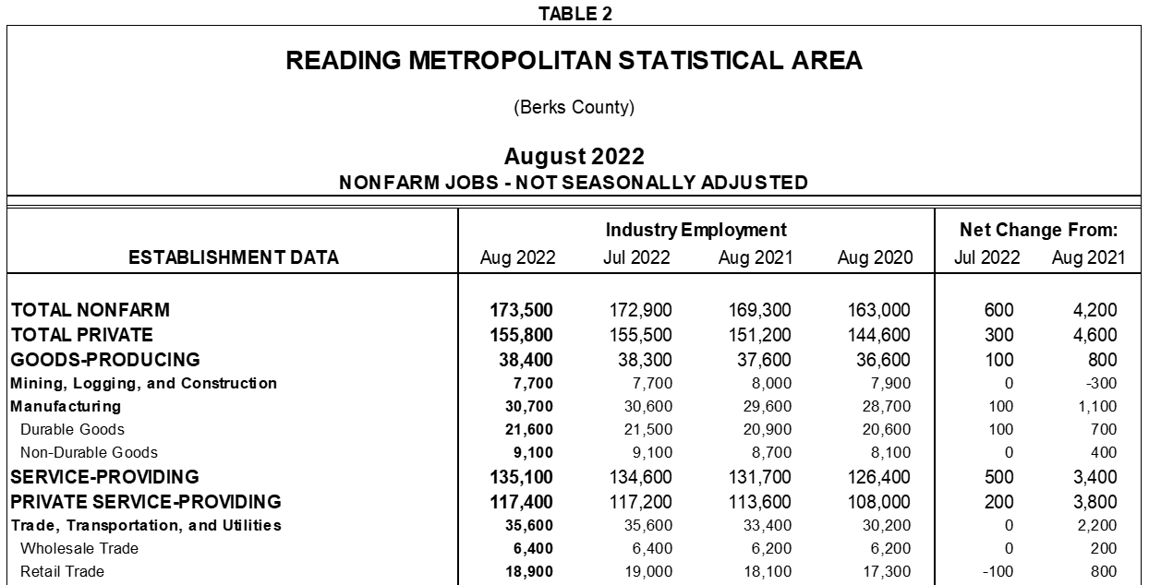
Sub-state Areas

Slide 20
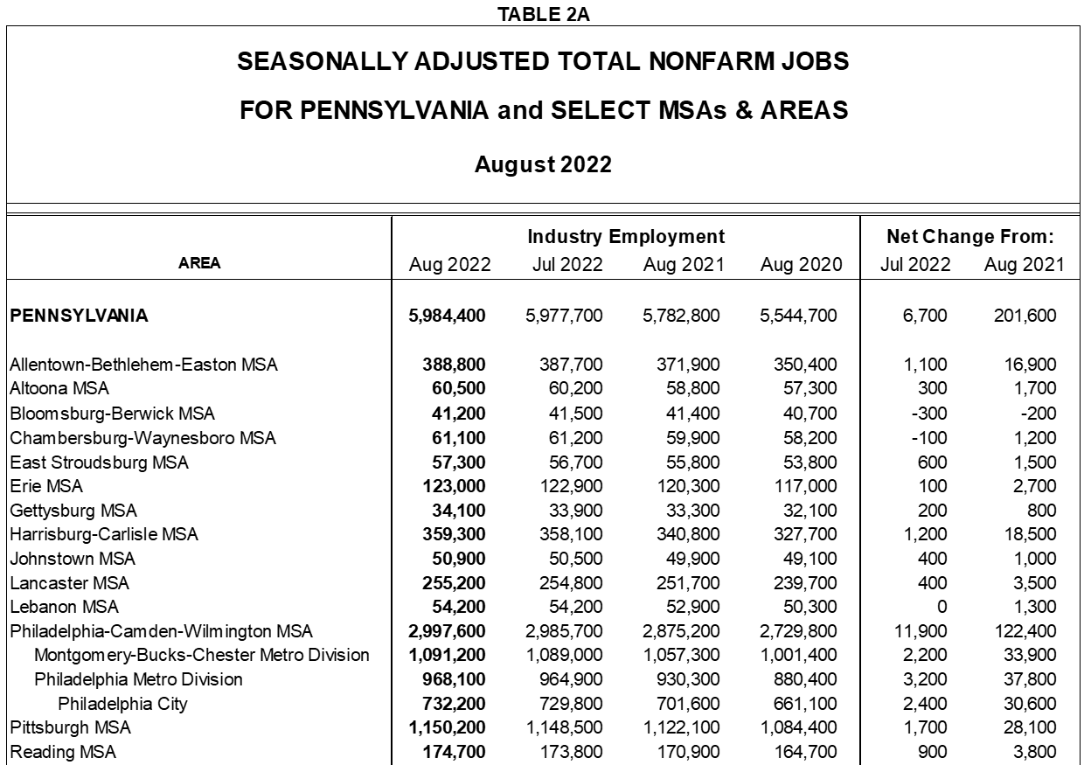
Sub-state Areas

Slide 21
Release Schedules
September Data Releases
National (BLS) – First Friday unless 1st of month
(September data released on Oct. 7th)
State (L&I / CWIA) – Two Fridays later
(September release date: Oct. 21st)
Area (CWIA) – Approx. 10 days after State Data is released
(September release date: Nov. 1st)
Notes:
blah

Slide 22
Civilian Labor Force (CLF) Packet
Civilian Labor Force Packet
www.workstats.dli.pa.gov/Documents/Monthly%20Press%20Releases/clf.pdf

Slide 23
Civilian Labor Force (CLF) Packet
Supplement to the Press Releases
Released at same time as local data
Located in MEDIA CENTER
LAUS data, broken down by:
Geography
Time Frames
Seasonal Adjustment

Slide 25
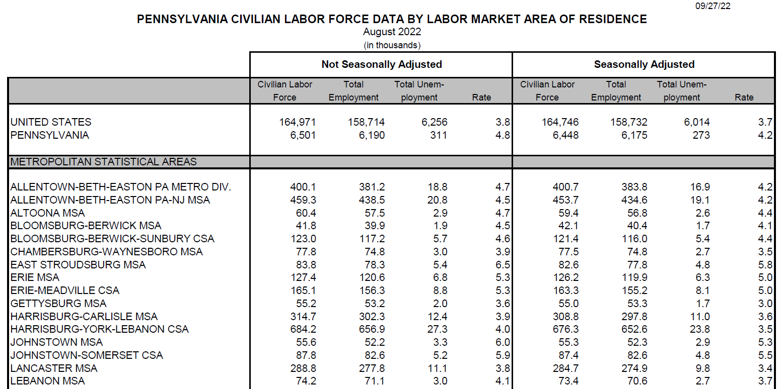
CLF – MSA Comparison

Slide 26
CLF – County Comparison

Slide 27
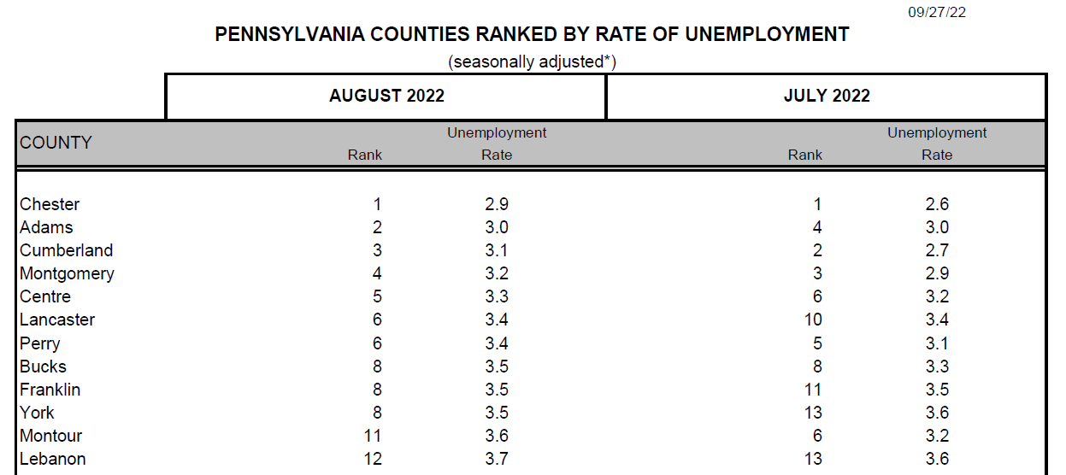
CLF – County Rankings

Slide 28
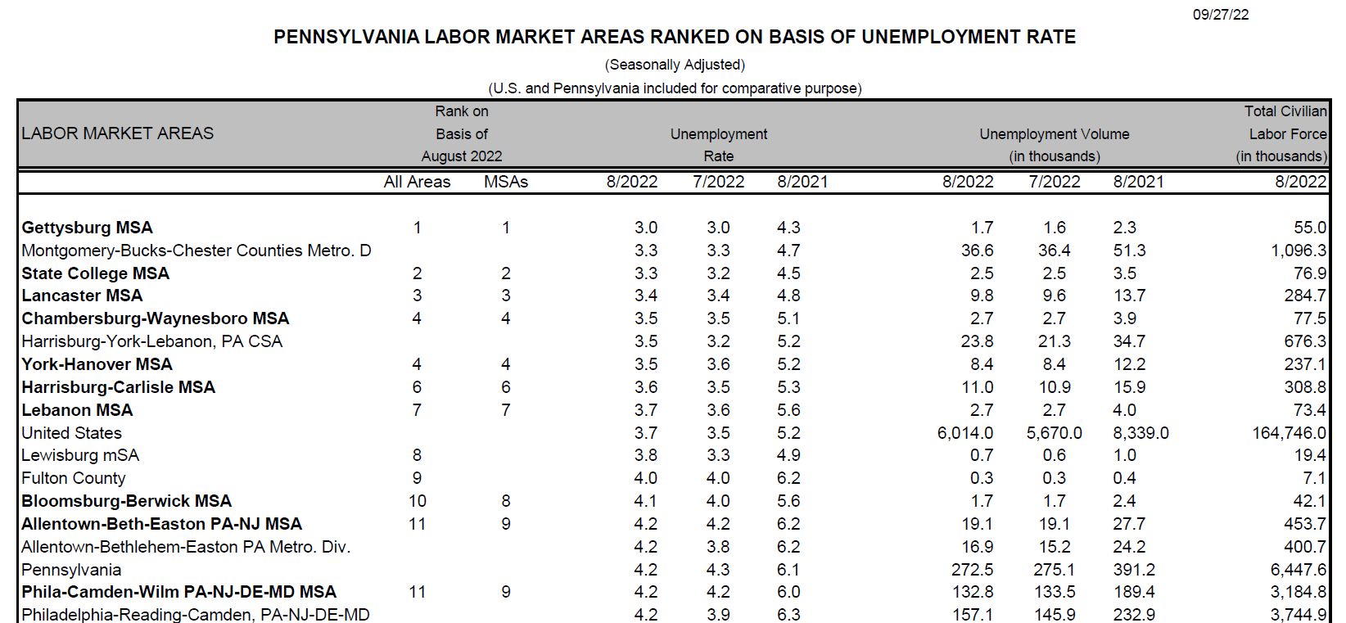
CLF – Labor Market Area Rankings

Slide 29
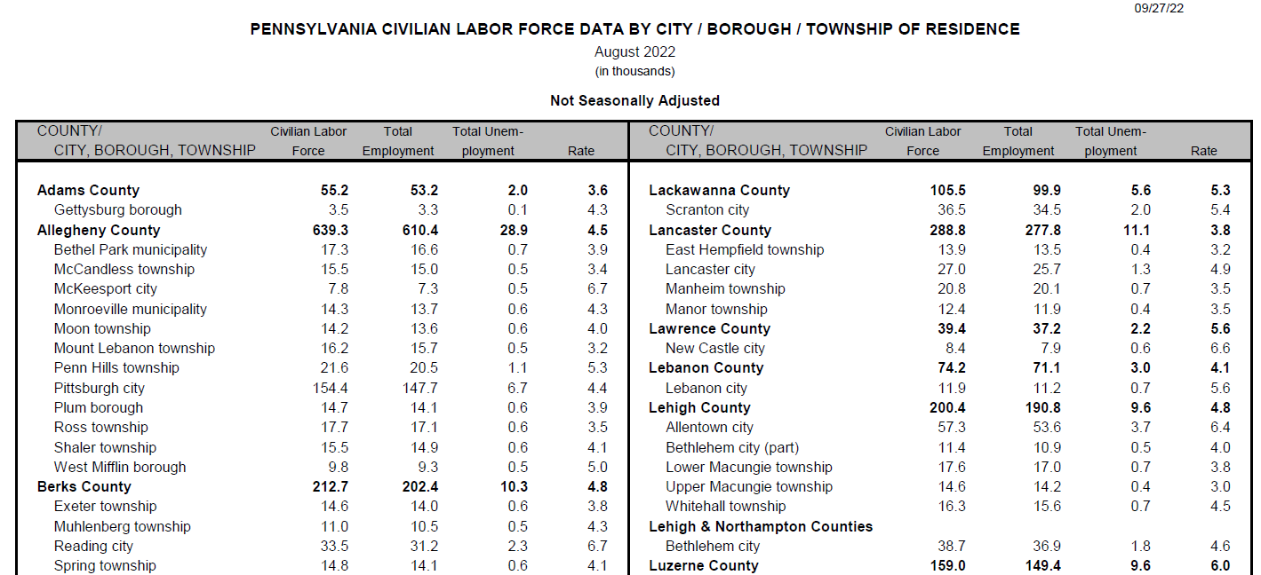
CLF – Minor Civil Divisions

Slide 30
PA Monthly Workstats
www.workstats.dli.pa.gov/Documents/PAMW/PAMW.pdf

Slide 31
Pennsylvania Monthly Workstats
Fast Facts, anyone?
8-page document
Location: Products A to Z
Features:
“Big Numbers”
CES (Jobs data)
LAUS (Labor Force data)
UC Claims data
Pennsylvania Employer Activity

Slide 32
Pennsylvania Monthly Workstats

Slide 33
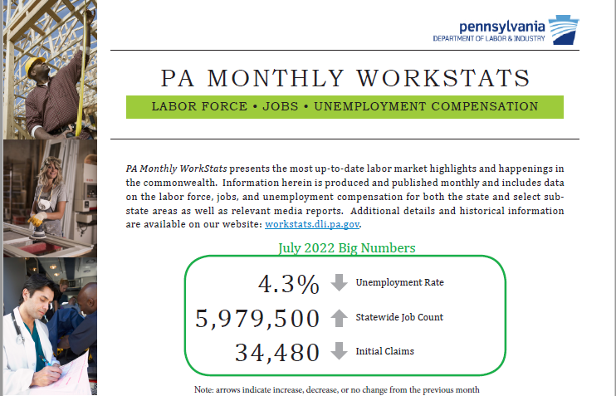
Monthly Workstats – Big Numbers

Slide 34
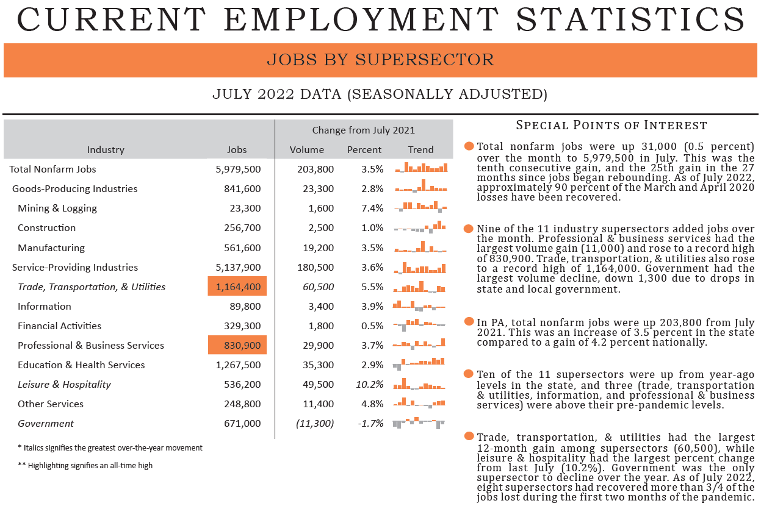
Monthly Workstats – Jobs (CES)

Slide 35
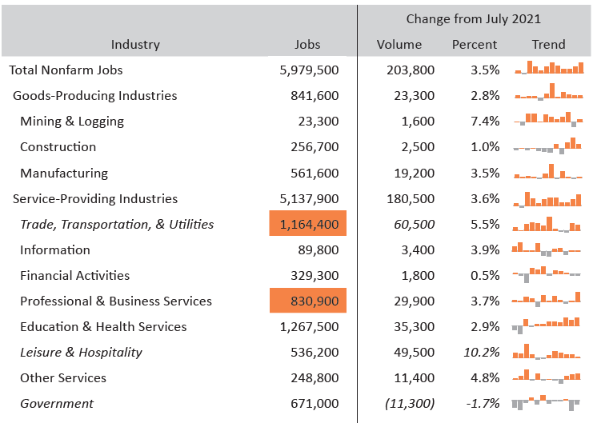
Monthly Workstats – Jobs (CES)

Slide 36
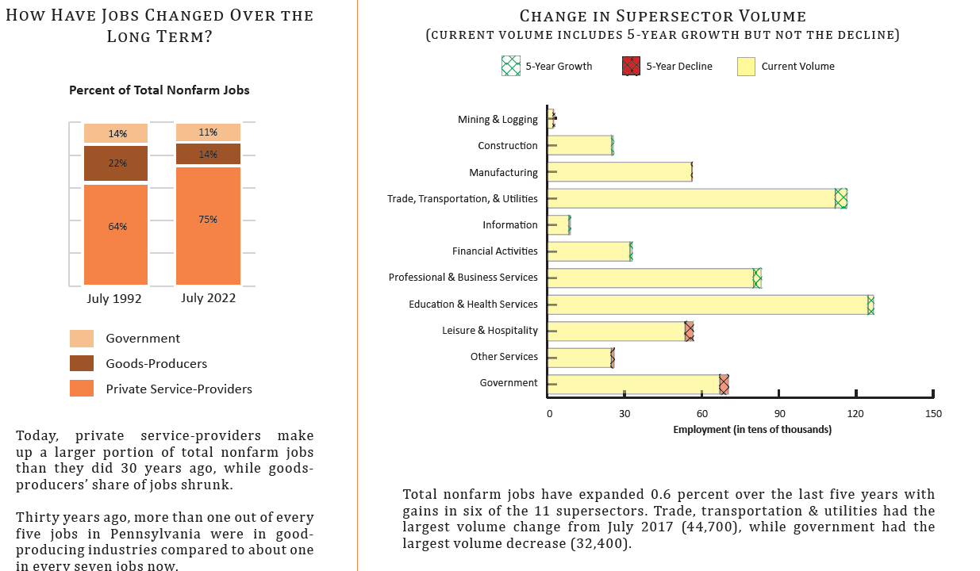
Monthly Workstats – Jobs (CES)

Slide 37
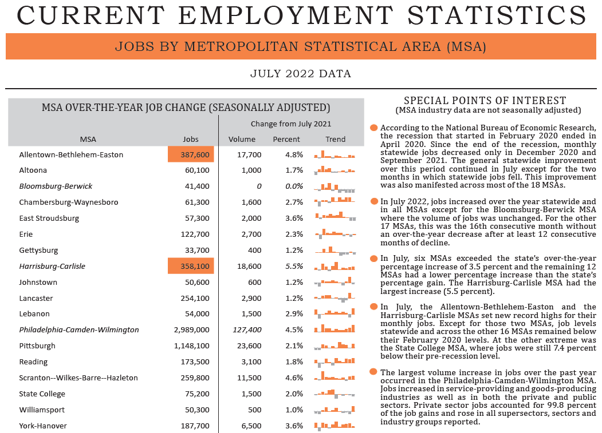
Monthly Workstats – Jobs (CES)
Notes:
Page 3 top cropped table and text

Slide 38
Monthly Workstats – Jobs (CES)
Notes:
Page 3 top cropped table only

Slide 39
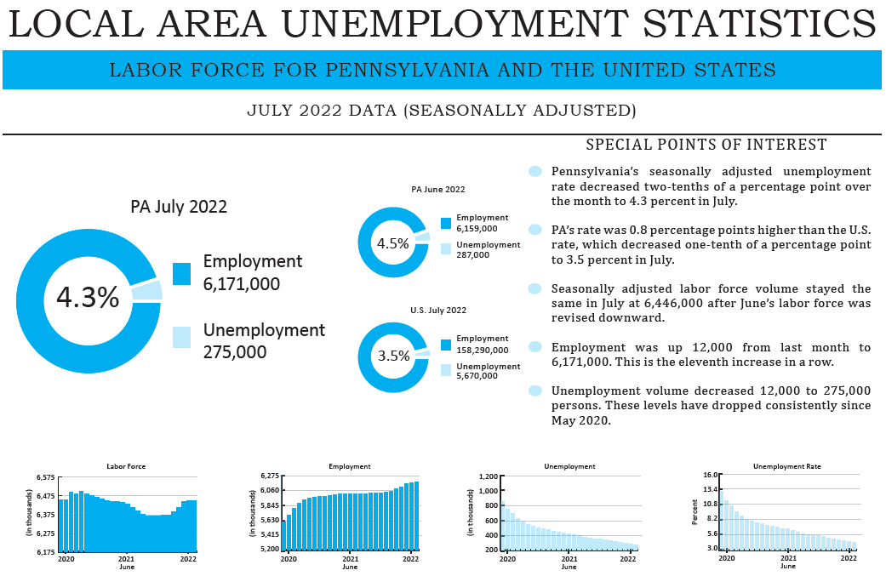
Monthly Workstats – Labor Force (LAUS)

Slide 40
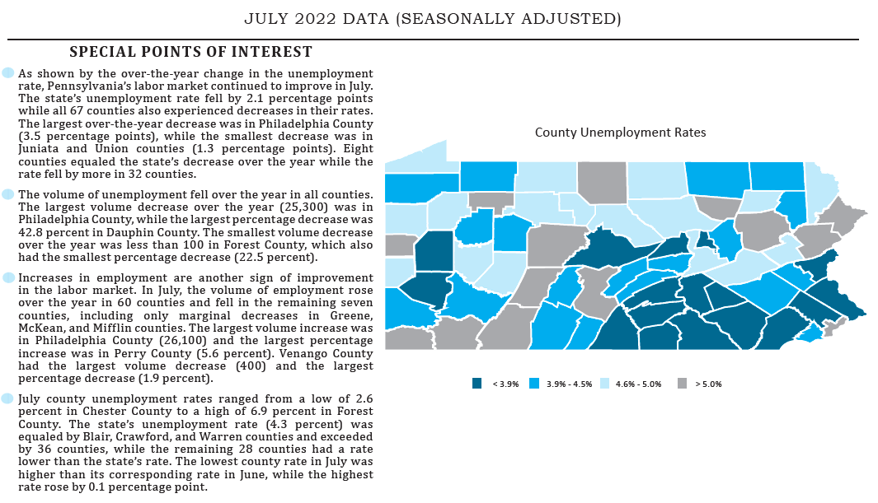
Monthly Workstats – Labor Force (LAUS)
Notes:
Cropped out top 2 headings

Slide 41
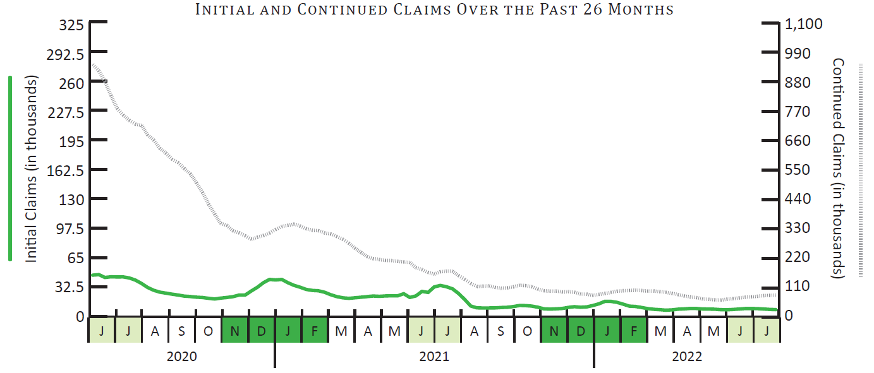
Monthly Workstats – UC Claims Data

Slide 42
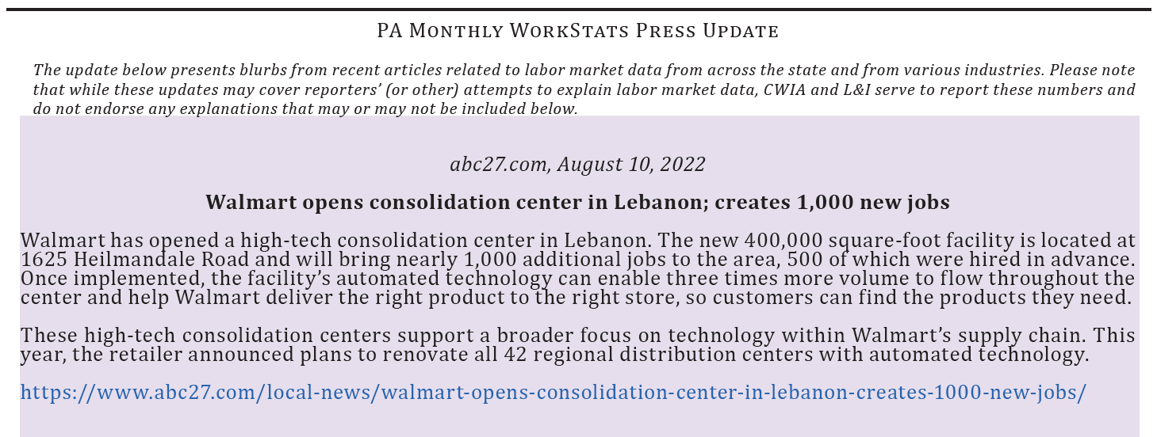
Monthly Workstats – Press Update

Slide 43
Area Profiles
www.workstats.dli.pa.gov/Products/CountyProfiles/Pages/default.aspx

Slide 44
Area Profiles
2-page document
Economic snapshot by geography
Location: Products A to Z
(Note: County and WDA Profiles list separately)
Multiple data programs, including:
Census, BEA
Job Openings (Help Wanted On-line)
QCEW (Establishments, Jobs, Wages)
Occupational Wages

Slide 45
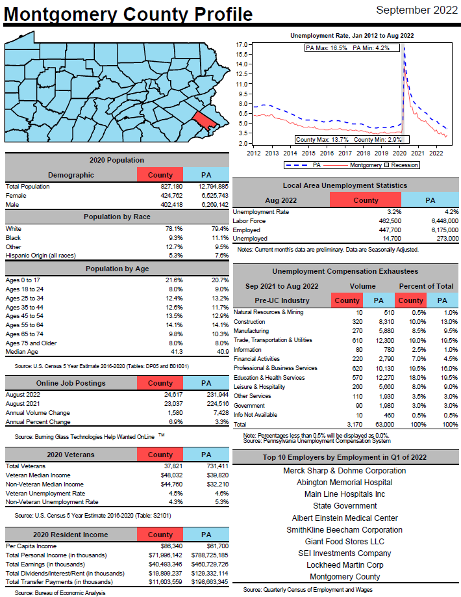
Area Profiles

Slide 46
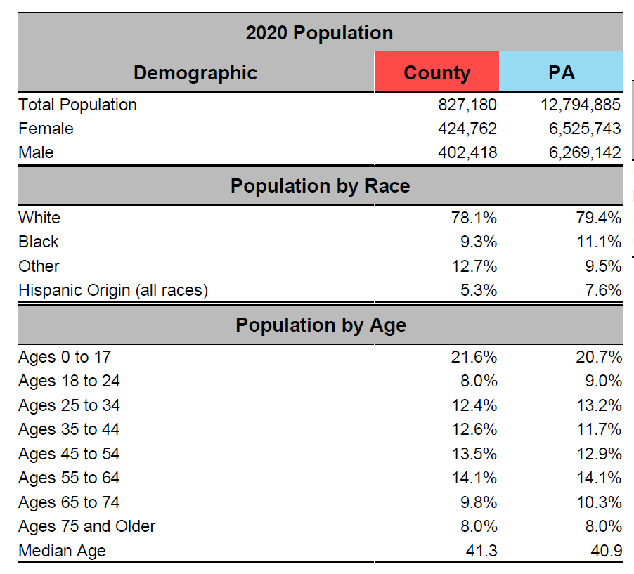
Area Profiles – Population/Census

Slide 47
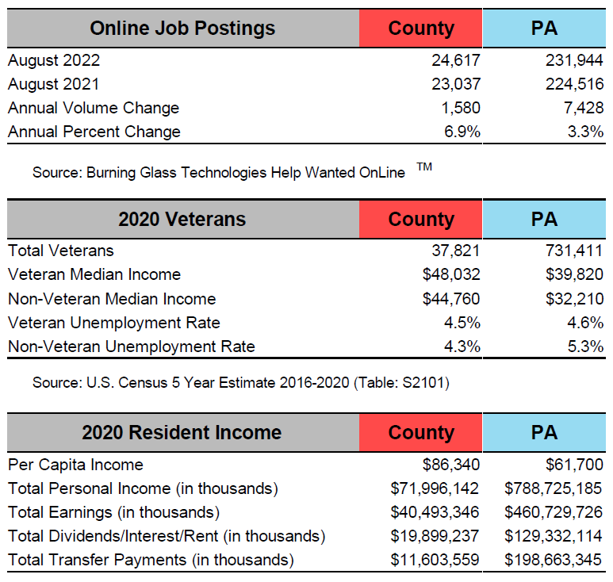
Area Profiles – HWOL/Census/BEA

Slide 48
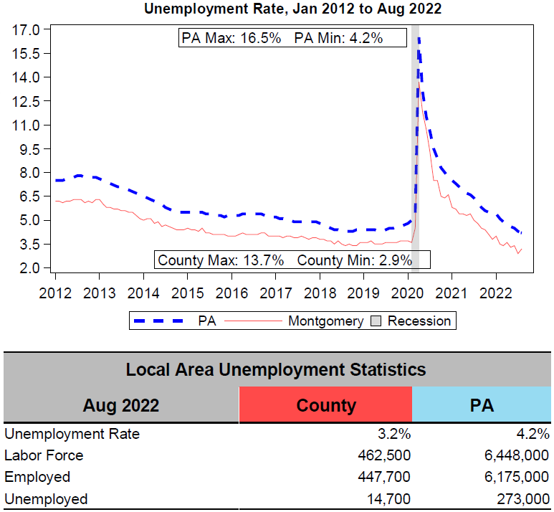
Area Profiles – Labor Force (LAUS)

Slide 49
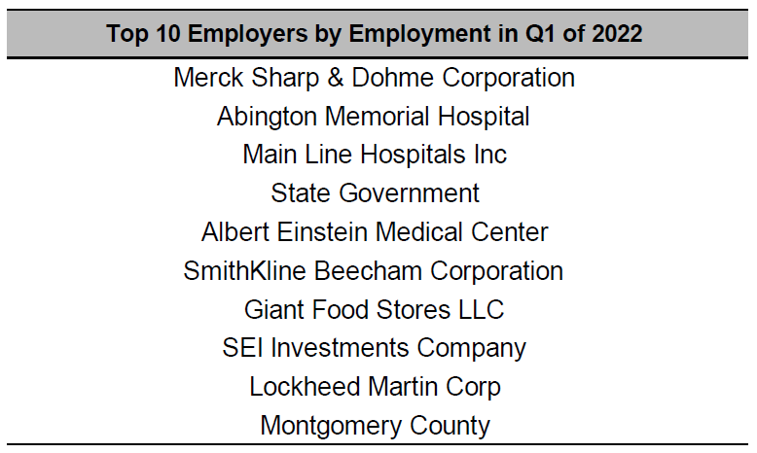
Area Profiles – Top 10 Employers (QCEW)

Slide 50
Area Profiles – Employment and Wages (QCEW)

Slide 51
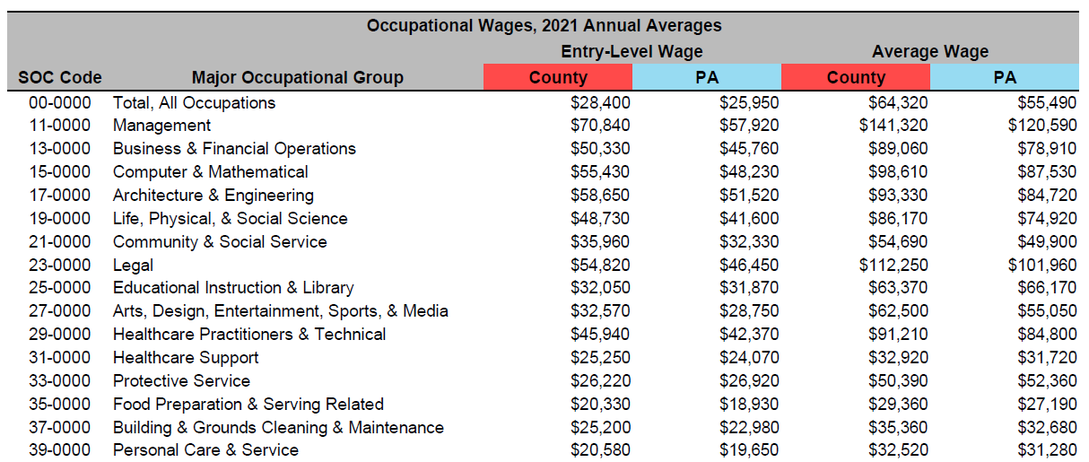
Area Profiles – Occupational Wages (OEWS)

Slide 52
Questions?
https://www.workstats.dli.pa.gov

